Slide 1
∇
SESSION 1 OF 3
Vectors & Norms
Data points, embeddings, and how you measure them
Module 2
Module 2, Session 1 — Vectors & Norms

Slide 2
Σ
Here's What the Diagnostic Showed
23 responses
Matrix mechanics: solid
91% got Av right on the diagnostic's own example — Session 2 stays brisk on pure mechanics, as planned.
Orthogonality: the real gap
Only 45% correct — the weakest result on the whole diagnostic. That's exactly what today slows down for.
Confidence didn't predict score
Self-rated confidence and actual performance barely correlated. Feeling unsure isn't a reliable signal here — in either direction.
Framing, not a scoreboard — this is about how the class is calibrated, never about individual grades.
Recap
Module 2, Session 1 — Vectors & Norms

Slide 3
∇
Whose Taste Is Closest to A's?
Just by eyeballing the numbers — no calculation yet. Take a guess.
User | Action | Comedy | Drama | Sci-Fi
A (target) | 4 | 4 | 1 | 2
B | 2 | 2 | 1 | 2
C | 5 | 4 | 2 | 5
D | 5 | 4 | 3 | 2
E | 5 | 5 | 2 | 1
Each user is a vector in ℝ⁴ — a taste embedding. “Closest” is about to become a literal, computable thing.
Opening Hook — guess first
Module 2, Session 1 — Vectors & Norms

Slide 4
Σ
Euclidean Distance Says...
User E
L2 (straight-line) distance to A
Now guess:
If we measure “distance” a different way — just add up the absolute differences instead — same answer, or could it differ?
Opening Hook — first reveal
Module 2, Session 1 — Vectors & Norms

Slide 5
∫
They Disagree
User D
User E
L1 (taxicab) nearest to A
L2 (Euclidean) nearest to A
The vocabulary, used now:
Each row is a user embedding. A real recommender usually skips “distance” entirely — it computes u·v, the dot product of a user and item embedding, and calls it a similarity score.
Opening Hook — the payoff
Module 2, Session 1 — Vectors & Norms

Slide 6
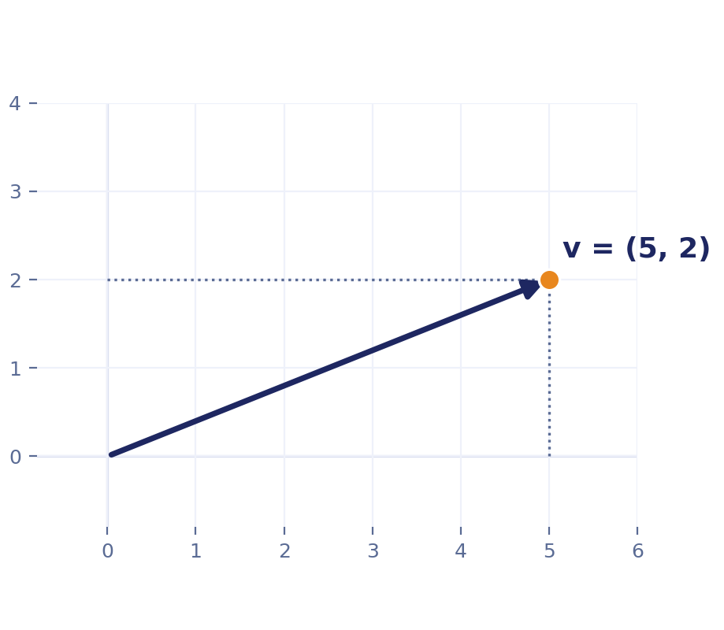
∇
A Vector Is Three Things at Once
A List
(5, 2) — what a computer stores.
= a weight vector or feature vector
A Point
the marked location on the plane.
= a data point, or an embedding
An Arrow
displacement from the origin.
= what norms and dot products need
Same vector v = (5, 2) as the diagnostic. The picture shows all three views together: the dotted lines are the list (5, 2); the dot is the point; the arrow is the displacement. Which one is “correct” depends only on what question you're asking.
Vectors
Module 2, Session 1 — Vectors & Norms

Slide 7
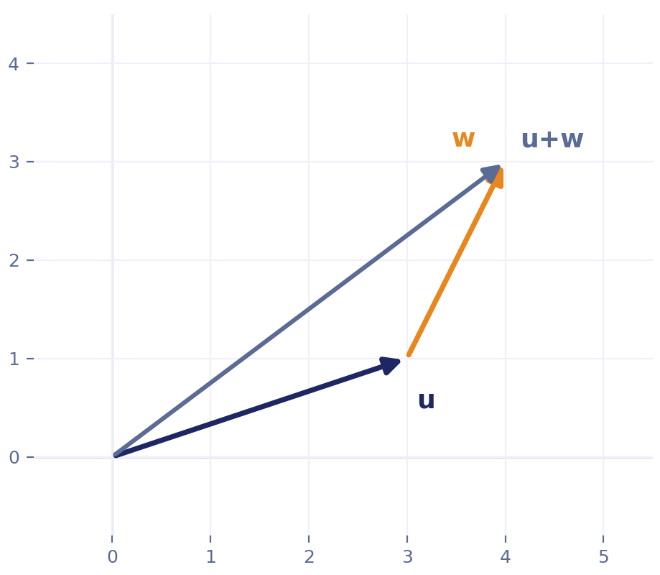
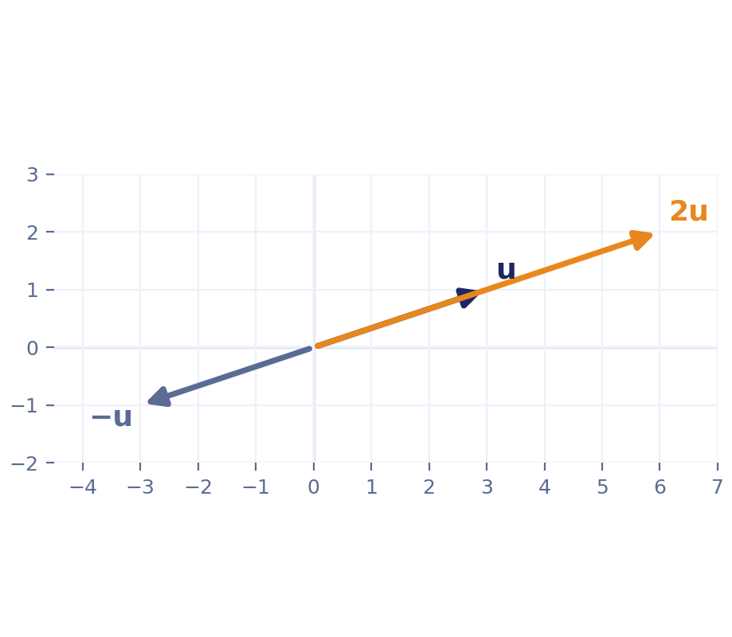
Σ
Operations, Worked
u = (3, 1), w = (1, 2)
Linear combination:
c₁u + c₂w
a weighted sum — returns constantly all course
Addition, tip-to-tail: u + w = (4, 3)
Scalar mult.: 2u stretches, −u flips
Vectors — operations
Module 2, Session 1 — Vectors & Norms

Slide 8
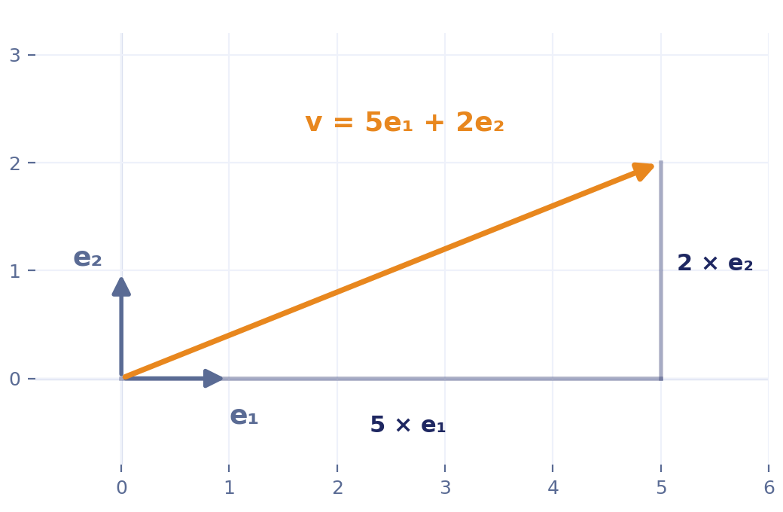
∫
Building Any Vector From Building Blocks
e₁ = (1, 0)
e₂ = (0, 1)
v = (5, 2) = 5e₁ + 2e₂
A basis is a minimal set of vectors that can build every vector in a space through linear combinations. The count of vectors in that set is the space's dimension.
Why this earns its time: Session 2's rank material is meaningless without this landing first.
Vectors — basis
Module 2, Session 1 — Vectors & Norms

Slide 9
∇
Invent the Rule
Suppose I asked you to invent your own rule for “how big is a vector,” with no formula given. What properties would any reasonable rule have to satisfy?
Take answers before the next slide.
Norms — ask first
Module 2, Session 1 — Vectors & Norms

Slide 10
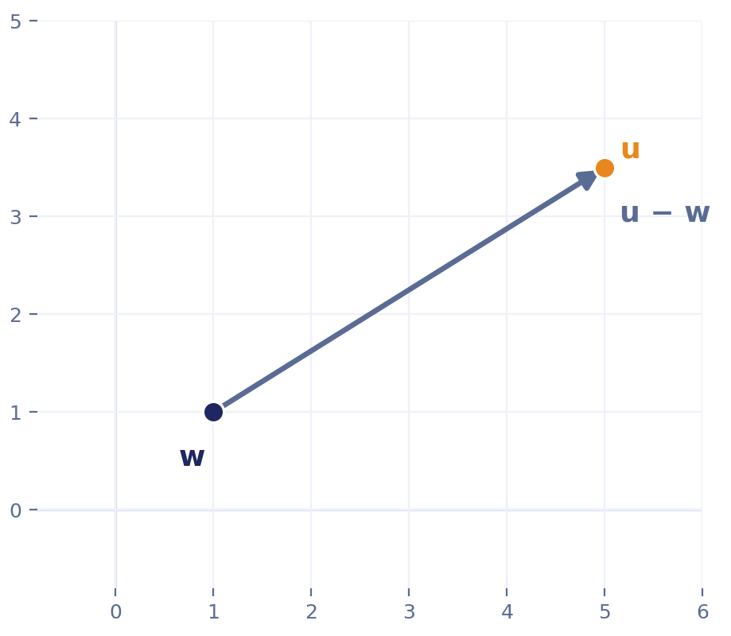
∇
What Does “Distance” Actually Mean?
The hook computed “distance between two users” before norms were even defined. Here's the missing link.
A norm measures the size of one vector.
distance(u, w) = ‖u − w‖
The difference vector u − w is literally the arrow connecting the two points — its length is the distance. Nothing new to prove: this is just the norm, applied to a difference.
(No separate “metric” formalism needed here — every distance this course uses comes from a norm this way.)
Norms — the bridge
Module 2, Session 1 — Vectors & Norms

Slide 11
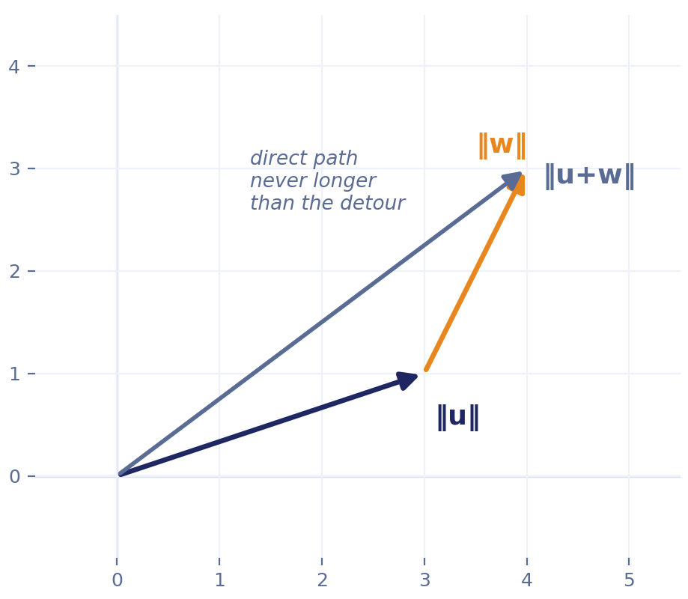
Σ
What Makes Something a Norm
Non-negativity
Can't be negative; zero only for the zero vector.
Homogeneity
‖cv‖ = |c|‖v‖ — doubling the vector doubles the size.
Triangle inequality
‖u+w‖ ≤ ‖u‖+‖w‖ — a detour is never shorter.
The triangle inequality, pictured — going directly (u+w) is never longer than the detour through u then w.
Any function satisfying all three earns the name “norm” — which is why three totally different formulas can all be legitimate answers.
Norms — the reveal
Module 2, Session 1 — Vectors & Norms

Slide 12
∫
One Vector, Three Honest Answers
diff = (4, −3)
L1
L2
L∞
7
5
4
|4|+|−3|
√(4²+3²)
max(4,3)
Same formula, a model's weight vector w:
Ridge regression: adds ‖w‖₂² to the loss to keep weights small. Lasso: adds ‖w‖₁ instead, same goal, tends to zero weights out entirely. Both are just “penalize weight size” — details in Module 7, but the formula is already familiar.
Norms — worked example
Module 2, Session 1 — Vectors & Norms

Slide 13
∇
Place Your Bet
Fixed L1 budget of 1. Spend it concentrated, (1, 0) — or spread evenly, (0.5, 0.5). Both cost 1 under L1.
Which one has the bigger Euclidean (L2) length — concentrated, spread, or the same?
Most people guess “same.” Check the next slide.
Norms — guess first
Module 2, Session 1 — Vectors & Norms

Slide 14
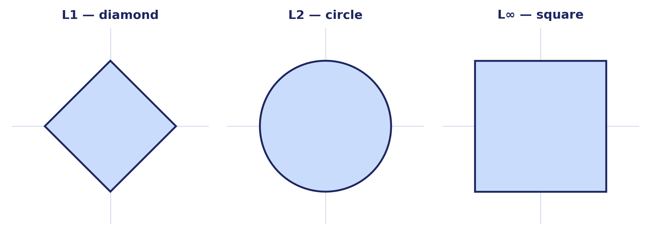
Σ
Concentrating Costs More Under L2
Concentrated (1, 0)
Spread (0.5, 0.5)
Same L1 cost, different L2 — squaring means one big difference costs more than several small ones adding to the same total.
L2 = 1
L2 ≈ 0.71
This is exactly why User D and User E traded places earlier.
Separately: the corners you see above (L1 on the axes, none on L2) are the reason Lasso can zero out a coefficient and Ridge can't — next slide.
Norms — the payoff
Module 2, Session 1 — Vectors & Norms

Slide 15
∫
A Different Question
L1's diamond has corners sitting exactly on the axes. L2's circle has none anywhere.
If a shrinking region has to touch one of these shapes for the first time, where's it more likely to land — somewhere smooth, or right on a corner?
This is the actual mechanism behind exactly-zero coefficients — not the budget argument from before.
Norms — a second mechanism
Module 2, Session 1 — Vectors & Norms

Slide 16
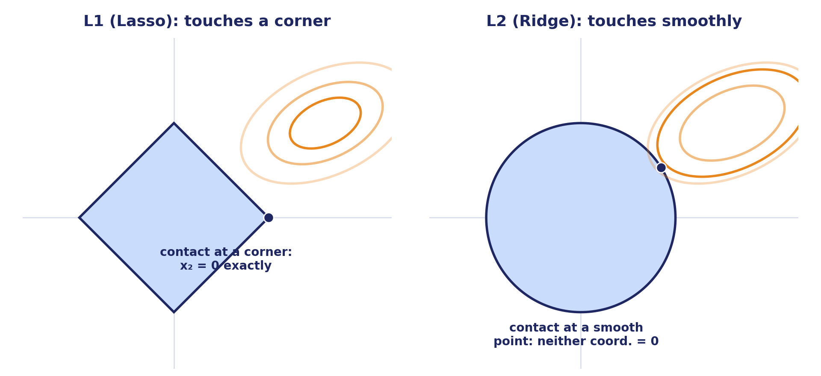
Σ
Why Lasso Actually Lands on Zero
A regularized fit is found where the loss's contours first touch the norm ball as the penalty grows.
Corners are disproportionately likely contact points — many contour orientations all touch the same corner first. The circle has none to land on, so Ridge shrinks smoothly instead.
Norms — the mechanism
Module 2, Session 1 — Vectors & Norms

Slide 17
∫
Your Turn (10 min)
Pick two rows from the hook table. Compute L1 and L2 distance by hand.
Do the two norms agree on who's “nearest”?
Interactive
Module 2, Session 1 — Vectors & Norms

Slide 18
∇
NEXT SESSION
Matrices & Rank
Built directly on today's basis/dimension idea — not a new topic.
Today's notebook: the recommendation demo, editable, plus a real-data version of the same L1/L2 disagreement — in R and Python.
Optional further reading: Koren, Bell & Volinsky, "Matrix Factorization Techniques for Recommender Systems" (IEEE Computer, 2009) — the real paper behind today's hook, dot products and all.
Wrap-up
Module 2, Session 1 — Vectors & Norms

Slide 19
BACKUP — QUICK REFERENCE
Definitions — jump here if a specific word is the problem
Vector
list / point / arrow — three views of one object
Feature
one measured quantity describing a sample
Feature vector
[vector] + [feature] — a sample's features, stacked
Weight vector
[vector] of a model's learned parameters
Embedding
a vector a model produces to represent something
Norm
a size-measure satisfying 3 rules (see next slide)
Distance
[norm] of a difference: dist(u,w) = ‖u−w‖
Unit ball
[norm], applied to a boundary — the set at distance 1
Formal aside, optional: a vector can more generally be any element of a set closed under addition and scalar multiplication (a “vector space”) — polynomials and functions qualify, not just lists of numbers. This course only ever uses ℝⁿ (ordinary lists), which is the case VMLS covers throughout; MML §2.4 has the general definition if it's ever needed.

Slide 20
BACKUP — QUICK REFERENCE
Key Results — restate, don't re-derive
Any function satisfying non-negativity, homogeneity, and the triangle inequality qualifies as a norm.
Fixed L1 total: concentrating in one coordinate gives the largest L2; spreading evenly gives the smallest.
→ why L1/L2 disagree on nearest neighbor (a distance argument).
L1's diamond has corners on the axes; L2's circle has none. Contour-touches-corner is disproportionately likely.
→ why Lasso can zero a coefficient and Ridge can't (a separate, optimization argument).

