Slide 1
Σ
SESSION 2 OF 3
Matrices & Rank
What a matrix does, and how much of it is actually new information
Module 2
Module 2, Session 2 — Matrices & Rank

Slide 2
∇
Quick Recap Before We Build on It
Last session: vectors & norms
Today: matrices, for the first time
A vector as list / point / arrow. Linear combinations — weighted sums of vectors. A basis: the smallest set of vectors that builds everything else.
A matrix as a function that moves vectors. Then: how many of a matrix's rows or columns are actually new information, versus redundant.
That basis idea is the one piece today actually depends on — not vectors or norms in general.
Nothing here is a fresh, disconnected topic — each piece today answers a question the previous one raises.
Recap
Module 2, Session 2 — Matrices & Rank

Slide 3
Σ
Why Is the Answer (12, 23)?
A = [[2, 1], [3, 4]], v = (5, 2) — the exact example from the diagnostic
Row by row:
Row 1: (2)(5) + (1)(2) = 12
Row 2: (3)(5) + (4)(2) = 23
A is what that function looks like written down.
Mechanical by design — the point isn't the arithmetic. What just happened: a matrix took a vector in and gave a different vector out. Av is a function applied to v, the same object as f: ℝⁿ → ℝᵐ from Day 1.
Matrices — the mechanics
Module 2, Session 2 — Matrices & Rank

Slide 4
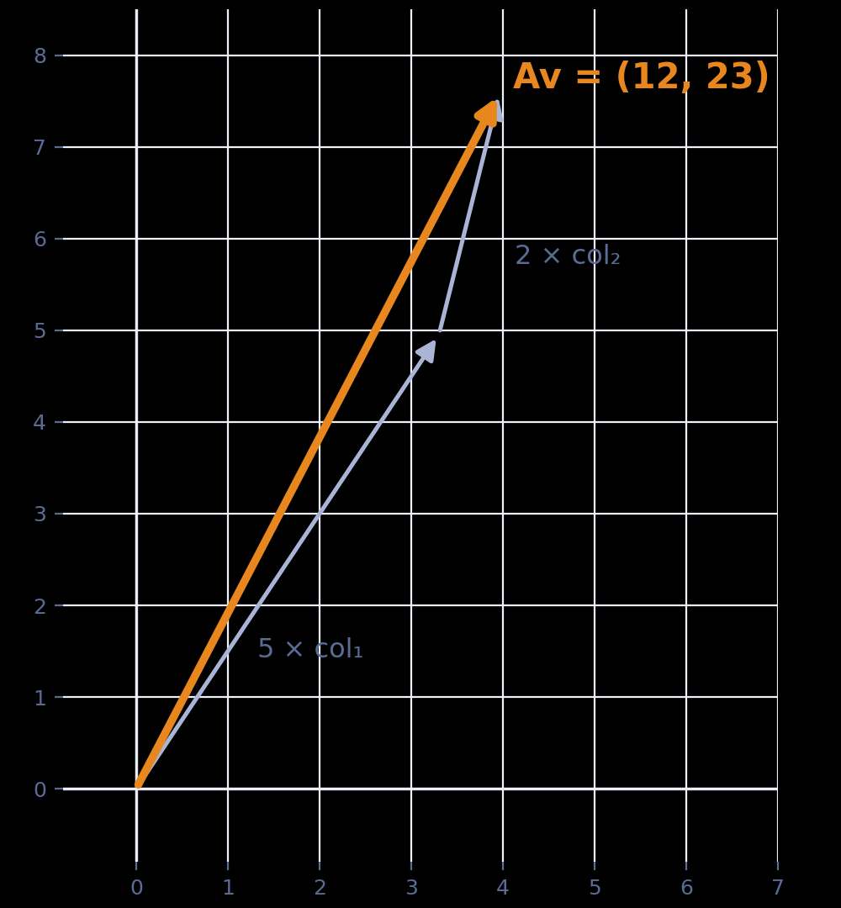
∫
A Better Way to See the Same Answer
A's columns are (2, 3) and (1, 4). v = (5, 2) says “5 of the first, 2 of the second.”
Av is a linear combination of A's columns, weighted by v's entries.
Xw = w₁x₁ + w₂x₂ + ⋯ + wₚxₚ
The same “weighted sum of vectors” idea from Session 1, doing real work for the first time.
Column space: every output Av could possibly produce, over all v — every combination A's columns can build.
The bold amber arrow is the answer — the two thin ones are just the ingredients that build it.
Matrices — the column picture
Module 2, Session 2 — Matrices & Rank

Slide 5
Σ
Coincidence, or Not?
A's columns: col₁ = (2,3), col₂ = (1,4). We already know Av = (12, 23) for v = (5, 2) = 5e₁ + 2e₂.
What do you get computing 5(Ae₁) + 2(Ae₂) directly? Same answer — coincidence, or does this always work?
Try it, then guess whether it's guaranteed.
Matrices — guess first
Module 2, Session 2 — Matrices & Rank

Slide 6
∫
What “Linear” Actually Means
5(Ae₁) + 2(Ae₂) = 5(2,3) + 2(1,4) = (10,15)+(2,8) = (12,23) — same as Av. Always, for every matrix and input.
Additivity: A(u+w) = Au+Aw
Homogeneity: A(cu) = cAu
Not every function qualifies:
f(v) = v + (1,1), a shift.
f(u)+f(w) = u+w+(2,2)
f(u+w) = u+w+(1,1)
Together: A(c₁u + c₂w) = c₁Au + c₂Aw — a combination of inputs maps to the same combination of outputs.
Not equal — a shift breaks additivity. “Simple” and “linear” aren't synonyms.
This — not “a grid of numbers” — is what a linear transformation actually is.
Why this matters at work: every NN layer is linear (matrix multiply) + a nonlinear activation. Stack linear layers alone and they collapse into one — the nonlinearity is the entire reason depth adds anything.
Matrices — linearity
Module 2, Session 2 — Matrices & Rank

Slide 7
∇
Picture It First
R = [ cos45° −sin45° ] ≈ [ 0.71 −0.71 ]
[ sin45° cos45° ] [ 0.71 0.71 ]
If I apply this matrix to every point of a square, what do you picture happening — bigger, smaller, tilted, stretched?
Guess before the next slide.
Matrices — guess first
Module 2, Session 2 — Matrices & Rank

Slide 8
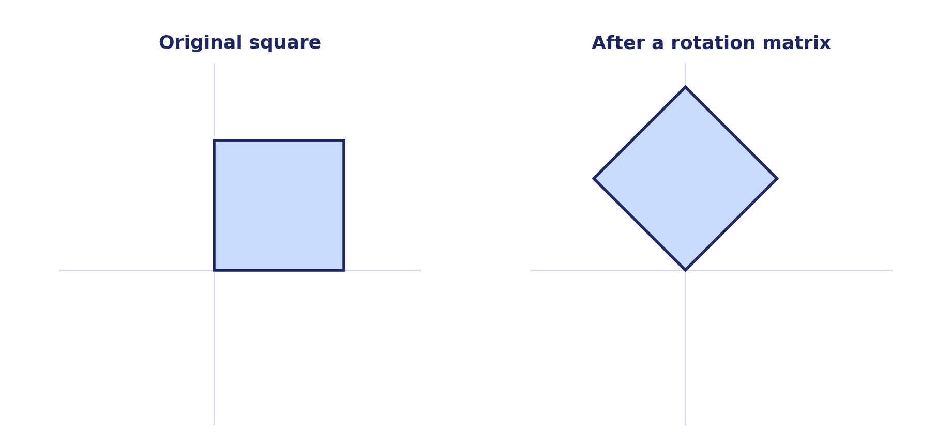
Σ
Same Shape, Just Turned
Linearity, doing work again: a straight edge is a combination of its two endpoints, so it has to map to a straight edge. Checking the 4 corners — (0,0), (1,0), (1,1), (0,1) — is enough to draw the whole shape.
Composition, briefly: rotate then scale is a single matrix, SR — “apply one transformation, then another,” not a new rule. Order matters (SR ≠ RS in general).
Matrices — what it means
Module 2, Session 2 — Matrices & Rank

Slide 9
∫
Multiplication & Transpose — Mechanics
Matrix multiplication
Transpose (A^{T})
Inner dimensions must match: (m×n)(n×p) → (m×p). Beyond 2×2, so the rule isn't just a square-matrix habit:
Flip across the diagonal — rows become columns:
[1 2 3]^T [1 4]
[4 5 6] = [2 5]
[3 6]
[1 2 0] [2 0] [4 6]
[3 1 4] × [1 3] = [7 7]
[0 1]
Not just bookkeeping — A^{T}v shows up constantly once we reach gradients (Module 5) and normal equations (Module 4).
(2×3) × (3×2) → (2×2)
Matrices — operations
Module 2, Session 2 — Matrices & Rank

Slide 10
∇
SO FAR TODAY: WHAT A MATRIX DOES. NOW: WHAT IT LOSES.
Does It Add Anything New?
v₁ = (1, 2), v₂ = (2, 4). Does v₂ give you a genuinely new direction, or could you have built it from v₁ alone?
Then: v₁ = (1, 2), v₃ = (3, 1). Same test — can v₃ be built from v₁ alone this time?
Try both before the reveal.
Rank — guess first
Module 2, Session 2 — Matrices & Rank

Slide 11
Σ
Linear Independence, Tested Not Told
v₁ = (1,2), v₂ = (2,4)
v₁ = (1,2), v₃ = (3,1)
(2,4) = 2·(1,2) — yes, c = 2 works.
Would need c=3 and c=0.5 at once — no single c works.
Dependent — v₂ adds nothing v₁ didn't already give you.
Independent — a genuinely new direction.
The general rule, now earned: a set is linearly dependent exactly when one vector can be written as a combination of the others.
Rank — independence
Module 2, Session 2 — Matrices & Rank

Slide 12
∇
Rank = Dimension of the Column Space
Recall, Session 1: a basis is a minimal set of vectors that builds everything through linear combinations — dimension is just how many vectors that takes.
Columns (2,4) and (1,2): column 2 = ½ × column 1 — same dependent relationship, relabeled.
Two columns, but a basis for what they span needs only 1 vector — rank 1, even though it's a 2×2 matrix.
Kill a real misconception here
18% on the diagnostic thought rank-deficient meant “not square.” A non-square matrix (say 2×3) can be full rank; shape was never the test — independence always was.
Rank — the definition
Module 2, Session 2 — Matrices & Rank

Slide 13
Σ
Why Rank Matters, Three Places
Module 3 (SVD)
The Day 1 compression demo, properly explained — an image “looks” like it needs 768 numbers per column, but its effective rank is far lower.
Real data (today's notebook)
A “composite score” column built from existing columns adds a column but zero rank. The real-data name for this: multicollinearity.
A promise, not yet proved
Fitting a model needs X^T X to be invertible — and X^T X is invertible exactly when X has full column rank. Why? Next session.
Rank — why it matters
Module 2, Session 2 — Matrices & Rank

Slide 14
∫
Predict Before You See It
M = [ 2 1 ]
[ 4 2 ]
Same matrix as a moment ago — row 2 = 2 × row 1, rank 1.
If I multiply every point of a square by M, what happens to the square's shape?
Common guesses: shrinks, gets smaller, skewed. Check the next slide.
Rank — guess first
Module 2, Session 2 — Matrices & Rank

Slide 15
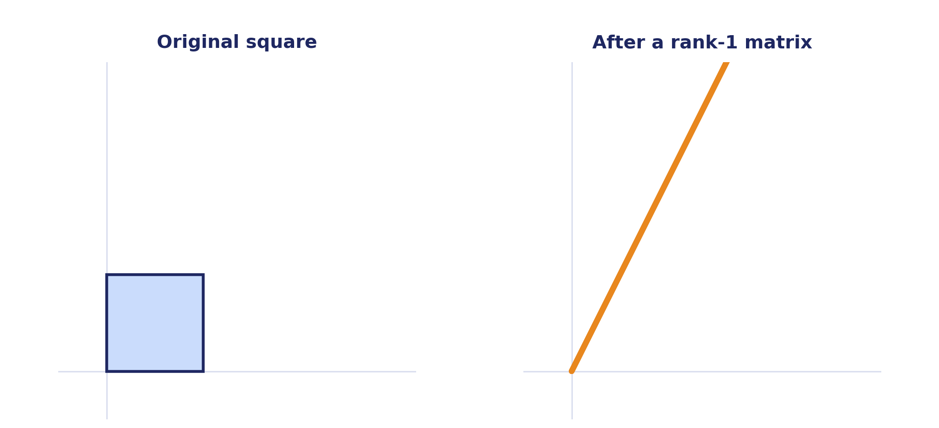
Σ
Flattened, Not Shrunk
An entire 2-dimensional shape reduced to 1 dimension — and it's not reversible by multiplying by anything else. This is why Ax = b sometimes has no clean solution, and why least squares exists.
Rank — the collapse
Module 2, Session 2 — Matrices & Rank

Slide 16
∇
NEXT SESSION
Orthogonality & Projection
Real rigor — the one session we don't compress, even if time runs short elsewhere. Introduces the dot product for the first time, building on Session 1's norms and today's independence ideas.
Today's notebook: matrix-as-transformation and rank-deficiency demos, now with the column picture and linearity checks added — in R and Python.
Wrap-up
Module 2, Session 2 — Matrices & Rank

Slide 17
BACKUP — QUICK REFERENCE
Definitions — jump here if a specific word is the problem
Matrix
a function that maps a vector to a vector, via Av
Linear transformation
what a matrix represents
Column space
every possible output Av can produce, over all v
Linearly dependent
one vector = a combination of the others
Linearly independent
no vector can be built from the others
Rank
the dimension of a matrix's column space
Rank-deficient
rank less than the max possible for its size
Multicollinearity
the real-data name for rank-deficiency in features
Singular matrix
a square matrix with no inverse (not full rank)

Slide 18
BACKUP — QUICK REFERENCE
Key Results — restate, don't re-derive
Av = a linear combination of A's columns, weighted by v's entries: Xw = w₁x₁ + ⋯ + wₚxₚ.
rank(A) = dimension of A's column space.
A set of vectors is linearly dependent iff one can be written as a combination of the others. A^T A is invertible iff A has full column rank.

