Slide 1
∫
SESSION 3 OF 3
Orthogonality & Projection
Real rigor — one question, asked at three scales: a number, a line, then a whole subspace.
Not flex time — the one session this module doesn't compress.
Module 2
Module 2, Session 3 — Orthogonality & Projection

Slide 2
∇
One Question, Three Scales
Built on Session 1 & 2
Today, at three scales
Norms measured a vector's size. Independence tested whether a vector added anything new. Today's question needs both: what does it mean for two directions to carry zero overlapping information?
A number (the dot product) → a line (project onto one direction) → a whole subspace (project onto many at once). Same question, same answer, bigger stage each time.
Recap & throughline
Module 2, Session 3 — Orthogonality & Projection

Slide 3
Σ
A Word You Already Use
You've all used the word “orthogonal” in a software context before — orthogonal design, decoupled modules, independent concerns. What did you mean by it there?
We're about to define the exact same idea mathematically — same intuition, not a coincidence of shared vocabulary.
Dot product — anchor
Module 2, Session 3 — Orthogonality & Projection

Slide 4
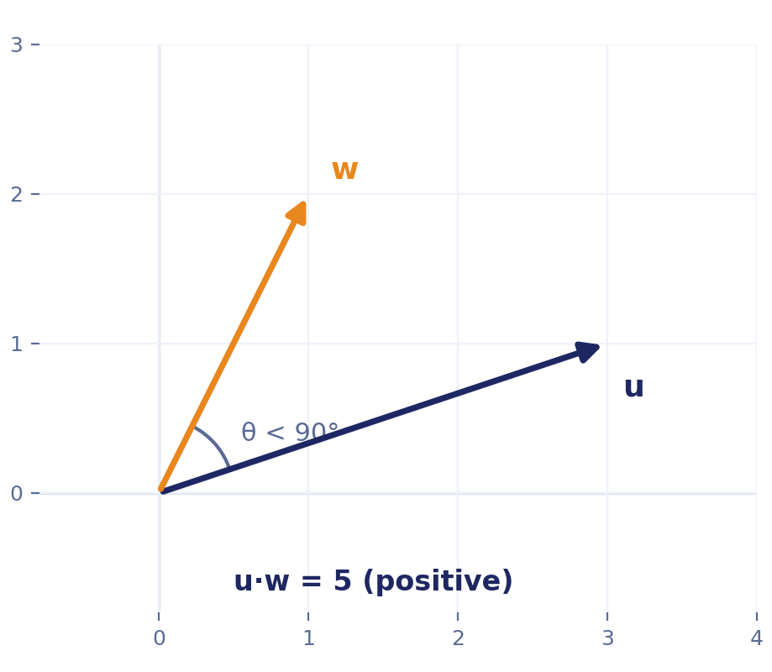
∫
The Dot Product, Two Ways
Algebraic: u·w = Σuᵢwᵢ
Geometric: u·w = ‖u‖‖w‖cosθ
u=(3,1), w=(1,2): u·w = 3(1)+1(2) = 5
θ = 90° makes cosθ = 0, so u·w = 0 exactly when u and w are perpendicular — this defines orthogonality algebraically, no angle needed.
Dot product — the reveal
Module 2, Session 3 — Orthogonality & Projection

Slide 5
Σ
Cosine Similarity, Actually Built
Named twice in Session 1 as a promise. Here's the actual derivation, not a third mention.
Rearrange the geometric form:
User A=(4,4,1,2), User D=(5,4,3,2) — the hook's own data:
cosθ = (u·w) / (‖u‖‖w‖)
A·D=43, ‖A‖≈6.08, ‖D‖≈7.35
cosθ = 43/44.7 ≈ 0.96
The name isn't decorative — this literally is the cosine of the angle between the two vectors, nothing added.
Close to 1 — nearly the same direction, i.e. very similar taste profile.
Range: −1 (opposite) → 0 (orthogonal) → 1 (same direction).
What Session 1 blurred past: the raw dot product still depends on magnitude — a user who rates everything a 5 gets a bigger dot product with almost anyone, regardless of actual taste match. Cosine similarity divides that out deliberately, comparing direction only — which is why production recommender and embedding-search systems overwhelmingly use cosine similarity specifically, not the raw dot product.
Dot product — cosine similarity
Module 2, Session 3 — Orthogonality & Projection

Slide 6
∇
From the Diagnostic Itself
u = (1, 3), w = (2, −1). u·w = 1(2) + 3(−1) = −1.
u·w is negative here. Does that mean u and w point exactly opposite — 180° apart — or could the angle be something else?
A quarter of wrong answers on the diagnostic picked “exactly opposite.” Guess before the reveal.
Dot product — guess first
Module 2, Session 3 — Orthogonality & Projection

Slide 7
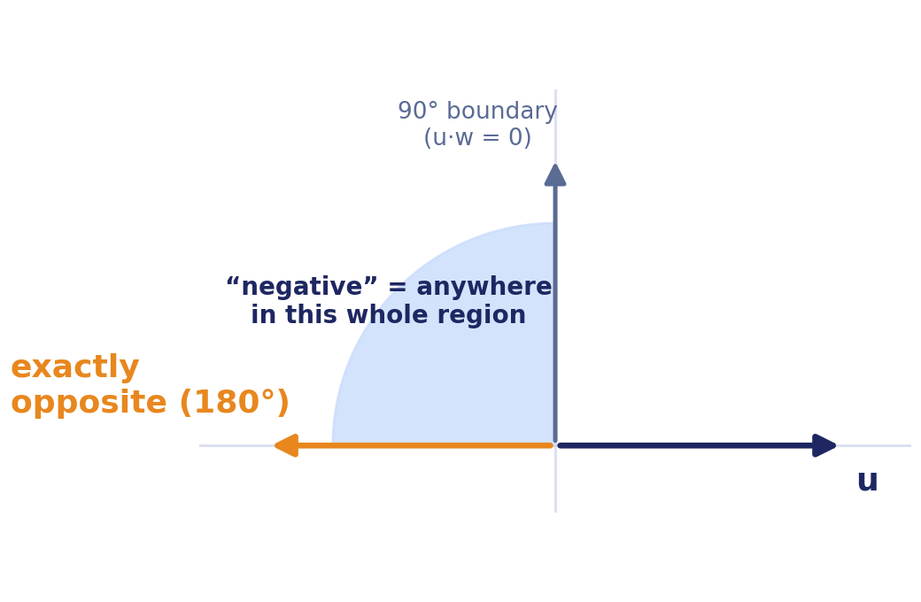
Σ
Negative Is a Region, Not a Point
90° is the boundary, not a landmark to compare against.
cosθ < 0 for the entire range from 90° to 180°. “Negative” only narrows it to “more than 90°, somewhere.” Exactly opposite (180°) is one specific, extreme case inside that range — not what negative means in general.
Contrast: this session's u=(3,1),w=(1,2) → u·w=5, positive, so <90°. Same test, opposite sign.
Dot product — the fix
Module 2, Session 3 — Orthogonality & Projection

Slide 8
∫
Where's the Closest Point?
Here's a line through the origin, direction a. Here's a point b, off the line.
Where's the closest point to b that's actually on the line through a?
Point at the board. Then: what property must the leftover piece — b minus whatever point you picked — have, for that point to truly be closest?
Projection — guess first
Module 2, Session 3 — Orthogonality & Projection

Slide 9
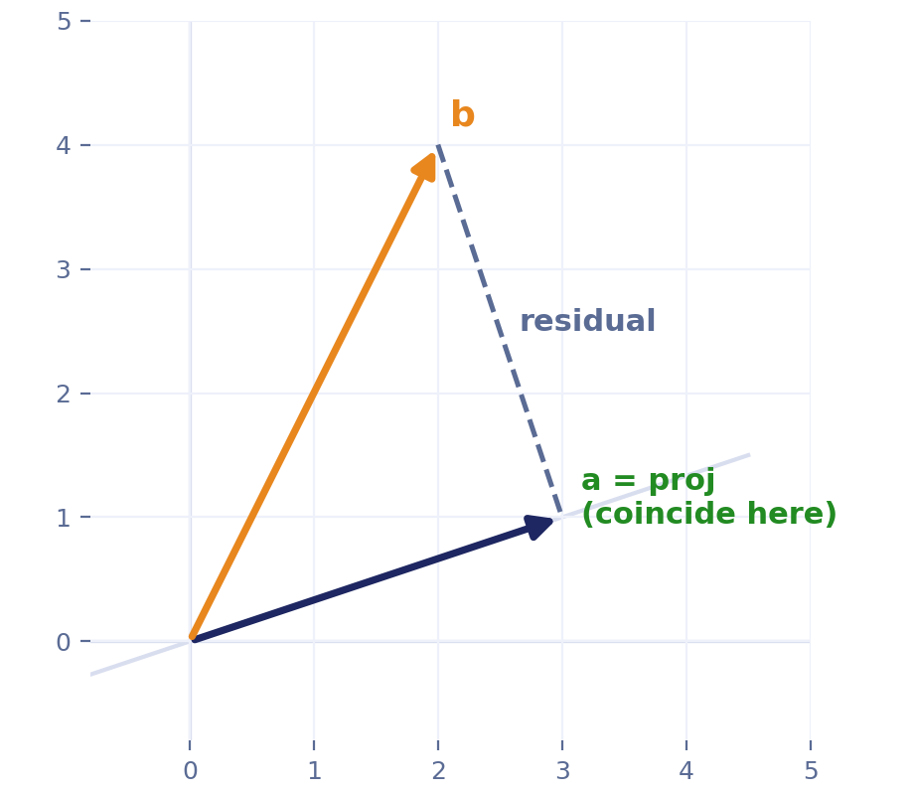
∇
Derived, Not Handed Down
Perpendicularity is the stopping condition: (b − c·a)·a = 0
Expand: b·a − c(a·a) = 0 → c = (a·b)/(a·a)
proj_a(b) = ((a·b)/(a·a))·a
a=(3,1), b=(2,4): a·b=10, a·a=10, c=1
projection=(3,1), residual=(−1,3)
Check: residual·a = −3+3 = 0 ✓
Habit that catches almost every mistake: always verify residual·a = 0.
Projection — the derivation
Module 2, Session 3 — Orthogonality & Projection

Slide 10
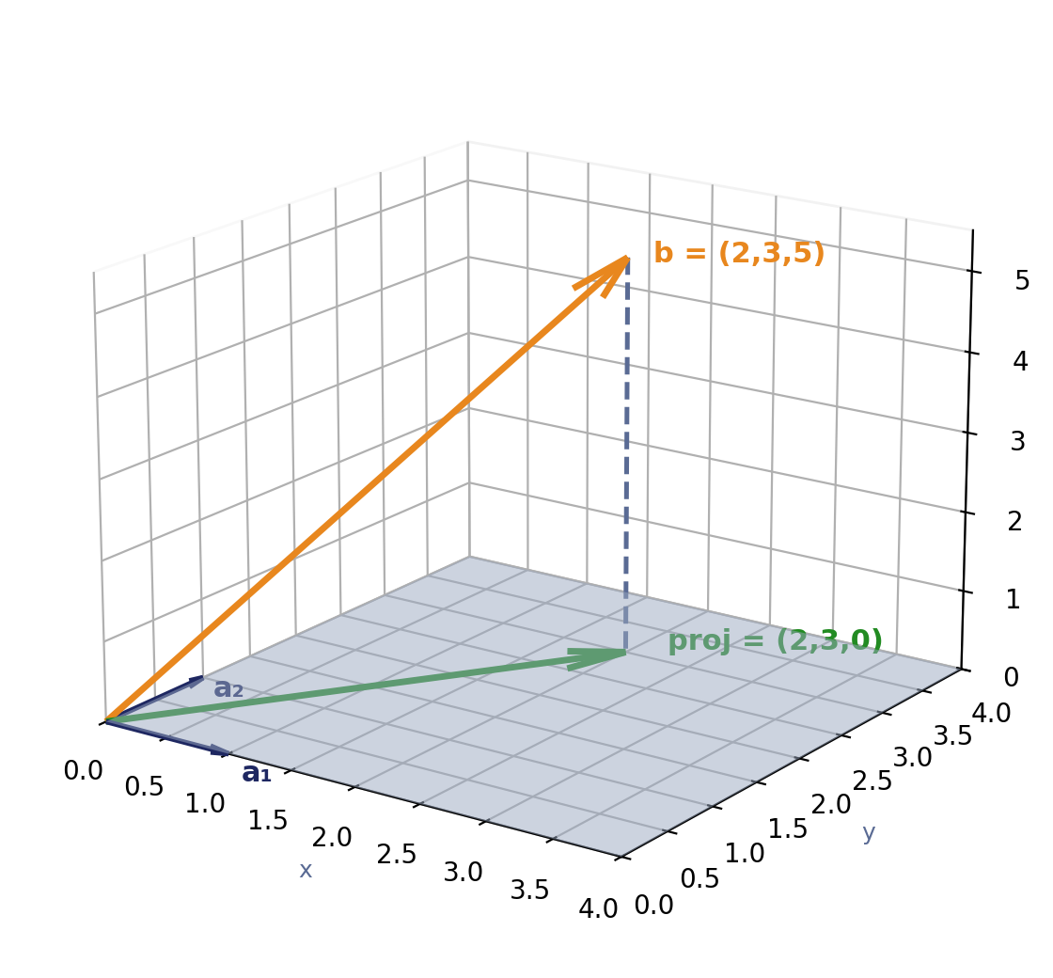
Σ
One Level Up — A Case You Can Check by Hand
a₁=(1,0,0), a₂=(0,1,0) span the xy-plane. b=(2,3,5).
Closest point is obvious by inspection: (2,3,0) — just drop the z-coordinate.
Residual = (0,0,5). Check against BOTH directions:
residual·a₁ = 0, residual·a₂ = 0 — orthogonal to every vector in the subspace, not just one. Deliberately easy, before it gets hard.
Subspace — the easy case
Module 2, Session 3 — Orthogonality & Projection

Slide 11
∇
Would You Need to Check Every One?
The plane also contains diagonal directions — a₁+a₂, 3a₁−a₂, infinitely many we never checked.
Is the residual automatically orthogonal to those too, or would we need to check every single one separately?
This is genuinely non-obvious the first time — guess before the reveal.
Subspace — guess first
Module 2, Session 3 — Orthogonality & Projection

Slide 12
Σ
The Formula Falls Out of the Argument
A diagonal direction is c₁a₁+c₂a₂. residual·(c₁a₁+c₂a₂) = c₁(residual·a₁) + c₂(residual·a₂) = 0 — true no matter what c₁,c₂ are. Checking a small spanning set is enough to guarantee the whole subspace.
Stack a₁,a₂ as columns of A. “c₁(r·a₁)+c₂(r·a₂)=0 for every c₁,c₂” is exactly Aᵀ(residual) = 0:
Aᵀ(b−Ax̂) = 0 → AᵀAx̂ = Aᵀb → x̂ = (AᵀA)⁻¹Aᵀb
Same derivation as before, just written for p directions instead of one. Nothing new was proven.
The one fact worth saying unprompted: the shortest distance from a point to a subspace is always along the perpendicular — any other path could be shortened by sliding toward it.
Subspace — the formula
Module 2, Session 3 — Orthogonality & Projection

Slide 13
∫
Closing a Loop From Two Sessions Ago
(A^{T}A)⁻¹ only works if A^{T}A can be inverted.
When does a matrix fail to be invertible — what did we call that, two sessions ago?
Let the room connect it: AᵀA is invertible exactly when A has full column rank.
Rank, closing the loop
Module 2, Session 3 — Orthogonality & Projection

Slide 14
∇
A Map, Not a Syllabus
If rank(A) < number of columns, AᵀA is singular and there's no unique x̂ — the Session 2 question closes right here.
PCA and SVD
generalize “find the best-fitting subspace” rather than projecting onto one already chosen
Gram–Schmidt and QR
build a convenient (orthonormal) basis for a subspace — the optional deep-dive, next
Regularized regression
modifies this exact formula when AᵀA is singular or near-singular, instead of requiring full rank
Scope, restrained
Module 2, Session 3 — Orthogonality & Projection

Slide 15
Σ
OPTIONAL — DEEP DIVE
Two Things Worth Actually Proving
Not gating — a bonus sessional-exam question at most, never load-bearing for the grade.
Why the two dot-product formulas are actually equal (chunk 2's promise, delivered)
Law of cosines: ‖u−w‖² = ‖u‖² + ‖w‖² − 2‖u‖‖w‖cosθ
Algebraic expansion: ‖u−w‖² = (u−w)·(u−w) = ‖u‖² − 2u·w + ‖w‖²
Set equal, cancel ‖u‖²+‖w‖², divide by −2: u·w = ‖u‖‖w‖cosθ
Four lines — short enough to include even when time is tight.
Gram-Schmidt, gestured at — not derived
“The general recipe for building an orthogonal basis out of any set of vectors.” MML §3.5 (same notation, better for “why”) or VMLS §5.3–5.4 (more computational, better for “how”) — pick the one that fits, don't derive it live.
Optional deep-dive
Module 2, Session 3 — Orthogonality & Projection

Slide 16
∇
Your Turn (10 min)
Compute a projection and residual by hand, for a new a and b.
Check: is the residual really orthogonal to a?
Interactive
Module 2, Session 3 — Orthogonality & Projection

Slide 17
∫
A Note on Quiz 1
Quiz 1 covers the whole Linear Algebra block — all three sessions plus Modules 3 and 4 — not this week in isolation.
The full quiz won't exist until Module 4 lands. This week's material — and this week's notebook — are for building vocabulary, not for cramming ahead of a quiz that isn't ready yet.
Assessment
Module 2, Session 3 — Orthogonality & Projection

Slide 18
∇
NEXT MODULE
Module 3: Decompositions (SVD / PCA)
Rank tells you the real complexity — SVD turns that into the actual machinery behind the Day 1 compression demo.
Module 4 applies today's derivation to Ax=b and regression — not a re-derivation, an application.
Today's notebook: the projection derivation worked interactively, a real-data (Iris) projection plotted, and last session's rank-deficiency demo — in R and Python.
Wrap-up
Module 2, Session 3 — Orthogonality & Projection

Slide 19
BACKUP — QUICK REFERENCE
Definitions — jump here if a specific word is the problem
Dot product
u·w = Σuᵢwᵢ, algebraically; ‖u‖‖w‖cosθ, geometrically
Orthogonal
[dot product] = 0 — perpendicular, no overlapping information
Span
the set of all linear combinations of a set of vectors
Subspace
[span], named as a place — everything a direction set can reach
Projection
the point in a subspace closest to a given vector
Residual
[vector] − [projection] — always orthogonal to the subspace
Normal equations
AᵀAx̂ = Aᵀb, whose solution gives the projection's coefficients
Orthonormal basis
[basis] + [orthogonal], with length 1 added
Gram–Schmidt
builds an orthonormal basis from any set of vectors (named, not derived)

Slide 20
BACKUP — QUICK REFERENCE
Key Results — restate, don't re-derive
u·w = 0 ⇔ u and w are orthogonal.
The closest point in a subspace to b is characterized by one condition: the residual is orthogonal to every vector in the subspace. The shortest distance to a subspace is always along the perpendicular.
General projection formula: x̂ = (AᵀA)⁻¹Aᵀb, valid whenever A has full column rank.

