Slide 1
MODULE 3 · SESSION 1 OF 4
Why Some Directions Are Special
Determinant, Trace & Eigenvalues
λ
Mathematical Foundations for Data Science & Computational Intelligence
Mohsin Raza

Slide 2
90 MINUTES
Today's Session
1
Reconnect to the chain
5 min
2
What does a matrix do?
20 min
3
Determinant & trace
25 min
4
Eigenvalues, computed
30 min
5
Close & bridge to Session 2
10 min
Module 3 · Session 1 — Decompositions I
2

Slide 3
RECONNECT
The Story So Far
Modules 1–2
Today
This Module
Vectors, matrices,
systems & projections
→
Does a matrix have
special directions?
→
Decompose any
matrix into simple pieces
Every matrix acts on vectors — stretching, rotating, sometimes collapsing them. Today's question: are there directions a matrix leaves alone, only scaling? That question is the seed of everything this module builds.
Module 3 · Session 1 — Decompositions I
3

Slide 4
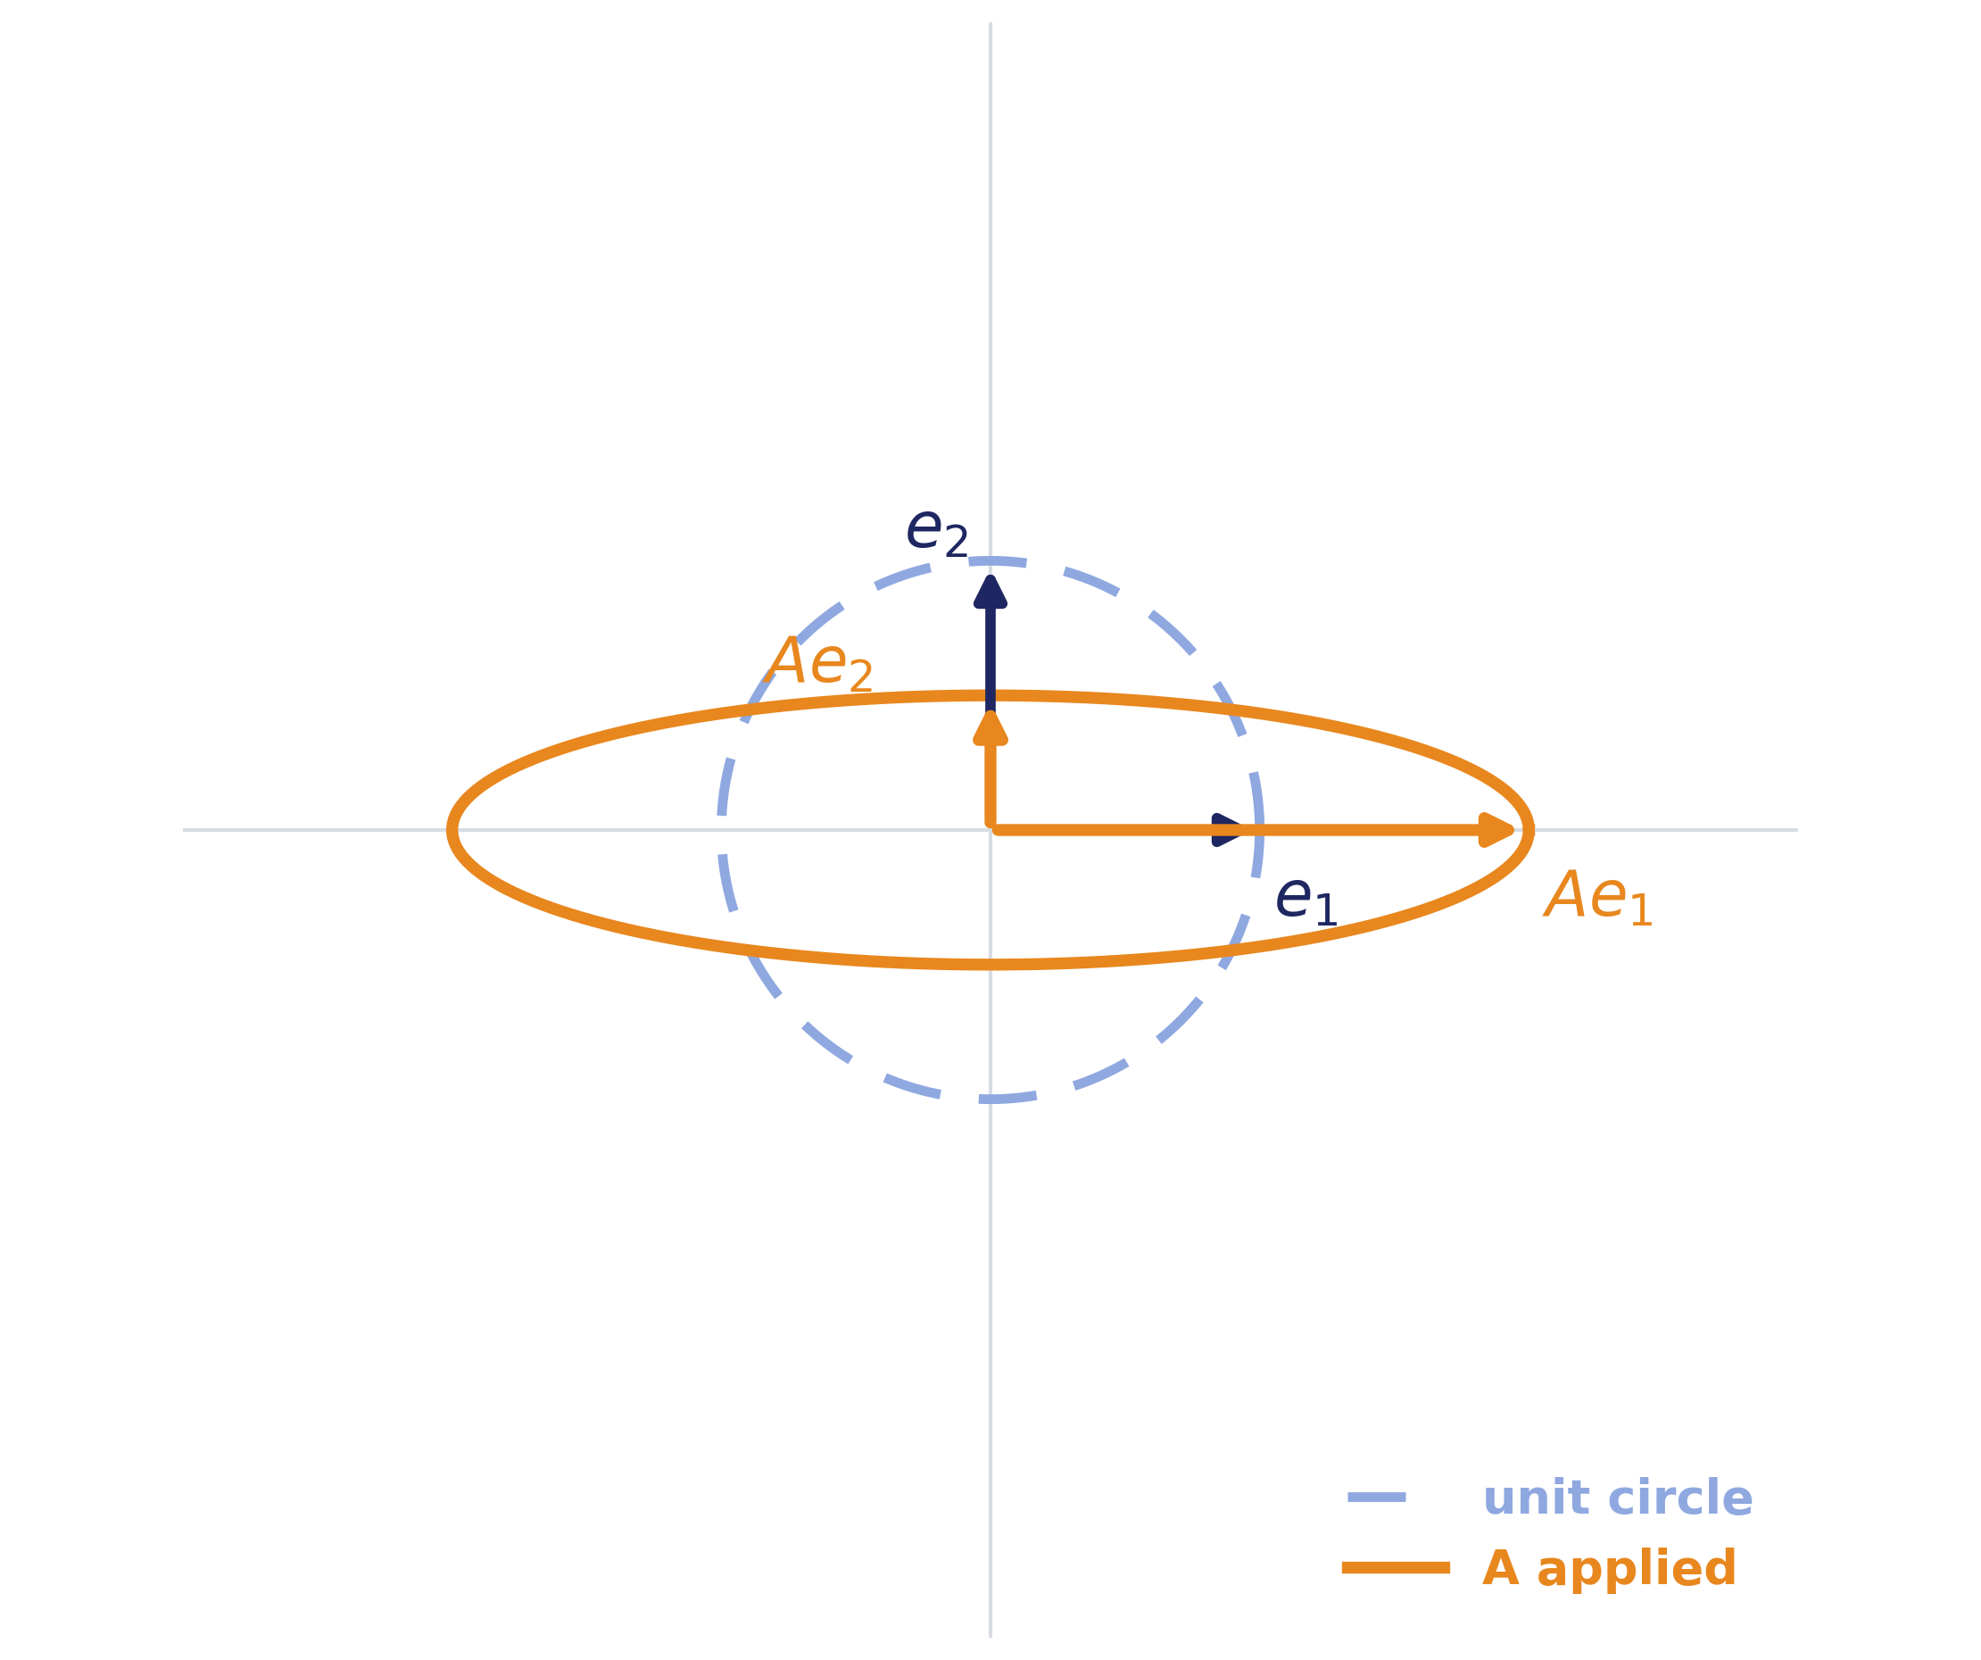
GUIDED QUESTION
What Does a Matrix Do?
If I apply A to every point on the unit circle…
• What shape comes out?
• Is every point stretched the same amount, in the same direction?
• Are there directions that only get scaled — not rotated?
Watch the axes: e₁ and e₂ map to Ae₁ and Ae₂ — same length change, but does the direction survive?
Module 3 · Session 1 — Decompositions I
4

Slide 5
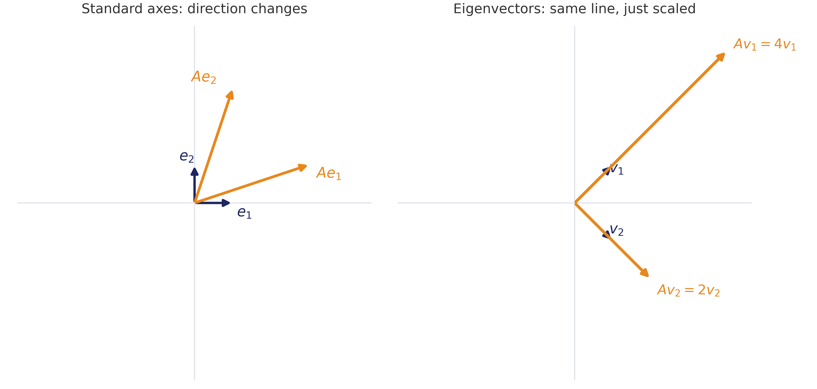
GUIDED QUESTION
Do Any Directions Survive?
The standard axes don't survive A = [[3,1],[1,3]] intact — but some other pair of directions does: they only get longer or shorter, never rotated.
Module 3 · Session 1 — Decompositions I
5

Slide 6
Eigenvectors & Eigenvalues, Defined
Av = λv
Eigenvector (v):
a direction A doesn't rotate off of — only stretches, shrinks, or flips.
Eigenvalue (λ):
the scale factor along that direction.
λ
A matrix can have several eigenvector directions — each with its own eigenvalue.
Module 3 · Session 1 — Decompositions I
6

Slide 7
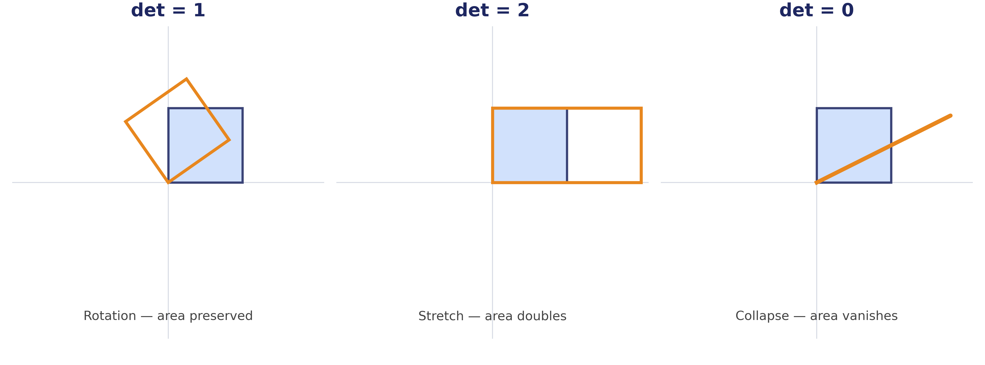
DETERMINANT
What Happens to Area?
The determinant is the scale factor a matrix applies to area (or volume, in higher dimensions).
Module 3 · Session 1 — Decompositions I
7

Slide 8
WHY IT MATTERS
det(A) = 0: A Dimension Is Destroyed
When det(A) = 0, the transformation collapses space — information is destroyed and can't be recovered.
That's exactly what “rank-deficient” meant on the diagnostic: redundant rows/columns, a collapsed dimension, and no way to undo the map.
No inverse exists when det(A) = 0.
det = 0
→ no inverse
Module 3 · Session 1 — Decompositions I
8

Slide 9
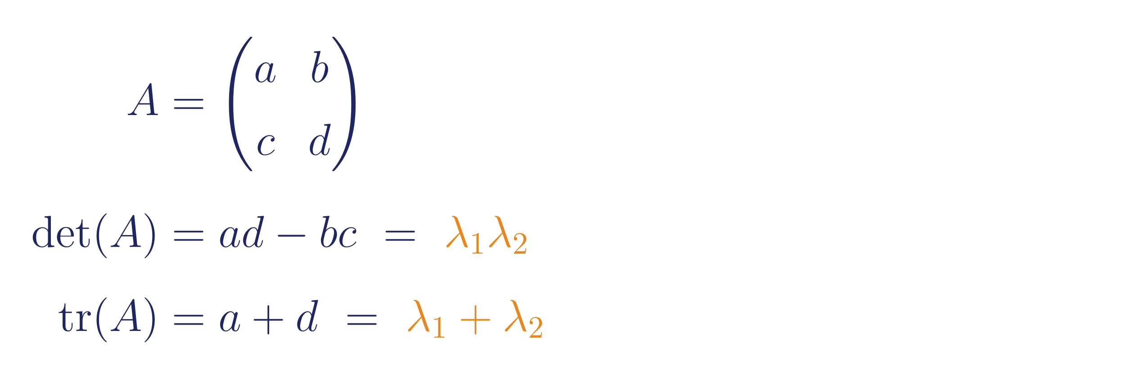
THE CONNECTION
Determinant, Trace & Eigenvalues
We won't derive this today — it's a short, elegant proof in the optional bonus notes. Worth knowing it exists: eigenvalues carry the same information as determinant and trace, just split apart.
Module 3 · Session 1 — Decompositions I
9

Slide 10
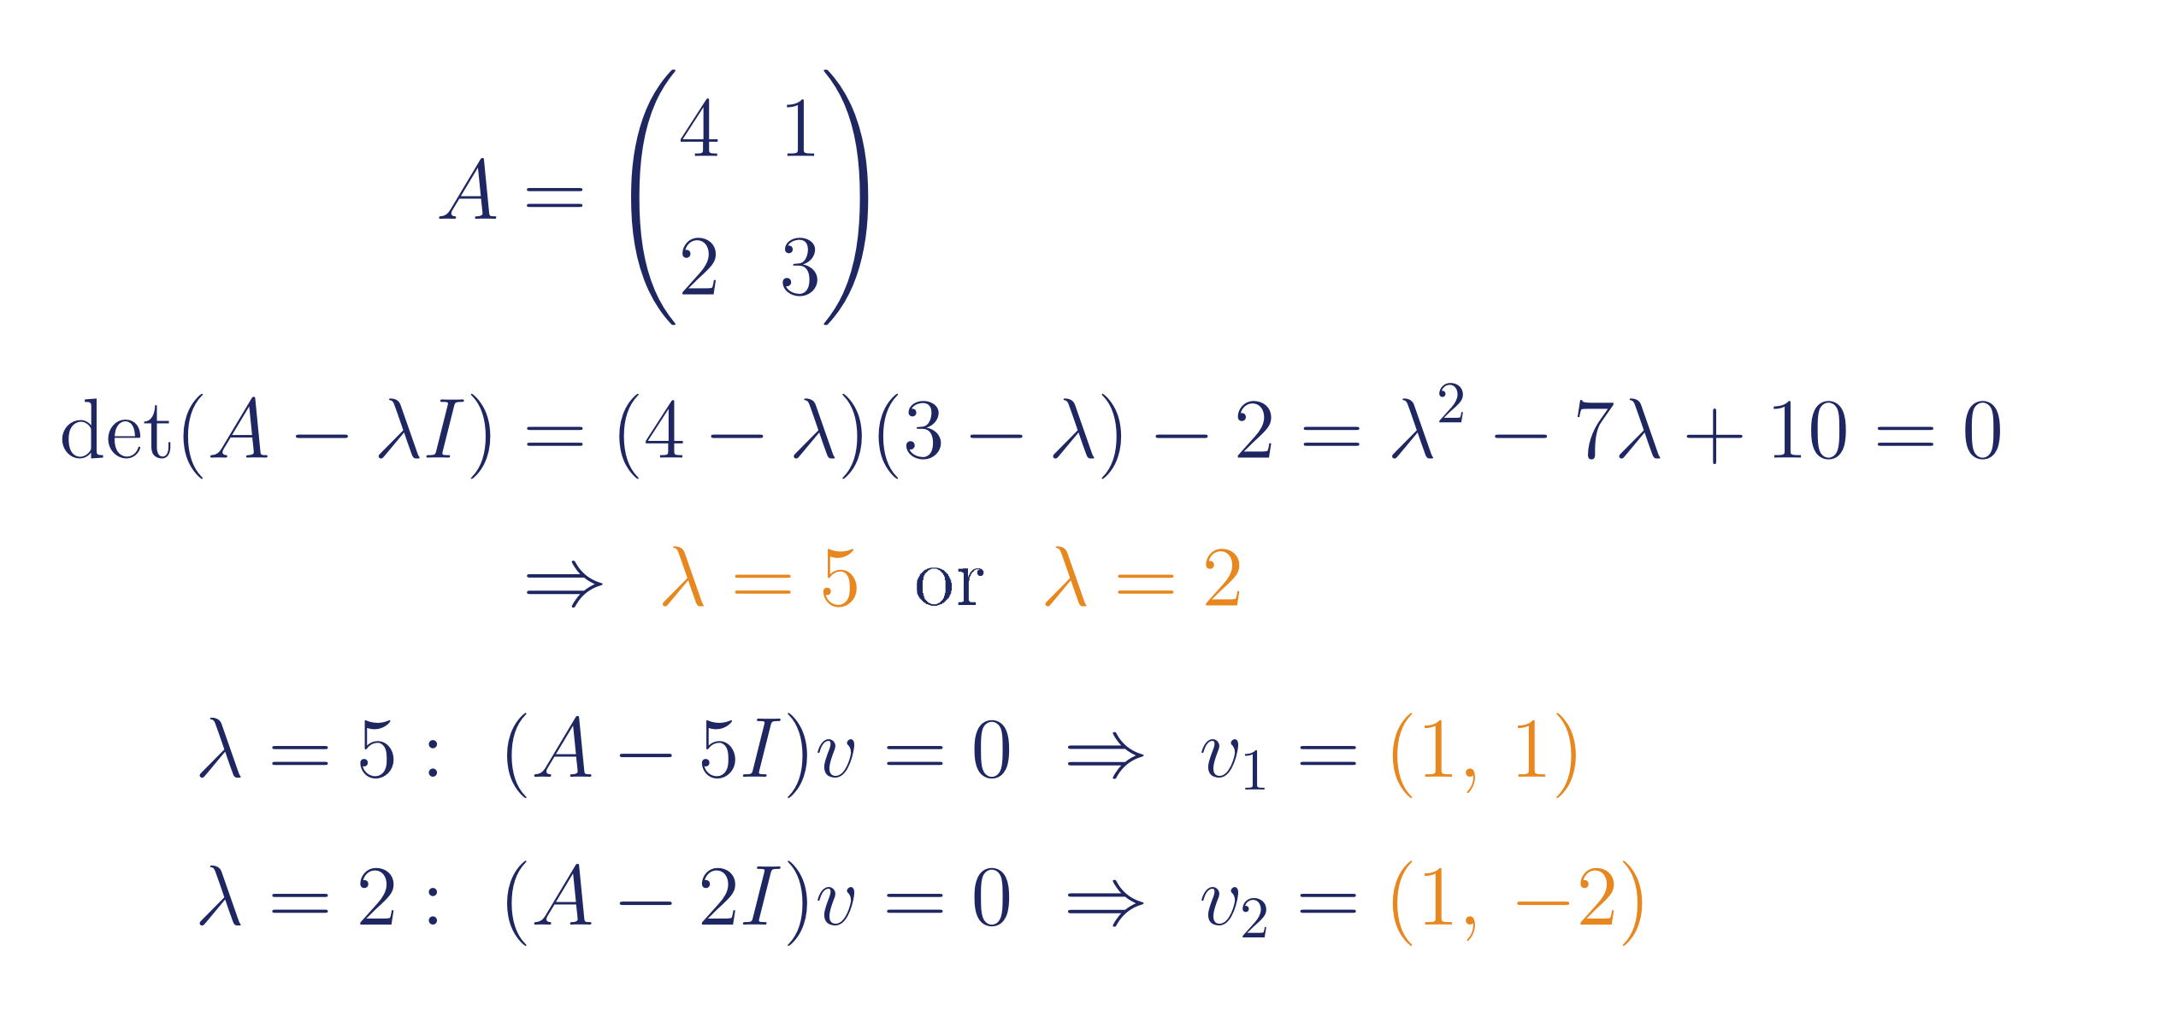
EIGENVALUES & EIGENVECTORS, COMPUTED
Worked Example
Same recipe every time: build the characteristic polynomial det(A−λI)=0, solve for λ, then solve (A−λI)v=0 for each eigenvalue.
Module 3 · Session 1 — Decompositions I
10

Slide 11

GUIDED PRACTICE
Your Turn
Working together:
1. Build the characteristic polynomial
2. Solve for λ
3. Find each eigenvector v
(Answer: λ = 6, 1)
Module 3 · Session 1 — Decompositions I
11

Slide 12
INDUSTRY FRAMING
Where This Shows Up
P
≈
C
★
PageRank
Structural & Vibration Analysis
Control Systems
PCA (Session 4)
Google's original ranking algorithm is an eigenvector problem.
Eigenvalues predict resonance and failure modes in engineering.
Stability of a controlled system is an eigenvalue question.
The top eigenvector of a covariance matrix is the first principal component.
Module 3 · Session 1 — Decompositions I
12

Slide 13
SESSION 1 — CLOSE
Every matrix has special
directions it only scales.
λ
Next session: what happens when we rebuild the whole matrix out of these directions — and why that idea needs to go further than square matrices alone.
Reading: MML §4.1–4.2

Slide 14
BACKUP
The 2×2 Determinant Formula
For A = [[a,b],[c,d]], the determinant ad − bc falls straight out of tracking how the unit square's area changes under the map — no need to memorize it as a rule from nowhere.
For 3×3 and larger: cofactor expansion along any row or column — shown on the board if it comes up, not required for this course's core assessment.
Module 3 · Session 1 — Decompositions I
14

Slide 15
BACKUP
Finding Eigenvalues at Scale: Power Iteration
The characteristic-polynomial method doesn't scale — for a 10,000×10,000 matrix you can't factor a degree-10,000 polynomial by hand or practically by computer.
Power iteration: repeatedly multiply a random vector by A and renormalize — it converges to the eigenvector with the largest eigenvalue.
This is closer to what real systems (including PageRank) actually do.
v₀
→
Av₀
→
A²v₀
→
…
→
v (top eigenvector)
Module 3 · Session 1 — Decompositions I
15

Slide 16
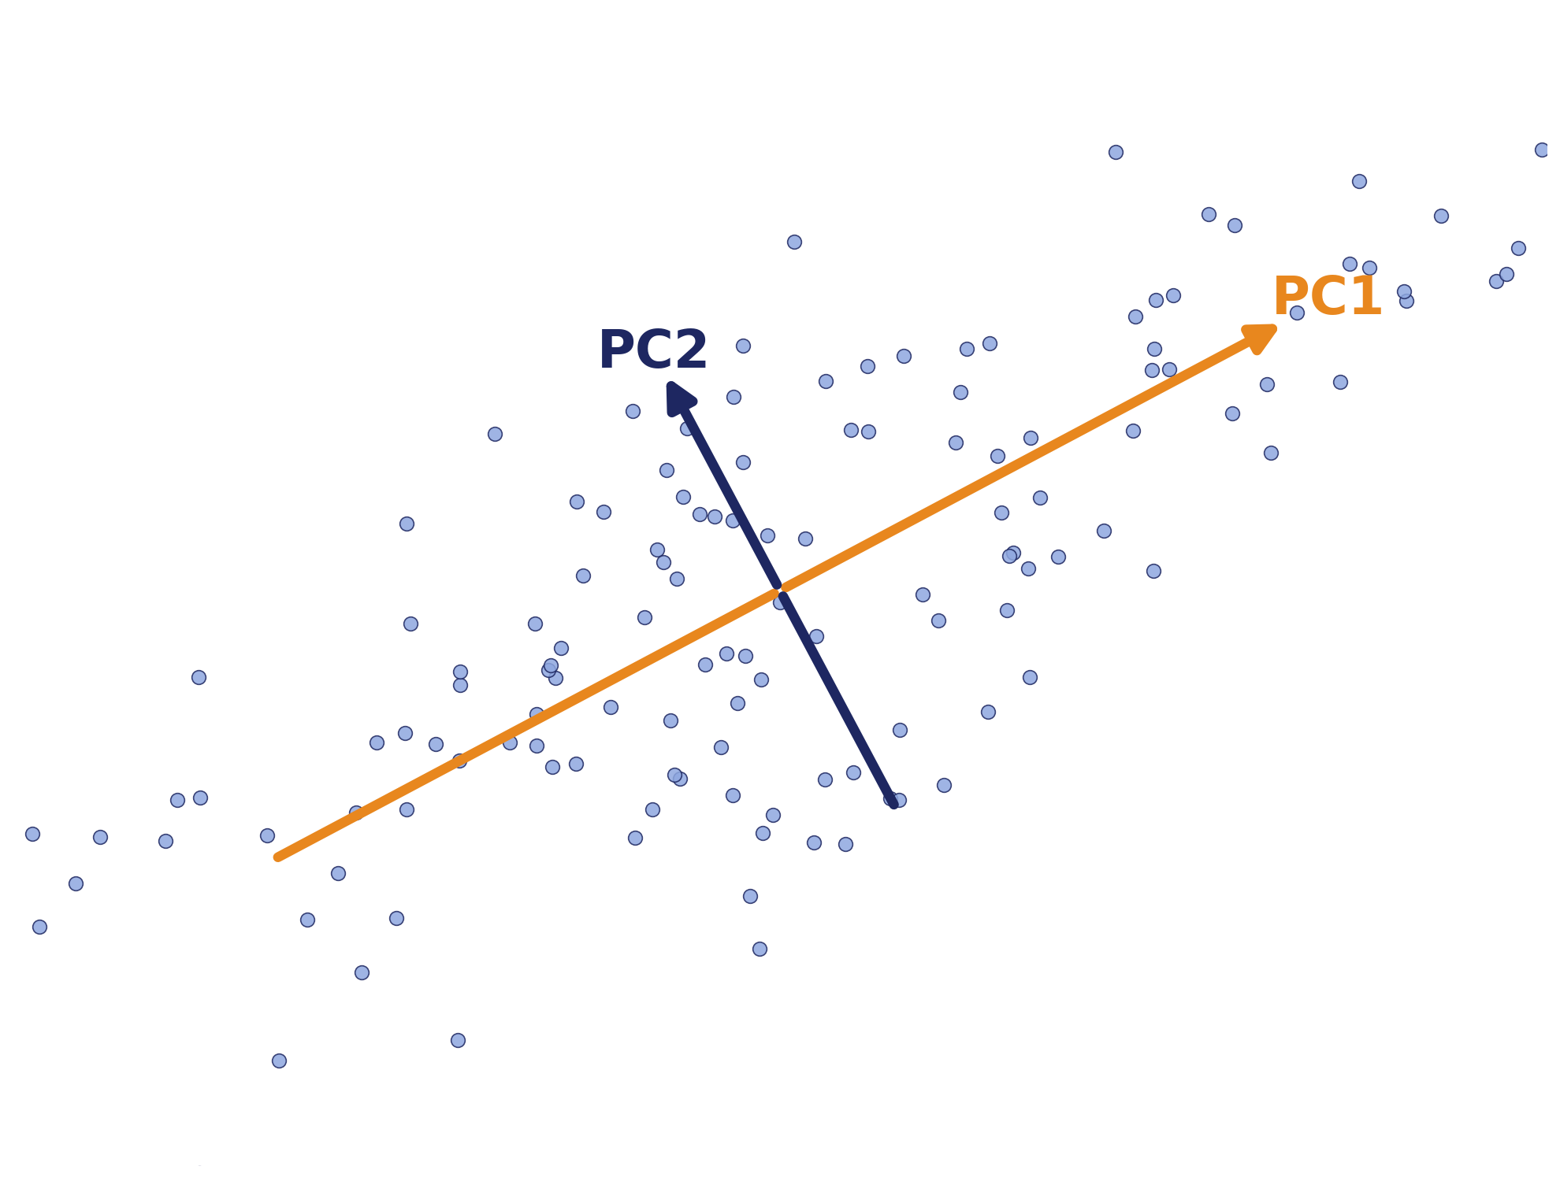
BACKUP
Preview: PCA via the Covariance Matrix
Session 4 computes PCA via SVD of the data matrix directly. The classic textbook route goes through eigenvectors instead — useful to see both:
1. Center the data, compute the covariance matrix C
2. Find C's eigenvectors — ranked by eigenvalue (= variance captured)
3. The top eigenvector is the first principal component
Module 3 · Session 1 — Decompositions I
16

