Slide 1
MODULE 3 · SESSION 2 OF 4
Eigendecomposition — and
Why We Need Something More General
Σ
Diagonalization, Its Limits & the Road to SVD
Mathematical Foundations for Data Science & Computational Intelligence
Mohsin Raza

Slide 2
90 MINUTES
Today's Session
1
Reconnect
5 min
2
Diagonalization
25 min
3
Where it breaks down
20 min
4
Introducing SVD
30 min
5
Close & bridge to Session 3
10 min
Module 3 · Session 2 — Decompositions II
2

Slide 3
RECONNECT
The Story So Far
Session 1
Today
This Module
Some directions are
special: eigenvectors
→
Rebuild the matrix
from those directions
→
Discover the limit —
and meet SVD
Last time we found that some matrices have special directions — eigenvectors — that only get scaled. Today: what if we rebuild the whole matrix out of those directions?
Module 3 · Session 2 — Decompositions II
3

Slide 4
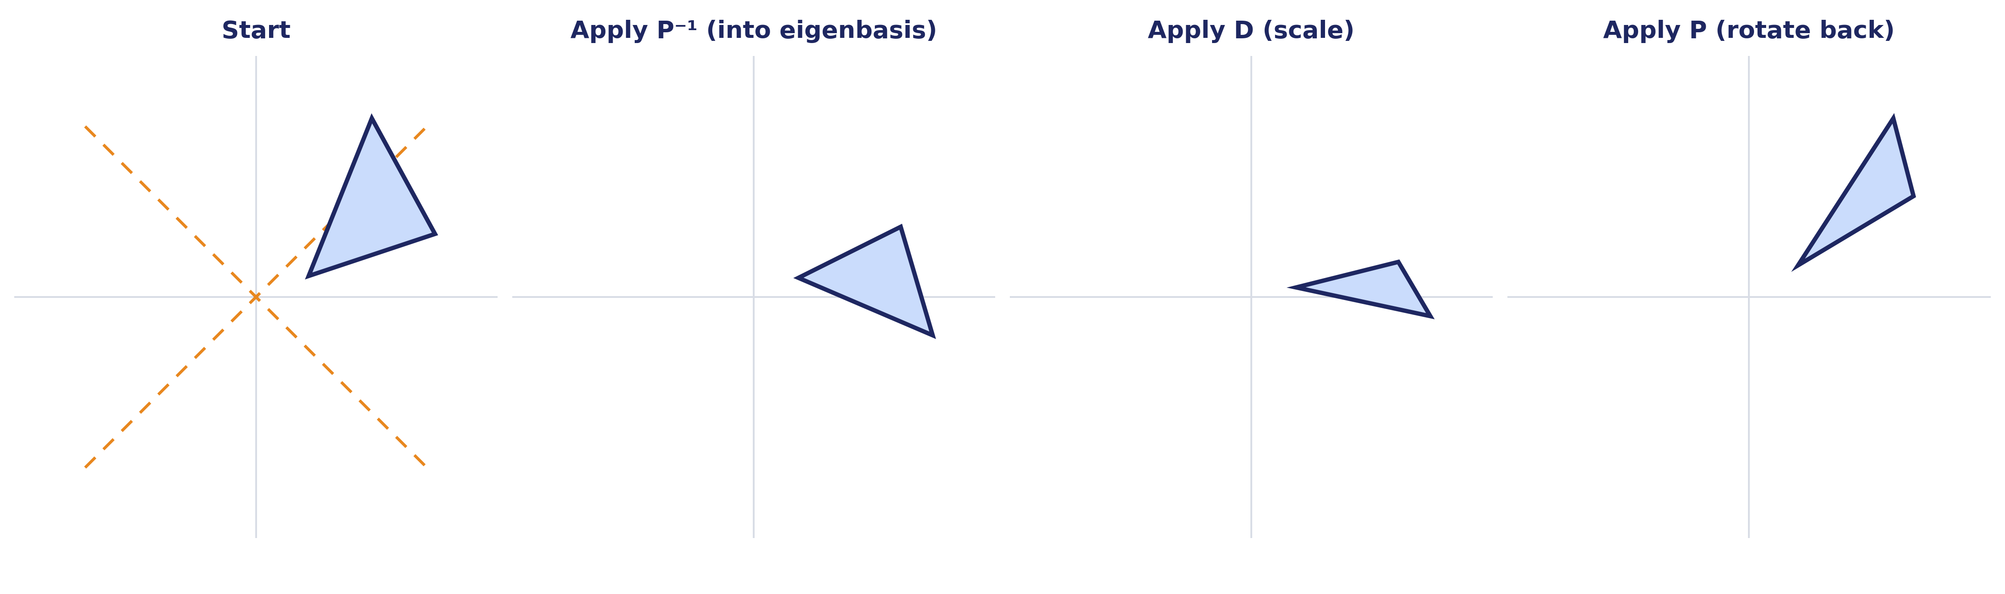
THE GEOMETRIC STORY
Diagonalization: A = PDP⁻¹
To understand what a messy matrix does: rotate into the eigenbasis — where it's just a scaling — do the scaling, then rotate back.
Careful: P⁻¹ = P^{T} here only because A is symmetric, so P is orthogonal. For a general matrix, use P⁻¹ — P^{T} alone is not enough.
Module 3 · Session 2 — Decompositions II
4

Slide 5
GUIDED QUESTION
Why Would We Ever Want This?
Aⁿ = P Dⁿ P⁻¹
Computing powers of D is trivial — just raise each diagonal entry. Computing Aⁿ directly means n full matrix multiplications.
Markov chains
Network diffusion
Repeated transforms
Predicting long-run behavior of a random process
How influence or disease spreads through a graph over time
Graphics & robotics: applying the same operation many times
Module 3 · Session 2 — Decompositions II
5

Slide 6
GUIDED QUESTION
But What Matrix Did We Just Use This On?
A square matrix.
What about the raccoon image from Day 1 — was that matrix square?
768 × 1024. Not square.
Diagonalization, as we've just built it, doesn't even apply to the exact demo shown three weeks ago.
768×1024
≠ square
Module 3 · Session 2 — Decompositions II
6

Slide 7
THE GAP
We need a decomposition that
works for any matrix — always.
Σ
Square or not. Diagonalizable or not. No exceptions.
The short reason why is in the backup slides, if you want it.
Module 3 · Session 2 — Decompositions II
7

Slide 8
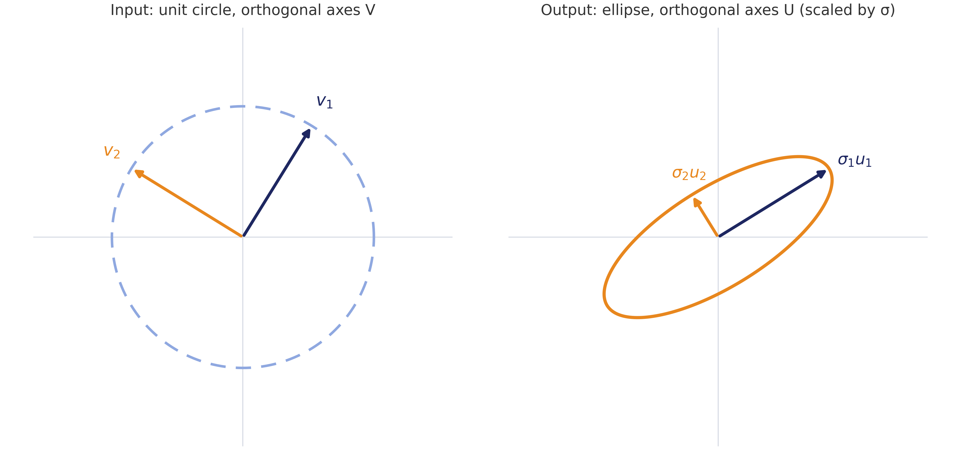
SAME IDEA, TWO DIFFERENT BASES
Introducing the SVD
Recall: eigenvectors were directions A doesn't rotate, only scales. Singular vectors generalize that — orthogonal directions (V) still map to orthogonal directions (U), even when the direction itself is allowed to change.
Module 3 · Session 2 — Decompositions II
8

Slide 9
Naming the Pieces
A = U Σ V^{T}
U — left singular vectors:
orthogonal basis for the output space.
Σ — singular values:
always ≥ 0, ordered largest to smallest.
V — right singular vectors:
orthogonal basis for the input space.
RECALL — SESSION 1
Av = λv
same direction, just scaled.
TODAY
Avᵢ = σᵢuᵢ
direction can rotate (v → u) — but orthogonal in still means orthogonal out. That's the special property now.
Σ
Module 3 · Session 2 — Decompositions II
9

Slide 10
INDUSTRY FRAMING
Where This Shows Up
N
L
★
The Netflix Prize
Latent Semantic Analysis
LoRA (Module 11 preview)
SVD on a users×movies matrix uncovered hidden taste dimensions no one hand-labeled.
The same idea applied to documents×words — search engines finding topics, not keywords.
Fine-tuning large models cheaply leans on this same low-rank thinking.
Module 3 · Session 2 — Decompositions II
10

Slide 11
SESSION 2 — CLOSE
Every matrix, no exceptions,
has an SVD.
Σ
Next session: we go back to that raccoon image and finally explain why keeping just 50 of these components reconstructed something recognizable from 768.
Reading: MML §4.4, §4.5 (first half)

Slide 12
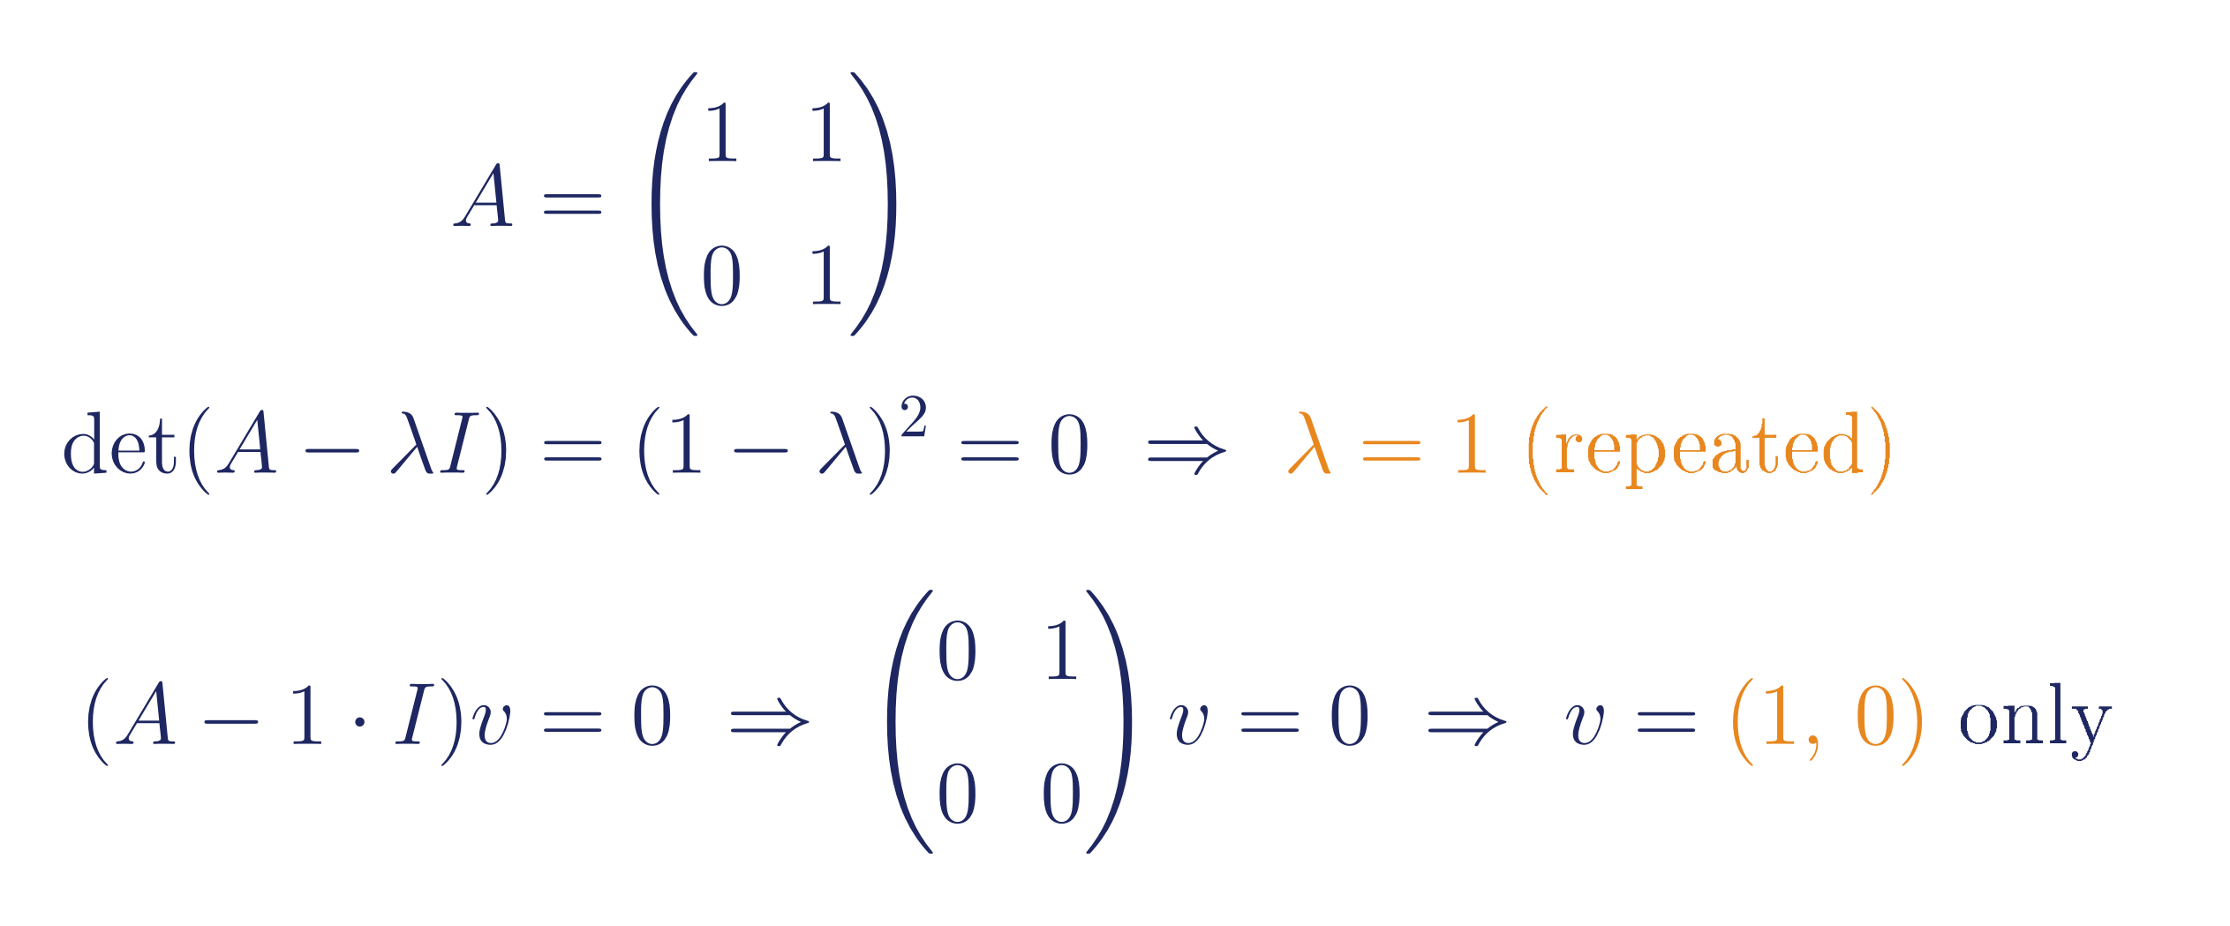
BACKUP
When Diagonalization Fails Completely
Some matrices aren't just "non-square" — they're not diagonalizable at all, even if square.
This shear matrix has a repeated eigenvalue but only one independent eigenvector direction — not enough to build a full eigenbasis.
SVD doesn't care — it still exists.
Module 3 · Session 2 — Decompositions II
12

Slide 13
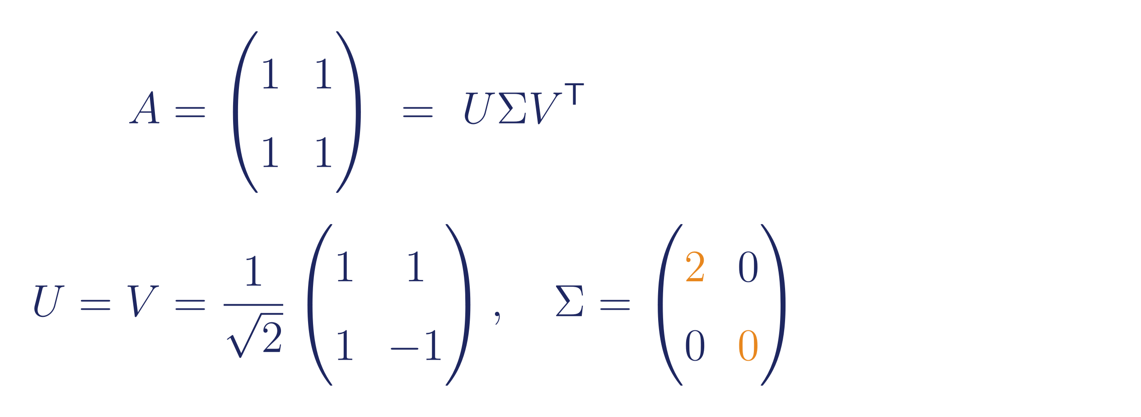
BACKUP
Worked Example: A Rank-Deficient Matrix
Notice Σ has a zero — that's the SVD directly exposing that A is rank-deficient (det(A)=0), exactly the Session 1 idea, now visible as a number instead of just "no inverse."
Careful: U = V here only because A is symmetric with no negative eigenvalues ("positive semi-definite" — all its eigenvalues are ≥ 0). In general U and V are not the same — they're bases for different spaces (output vs. input) and only coincide in special cases like this one.
Module 3 · Session 2 — Decompositions II
13

Slide 14
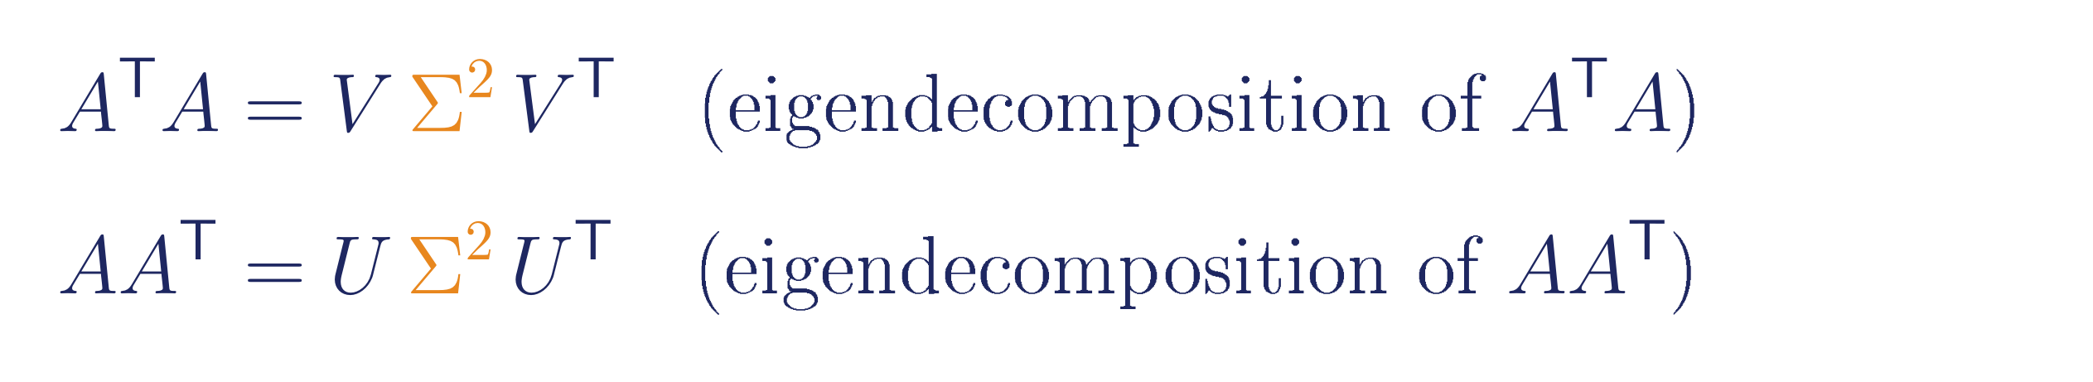
BACKUP
Where U, Σ, V Come From — and Why SVD Always Exists
V's columns are eigenvectors of A^{T}A; U's columns are eigenvectors of AA^{T}; singular values are the square roots of the shared eigenvalues of either.
The actual reason SVD has no exceptions:
A^{T}A and AA^{T} are symmetric for any matrix A — square or not, diagonalizable or not. The spectral theorem guarantees every symmetric matrix has a full set of real, orthogonal eigenvectors, no exceptions. Diagonalization can fail on A itself; it never fails on A^{T}A or AA^{T}. That's the whole guarantee.
Module 3 · Session 2 — Decompositions II
14

