Slide 1
MODULE 3 · SESSION 3 OF 4
SVD Delivers: Matrix Approximation
Truncated SVD: Compression, Structure & Limits
Σ
Mathematical Foundations for Data Science & Computational Intelligence
Mohsin Raza

Slide 2
90 MINUTES
Today's Session
1
Reconnect
5 min
2
Truncated SVD & Eckart-Young
20 min
3
The Payoff: Compression & Choosing k
27 min
4
New Demo: Document-Term Matrix
25 min
5
Industry Framing & Limitations
8 min
6
Close & Bridge to Session 4
5 min
Module 3 · Session 3 — SVD Delivers: Matrix Approximation
2

Slide 3
RECONNECT
The Story So Far
Session 2
Today
This Module
SVD exists for
any matrix — no exceptions
→
SVD gives the best
rank-k approximation
→
PCA: the most common
use of exactly this idea
We spent last session proving SVD always exists. Today: why truncating it gives the best possible low-rank approximation — best in reconstruction error, for a given rank k.
Module 3 · Session 3 — SVD Delivers: Matrix Approximation
3

Slide 4
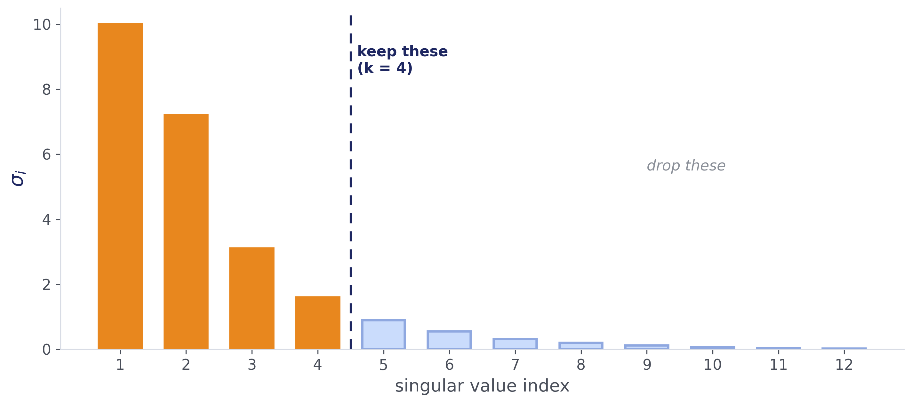
GUIDED QUESTION
What If We Just... Drop the Small Ones?
Recall: singular values are always ≥ 0, ordered largest to smallest. If most of them are tiny — what happens if we just drop them, and keep only the top k?
Module 3 · Session 3 — SVD Delivers: Matrix Approximation
4

Slide 5
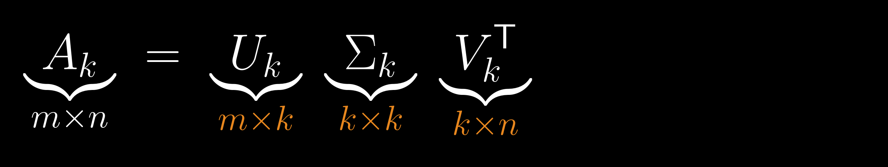
The Truncated SVD
Keep only the first k columns of U, the first k singular values of Σ, and the first k rows of Vᵀ. Throw the rest away.
Check: (m×k)(k×k)(k×n) multiplies out to m×n — same shape as A.
Σ
Module 3 · Session 3 — SVD Delivers: Matrix Approximation
5

Slide 6
GUIDED QUESTION
Is This the Best We Can Do?
Among all possible rank-k matrices — not just truncated SVD — which one gets closest to A?
It provably is the best — among all rank-k approximations, in both the Frobenius and spectral norms. This is the Eckart-Young theorem.
The proof is short and elegant, but not required here — it's in the backup slides, and might show up as an optional sessional bonus question. Never load-bearing.
Module 3 · Session 3 — SVD Delivers: Matrix Approximation
6

Slide 7
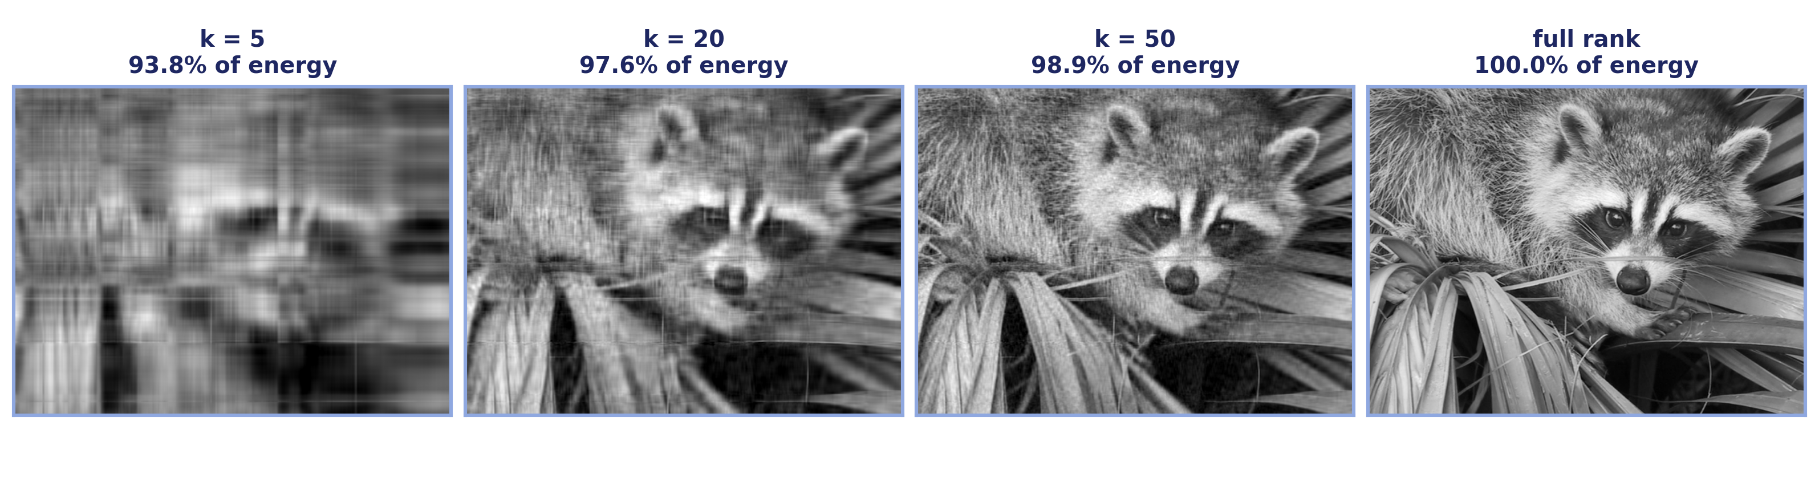
THE PAYOFF
Image Compression via Truncated SVD
This is the actual Day 1 photo. k in Aₖ = UₖΣₖVₖᵀ is exactly this k. The energy percentages above each panel are computed live, directly from this image's own singular values — not asserted from memory. "Energy" = sum of squared singular values, top k over all.
Notice how fast this saturates: even k=5 already captures 93.8% of the energy — real photographs tend to be very low-rank in exactly this way, which is precisely why this compression trick works so well on them. Eckart-Young guarantees this is the best possible rank-k approximation of this image, for every k shown.
Module 3 · Session 3 — SVD Delivers: Matrix Approximation
7

Slide 8
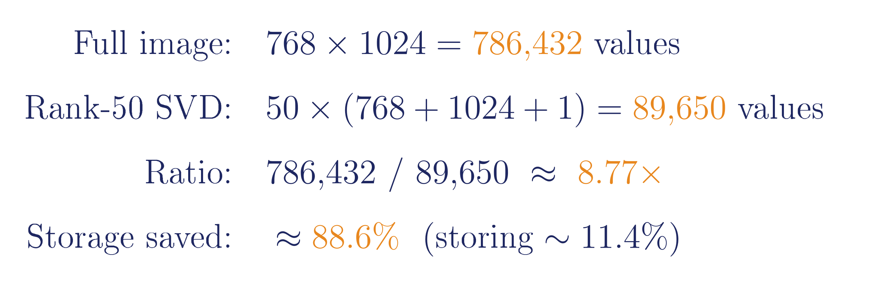
Quantifying the Compression
This is a comparison in number of values, not bytes. If the original is stored as uint8 and the SVD factors as float32, actual byte-level savings differ from this ratio.
Module 3 · Session 3 — SVD Delivers: Matrix Approximation
8

Slide 9
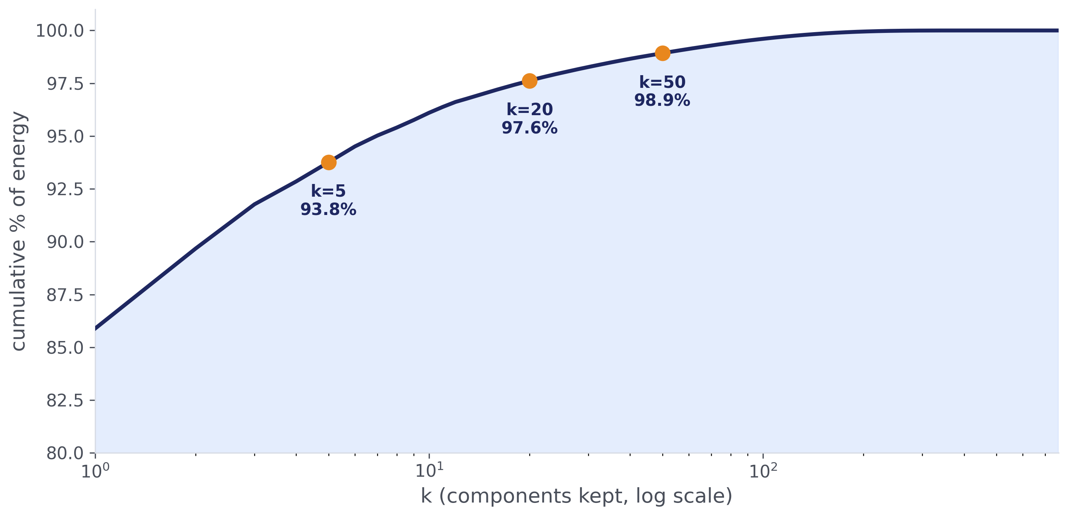
A QUESTION YOU'LL ASK
How Do You Actually Choose k?
Cumulative energy
Pick k where the curve crosses a target, e.g. 90% or 95%.
Elbow method
Look for where the curve visibly flattens — in this photo, the marginal gain is already small by k≈20–50, which is exactly why k=50 looked so good on the previous slide.
Domain constraints
Storage budget, latency, or a required compression ratio can set k directly.
Error vs. compression
Smaller k = more compression, more reconstruction error. There's no free lunch — pick the tradeoff that fits the task.
Module 3 · Session 3 — SVD Delivers: Matrix Approximation
9

Slide 10
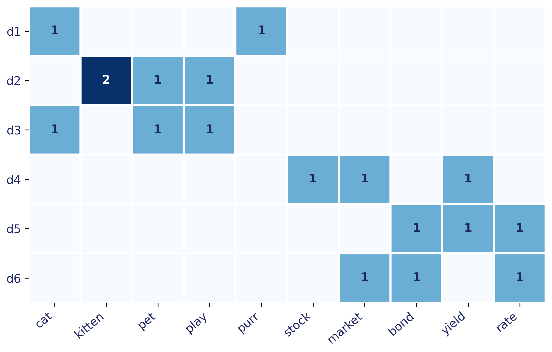
NEW DEMO
New Data, Same Math
Same operation, completely different data type. SVD doesn't know or care whether the columns are pixels or word counts.
Module 3 · Session 3 — SVD Delivers: Matrix Approximation
10

Slide 11
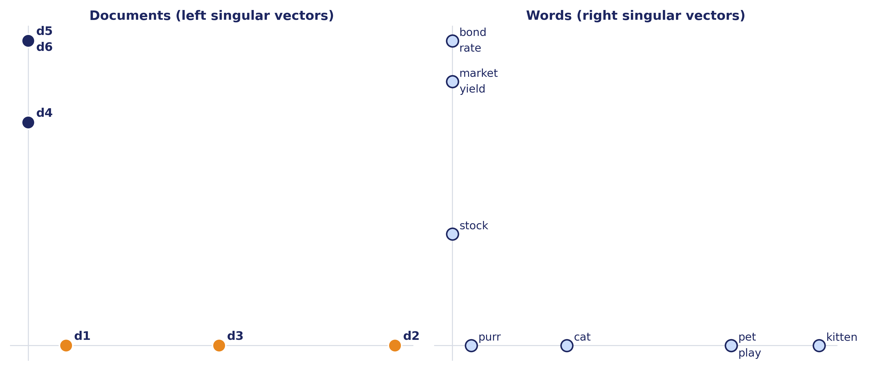
NEW DEMO, CONTINUED
SVD Finds the Topics
Left singular vectors group documents by topic; right singular vectors group words by topic — no topic labels ever given to the algorithm.
Two caveats worth knowing: raw counts are fine for this toy demo, but real systems usually preprocess first (TF-IDF, stopword removal, normalization) — raw counts alone often give mediocre topics at real scale. Also, singular vectors have a sign ambiguity: flipping every sign in a component (v → −v, u → −u together) doesn't change the reconstruction, so don't read meaning into which side of zero a point lands on, only its grouping with others.
Module 3 · Session 3 — SVD Delivers: Matrix Approximation
11

Slide 12
INDUSTRY FRAMING
Where This Shows Up
D
M
G
Denoising
Medical Imaging
Genomics
Separating signal from noise by keeping only high-singular-value structure.
MRI/CT reconstruction and compression via low-rank structure.
Gene-expression matrices (genes × samples) summarized by dominant components.
Low-rank structure is signal; the discarded components are noise or redundancy.
Module 3 · Session 3 — SVD Delivers: Matrix Approximation
12

Slide 13
HONEST LIMITATIONS
When Low-Rank SVD Isn't Enough
Assumes linear structure
Cost at scale
SVD only finds linear combinations. Genuinely nonlinear structure (e.g. a spiral) won't compress well no matter the choice of k.
Computing a full SVD is expensive for very large matrices — real systems use randomized or truncated algorithms, not the textbook computation.
Components can be hard to interpret
Missing data needs care
The document-term demo's topics were readable by design. Real singular vectors are often dense, signed combinations that resist a clean one-line story.
Ordinary SVD assumes a complete matrix. Missing entries (common in real recommender data) need specialized methods, not naive SVD.
Module 3 · Session 3 — SVD Delivers: Matrix Approximation
13

Slide 14
SESSION 3 — CLOSE
SVD gives the best rank-k
approximation of any matrix.
Σ
Next session: a very specific, very common use of exactly this idea — reducing messy, high-dimensional data down to the few directions that actually explain what's going on. That's PCA.
PCA is just SVD on centered data — same math, one preprocessing step.
Reading: MML §4.5 (remainder), §4.6

Slide 15
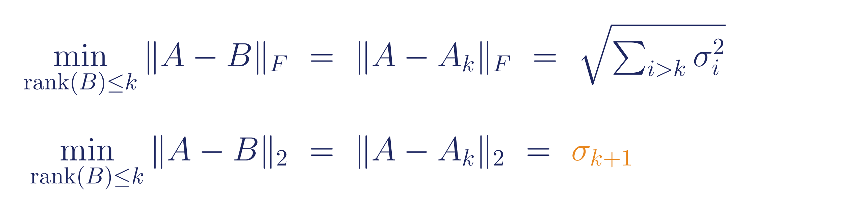
BACKUP
Eckart-Young Theorem, Stated
The best rank-k approximation of A, in both Frobenius and spectral norm, among ALL rank-k matrices, is the truncated SVD Aₖ — and the leftover error is exactly determined by the singular values you dropped. Full proof sketch on the board if a student wants it — short and elegant, but never required.
Module 3 · Session 3 — SVD Delivers: Matrix Approximation
14

Slide 16
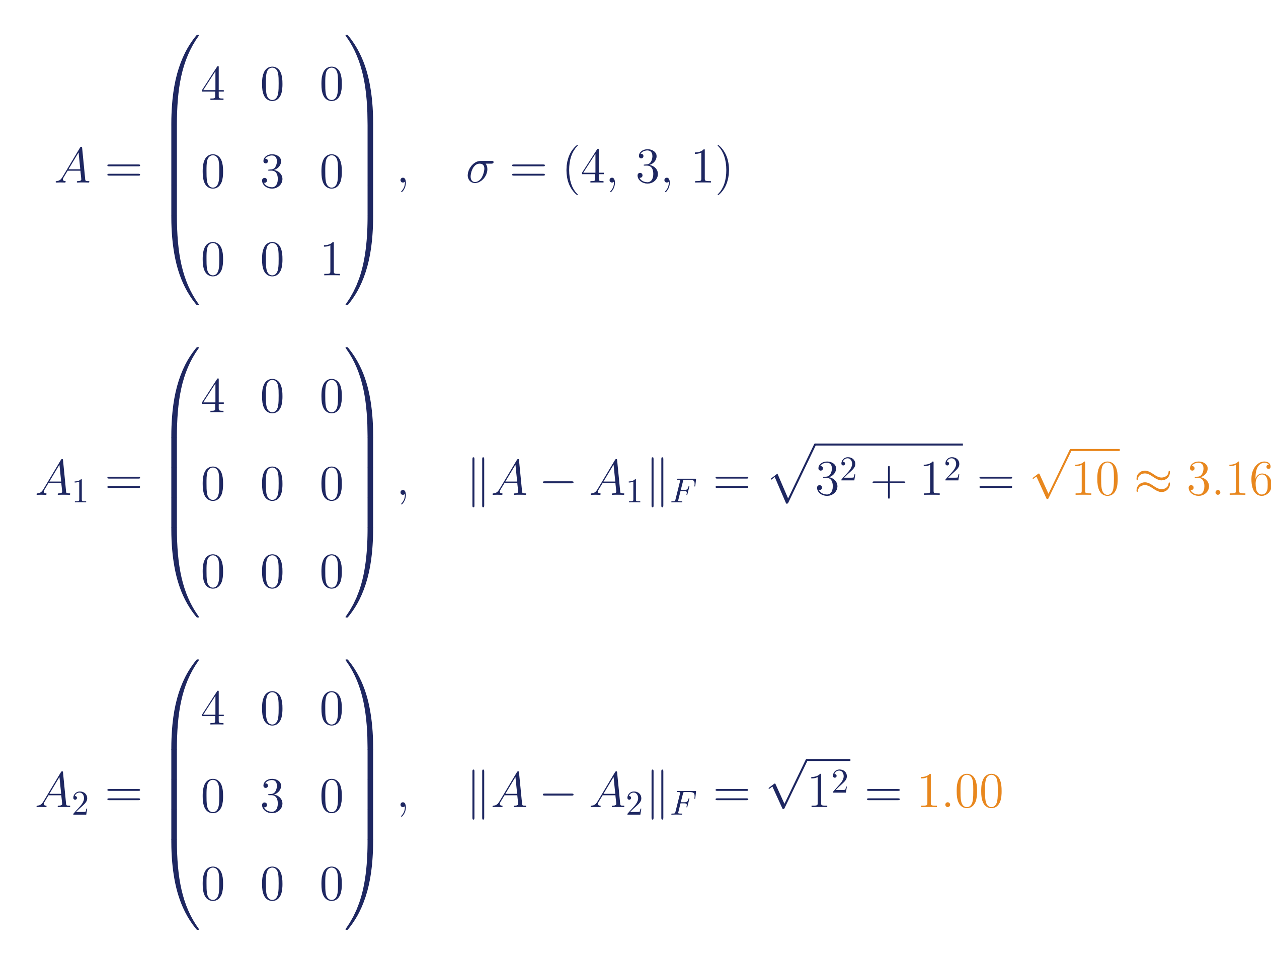
BACKUP
Worked Example: Truncation Error Shrinking
Module 3 · Session 3 — SVD Delivers: Matrix Approximation
15

Slide 17
BACKUP
The Full Arithmetic Behind the Compression Claim
Same numbers as slide 8, spelled out again here for a student who wants to work through the arithmetic themselves without the slide moving on.
Module 3 · Session 3 — SVD Delivers: Matrix Approximation
16

