Slide 1
MODULE 3 · SESSION 4 OF 4
Principal Component Analysis: SVD in Action
The Most Common Use of Everything We've Built
Σ
Mathematical Foundations for Data Science & Computational Intelligence
Mohsin Raza

Slide 2
90 MINUTES
Today's Session
1
Reconnect
5 min
2
Why Do We Need This?
20 min
3
PCA via SVD
25 min
4
Demo: The Iris Dataset
25 min
5
Synthesis & Bridge to Module 4
15 min
Module 3 · Session 4 — PCA: SVD in Action
2

Slide 3
RECONNECT
The Story So Far
Sessions 1–2
Session 3
Today
Special directions
exist — SVD finds them
for any matrix
→
SVD gives the best
possible rank-k
summary
→
The single most
common real-world
use of this idea
Every session this module has built toward one destination. Today we arrive.
Module 3 · Session 4 — PCA: SVD in Action
3

Slide 4
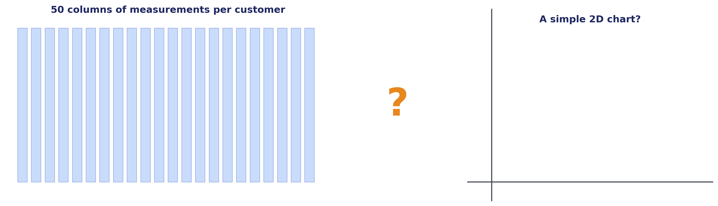
GUIDED QUESTION
50 Numbers Per Customer. Now What?
You have 50 measurements per customer — spending across 50 categories. You want to plot your customers on a simple 2D chart to see patterns. You obviously can't plot 50 dimensions. What do you do?
Module 3 · Session 4 — PCA: SVD in Action
4

Slide 5
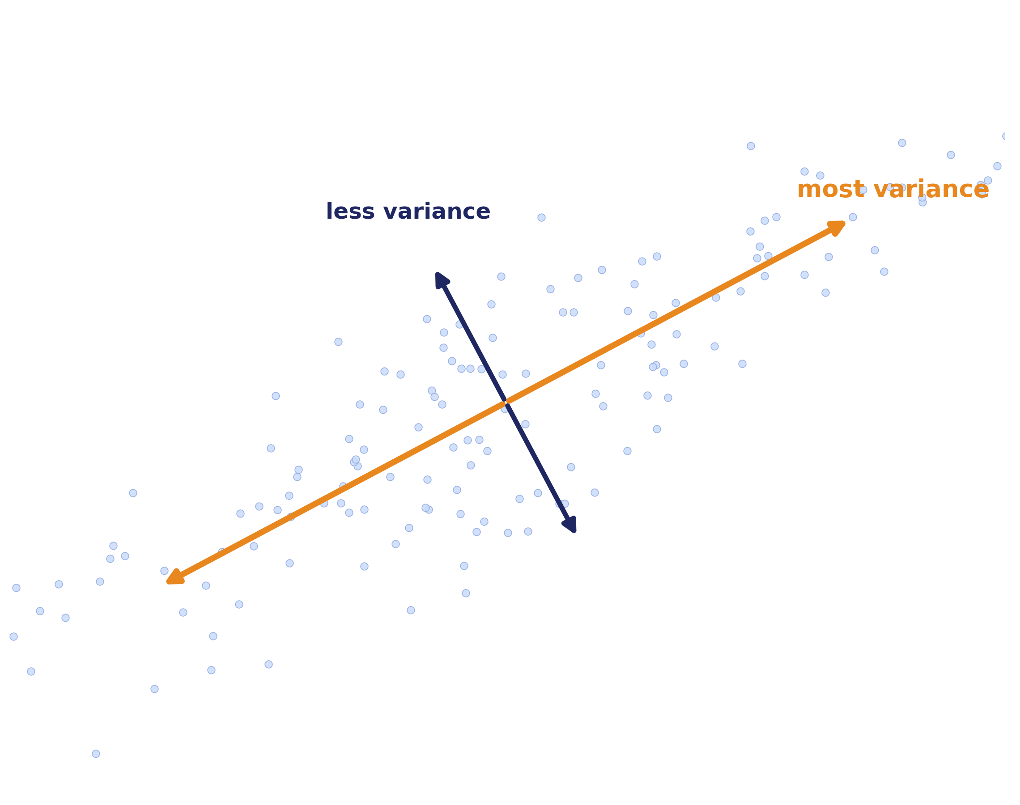
GUIDED QUESTION, CONTINUED
Which Directions Have the Most Spread?
The direction of maximum variance is an eigenvector of the covariance matrix — the one with the largest eigenvalue. That's the first principal component.
Module 3 · Session 4 — PCA: SVD in Action
5

Slide 6
PCA via SVD
Center
the data
→
X_centered
→
SVD
→
UΣV^{T}
→
Principal
Components
You could compute PCA by eigendecomposing the covariance matrix directly — many textbooks teach it that way first. In practice it's usually computed via SVD of the centered data matrix directly — same answer, more numerically stable, and it's the exact tool we've spent three sessions building.
Explained variance = proportion of Σ's total energy captured by the top k components — same idea as "k=50 captured 98.9% of the image" from Session 3.
Σ
Module 3 · Session 4 — PCA: SVD in Action
6

Slide 7
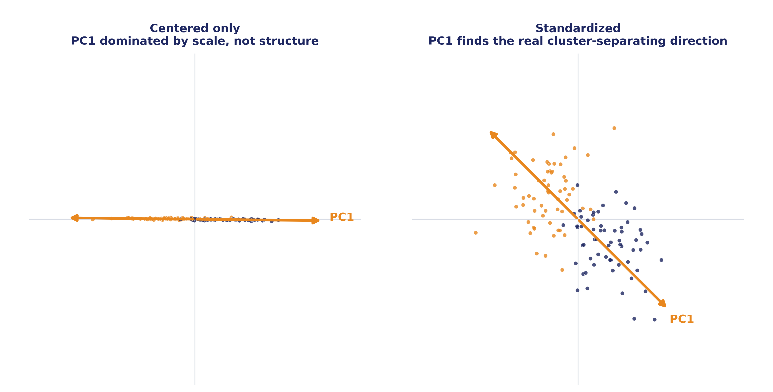
A PRACTICAL GOTCHA
Careful: Centering Isn't Always Enough
Variance is about spread around the mean — that's why we center. But if features are on very different scales (income in dollars vs. age in years), centering alone isn't enough. Standardizing (center, then divide by standard deviation) is usually the right move.
Module 3 · Session 4 — PCA: SVD in Action
7

Slide 8
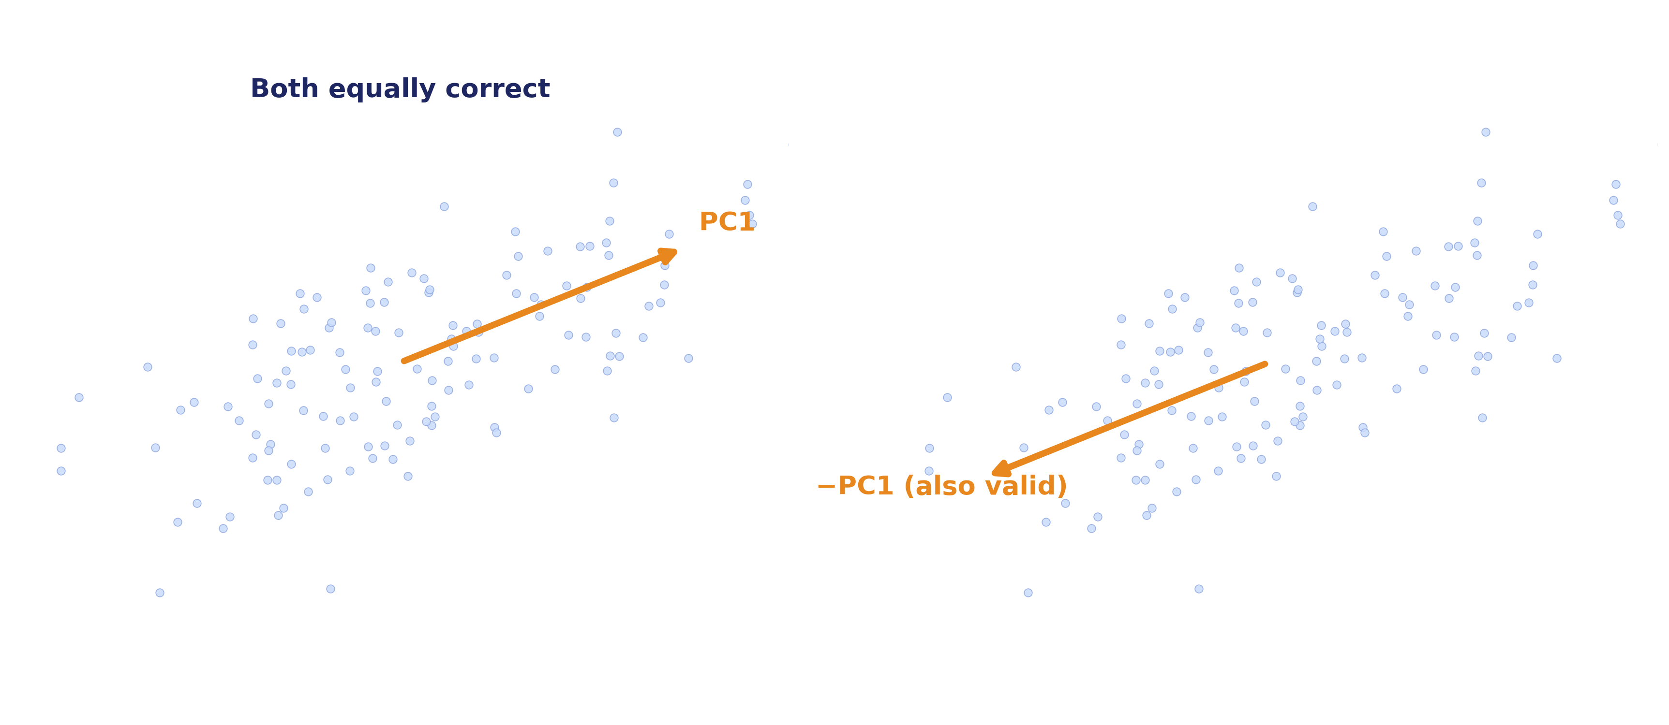
A QUICK CALLBACK
One More Thing Carries Over: Sign Ambiguity
Principal components — like singular vectors generally — are only defined up to a sign flip. A component and its negation represent the same direction.
Module 3 · Session 4 — PCA: SVD in Action
8

Slide 9
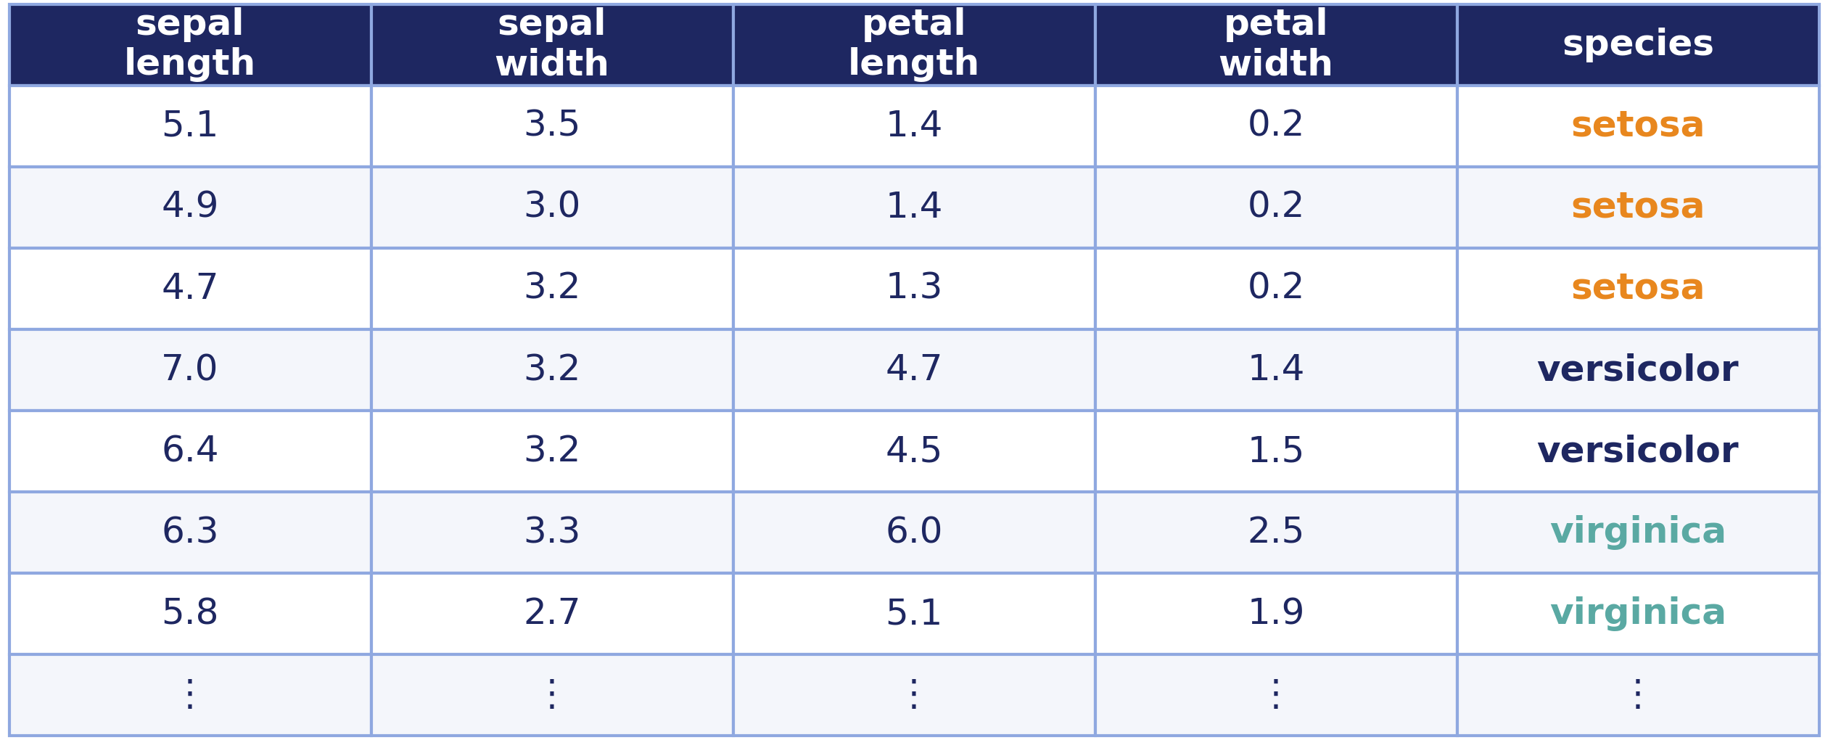
DEMO
Demo: The Iris Dataset
150 flowers total — 4 measurements each, 3 species
Same math, real data: do the measurements alone separate the species, without ever being told which is which?
Module 3 · Session 4 — PCA: SVD in Action
9

Slide 10
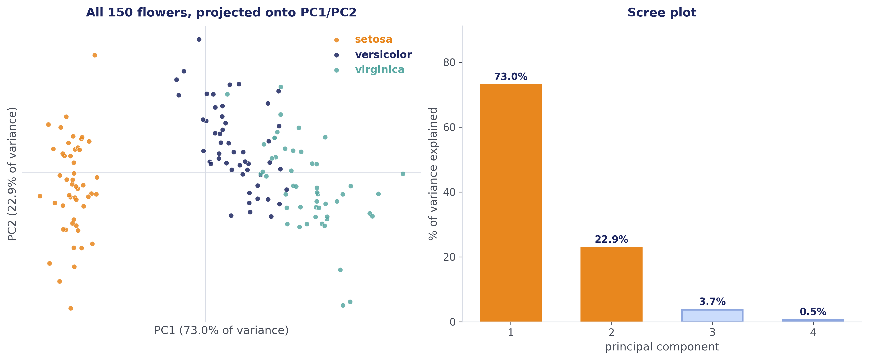
DEMO, CONTINUED
The Projection and the Scree Plot
One species splits off cleanly. The other two overlap. That's not a failure of PCA — it's an honest reflection of the data: those two species really are more similar to each other on these four measurements.
Module 3 · Session 4 — PCA: SVD in Action
10

Slide 11
DELIBERATE CALLBACK, NOT NEW CONTENT
How Many Components? (You Already Know This)
Cumulative variance
Elbow method
Pick k where the curve crosses a target, e.g. 90% or 95%.
Look for where the scree plot visibly flattens.
Domain constraints
Error vs. compression
"I need to visualize this, so k=2 or k=3, full stop."
Smaller k = more compression, more reconstruction error. No free lunch.
Module 3 · Session 4 — PCA: SVD in Action
11

Slide 12
INDUSTRY FRAMING
Where This Shows Up
E
F
V
Exploratory Data Analysis
Feature Engineering
Visualization
The first thing many data scientists do with a new high-dimensional dataset, before any modeling.
Principal components used directly as inputs to a downstream model, especially when original features are correlated.
The standard way to "see" a high-dimensional dataset at all.
Module 3 · Session 4 — PCA: SVD in Action
12

Slide 13
MODULE 3 — THE WHOLE STORY
Σ
Every Matrix Hides Structure. SVD Finds It. PCA Uses It.
Session 1
Session 2
Session 3
Session 4
Special directions
exist
→
Every matrix
has them
→
Best possible
summary
→
Here's how
it's used
Find the structure. Keep the best part. Use it.
Next module: back to systems and projections — Ax = b and least squares — the direct machinery for fitting a model to data. It reuses everything we just built.
Reading: MML Ch. 10

Slide 14
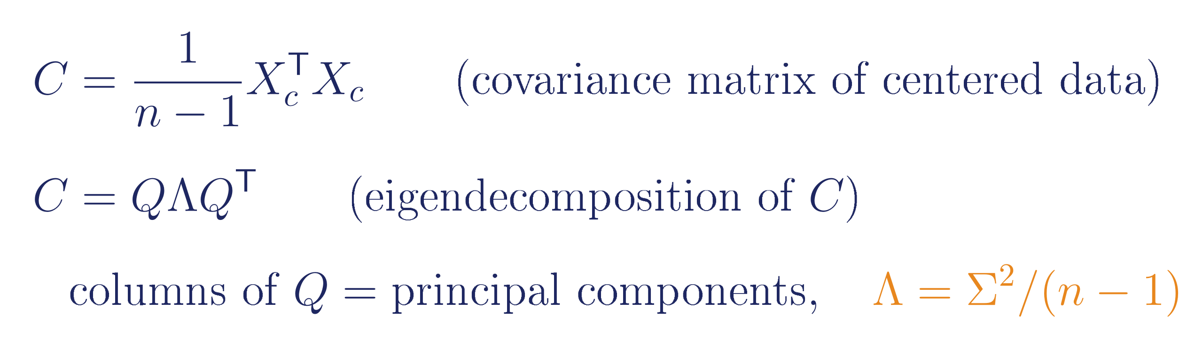
BACKUP
PCA via the Covariance Matrix (the Other Route)
Same answer as the SVD route — this is the classical way PCA is often taught first. Useful to know it's not a different method, just a different (less numerically stable) way to compute the same result.
Module 3 · Session 4 — PCA: SVD in Action
14

Slide 15
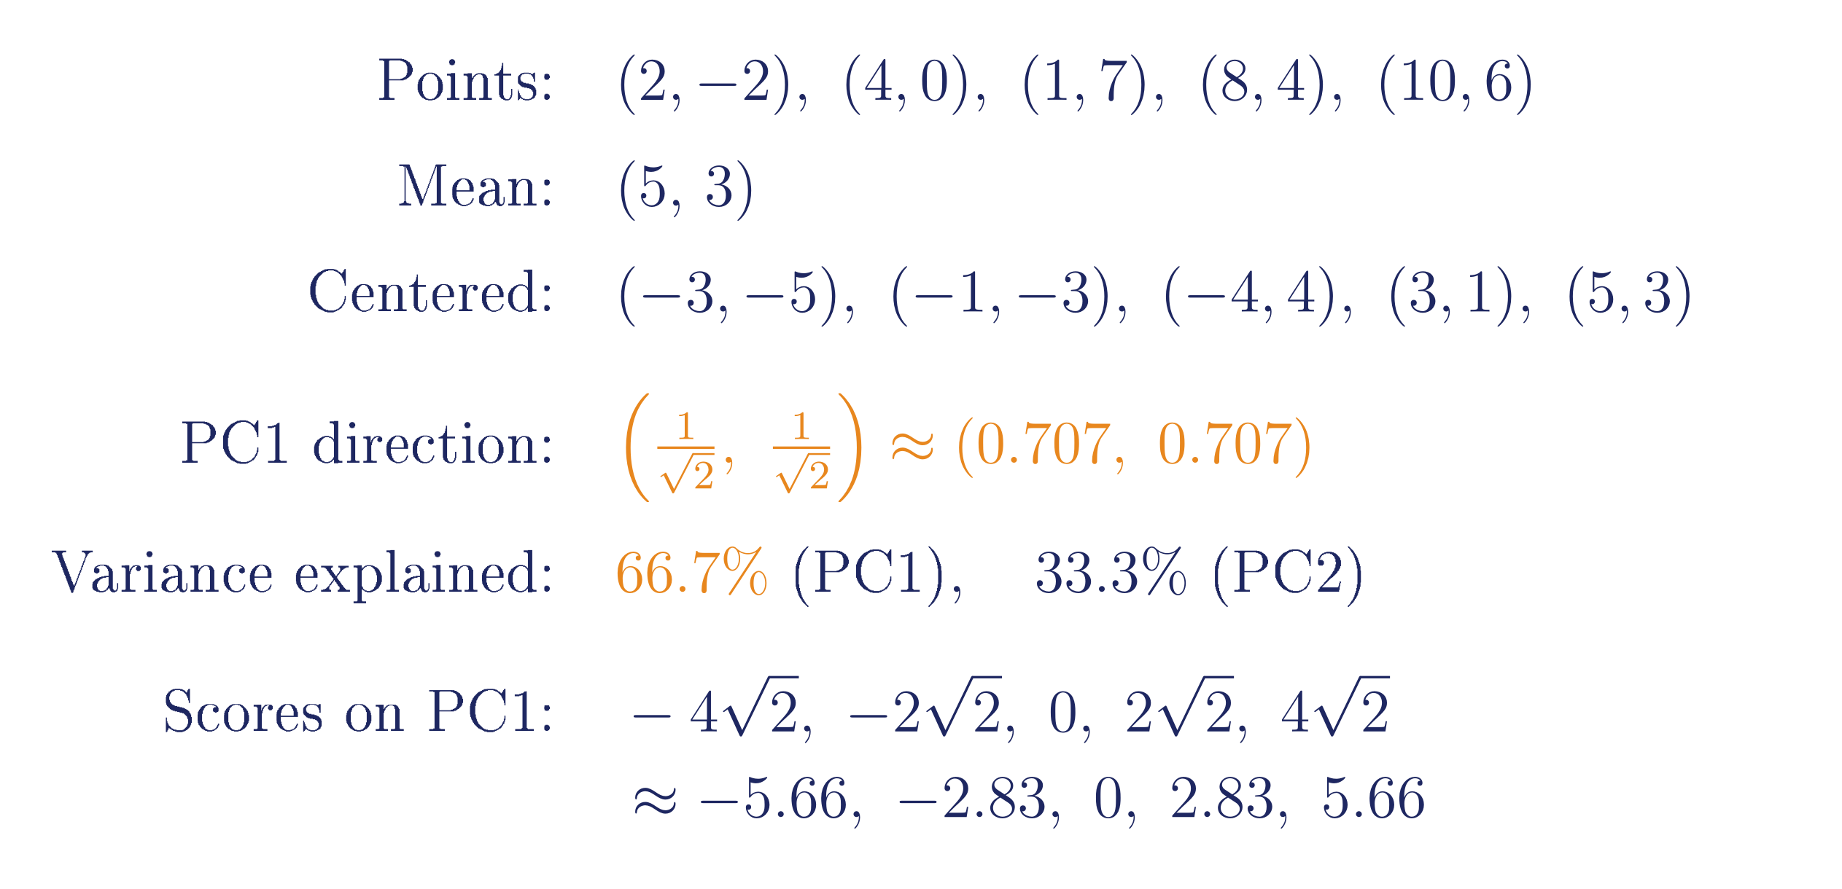
BACKUP
Worked Example: PCA by Hand
Module 3 · Session 4 — PCA: SVD in Action
15

Slide 16
BACKUP
When PCA Isn't the Right Tool
Sensitive to outliers
Assumes linear relationships
Requires numeric features
A single extreme point can dominate a principal component.
Genuinely nonlinear structure needs something else (t-SNE, UMAP).
Categorical data needs encoding first — naive one-hot encoding interacts awkwardly with PCA's variance-based logic.
Module 3 · Session 4 — PCA: SVD in Action
16

