Slide 1
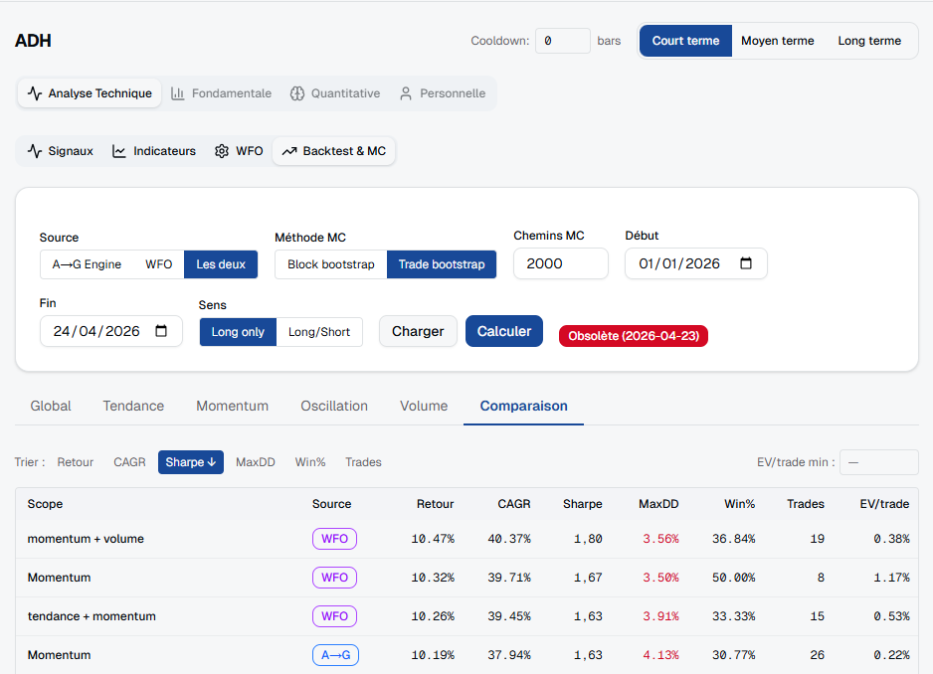
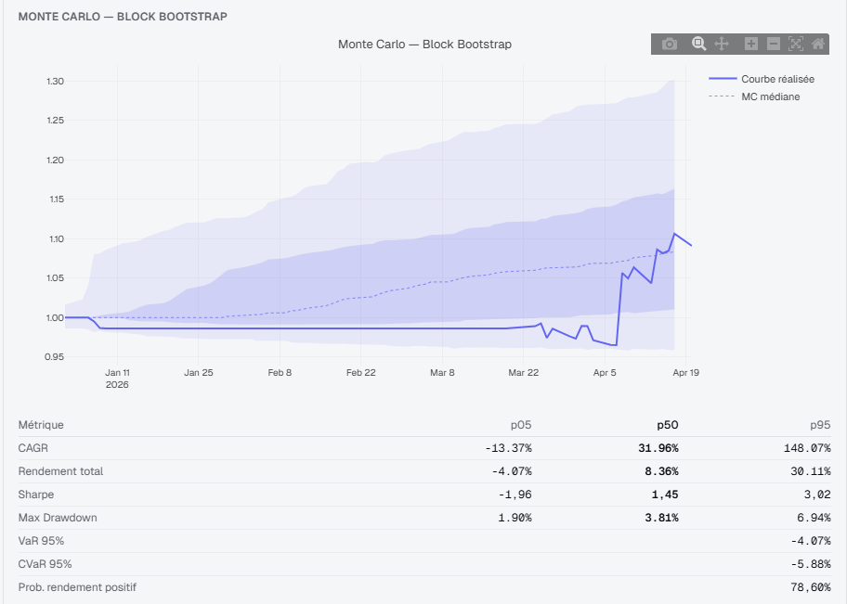
Weekly Report — Week ending 2026-04-24
Highlights: robustness layer, macro/factor study, app integration

Slide 2
Executive Summary
Added per-signal backtest + Monte Carlo robustness panel to signal pages
Completed macro/factor descriptive study for MASI (results extracted)
Drafted app-level factor-layer design and analytics API/frontend contract

Slide 3
Key Findings (concise)
ATW — US10Y: Spearman 0.009, p=0.496
ATW — VIX: Spearman -0.029, p=0.021

Slide 4
Work Completed This Week
Per-signal backtest + Monte Carlo robustness UI integrated on signal pages
Macro/factor study executed; outputs saved under iLoveZIP_Create/factor_lab_outputs
Docs and app-level factor-layer design drafted (docs/factor-layer)

Slide 5
Next Steps
Add any additional symbol numbers to the PPTX if needed
Run unit tests for stats/alignment and ingest key macro series for validation
Prepare PR with code + docs for review

Slide 6
Artifacts
Local analysis: c:\Users\taha\Downloads\iLoveZIP_Create
Extracted summary: docs/presentations/factor_summary.json
PPTX output: C:\Users\taha\Downloads\backtester_signal_engine_autoaccept\docs\presentations\weekly_report_2026-04-24.pptx

