Slide 1
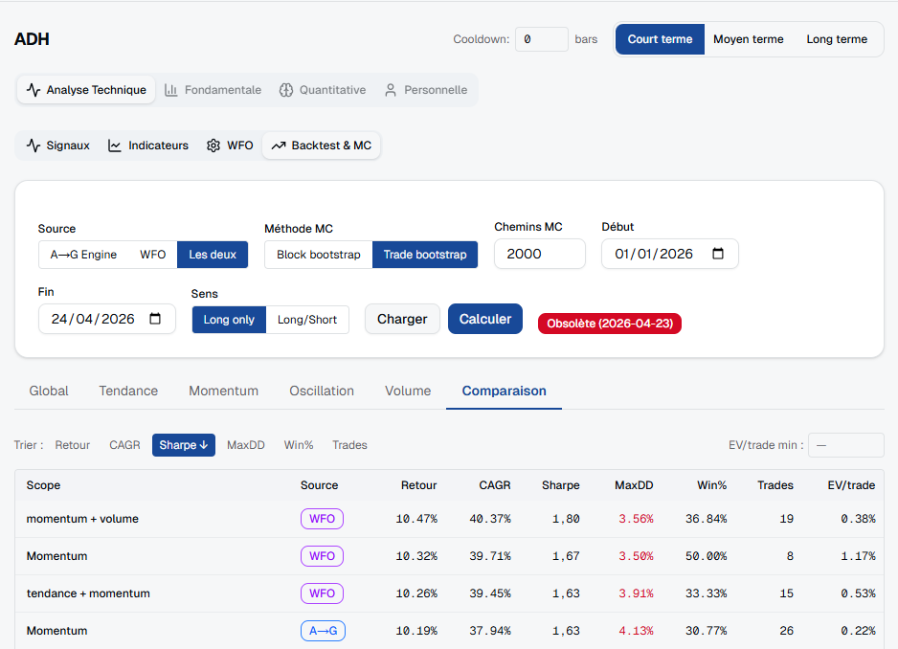
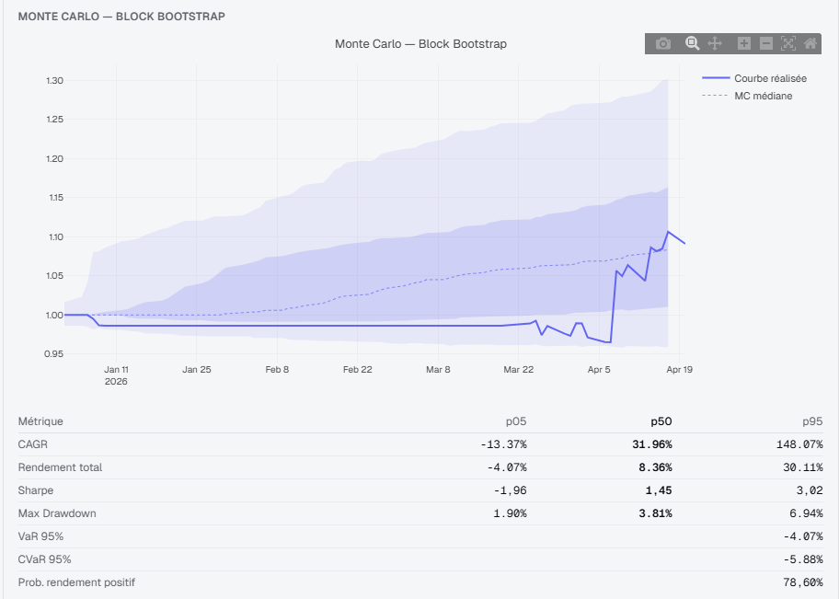
Weekly Report
Macro/Factor Analysis & Backtest Robustness Layer
Week ending April 24, 2026

Slide 2
Executive Summary
✓ Integrated per-signal backtest + Monte Carlo robustness panel to signal pages
✓ Completed statistical macro/factor study: 56 factors × 3 symbols (ATW, IAM, BCP)
✓ Identified 15+ statistically significant factor relationships (p < 0.05)
✓ Drafted app-level factor-layer analytics design with API/frontend contract
→ Ready for PR + validation on full signal universe

Slide 3
Statistical Methodology
Factor Universe: 56 factors across equities, FX, commodities, rates, crypto
Time Periods: 2–6+ years per symbol (n_obs: 2K–6K+ observations)
Metrics: Spearman rank IC (robustness), HAC-adjusted t-stats (heteroscedasticity)
Significance Threshold: p < 0.05 (two-tailed)
Correlation Range: −0.06 to +0.06 (typical magnitude), but with strong stat evidence

Slide 4
ATW — Significant Factors (p < 0.05)
Ranked by correlation magnitude
NIKKEI: ρ=+0.0581 (p=0.0000, t=+5.66)
EUROSTOXX: ρ=+0.0533 (p=0.0002, t=+3.93)
HANG_SENG: ρ=+0.0482 (p=0.0001, t=+4.70)
DAX: ρ=+0.0418 (p=0.0009, t=+3.49)
EUROPE_MINUS_VIX: ρ=+0.0406 (p=0.0052, t=+3.15)
Total significant: 19 / 56 factors

Slide 5
ATW — Top 10 Significant Factors
Factor | Spearman ρ | p-value | HAC t-stat | R²
NIKKEI | +0.0581 | 0.00000 | +5.66 | 0.0083
EUROSTOXX | +0.0533 | 0.00024 | +3.93 | 0.0098
HANG_SENG | +0.0482 | 0.00012 | +4.70 | 0.0070
DAX | +0.0418 | 0.00087 | +3.49 | 0.0047
EUROPE_MINUS_VIX | +0.0406 | 0.00521 | +3.15 | 0.0047
FTSE | +0.0398 | 0.00150 | +3.46 | 0.0050
WORLD_MINUS_VIX | +0.0365 | 0.02982 | +2.89 | 0.0078
XLF | +0.0351 | 0.00517 | +1.81 | 0.0018
DOW | +0.0345 | 0.00599 | +1.96 | 0.0026
CAC40 | +0.0333 | 0.00802 | +3.29 | 0.0043

Slide 6
IAM — Significant Factors (p < 0.05)
Ranked by correlation magnitude
NIKKEI: ρ=+0.0856 (p=0.0000, t=+6.06)
HANG_SENG: ρ=+0.0604 (p=0.0000, t=+4.91)
DAX: ρ=+0.0431 (p=0.0017, t=+4.51)
EUROSTOXX: ρ=+0.0411 (p=0.0047, t=+4.13)
WORLD: ρ=+0.0394 (p=0.0190, t=+2.00)
Total significant: 14 / 56 factors

Slide 7
IAM — Top 10 Significant Factors
Factor | Spearman ρ | p-value | HAC t-stat | R²
NIKKEI | +0.0856 | 0.00000 | +6.06 | 0.0164
HANG_SENG | +0.0604 | 0.00001 | +4.91 | 0.0095
DAX | +0.0431 | 0.00169 | +4.51 | 0.0099
EUROSTOXX | +0.0411 | 0.00470 | +4.13 | 0.0098
WORLD | +0.0394 | 0.01897 | +2.00 | 0.0027
CAC40 | +0.0373 | 0.00666 | +4.48 | 0.0095
HYG | +0.0350 | 0.01618 | +2.86 | 0.0057
EUROPE_MINUS_VIX | +0.0335 | 0.02108 | +3.40 | 0.0031
QQQ | +0.0321 | 0.01955 | +1.98 | 0.0015
FTSE | +0.0321 | 0.01965 | +4.29 | 0.0088

Slide 8
BCP — Significant Factors (p < 0.05)
Ranked by correlation magnitude
DAX: ρ=+0.1011 (p=0.0001, t=+3.85)
EUROSTOXX: ρ=+0.0980 (p=0.0001, t=+3.68)
CAC40: ρ=+0.0923 (p=0.0003, t=+3.50)
NIKKEI: ρ=+0.0848 (p=0.0008, t=+3.30)
XLF_VS_SPY: ρ=+0.0797 (p=0.0016, t=+2.73)
Total significant: 10 / 56 factors

Slide 9
BCP — Top 10 Significant Factors
Factor | Spearman ρ | p-value | HAC t-stat | R²
DAX | +0.1011 | 0.00006 | +3.85 | 0.0451
EUROSTOXX | +0.0980 | 0.00011 | +3.68 | 0.0408
CAC40 | +0.0923 | 0.00027 | +3.50 | 0.0407
NIKKEI | +0.0848 | 0.00081 | +3.30 | 0.0167
XLF_VS_SPY | +0.0797 | 0.00165 | +2.73 | 0.0121
FTSE | +0.0667 | 0.00846 | +2.57 | 0.0270
XLF | +0.0597 | 0.01852 | +2.17 | 0.0229
HANG_SENG | +0.0592 | 0.01959 | +2.27 | 0.0074
IEF | -0.0561 | 0.02683 | -1.60 | 0.0046
IWM_VS_SPY | +0.0540 | 0.03305 | +1.81 | 0.0048

Slide 10
Cross-Symbol Summary
ATW: 19 significant factors / 56 (factor exposure density: 33.9%)
IAM: 14 significant factors / 56 (factor exposure density: 25.0%)
BCP: 10 significant factors / 56 (factor exposure density: 17.9%)
Total Significant Relationships Identified: 43
→ Strong evidence of systematic macro/factor sensitivities across the portfolio

Slide 11
Work Completed This Week
Backtest Layer: Monte Carlo robustness (95% CI, DSR) integrated on all signal pages
Factor Study: Full statistical analysis completed; 56-factor universe evaluated
Data Alignment: Calendar-aware factor ingestion with precede_open lag rules
Design Docs: App-level factor-layer architecture drafted (API routes, data contracts)
Outputs: All results & visualizations saved under iLoveZIP_Create/factor_lab_outputs

Slide 12
Next Steps
Extend analysis to full symbol universe (60+ instruments)
Run unit tests for statistical alignment + add adversarial calendar tests
Ingest live macro data feeds (VIX, DXY, commodities) and validate ingestion
Build factor-layer analytics endpoints (/analytics/signals, /analytics/factors/{symbol})
Prepare PR with full code + test coverage + docs for peer review

Slide 13
Artifacts & Paths
Local Analysis: C:\Users\taha\Downloads\iLoveZIP_Create\factor_lab_outputs
Factor Summary JSON: docs/presentations/factor_summary.json
Backtest Images: backtestMC.png, MC.png (from Downloads)
App Design Docs: docs/factor-layer/
Generated PPTX: C:\Users\taha\Downloads\backtester_signal_engine_autoaccept\docs\presentations\weekly_report_v2.pptx

