Slide 1

An Efficient Multiphase Flow Model of Tumour Growth
Tahani Alrefai; Mark Walkley; Oliver Harlen; Peter Jimack

Slide 2
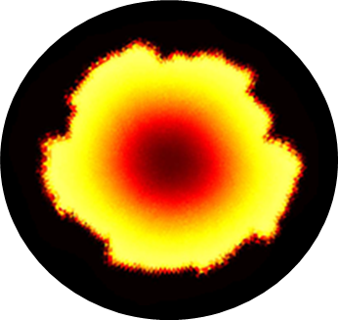
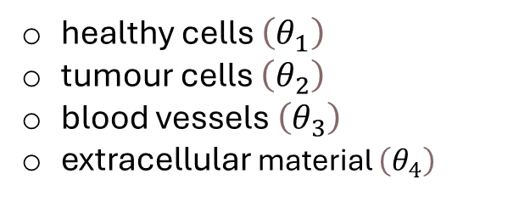
Mathematical Model Overview
Modelling vascular tumour growth.
Continuum model of Hubbard and Byrne*
A multiphase system of four different phases:
healthy cells $\left(θ_{1}\right)$
tumour cells $\left(θ_{2}\right)$
blood vessels $\left(θ_{3}\right)$
extracellular material $\left(θ_{4}\right)$
2D simulation of tumour cells at a final time T=200
* M. Hubbard and H. Byrne. Multiphase modelling of vascular tumour growth in two spatial dimensions. Journal of Theoretical Biology, 316(16):70-89, 2013.

Slide 3
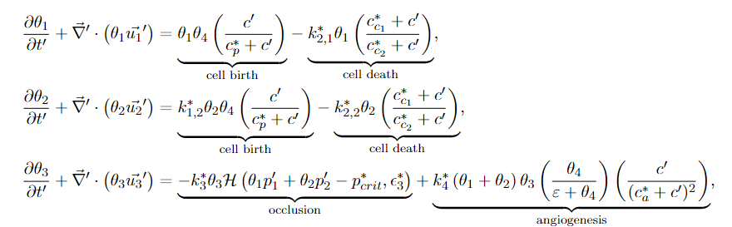
Mathematical Model Overview
The model containing three sets of governing equations :
1. Mass balance Equations:
The first set is the mass balance equations for the volume fraction of the four phases, $θ_{i}$ for $i=1,…, 4$.

Slide 4
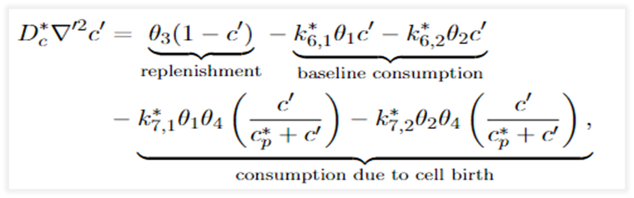
Mathematical Model Overview
The second set is the momentum balance equations where (𝑢_𝑖 ) ⃗ are the velocities and the pressure 𝑝_𝑖 corresponding to the phase 𝑖=1, …, 4.
3. Nutrient Equation:
The final equation is a nutrient equation for the nutrient and oxygen concentration $c$.

Slide 5
Objectives
solving large-scale 3D model of tumour growth
importance of scalable linear algebra
importance of parallel computing

Slide 6
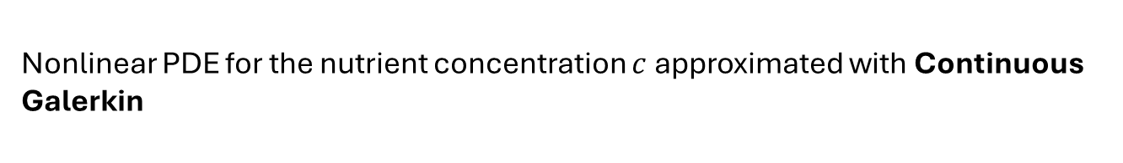
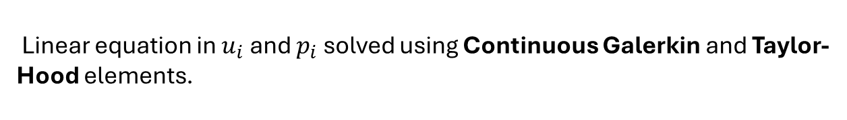
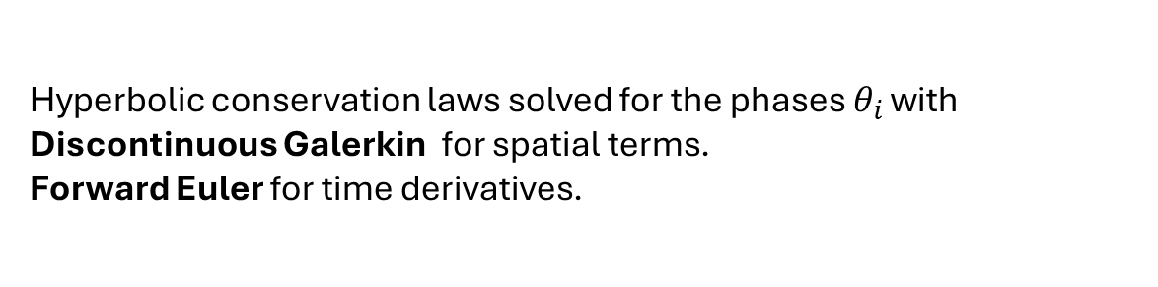
Finite Elements Discretisation
Hyperbolic conservation laws solved for the phases $θ_{i }$with Discontinuous Galerkin for spatial terms. Forward Euler for time derivatives.
Mass Balance Equations:
Linear equation in $u_{i}$ and $p_{i}$ solved using Continuous Galerkin and Taylor-Hood elements.
Momentum Balance
Equations:
Nonlinear PDE for the nutrient concentration $c$approximated with Continuous Galerkin
Nutrient Equation:

Slide 7
Algebraic System Solvers within a Time-Step
1. Convection Equations:
Solver: Conjugate Gradient Method
2. Momentum Equations:
Solver: Generalized Minimal Residual (GMRES)
Block Preconditioning: Algebraic Multigrid (AMG) for
each of the Velocity Blocks and Conjugate Gradient Method (CG) for the pressure block.
3. Nutrient Equation:
Nonlinear Solver: Newton’s Method
Linear solver: CG preconditioned with AMG

Slide 8
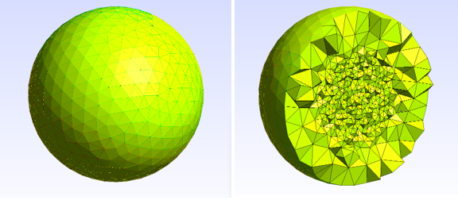
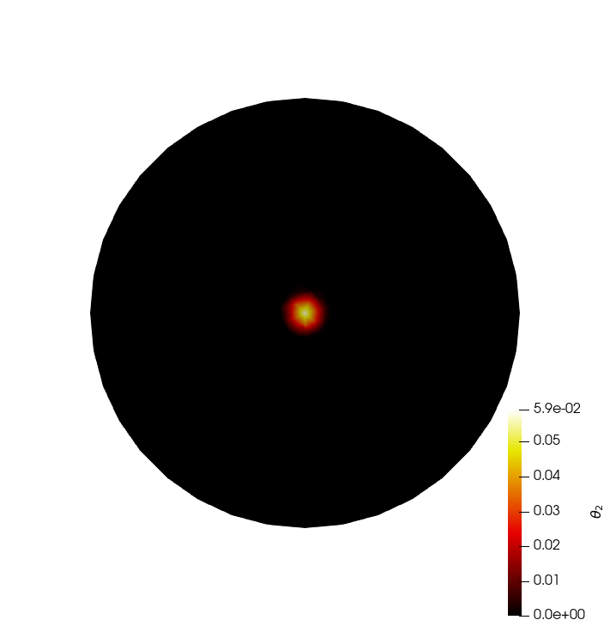
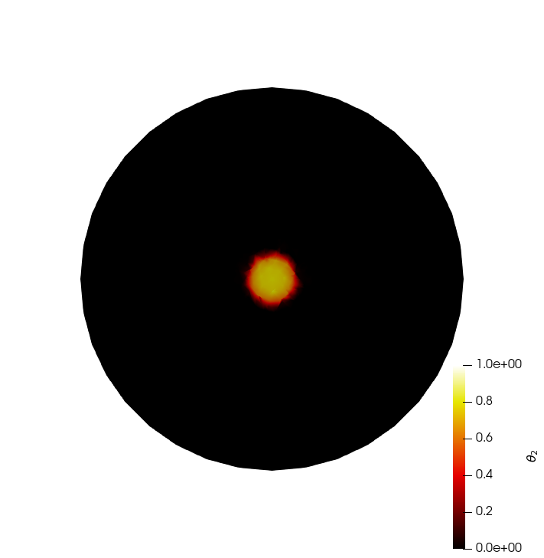
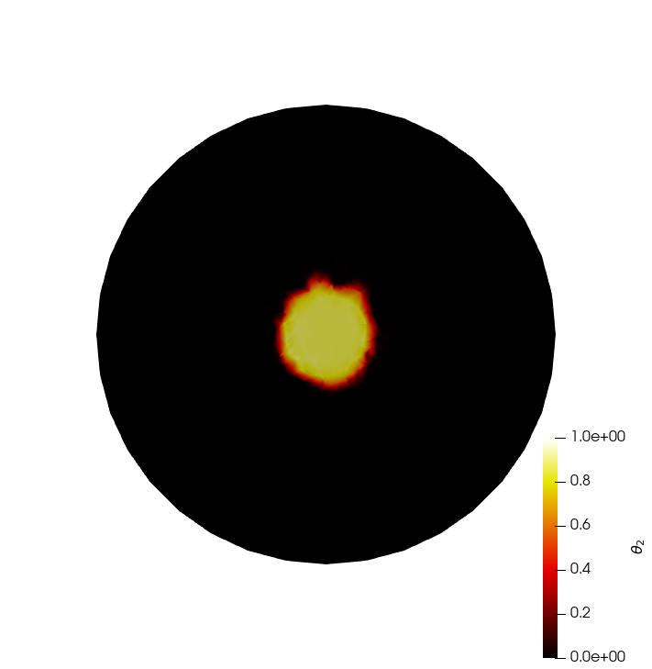
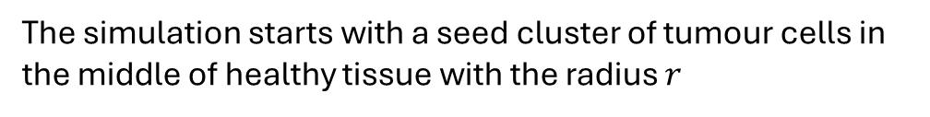
3D Results
The simulation starts with a seed cluster of tumour cells in the middle of healthy tissue with the radius $r$
Unstructured Meshes: Flexible grids of spherical geometries to simulate more realistic tumor growth scenarios.
(a) T = 0 (b) T = 50 (c) T = 100
The images show cross-sections through the middle of the spherical tumor mesh at different time points.

Slide 9
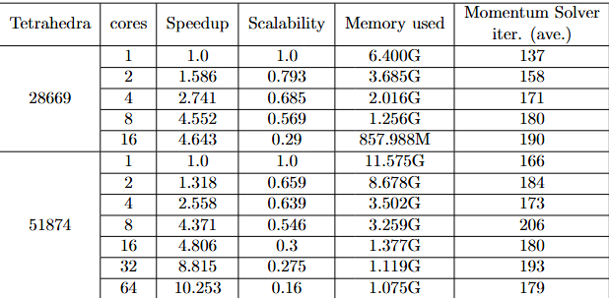
Parallel Performance
Machine Architecture
ARC4 : HPC cluster at Leeds
Intel Xeon Gold 6138 CPUs (‘Sky Lake’)
149 nodes with 40 cores and 192GB of memory each

