Slide 1
A Fast Local Search Algorithm for the Latin Square Completion Problem
Authors: Shiwei Pan, Yiyuan Wang, and Minghao Yin.
Published in: ﻿AAAI Conference.
Publication date: 2022-06-28.

Slide 2
Agenda
Paper Overview
Problem Definition
Relevance to Machine Intelligence Course
Related Work
Paper Scientific Contribution
Conclusion and Evaluation

Slide 3
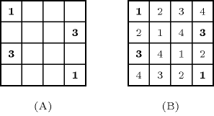
Paper Overview
Solve Latin square completion (LSC) problem using local search.

Slide 4
Paper Overview
Solve Latin square completion (LSC) problem using local search.
Propose a new initialization technique to reduce the search space.
Propose a new conflict value selection heuristic for the local search.
Propose a new restart method that takes into account the previous history search information in evaluating the new candidate solution.
Results show that the proposed algorithm is better than all the heuristic algorithms.

Slide 5
Problem Definition
The paper tries to find a solution to the LSC problem in a reasonable time. This target is achieved by using a local search algorithm that uses new ideas to make this solution faster than the previously developed local search algorithms and also with a higher success rate initialization technique to reduce the search space.

Slide 6
Relevance to MI Course
The main used algorithm is the local search.
The reduction step models the LSC as a binary CSP problem.
The restart of the algorithm is a combination between the random restart search, local beam search, and genetic algorithm.

Slide 7
Related Work
Exact algorithms, that can be used to solve only small-sized problems.
Many heuristic algorithms were proposed to solve large-sized problems the best one is called MMCOL.
MMCOL uses:
Domain constraint graph and constraint propagation to reduce the search space.
Cross-over operator to generate new solutions.
Iterated tabu search.
MMCOL has a high success rate but it still needs a lot of computation time.

Slide 8
Paper Scientific Contribution

Slide 9
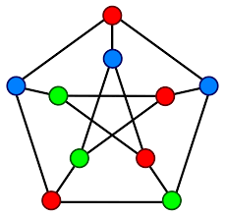
Reduction and Construction
The first step is to convert the LSC to a pre-coloring extension problem (PEP) with color classes of size n.

Slide 10
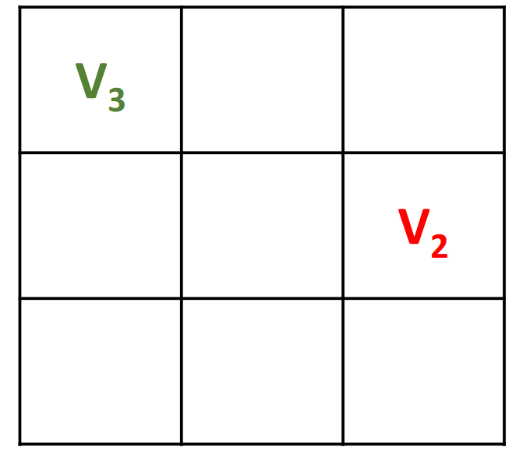
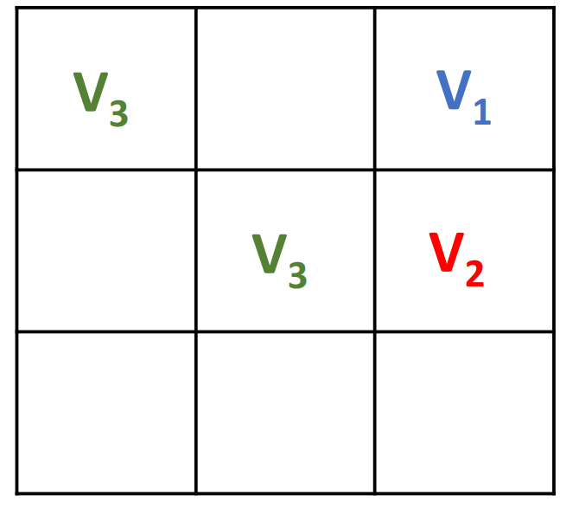
Reduction and Construction
The first step is to convert the LSC to a pre-coloring extension problem (PEP) with color classes of size n.
Apply reduction rules:
If a vertex has only one optional color class -> put the vertex in this color class.

Slide 11
Reduction and Construction
The first step is to convert the LSC to a pre-coloring extension problem (PEP) with color classes of size n.
Apply reduction rules:
If a vertex has only one optional color class -> put the vertex in this color class.
﻿Assign a color to the vertex if the difference between the domain of the vertex and the union of the domains of its neighbors in a row is equal to one

Slide 12
Reduction and Construction
The first step is to convert the LSC to a pre-coloring extension problem (PEP) with color classes of size n.
Apply reduction rules:
If a vertex has only one optional color class -> put the vertex in this color class.
﻿Assign a color to the vertex if the difference between the domain of the vertex and the union of the domains of its neighbors in a row is equal to one
{2}
{1}
{1,3}
{1,2}
{1,2,3}
{3}

Slide 13
Reduction and Construction
The first step is to convert the LSC to a pre-coloring extension problem (PEP) with color classes of size n.
Apply reduction rules:
If a vertex has only one optional color class -> put the vertex in this color class.
﻿Assign a color to the vertex if the difference between the domain of the vertex and the union of the domains of its neighbors in a row is equal to one
{2}
{1}
{1,3}
{1,2}
{1,2,3}
{3}

Slide 14
Reduction and Construction
The first step is to convert the LSC to a pre-coloring extension problem (PEP) with color classes of size n.
Apply reduction rules:
If a vertex has only one optional color class -> put the vertex in this color class.
﻿Assign a color to the vertex if the difference between the domain of the vertex and the union of the domains of its neighbors in a row is equal to one
Same as the rule 2 but it is for columns.
In the construction step, ﻿the algorithm each time picks a vertex at random and assigns it a color from its domain.

Slide 15
Scoring Functions
The primary scoring function of the algorithm is the number of conflicting edges.
The newly added secondary function is the c-score which ﻿ indicates the number of times the vertex has been selected as a conflicting value in the past.
The ﻿c-score of a vertex is used as a tie-breaking criterion when more than one vertex has equal values on the primary scoring function.
The c-score has two update rules:
If ﻿two vertices are selected as conflict values, the c-score of both vertices is incremented by 1
The ﻿c-score of the vertex is reset to 0 if ﻿the movement of a vertex from one color to another color causes conflicts on the vertex to be removed

Slide 16
Search Restart
When falling into local minima, the search is restarted by constructing a new initial solution.
The generated solution benefits from the solution pool of the best-found solution so far.
The generated solution is modified before passing it to the algorithm to restart the search

Slide 17
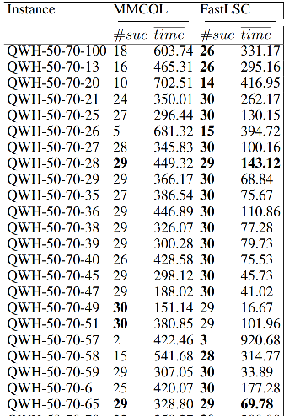
Conclusion and Evaluation
The fast LSC algorithm outperforms other heuristic algorithms in terms of running time and success rate

Slide 18
Conclusion and Evaluation
The authors did great work and the results show that they succeeded in their target.
We suggest that the proposed solution can be used to solve the sudoku by doing a slight modification in the constraints and by adding a fourth reduction rule.
We suggest making the algorithm make bad moves with a small probability to skip the local minima. The bad moves gradually decrease in size and frequency and the probability of the bad move decreases exponentially with the “badness” of the move.

Slide 19
Thank you

Slide 20
Backup Slides

Slide 21
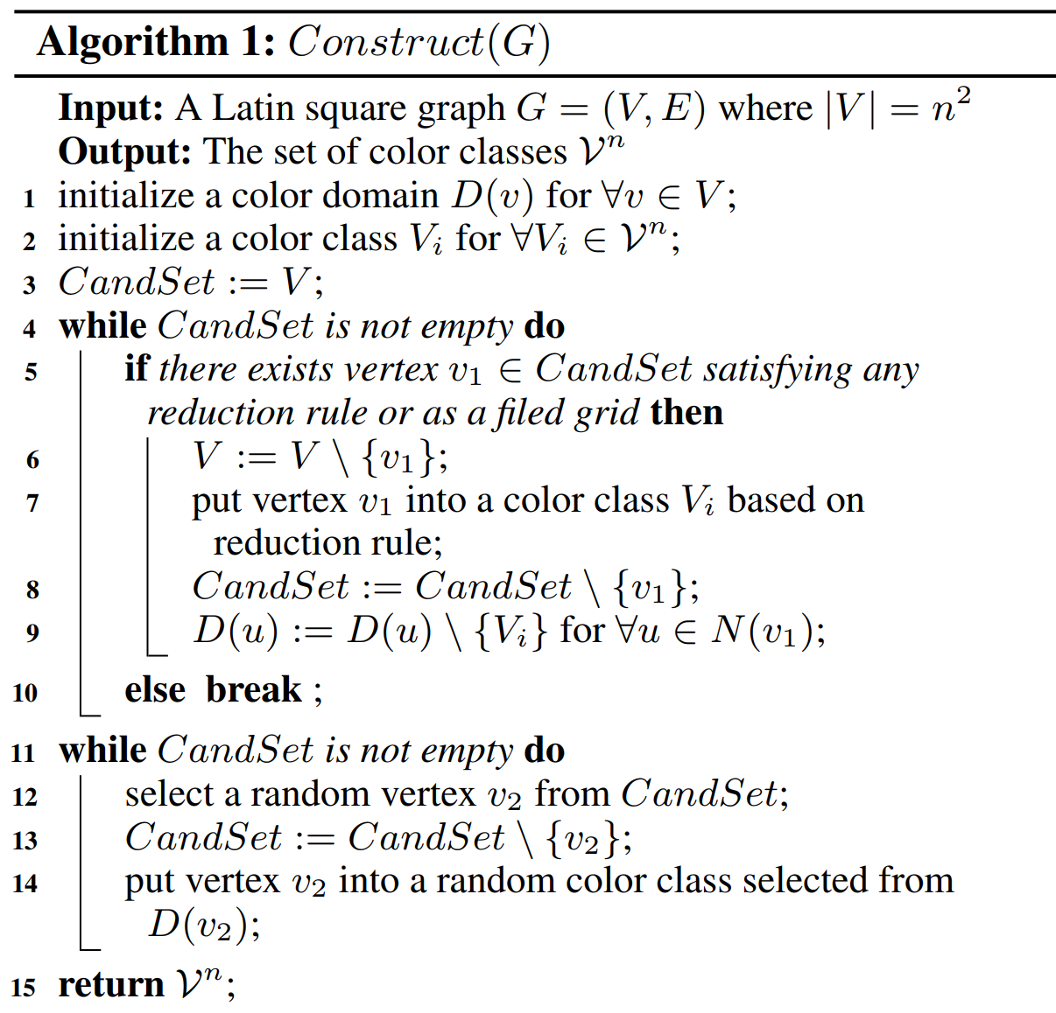

Slide 22
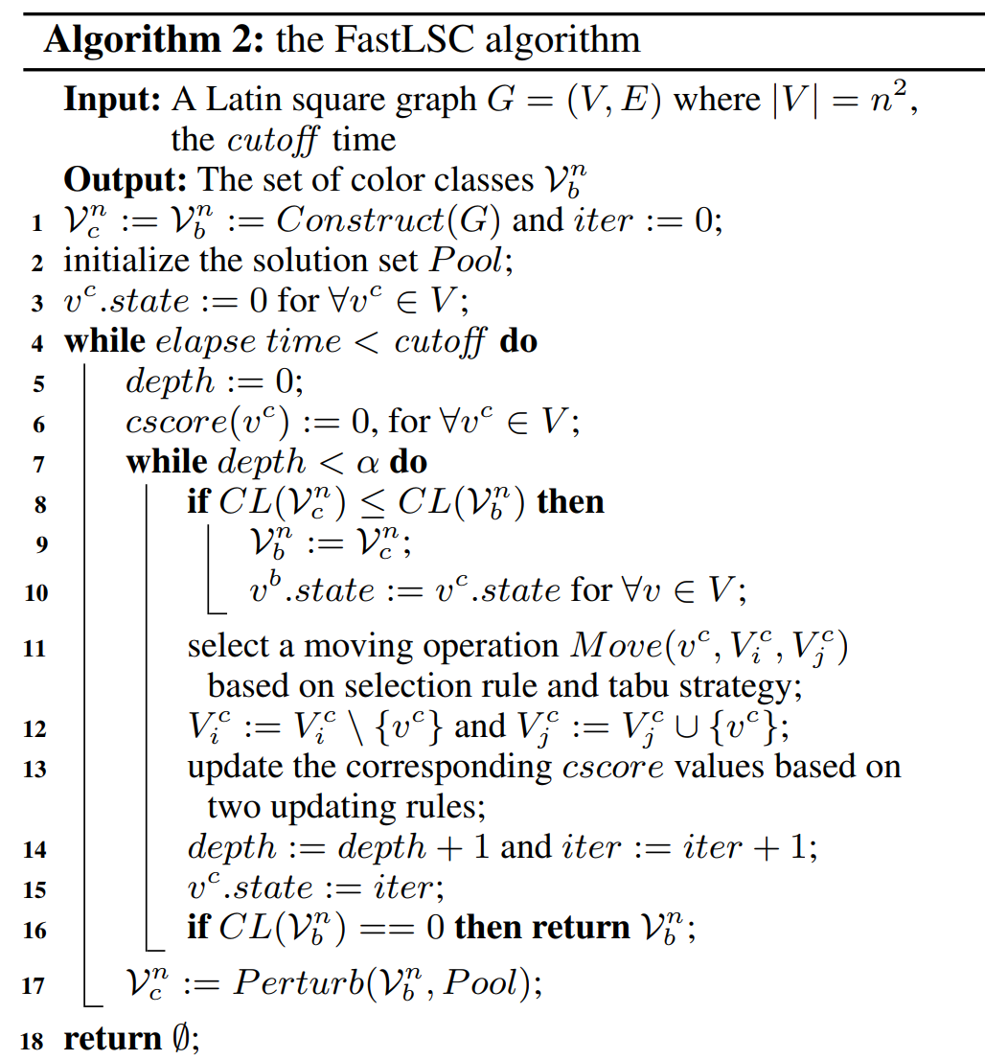

Slide 23
