Slide 1

Relations RDBMS

Slide 2
Présenté par
TAHER CHABAANE

Slide 3
RDBMS Definition
A relational database management system (RDBMS) is a collection of programs and capabilities that enable IT teams and others to create, update, administer and otherwise interact with a relational database. RDBMSes store data in the form of tables, with most commercial relational database management systems using structured query language (SQL) to access the database. However, since SQL was invented after the initial development of the relational model, it is not necessary for RDBMS use

Slide 4
MySQL
MySQL is a relational database management system based on SQL – Structured Query Language. The application is used for a wide range of purposes, including data warehousing, e-commerce, and logging applications.

Slide 5
PostgreSQL
PostgreSQL is an advanced, enterprise class open source relational database that supports both SQL (relational) and JSON (non-relational) querying. It is a highly stable database management system, backed by more than 20 years of community development which has contributed to its high levels of resilience, integrity, and correctness. PostgreSQL is used as the primary data store or data warehouse for many web, mobile, geospatial, and analytics applications. The latest major version is PostgreSQL 12.

Slide 6
Microsoft SQL Server
Microsoft SQL Server is one of the market leaders for database technology. It's a relational database management system that supports a number of applications, including business intelligence, transaction processing and analytics

Slide 7
Diffrence between RDBMS
Database Management System (DBMS) is a software that is use to define, create and maintain a database and provides controlled access to the data. Relational Database Management System (RDBMS) is an advanced version of a DBMS.

Slide 8
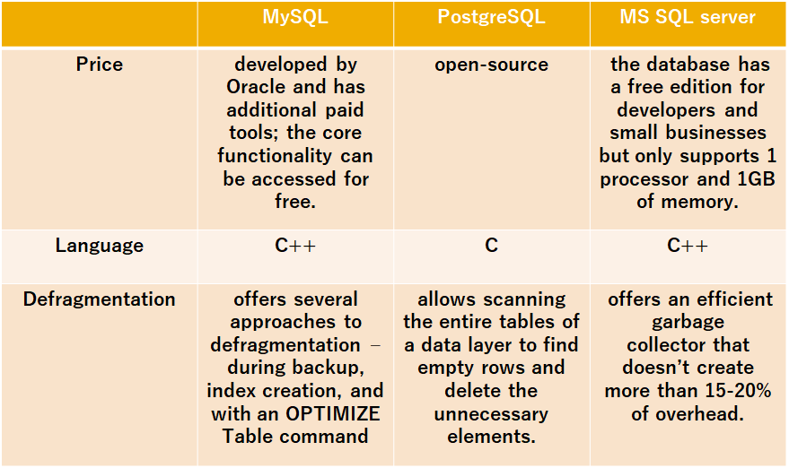

Slide 9
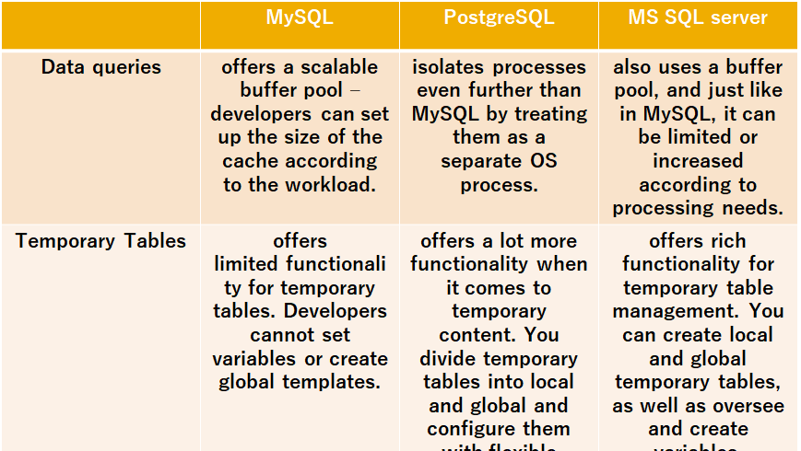

Slide 10
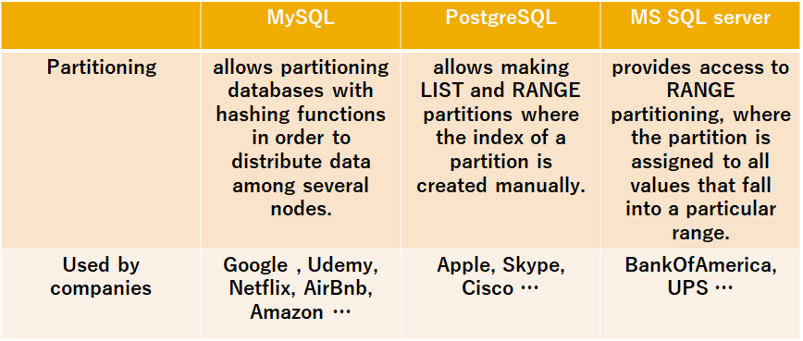

Slide 11
Conclusion
SQL server is a database management system which is mainly used for e-commerce and providing different data warehousing solutions. PostgreSQL is an advanced version of SQL which provides support to different functions of SQL like foreign keys, subqueries, triggers, and different user-defined types and functions.
SQL is a query language, whereas MySQL is a relational database that uses SQL to query a database. You can use SQL to access, update, and manipulate the data stored in a database. SQL is used for writing queries for databases, MySQL facilitates data storing, modifying, and management in a tabular format.

