Slide 1
Introduction To DataBase
MySQL
Postgre SQL
SQL Server
Taher Arfaoui

Slide 2
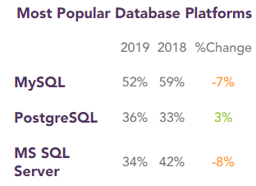
What is RDBM?
RDBMs are software systems that enable users to define, create, maintain and control access to relational databases.
Relational, because the databases’ tables are inter-jointed / inter-connected with a specific hierarchy (one-to-one, one-to-many and many-to-many).
So instead of having one gigantic table with multiple columns and rows we can divide this main table into inter-linked sub-tables. Making it easier to access data, to understand the database and to handle complex data configuration.

Slide 3
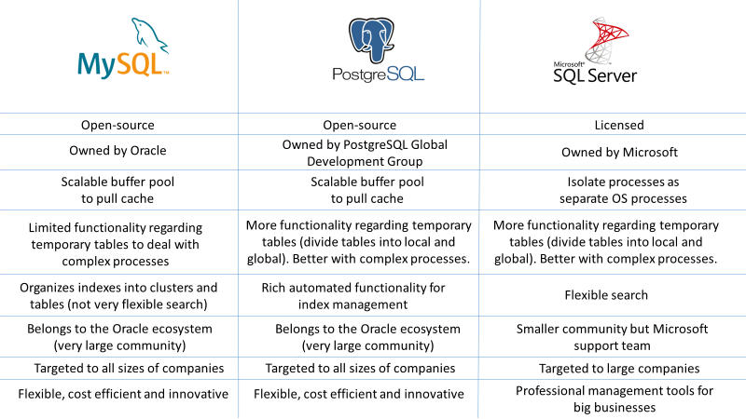
Comparison between:
MySQL, PostgreSQL, SQLServer

