Slide 1
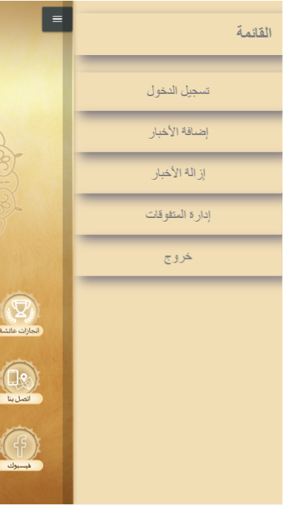
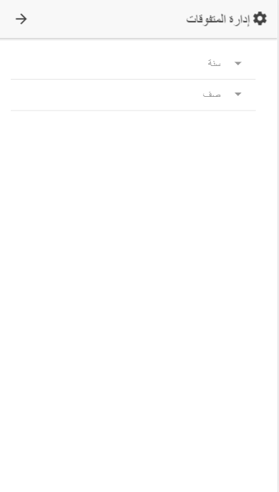
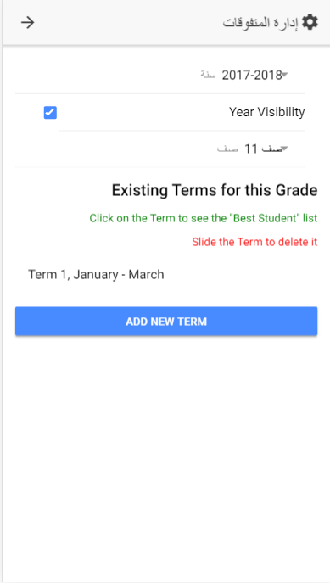
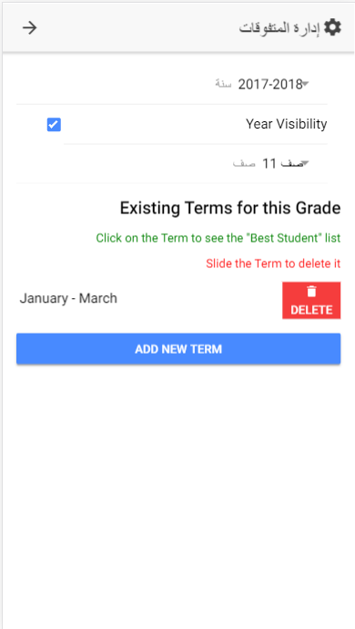
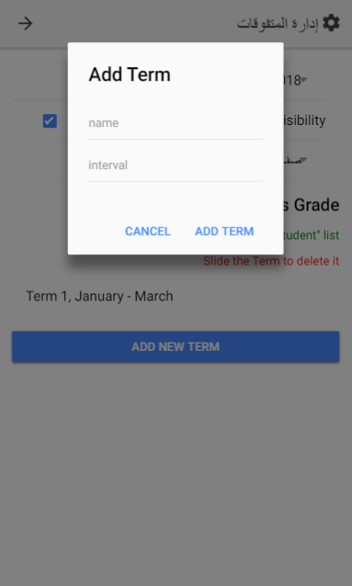
1
2
3
4
Choose Year and
Grade
- Components appear
after year and grade chosen.
- Years can be made visible
by checkbox.
- Terms can be added by button
Term can be deleted after sliding it
5
Years and Terms
Administration
Adding Term after
button clicked

Slide 2
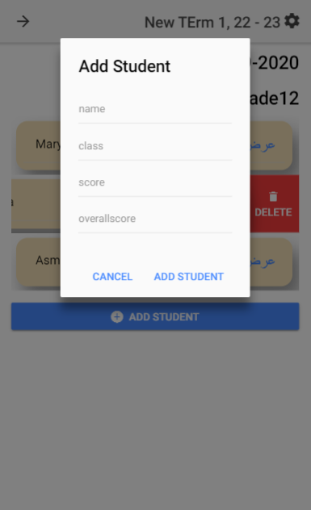
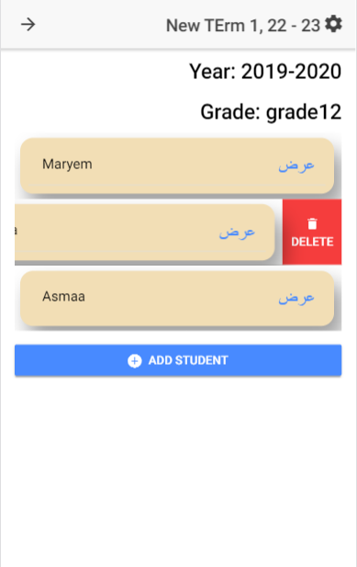
Students Administration
Click on Term to
see best student list of this term
Slide to remove a student
From the best student list
Enter Student Info to
Add student to the best
Student list
Click on button to add a
Student to the list
Student List is ordered by highest Score

Slide 3
Students
Student 1
Name: Asmaa Mohammad
Email: asma@gmail.com
Subjects
Subject1: English
Subject2: Arabic
Subject3: Math
Subject4: Religion
Exams
2015-2016
English
Exam name: First Term Exam
score: 78
Teachers note: please prepare more for next exam
Parents
Parent 1
name: Ahmed Mohamad
Email: ahmed@gmail.com
Student name: Asmaa Mohammad
Teachers Notes
Note 1
Teacher: Mr. Omer
Note Text: We are glad to tell you that your daughter is always ….

