Slide 1

POLYNOMIAL
Abstract Algebra

Slide 2
Submitted by
Kh. Tahera Mehjabin
IT 23604
27th November 2024

Slide 3
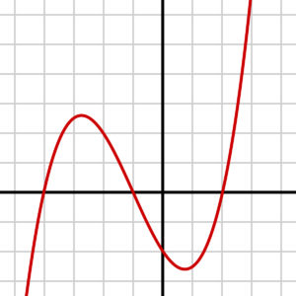
OUTLINE :
 INTRODUCTION OF POLYNOMIALS
 TYPES OF POLYNOMIALS
 POLYNOMIAL RINGS
 IRREDUCIBLE POLYNOMIAL
 PSEUDO RANDOM GENERATOR FOR
POLYNOMIAL
 POYNOMIAL PSEUDO-RANDOM NUMBER GENERATOR
VIA CYCLIC PHASE

Slide 4
POLYNOMIALS :
Polynomials are algebraic expressions that consist of variables and coefficients.
 Variables are also sometimes called indeterminates.
Addition, subtraction, multiplication, and also positive integer exponents can be perfomed for polynomial expressions.

Slide 5
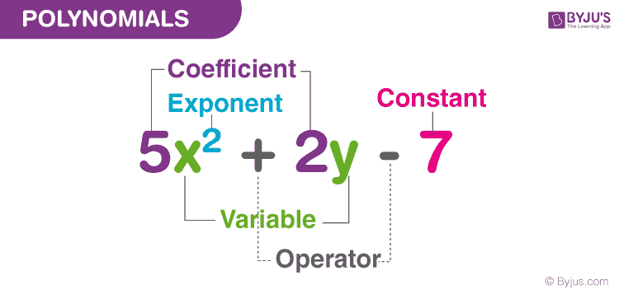

Slide 6
TYPES OF POLYNOMIALS
Monomials:
A monomial is a polynomial expression that contains only one term. For example 4t, 21x, 2y, 9pq.
Binomials:
A binomial is a polynomial with two, unlike terms. For example 3x + 4x²
Trinomial :
A trinomial is a polynomial with three, unlike terms. For example, 3x + 5x² – 6x³ and 12pq + 4x² – 10.

Slide 7
DEGREES OF POLYNOMIAL
Zero or constant polynomial
Polynomials with 0 degree. Example : 3 or 3x0
Linear polynomial
Polynomials with 1 as the degree. Example : x + y - 4, 5m + 7n, 2p
Quadratic polynomial
Polynomials with 2 as the degree . Example :
8x2 + 7y - 9, m2 + mn - 6
Cubic polynomial
Polynomials with 3 as the degree. Example : 3x3, p3 + pq + 7

Slide 8
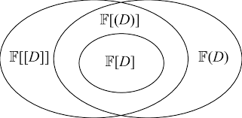
POLYNOMIAL RINGS
A polynomial ring or polynomial algebra is a ring formed from the set of polynomials in one or more indeterminates (traditionally also called variables) with coefficients in another ring, often a field.
fig - Relationship among polynomial rings

Slide 9
IRREDUCIBLE POLYNOMIAL
 An irreducible polynomial is a polynomial that cannot be factored into the product of two non-constant polynomials.
 An irreducible polynomial is also called a prime polynomial.
The polynomial x^2−2∈Q[x] is irreducible since
Solution :
it cannot be factored any further over the rational numbers.
x^2+1 is irreducible over the real numbers.

Slide 10
PSEUDO RANDOM GENERATOR FOR POLYNOMIAL
 Pseudorandom generators for low-degree polynomials are a
particular instance of a Pseudo Random Number Generator
( PRNG )
 In statistical tests, the tests are considered as evaluations of low
degree polynomials.
 Efficient procedure that maps a short truly random seed to a longer
pseudorandom string .

Slide 11
POLYNOMIAL PSEUDO-RANDOM NUMBER GENERATOR VIA CYCLIC PHASE
Polynomials f (x): f(x) = fo+f₁x + f2x² + + fnx"; f; ∈ GF (p")
are assigned to a Galois field GF (0).
If a generic algebra A (n) is defined in GF (0) and modular arithmetic modulo p [12] is used, the algebraic field Zip is the ring of quotients modulo the prime p (at least for the multiplication operator).
For example, addition of two polynomials in GF (2) and Z3 (2)
modulo (x³ + x + 1) is: f(x) = x²+1; f2 (x) = x²+x f(x) = ∑ f (x)
= f (x) + f2 (x) = x + 1
This is the polynomial equation .

Slide 12
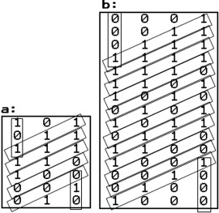
Figure : Pseudo random code generating

Slide 13
Reffenences :
1. Abstract Algebra : Theory and Applications
Thomas W. Judson
2. Polynomial pseudo random number generator via cyclic phase
Angelo Marchi, Alfonso Del Giudice, Antonio Liverani
Faculty of Economics

Slide 14
THANK YOU

