Slide 1
Machine Learning and Software Engineering
Tahira Iqbal
Software Dependability Group
Fortiss.

Slide 2
Base Concept
helps
Machine Learning
Software Engineering

Slide 3
Software Requirement engineering
Repair and Performance
Software Quality
Maintenance or task effort
Software size
Software Reliability
ML and SE
Development Cost
Software Defect Detection
Software Release Time
Testability of prog and modules
Software Effort
Reusability

Slide 4
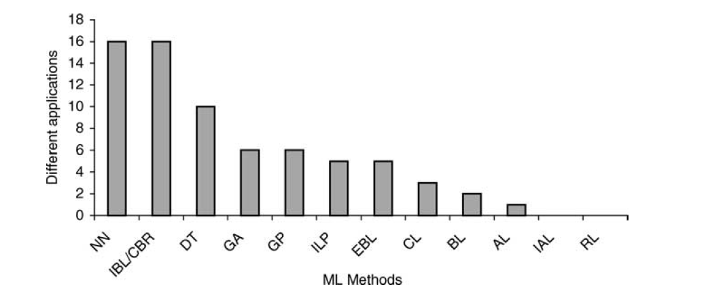
State-of-the-practice from the perspective of ML algorithms[1]
Notes:
In this paper, we adopt the
classification of Mitchell (1997a) and organize major types of learning methods into
the following groups: concept learning (CL), decision tree (DT) learning, artificial
neural networks (NN), Bayesian learning (BL), reinforcement learning (RL), genetic
algorithms (GA) and genetic programming (GP), instance-based learning (IBL, of
which case-based reasoning, or CBR, is a popular method), inductive logic programming
(ILP), analytical learning (AL, of which explanation-based learning, or EBL is a
method), and combined inductive and analytical learning (IAL). Table 1 describes the
main properties of the aforementioned types of learning.

Slide 5
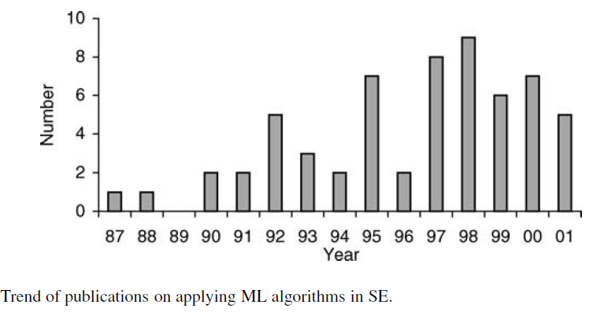
Publication trend (1987-2001) [1]

Slide 6
Targeted Conferences
International Conference of Software Engineering(ICSE).
Automated Software Engineering(ASE).
Foundation of Software Engineering(FSE).

Slide 7
ML scope in SE
Software Quality
Maintenance or task effort
Software Defect Detection
Development Cost
ML and SE
Software Requirement engineering
Testability of prog and modules
Repair and Performance

Slide 8
State-of-the-practice from the perspective of ML algorithms

Slide 9
Publication trend (2011-2017)

Slide 10
How Does it work
Neural Network
Recurrent Neural Network
Ranked Based Learner
Clustering
Decision Tree
Vector Space Model
Naïve Bayes
Random Forest
Nearest Neighbor
Active Learning
SUSI
Semi Supervised

Slide 11
Requirement Engineering
Systematic Literature Survey on RE+ML
Targeted Database: IEEE Xplorer Springer, Science Direct, ACM
Total Number of Paper=2549
First Filter(by Title) = 546
Second Filter(by Abstract, keywords)= 214

Slide 12
The highlighted Problems in our Database
Classification of software requirement i.e. FR or NFR
Detect Conflicts between requirements.
Requirement Prioritization.
Requirement Tractability.
Notes:
Classification of Requirments from appstores, addition of user comments, from tweets etc

Slide 13
Detecting User Story Information in Developer-Client conversation to Generate Extractive Summary[2].
Abstract—User stories are descriptions of functionality that a software user needs. They play an important role in determining which software requirements and bug fixes should be handled and in what order. Developers elicit user stories through meetings with customers. But user story elicitation is complex, and involves many passes to accommodate shifting and unclear customer needs. The result is that developers must take detailed notes during meetings or risk missing important information. Ideally, developers would be freed of the need to take notes themselves, and instead speak naturally with their customers. This paper is a step towards that ideal. We present a technique for automatically extracting information relevant to user stories from recorded conversations between customers and developers. We perform a qualitative study to demonstrate that user story information exists in these conversations in a sufficient quantity to extract automatically. From this, we found that roughly 10.2% of these conversations contained user story information. Then, we test our technique in a quantitative study to determine the degree to which our technique can extract user story information. In our experiment, our process obtained about 70.8% precision and 18.3% recall on the information

Slide 14
Research Problem
Automated Annotations???
File: the file name of the transcript
Conversation: an ID number for the conversation
Abstractive: an “in your own words” summary
Extractive: a list of turns summarizing the transcript
Role: a list of turns summarizing the role
Function: a list of turns summarizing the function Rationale: a list of turns summarizing the rationale
Under sampling problem ???
Data Unavailability???

Slide 15
References
[1] Du Zhang, Jefferey J.P.Tsai. “Machine Learning and Software engineering”. Software Quality Journal, 11, 87–119, 2003.
[2] Paige Rodeghero, Siyuan Jiang, Ameer Armaly, and Collin McMillan. “Detecting User Story Information in Developer-Client Conversations to Generate Extractive Summaries”. In ICSE, 2017.

Slide 16
First Chosen Topic
Software Defect Detection/ Software Bug Detection.
NASA Dataset
Cross Prediction
Justin Time(JIT)
Automated parameter optimization of classification techniques for defect prediction model (ICSE 16).
Data Quality: Some comments on the NASA Software Defect Dataset(IEEE transaction on software engineering 2013).
Revisiting the impact of classification techniques on the performance of Defect Prediction Model.
…..

