Slide 1
Introductory Talk
Tahira Iqbal
Iqbal@fortiss.org

Slide 2
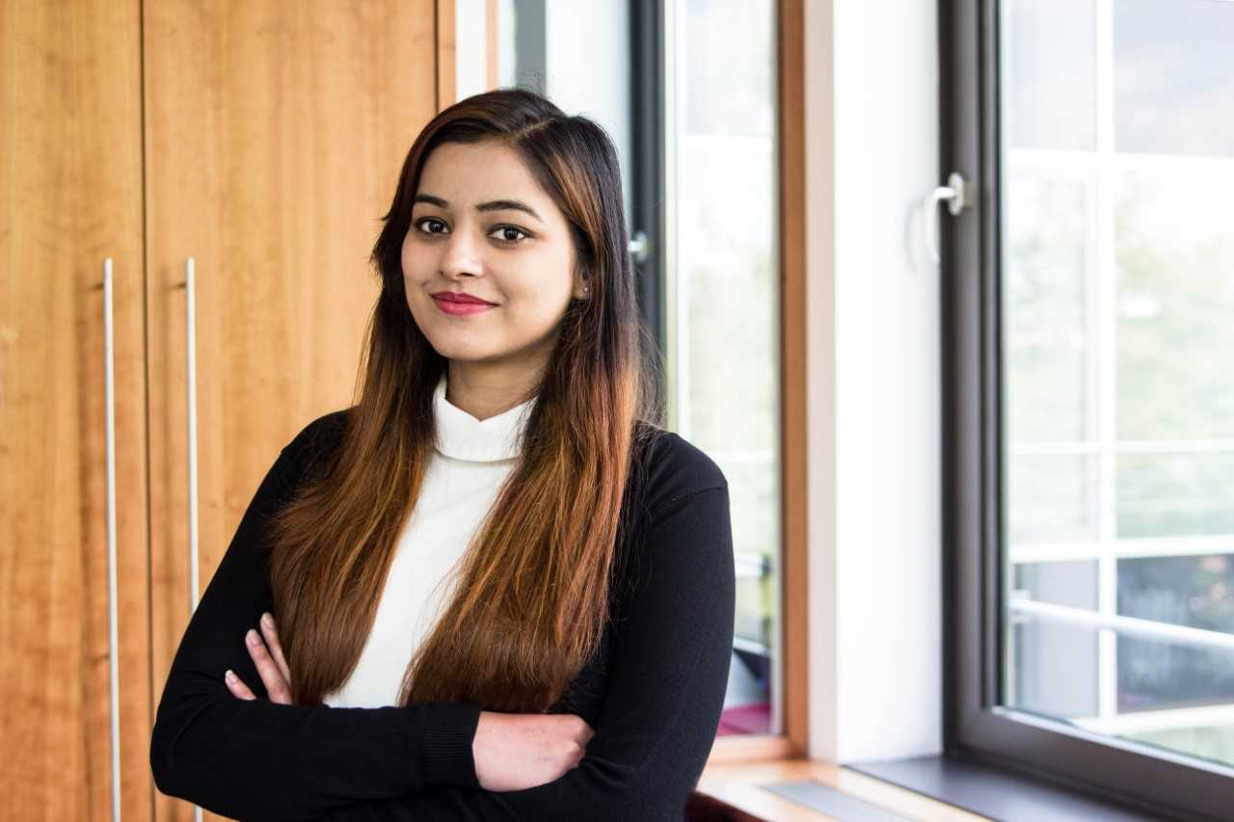
Introduction
Name: Tahira Iqbal.
Biography: April, 1993 Pakistan.
2010-2014 B.E in Software Engineering.
2014-2016 Masters in Software Engineering.
2017 Research Assistant in Korea
2017 Fortiss, Germany as OCPS ESR10.

Slide 3
Education
Bachelor in Engineering Software Engineering 2010-2014
Namal College an assoisated college of University of Bradford,UK.
Bachelor Thesis:
Title: Animal Disease Diagnostic System
The purpose of this project was to facilitate the farmers by providing a desktop application, which can diagnose disease(s) by entering observed symptoms. The data used is a mixture of bookish knowledge and real-time data collected from farmers. The technique used for disease diagnosis is case based reasoning.

Slide 4
Education
Master in Science Software Engineering 2014-2016.
Iqra University Islamabad Campus.
Master Thesis:
Title: Evaluating the Software Quality Based on Source Code Using ISO/IEC 25010.
The purpose of the project is to provide a new model based on ISO/IEC 25010 standard that evaluates part of software quality determined using source code only. The proposed method discusses different parameters and how they are mapped to different characteristics and sub-characteristics of software quality. A weight-based approach is used to evaluate software quality, as well as quality of characteristics and sub-characteristics of a software. The results present which code will form a better software in each category with respect to overall quality, characteristic level quality and sub-characteristic level quality.

Slide 5
Research Interest
Software Engineering
Quality Engineering
Optimization of Software and its processes.
Machine Learning
Requirement engineering.

Slide 6
OCPS Project
Base Concept
helps
Machine Learning
Software Engineering

Slide 7
OCPS Project
Software Requirement engineering
Repair and Performance
Software Quality
Maintenance or task effort
Software size
Software Reliability
ML and SE
Development Cost
Software Defect Detection
Software Release Time
Testability of prog and modules
Software Effort
Reusability

Slide 8
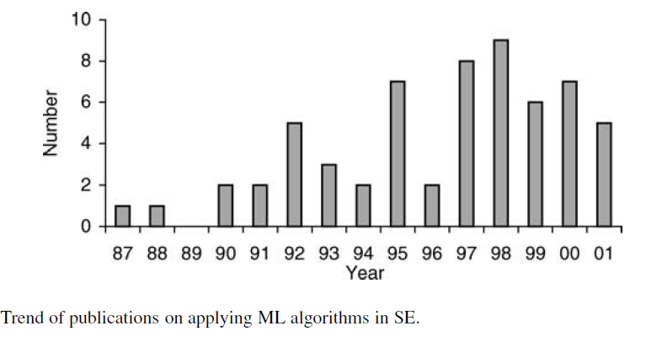
Publication trend (1987-2001)

Slide 9
Ocps Project
Title: Machine Learning in the engineering of Adaptive and Trustworthy Control Software.
Requirements are inputs to the planning and developing process for building the software. Inadequate Requirements Engineering (RE) is one of the main sources for the failure of development projects and culminates in exceeding budgets, missing functionalities or even the abortion of the project. In RE, one has to cope with the resulting variety of stakeholders and their multitude of different and possibly contradictory goals. This creates challenges for requirements elicitation, documentation, and management, especially with the involvement of different background stakeholders and users. In addition, the distinct key aspect of the RE, e.g., who wants functionality, what functionality do the end users want, etc., is difficult as compared to a traditional software system. However, involvements of different user background can make requirements engineering process complicated. Some of the useful information can be missed or declined. To deal with these RE problems caused in the developments of CPS needs to minimize and automate for making the system cost and time effective. The main goal of this project to identify the RE related problem especially for cyber physical system. As a solution, Machine Learning (ML) is a potential candidate. That will help to automate the system for overcoming the RE problems in this domain.

Slide 10
OCPS Project
Expected Outcome:
The main contribution expected through this project is bridging the gap between state-of-the-art RE theory and industrial practices, developing a tool with the enhancement and improvement of the targeted problem. That will ultimately contribute to improve the quality and also reduce the cost of the development process in control software.

Slide 11
OCPS Project
Present Research:
Working on Survey Paper
Writing Proposal for the Admission.

Slide 12
Thank you

