Slide 1
An Edge Service for Managing HPC Workflows
Submitted to:
Mr.Annajiat Alim Rasel
Senior Lecturer
Submitted by:
Tahiatun Nazi
ID:20301008

Slide 2
Introduction:
The HPC Edge Service is a powerful tool in the realm of High-Performance Computing (HPC).
It streamlines and optimizes complex workflows, offering a unified approach to HPC job management.

Slide 3
Hypothesis and purpose of the paper:
Contributions:
Developed the HPC Edge Service to address specific needs in scientific research.
Showcased its versatility, efficiency, and robust security measures.
Highlighted real-world applications and impressive performance, validating its value in scientific domains.
Hypothesis: The HPC Edge Service can improve high-performance computing for scientific research in terms of accessibility, efficiency, and security.
Purpose:
Streamline and secure HPC workflows.
Demonstrate real-world applicability.
Enhance data transfer and scheduling.
Enable efficient scientific research across domains.

Slide 4

Methodologies:
Argo and Balsam:
Argo and Balsam's roles
Coordination of job management
Workflow management
Interaction between Argo and Balsam

Slide 5
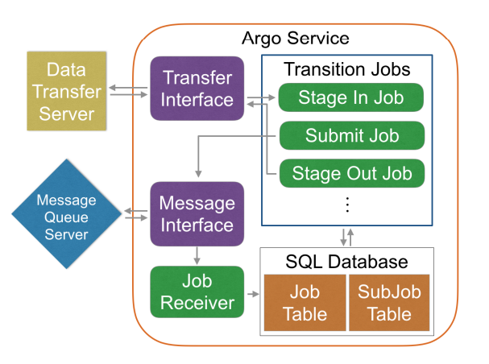
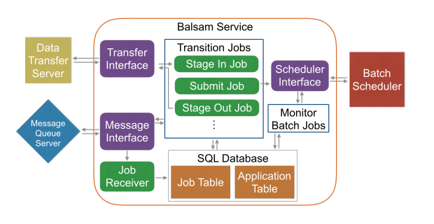
Figure 1:Agro Service
Figure 2: Balsam Service

Slide 6
Data Transfer:
Schedulers:
Scheduler plugins
Examples:
HTCondor
Cobalt
Slurm
Torque
Extensibility of scheduler support
Data transfer plugins
Supported protocols:
GridFTP
scp
cp
Credential handling

Slide 7
Web Interfaces and Security:
Django-based web interfaces
Example job table browser
User interaction with job management
Security measures:
SSL encryption
Application whitelisting
Applications :
ATLAS Event Generation
Fusion Experiments at DIII-D

Slide 8
Conclusion:
The HPC Edge Service caters to the specific requirements of high-performance computing in scientific research.
Versatile components like Argo and Balsam streamline workflows, boosting efficiency.
The availability of multiple data transfer and scheduler plugins provides flexibility in resource utilization.
User-friendly web interfaces empower researchers to manage intricate jobs.
Robust security measures are in place to protect data integrity and regulate system access.
Real-world success stories, such as ATLAS Event Generation, underline its practicality.
Over 122 million core-hours on Mira and 2000 Argo jobs demonstrate its outstanding performance.

Slide 9
Synthesis:
This study used a dynamic mixture of Argo and Balsam to successfully overcome workflow challenges. Nevertheless, a thorough examination of scalability and complex workflow scenarios is lacking in the paper. It makes a major contribution to research computing optimisation, but more effort is required to fully handle complicated, substantial projects.
Limitations:
Reduced Workflow Complexity: Less applicable in situations demanding complex task dependencies because it is less appropriate for extremely complex workflows.
Resource Heterogeneity: The paper does not address the challenges that may arise in highly heterogeneous environments, where resources have varying capabilities and configurations.
Scalability: Does not extensively discuss the scalability of the HPC Edge Service, particularly in scenarios involving a significant increase in the number of concurrent jobs or larger computational clusters.

Slide 10
Thankyou

