Slide 1

Improving HPC Application Performance in Cloud through Dynamic Load Balancing
Submitted to:
Mr.Annajiat Alim Rasel
Senior Lecturer
Submitted by:
Tahiatun Nazi
ID:20301008

Slide 2

Introduction:
INTRODUCTION
This paper introduces a load balancing technique for High-Performance Computing (HPC) in the cloud. It tackles challenges of heterogeneity and interference through object migration. Experimental results on OpenStack demonstrate substantial performance improvements, paving the way for efficient HPC in cloud environments.

Slide 3
Hypothesis
Contributions
Customized Cloud Setup: Establishing a controlled cloud environment using OpenStack, enabling specific configurations to test correctness and performance.
Innovative Load Balancer: Introducing a load balancing technique designed for HPC in the cloud, addressing challenges through adaptive strategies and object migration.
Experimental Validation: Presenting results from experiments on real cloud infrastructure, demonstrating the effectiveness of the proposed load balancing technique.
Addressing performance challenges in HPC cloud due to inherent heterogeneity in physical server types, a prevalent issue in cloud environments.
Tackling the impact of unpredictable interference from other VMs on HPC application performance.
Testing the hypothesis that a load balancing technique incorporating object migration can effectively handle heterogeneity and interference.

Slide 4
Methodologies:
Methodologies
Cloud Setup and Infrastructure:
OpenStack Implementation: Utilized OpenStack on the Open Cirrus testbed at HP Labs for controlled cloud environment setup.
Heterogeneous Nodes: Employed three types of physical servers - Fast nodes (Intel Xeon E5450, Xeon X3370) and a Slow node (Intel Xeon X3210), ensuring inherent heterogeneity.
Network Configuration: Interconnected nodes using commodity Ethernet (1Gbps internal to rack, 10Gbps cross-rack).
Virtualization: Implemented KVM for virtualization, selecting virtio-net as the network virtualization driver for optimal performance.

Slide 5
Methodologies
Experimental Execution and Benchmarks:
VM Specifications: Used VMs of type m1.small (1 core, 2 GB memory, 20 GB disk) for experiments, allowing up to 64 VMs.
HPC Benchmarks: Employed Stencil 2D, Wave2D, and Mol3D for evaluation, representing diverse computation kernels and molecular dynamics simulation.
Load Balancer Evaluation: Ran 500 iterations of Stencil 2D on 32 VMs with a mix of Fast and Slow nodes, introducing interference after 100 iterations for load balancing assessment.
Performance Metrics: Evaluated iteration time, CPU utilization, and impact on interference, demonstrating load balancer benefits under varying conditions.
Methodologies:

Slide 6
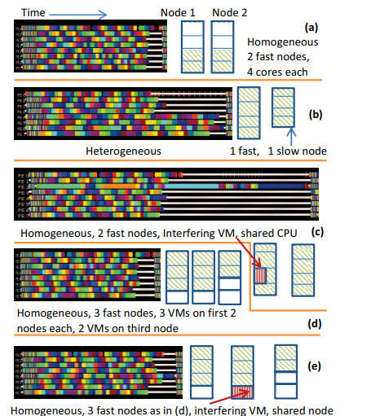
Figure: Experimental setup (on right) and timeline of 8 VMs showing one iteration of Stencil 2D: white portion = idle time, colored portions = application functions.

Slide 7
Conclusion:
OUR MISSION AND VISION
Innovative Load Balancing: Introduces a refined approach for HPC applications in cloud environments.
Addressing Heterogeneity: Effectively handles static and dynamic variations, enhancing performance.
Practical Impact: Demonstrates tangible improvements in execution time, showcasing real-world applicability.
Adaptive Runtimes: Highlights the importance of runtime systems in cloud-based HPC optimization.
Challenges and Future Work: Identifies the complexity of tuning for cloud efficiency, opening avenues for further research.
Applicability to Exascale: Suggests potential relevance and applicability to future exascale computing challenges.
Implications for Cloud HPC: Provides valuable insights for efficient cloud utilization, with implications for scalability and workload adaptability.
Path Forward: Encourages exploration of data-aware migration strategies and considers VM steal cycles.
Foundation for Future Research: Lays groundwork for larger-scale evaluations, simulations, or emulated environments in subsequent studies.

Slide 8
Limitations of the paper:
Limitations:
Static Heterogeneity Assumption: The paper assumes static heterogeneity, not considering variations in VM performance over time, potentially limiting adaptability to dynamic environments.
Sensitivity to Workload Characteristics: The effectiveness of load balancing may vary based on the nature of workloads, impacting generalizability.
Scalability Concerns: The study, while demonstrating efficacy, is limited in scale due to the available resources, and scalability to larger cloud environments requires further exploration.
Dependency on HPC Workload: The load balancing technique is tailored for HPC workloads; its applicability to diverse cloud applications needs investigation.
Lack of Real Cloud Scalability: While tested on a cloud-like environment, the paper lacks evaluation on a larger scale in a real cloud, impacting practical scalability.

Slide 9
STATISTICS
Synthesis:
Comprehensive Consideration: Successfully addresses both static and dynamic heterogeneity, enhancing application performance.
Real-world Impact: Demonstrates tangible improvements in execution time, validating the practicality of the proposed technique.
Adaptive Runtimes: Emphasizes the significance of adaptive parallel runtime systems in optimizing cloud-based HPC.
Challenges Revealed: Identifies the complexity of tuning applications for cloud efficiency, acknowledging limitations and opening avenues for future research.
Exascale Relevance: Suggests potential applicability to exascale computing challenges, providing insights into dynamic resource management.
Cloud HPC Optimization: Implications for efficient cloud utilization, scalability, and workload adaptability are highlighted.
Future Directions: Encourages exploration of advanced migration strategies, considering data-aware approaches and VM steal cycles.
Foundation for Exploration: Lays a foundation for future research, inviting larger-scale evaluations and simulations for a deeper understanding.

Slide 10
Thankyou

