Slide 1
Navigation System Using B-Tree and Lazy Loading
DSA Semester Project

Slide 2
Introduction
A mini navigation system similar to Google Maps.
Uses B-Tree database and lazy loading for efficiency.
Demonstrates DSA concepts in a real-world scenario.

Slide 3
Problem Statement
How to efficiently store and process thousands of nodes?
Full map cannot be loaded in memory.
Solution: Use disk-based B-Tree + lazy loading.

Slide 4
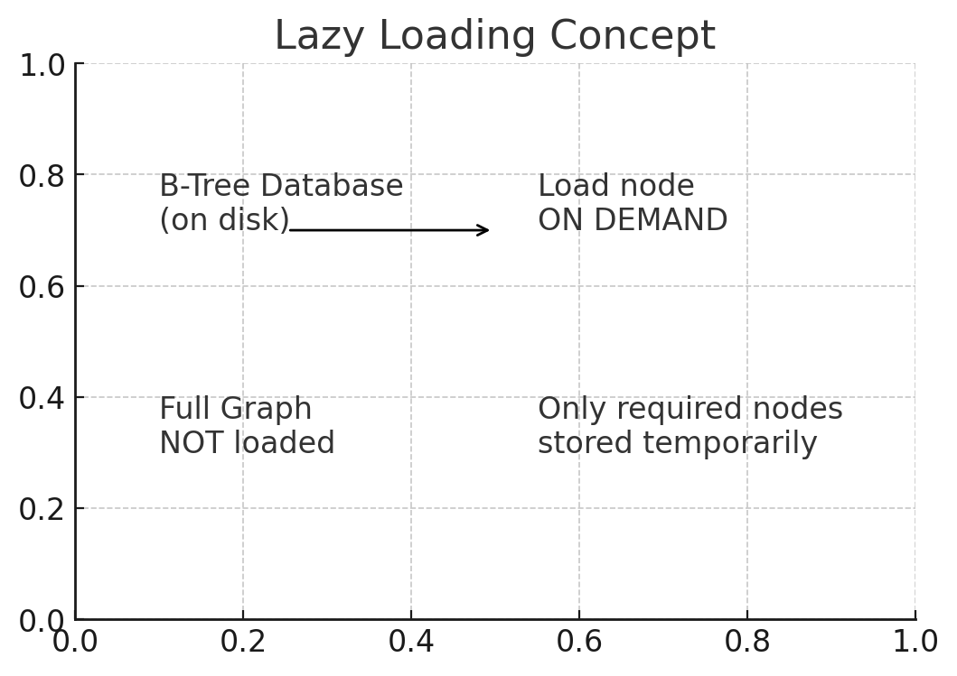
Lazy Loading Concept

Slide 5
Data Structures Used
- B-Tree as storage database
- AVL Tree / Maps for caching
- Priority Queue for Dijkstra
- Stack for path reconstruction
- Queue for BFS operations

Slide 6
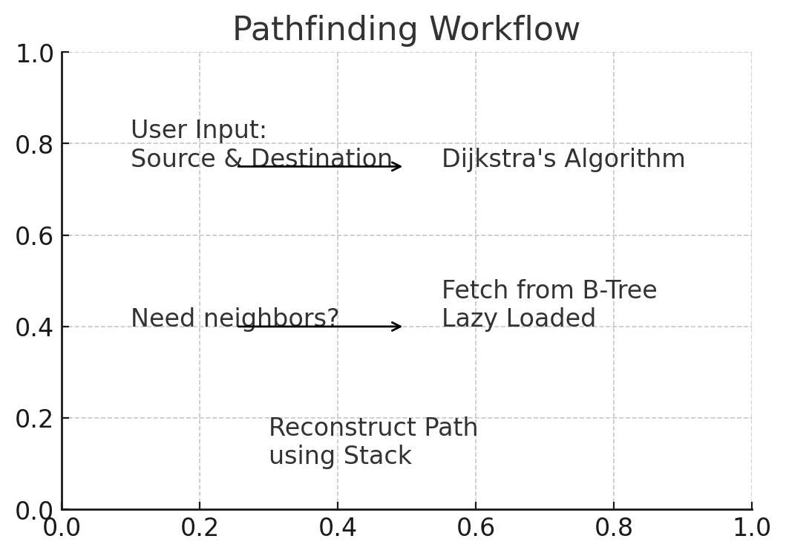
Pathfinding Workflow

Slide 7
Features
- Shortest path calculation
- Efficient memory usage
- Scalable dataset handling
- Realistic lazy-loaded graph processing

Slide 8
Conclusion
Project demonstrates practical use of DSA.
Lazy loading + B-Tree mimics real map systems.
Efficient, scalable, and structured design.

