Slide 1


Department of AIML_DS
Dept. of AIML DS

Slide 2
Data Structure and Applications
1BCS305
Dept. of AIML DS

Slide 3
MODULE-1
Introduction:
Syllabus:
Introduction: Data Structures, Classifications (Primitive & Non-Primitive).
Pointers and Dynamic Memory Allocation, Arrays, Dynamically Allocated Arrays, Structures and Unions, Polynomials.
Sparse Matrices: Sparse Matrix Representation and Transposing a Matrix.
Dept. of AIML DS

Slide 4
Basic Terminologies
Data Structure
– Data: are simply a value are set of values of different type which is called data types like string, integer, char etc.
– Structure: Way of organizing information, so that it is easier to use
– In simple words we can define data structures as
● Its a way organizing data in such a way so that data can be easier to use.
Dept. of AIML DS

Slide 5
Data Structure ..
– A data structure is a particular way of organizing data in a computer so that it can be used efficiently.
– A scheme for organizing related pieces of information.
A data structure is a systematic way of organizing and managing data in a computer so that it can be used efficiently. Data structures define the relationships among data elements, how they are stored, and how they can be accessed, manipulated, and modified.
Dept. of AIML DS

Slide 6
Basic Terminologies
Data: The term ‘DATA’ simply refers to a value or a set of values. These values may present anything about something, like it may be roll no of a student, marks, name of an employee, address of person etc.
Data item: A data item refers to a single unit of value. For eg. roll no of a student, marks, name of an employee, address of person etc. are data items. Data items that can be divided into sub items are called group items (Eg. Address, date, name), where as those who can not be divided in to sub items are called elementary items (Eg. Roll no, marks, city, pin code etc.).
Dept. of AIML DS

Slide 7
Basic Terminologies
Entity - with similar attributes ( e.g all employees of an organization) form an entity set.
Information: Data with given attribute or processed data.
Field is a single elementary unit of information representing an attribute of an entity.
Record is the collection of field values of a given entity.
File is the collection of records of the entities in a given entity set.
Dept. of AIML DS

Slide 8
Basic Terminologies
EXAMPLE:
Attributes: Name Age Gender Roll Number Branch
Values: A 17 M 109cs0132 CSE
B 18 M 109ee1234 ISE
Here, it is an example of student details where STUDENT is the given entity. Then name, age, Gender, roll number, branch are attributes and their values are properties (A, 17, M, 109cs0132, CSE). Collection of student details is student entity set and Roll number is the primary key which uniquely indicates each student details.
Dept. of AIML DS

Slide 9
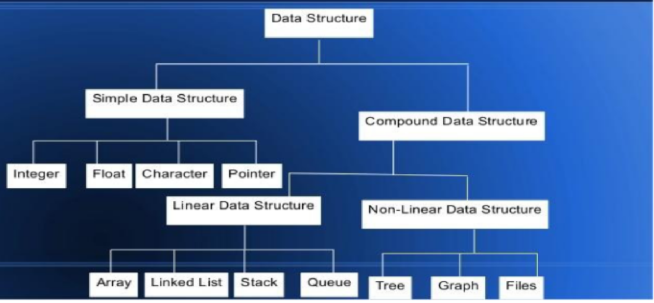
Classification of Data Structure
Dept. of AIML DS

Slide 10
Simple Data Structure: Simple data structure can be constructed with the help of primitive data structure. A primitive data structure used to represent the standard data types of any one of the computer languages (integer, Character, float etc.).
Compound Data Structure: Compound data structure can be constructed with the help of any one of the primitive data structure and it is having a specific functionality. It can be designed by user. It can be classified as Linear and Non-Linear Data Structure.
Dept. of AIML DS

Slide 11
Anything that can store data can be called as a data structure, hence Integer, Float, Boolean, Char etc, all are data structures. They are known as Primitive Data Structures and some complex Data Structures, which are used to store large and connected data. They are called Non-primitive Data Structures.
Examples:Array,Stack,Queue,Linked List,Tree,Graph
Dept. of AIML DS

Slide 12
Primitive Data Structure: The data Structures that can be Manipulated directly by Machine Instructions are called Primitive Data Structures.
For Example, in C language, the different primitive data structures are defined using the data types such as int, float, char, double and pointers.
Non-Primitive Data structure:
The data Structures that cannot be Manipulated directly by Machine Instructions are called Non-Primitive Data Structures.
Dept. of AIML DS

Slide 13
Non-Primitive data structure can be constructed with the help of any one of the primitive data structure and it is having a specific functionality. It can be designed by user. Arrays, Structure, Union, linked list, Stacks, Queue, trees, graphs etc are example for non primitive data structures.
It can be classified as
1) Linear data structure
2) Non-linear data structure
Dept. of AIML DS

Slide 14
Linear Data Structures: A linear data structure traverses the data elements sequentially, in which only one data element can directly be reached. Ex: Arrays, Linked Lists
Non-Linear Data Structures: Every data item is attached to several other data items in a way that is specific for reflecting relationships. The data items are not arranged in a sequential structure. Ex: Trees, Graphs
Dept. of AIML DS

Slide 15
Operation on Linear/Non-Linear
Data Structure
Add an element
Delete an element
Traverse / Display
Sort the list of elements
Search for a data element
Merge the list
Dept. of AIML DS

Slide 16
(1)Traversing: Accessing each record exactly once so that certain items in the record may be processed.
(2) Searching: Finding the location of a particular record with a given key value, or finding the location of all records which satisfy one or more conditions.
(3) Inserting: Adding a new record to the structure.
(4) Deleting: Removing the record from the structure.
(5) Sorting: Managing the data or record in some logical order (Ascending or descending order).
(6) Merging: Combining the record in two different sorted files into a single sorted file.
Dept. of AIML DS

Slide 17
Operations on linear data structures
1.Add an element
2.Delete an element
3.Traverse all the elements
4.Sort the list of elements
5.Search for a data element
Apply one or more functionality to create different types of data structures.
For example Stack, Queue, and Linked Lists.
Dept. of AIML DS

Slide 18
Types of Data Structure
Array: is commonly used in computer programming to mean a
contiguous block of memory locations, where each memory location
stores one fixed-length data item. e.g. Array of Integers int a[10], Array of Character char b[10].
Dept. of AIML DS

Slide 19

Stack: A stack is a data
structure in which items can
be inserted only from one
end and get items back from
the same end. There , the last
item inserted into stack, is
the the first item to be taken
out from the stack. In short
its also called Last in First
out [LIFO]
Dept. of AIML DS

Slide 20
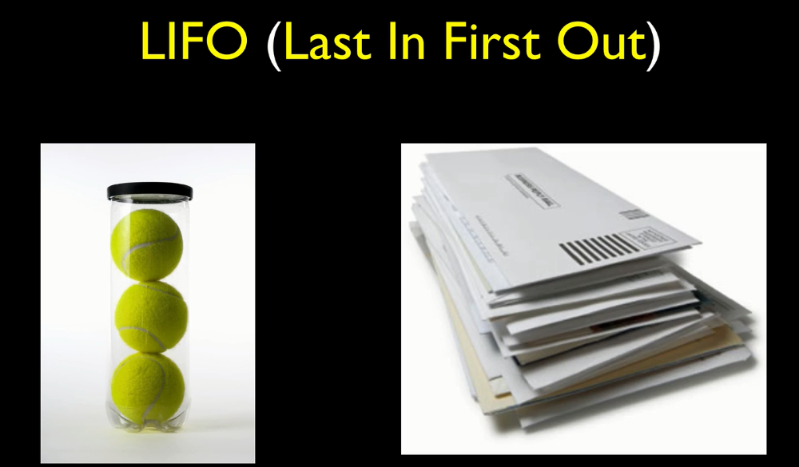
Dept. of AIML DS

Slide 21
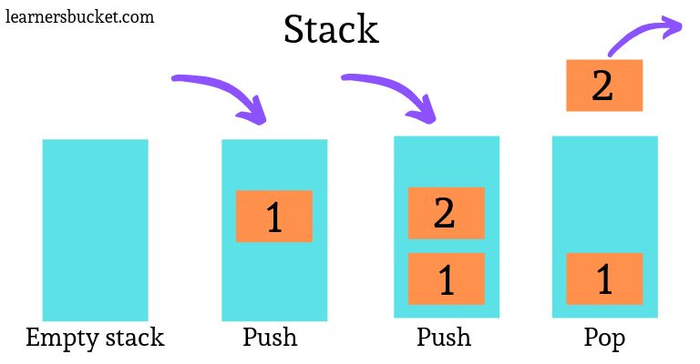
Dept. of AIML DS

Slide 22
Operations on Stack
Insert (PUSH)
Delete(POP)
Overflow
Underflow
Dept. of AIML DS

Slide 23
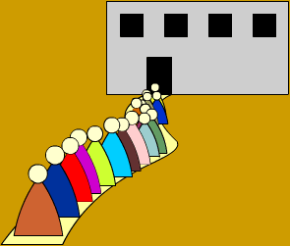
Queue: A queue is two
ended data structure in
which items can be
inserted from one end and
taken out from the other
end. Therefore , the first
item inserted into queue is
the first item to be taken
out from the queue. This
property is called First in
First out [FIFO].
Dept. of AIML DS

Slide 24

Dept. of AIML DS

Slide 25
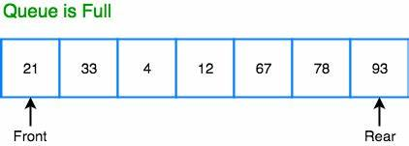
Dept. of AIML DS

Slide 26
front end-index to the first element-end at which elements are deleted.
rear end-index to the last element-end at which elements are added or inserted.
Dept. of AIML DS

Slide 27
LIFO:Last element Inserted is the First element to be deleted out.
FIFO: First element Inserted is the First element to be deleted out.
Dept. of AIML DS

Slide 28
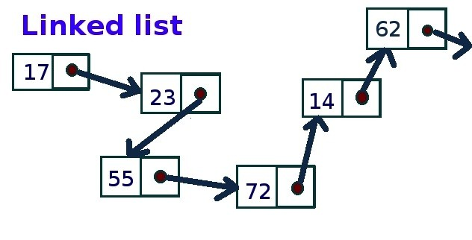
Linked List: Could alternately used to store items. In linked list space to store items is created as is needed and destroyed when space no longer required to store items. Hence linked list is a dynamic data structure space acquire only when need.
Dept. of AIML DS

Slide 29
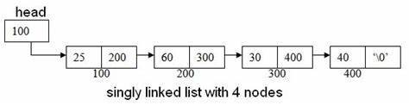
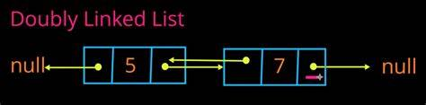
Dept. of AIML DS

Slide 30
Tree: is a non-linear data
structure which is
mainly used to represent
data containing a
hierarchical relationship
between elements.
Binary Tree: A binary
tree is a tree such that
every node has at most 2
child and each node is
labeled as either left of
right child
Dept. of AIML DS

Slide 31
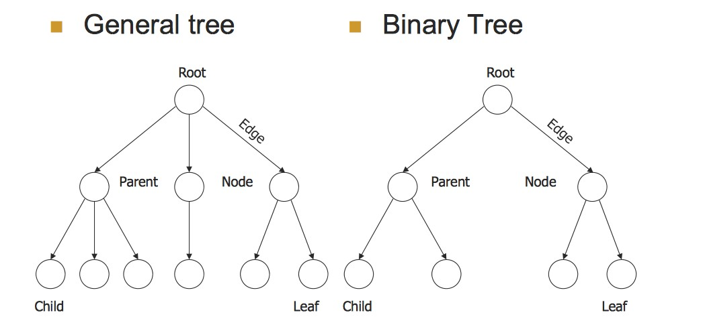
Dept. of AIML DS

Slide 32
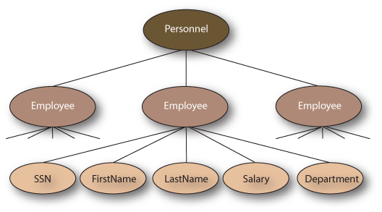
Dept. of AIML DS

Slide 33

Graph: It is a set of items connected by edges. Each item is called a vertex or node. Trees are just like a special kinds of graphs. Graphs are usually represented by G = (V, E), where V is the set vertices and E is the set of Edges.
Dept. of AIML DS

Slide 34
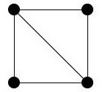
Undirected Graph: A graph
whose edges are unordered pair of vertices. That is each edge connects two vertices. In an undirected graph, direction is not important, if the path is available, it can be traversed in any direction.
Dept. of AIML DS

Slide 35
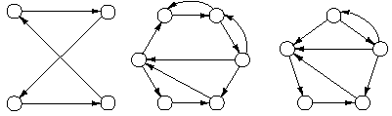
Directed Graph: In directed graph a directional edge connect two node/vertex. If there is one edge from one vertex to other then only this path can be followed.
Dept. of AIML DS

Slide 36
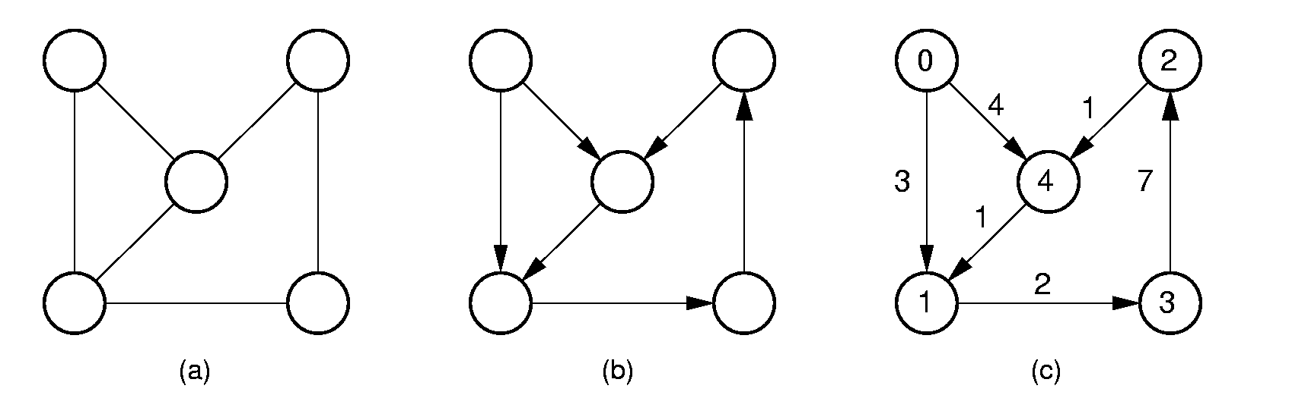
Weighted Graph: A graph having a weight, or number
associated with each edge.
Dept. of AIML DS

Slide 37
Selecting a Data Structure
Analyze the problem to determine the resource constraints a solution must meet.
Determine the basic operations that must be supported. Quantify the resource constraints for each operation.
Select the data structure that best meets these
requirements.
Dept. of AIML DS

Slide 38
Factor | Details | Examples
1. Understand the Problem Requirements
Operations | Identify the operations needed (insertion, deletion, searching, updating, traversing).
Frequency of Operations | Determine how often each operation will be performed. | Prioritize a data structure with fast search capabilities if searching is frequent.
Data Size | Consider the amount of data to manage. | Larger datasets may require more efficient data structures like trees or hash tables.
Dept. of AIML DS

Slide 39
2. Consider the Type of Data
Homogeneous vs. Heterogeneous | If all elements are of the same type, simpler structures like arrays may suffice. | For mixed data types, more complex structures like trees or graphs may be needed.
Fixed Size vs. Dynamic Size | Choose an array for fixed-size data; use linked lists or dynamic arrays for dynamic size. | Arrays (fixed), Linked Lists/Dynamic Arrays (dynamic).
Dept. of AIML DS

Slide 40
3. Performance Considerations
Time Complexity | Analyze time complexity of operations: O(1), O(log n), O(n). | Arrays (O(1) access), Linked Lists (O(1) insertion), Hash Tables (O(1) average).
Space Complexity | Consider memory requirements. | Hash Tables and Trees can be memory-intensive.
Dept. of AIML DS

Slide 41
4. Specific Use Cases
Stack Operations (LIFO) | Use stacks for Last-In, First-Out operations. | Function calls, parsing expressions.
Queue Operations (FIFO) | Use queues for First-In, First-Out operations. | Task scheduling, handling requests.
Hierarchical Data | Use trees for hierarchical structures. | File systems, organizational charts.
Graph Data | Use graphs for representing networks or relationships. | Social networks, web links, road maps.
Dept. of AIML DS

Slide 42
6. Scalability
Handling Large Data Sets | Select data structures that scale well with large datasets. | B-trees, Hash Tables (commonly used in databases).
Concurrency | Consider data structures that support concurrent access. | Concurrent Hash Maps for multi-threaded environments.
Dept. of AIML DS

Slide 43
7. Real-World Examples
Arrays | Best for simple data storage with quick index-based access. | Array of integers, list of fixed-size elements.
Linked Lists | Suitable for dynamic data with frequent insertion/deletion. | Dynamic collections, navigational systems.
Hash Tables | Ideal for quick search, insert, and delete operations. | Caches, associative arrays.
Trees | Useful for sorted data or hierarchical relationships. | Database indexes, file systems.
Graphs | Perfect for modeling relationships and networks. | Social networks, transport networks.
Dept. of AIML DS

Slide 44
Memory Allocation
Static Memory Allocation
It is a process where in the memory space is allocated during the compilation time.
Here the allocated memory space cannot be expanded or reduced to accommodate more or less data, i.e. the size of the allocated memory space is fixed and it cannot be altered during execution.
EX: Consider the declaration int a[10];
During compilation, the compiler will allocate 10 memory locations for the variable ‘a’ and once defined cannot be changed.
During execution we cannot have more than 10 data items, and if we use 3 locations, another 7 locations are wasted.
Dept. of AIML DS

Slide 45
Disadvantages:
In this type of memory allocation, the data structures require a fixed amount of storage. Since the amount of storage is fixed,
If the data structure in use, uses only a small amount of memory, rest of the memory is wasted.
If the data structure in use, tries to use more memory than actually allocated for it results in an overflow.
Because of these limitations, this type of memory allocation can be used in applications where the data size is fixed and known before processing.
Dept. of AIML DS

Slide 46
Dynamic Memory Allocation
It is the process of allocating memory space during run time. This type of memory allocation can be used in applications where the storage requirement is unpredictable.
The following are the functions using which additional memory space can be allocated or unwanted space can be deleted, thereby optimizing the use of storage space.
Dept. of AIML DS

Slide 47
Comparison of Static and Dynamic Memory Allocation
Sl.No | Static Memory Allocation | Dynamic Memory Allocation
1 | Memory is allocated during compilation time. | Memory is allocated during run time.
2 | The size of the allocated memory space is fixed and it cannot be altered during execution. | The size of the allocated memory space is not fixed and it can be altered (increased / decreased) during execution.
3 | This type of memory allocation can be used in applications where the data size is fixed and known before processing. | This type of memory allocation can be used in applications where the storage requirement is unpredictable.
4 | Execution is faster because memory is already allocated and only data manipulation is done. | Execution is slower because memory is has to be allocated and only then data manipulation is done.
5 | Part of memory allocated is stack memory or global/static memory. | Part of memory allocated is heap memory
6 | Ex: arrays | Ex: Dynamic arrays, linked lists
Dept. of AIML DS

Slide 48
1.malloc
Description: This function allocates and reserves a block of memory, specified in bytes and returns a pointer to the first byte of the allocated space.
Syntax:
ptr = (datatype *) malloc (size);
Where - ptr is a pointer of type datatype
- datatype can be any of the basic data type or user defined data type.
- size is the number of bytes required.
Example: ptr = ( int * ) malloc ( sizeof ( int ) );
Dept. of AIML DS

Slide 49
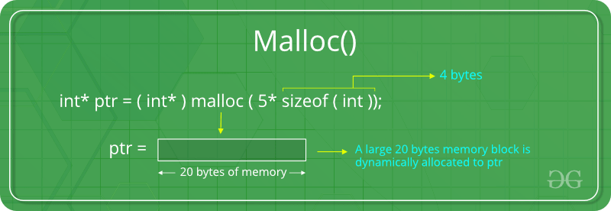
On successful execution of this statement, a memory space equivalent to size of int is reserved and the address of the first byte of the memory allocated is assigned to the pointer ptr of type int.
Return Value – On success, it returns a pointer of type void to the newly allocated block of memory. On failure i.e. if the specified size of memory is not available, it returns NULL.
Dept. of AIML DS

Slide 50
2.calloc
Description – This function allocates multiple blocks of same size, initializes all locations to zero and returns a pointer to the first byte of allocated space.
Syntax:
ptr = (datatype *) calloc (n, size);
Where - ptr is a pointer of type datatype
- datatype can be any of the basic data type or user defined data type.
- size is the number of bytes required.
- n is the number of blocks to be allocated of size bytes.
Dept. of AIML DS

Slide 51
Example: ptr = ( int * ) calloc (200, sizeof ( int ) );
On successful execution of this statement, a memory space equivalent to size of 200 int (array of 200 integers) is reserved and the address of the first byte of the memory allocated is assigned to the pointer ptr of type int.
Return Value – On success, it returns a pointer of type void to the newly allocated block of memory. On failure i.e. if the specified size of memory is not available, it returns NULL.
Dept. of AIML DS

Slide 52
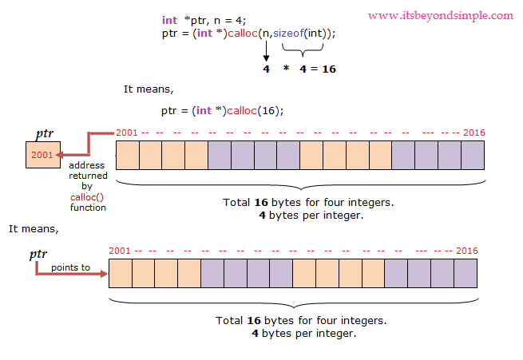
Dept. of AIML DS

Slide 53
3.realloc
Description – This function is used to alter the size of the previously allocated space which is allocated either by using malloc or calloc function.
Syntax:
ptr = (datatype *) realloc (ptr, size);
Where - ptr is the starting address of allocated memory obtained previously by calling malloc, calloc, or realloc functions.
- size is the number of bytes required for reallocation. The size specified may be larger or smaller than the previously allocated memory.
Dept. of AIML DS

Slide 54
Example:
If the original allocation is done by the statement
ptr = malloc(size);
Then reallocation of space may be done by the statement
ptr = realloc(ptr, newsize)
On successful execution of this statement, realloc allocates a new memory space of size newsize to the pointer variable ptr and returns a pointer to the first byte of the new memory block.
Return Value – On success, it returns a pointer to the newly allocated block of memory. On failure i.e. if the specified size of memory is not available, it returns NULL.
Dept. of AIML DS

Slide 55
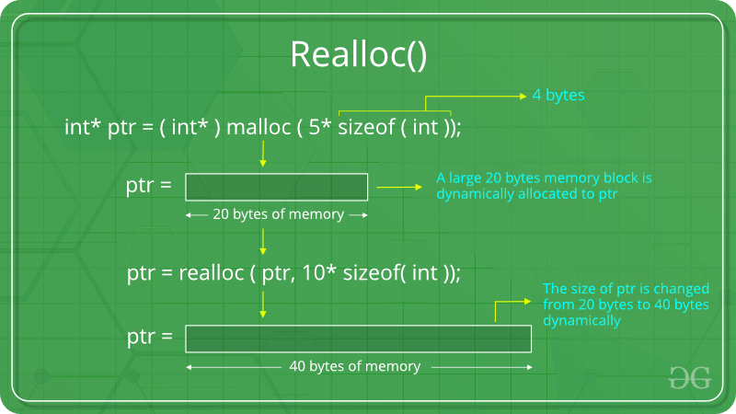
Dept. of AIML DS

Slide 56
Note:
The storage space allocated dynamically has no name and therefore its contents can be accessed only through a pointer.
It is the responsibility of a programmer to de-allocate memory whenever it is not required by the application.
In case of realloc( ), the contents of the old block will be copied into the newly allocated space and so, this function guarantees that the earlier contents are not lost.
Dept. of AIML DS

Slide 57
4.free
Description – This function de-allocates (frees) the allocated block of memory which is allocated by using the functions malloc( ), calloc( ) or realloc( ).
Syntax: free(ptr);
Where ptr is a pointer to a memory block which has already been created by invoking one of the 3 functions malloc( ), calloc( ) or realloc( ).
Return Value – None.
Dept. of AIML DS

Slide 58
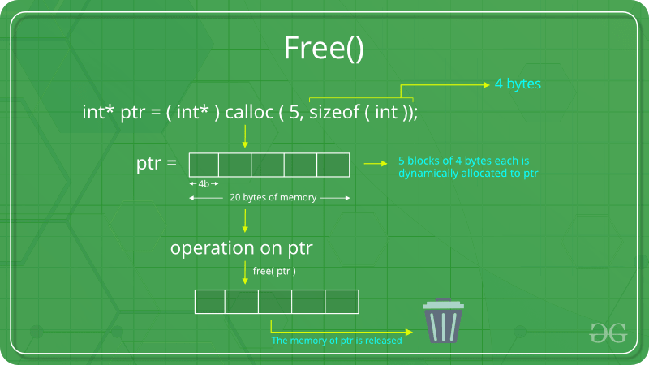
Dept. of AIML DS

Slide 59
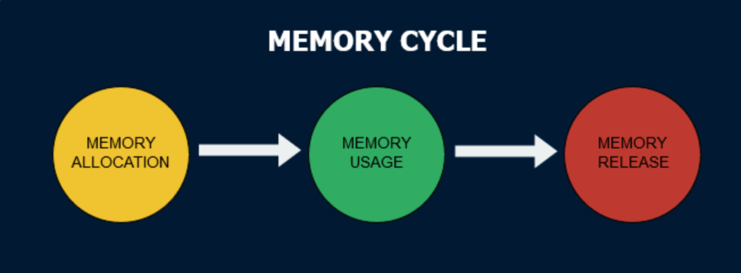
Dept. of AIML DS

Slide 60
Problems with Dynamic Memory Allocation
1.Memory Leakage
This is a problem where in a part of the memory is reserved but is not accessible to any of the applications.
Example: Consider the following program segment.
main ( )
{ int *a;
a = (int *)malloc(sizeof (int) );
*a =10;
a = (int *)malloc(sizeof (int) );
*a =20;
}
Here, memory for the variable ‘a’ is allocated twice. However, ‘a’ contains the address of most recently allocated memory, thereby making the earlier allocated memory inaccessible i.e. the memory location where the value 10 is stored is inaccessible to any of the application and is not possible to free so that it can be reused.
Dept. of AIML DS

Slide 61
2.Dangling Pointer
Any pointer pointing to a destroyed object or which does not contain a valid address is called a dangling pointer.
Example: Consider the following program segment
main ( )
{
int *a;
a =(int *)malloc(sizeof(int));
*a=20;
…….
…….
free(a);
}
Here, if we de-allocate the memory for the variable ‘a’ using free(a), the memory location pointing to by it is returned to the free pool. Now the pointer variable ‘a’ can be used, but the contents pointed by that cannot be used, because the pointer variable ‘a’ does not contain a valid address now and is called a dangling pointer.
Dept. of AIML DS

Slide 62
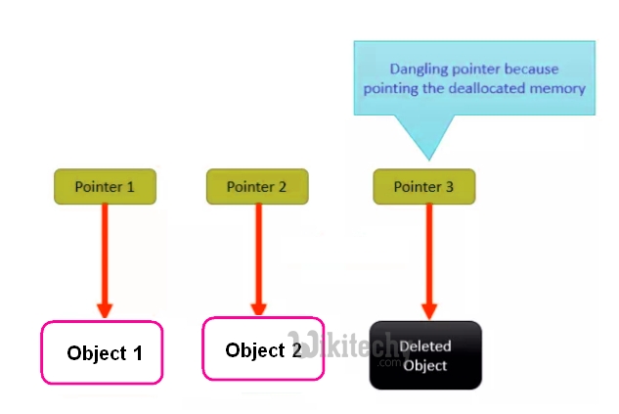
Dept. of AIML DS

Slide 63
Comparison of Malloc and Calloc
Sl.No | malloc ( ) | calloc ( )
1 | Syntax:ptr = (datatype*) malloc ( size ) (Takes only one argument which is the size of the block) | Syntax:ptr = (datatype*) calloc (n, size ) (Takes 2 arguments, first is number of blocks to be allocated and second is the size of each block)
2 | Allocates a block of memory of specified size. | Allocates multiple blocks of memory, each block with same size.
3 | Allocated space will not be initialized. | Each byte of the allocated space is initialized to zero.
4 | Since no initialization takes place, time efficiency is higher than calloc( ) | calloc( ) is computationally more expensive because of zero filling but, occasionally, more convenient than malloc( )
5 | This function can allocate the required size of memory even if the memory is not available contiguously but available at different locations. | This function can allocate the required number of blocks contiguously. If the required memory cannot be allocated contiguously, it returns NULL.
Dept. of AIML DS

Slide 64
Dynamic memory allocation for a 1-D array in C using malloc(),calloc() and realloc()
Using malloc()
int* arr = (int*)malloc(n * sizeof(int));
Calloc initializes the allocated memory to Zero
int* arr = (int*)calloc(n, sizeof(int));
realloc() resizes the previously allocated memory block
arr = (int*)realloc(arr, new_size * sizeof(int));
Dept. of AIML DS

Slide 65
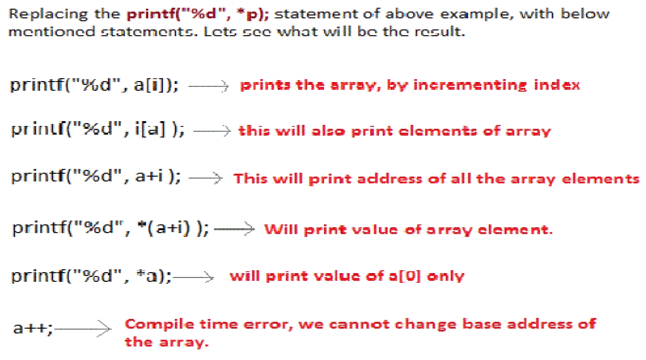
Dept. of AIML DS

Slide 66
Two-Dimensional Arrays using pointer to pointer
For multidimensional arrays the concept of array-of-arrays is used. A 2-dimensional array is represented as a 1-dimensional array of pointers where each pointer contains address of one dimensional array.
EX: To represent a 2-dimensional array int a[3][5]; we create a 1-dimensional array ‘a’ whose length is 3; each element of ‘a’ is a 1-dimensional array whose length is 5.
The following shows the memory structure.
Dept. of AIML DS

Slide 67
Two-Dimensional Arrays using pointer to pointer
For multidimensional arrays the concept of array-of-arrays is used. A 2-dimensional array is
represented as a 1-dimensional array of pointers where each pointer contains address of one
dimensional array.
EX: To represent a 2-dimensional array int a[3][5]; we create a 1-dimensional array ‘a’ whose
length is 3; each element of ‘a’ is a 1-dimensional array whose length is 5.
The following shows the memory structure.
Dept. of AIML DS

Slide 68
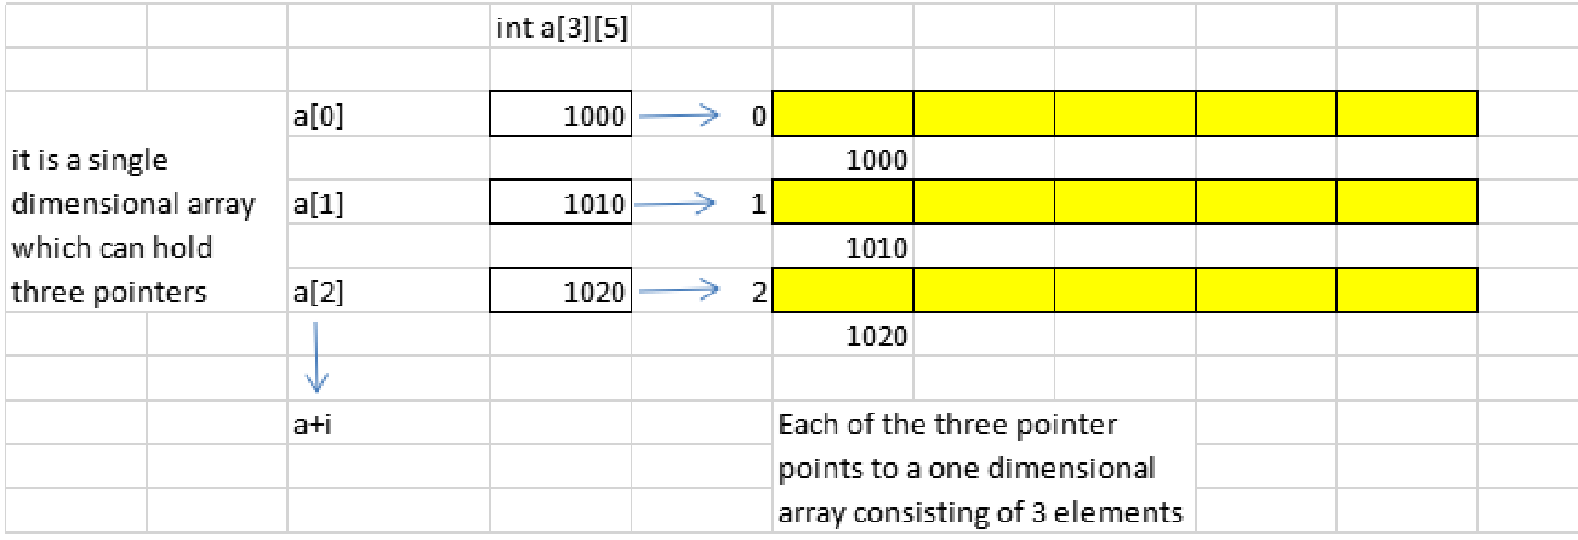
Dept. of AIML DS

Slide 69
The element a[i][j] is found by first accessing the pointer in a[i]. This gives the address of the zero th element of row ‘i’ of the array. Then by adding ‘j’ to this pointer the address of the jth element of row ‘i’ is found
This means,
The expression *(a + i) + j points to the jth element in the ith row i.e. *(a + i) + j = &a[i][j]
The expression *( *(a + i) + j ) gives the value of the element in ith row and jth column i.e. *( *(a + i) + j ) = a[i][j].
Dept. of AIML DS

Slide 70
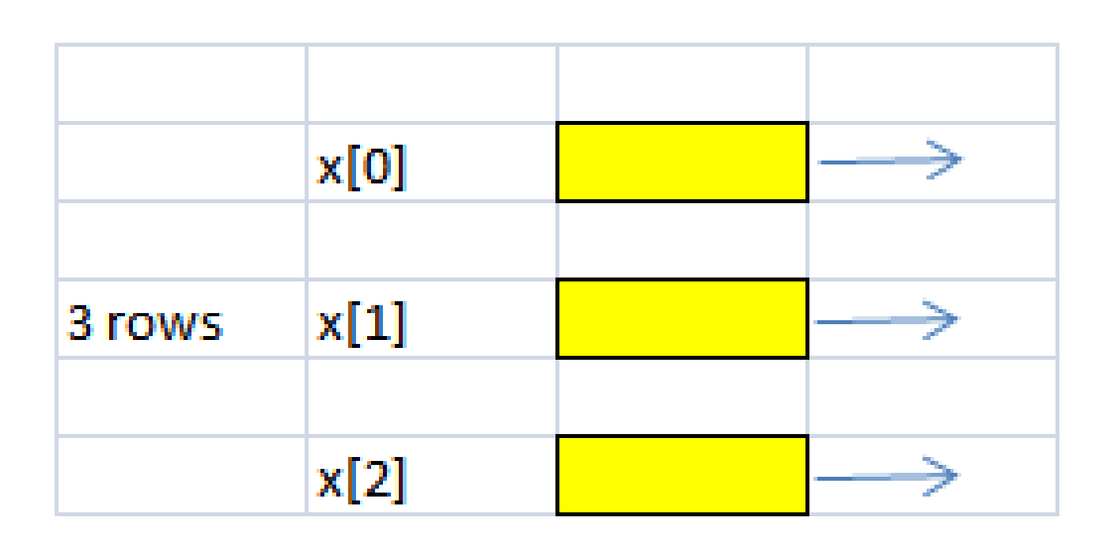
A 2-dimensional array with 3 rows and 5mcolumns can be created by allocating the memory dynamically in two stages.
Stage 1: Allocate memory for specified number of row pointers.
Example: allocate memory for 3 row pointers using
Pictorial representation is shown below
Dept. of AIML DS
array = (int**) malloc(rows * sizeof(int*));

Slide 71
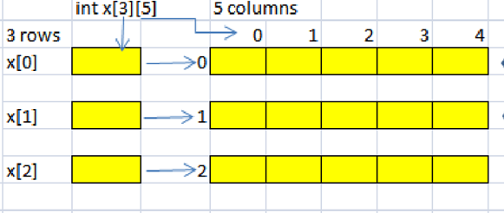
Stage 2: Allocate memory for each row with specified number of column .
Example: Allocate memory for 5 columns with respect to row x[0],x[1] and x[2]
Dept. of AIML DS
for (i = 0; i < rows; i++)
array[i] = (int*) malloc(cols * sizeof(int));

Slide 72
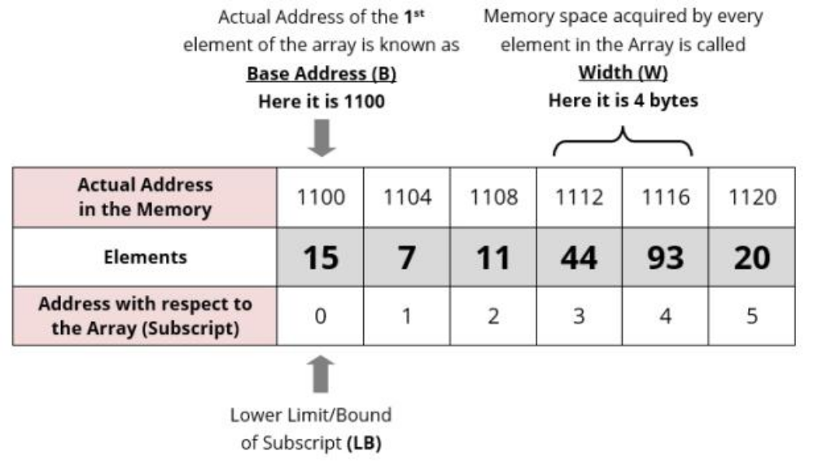
Address Calculation in single (one) Dimension Array
Dept. of AIML DS

Slide 73
Array of an element of an array say “A[ I ]” is calculated using the following formula:
Address of A [ I ] = B + W * ( I – LB )
Where,
B = Base address
W = Storage Size of one element stored in the array (in byte)
I = Subscript of element whose address is to be found
LB = Lower limit / Lower Bound of subscript, if not specified assume 0 (zero)
Dept. of AIML DS

Slide 74
Example:
Given the base address of an array B[1300…..1900] as 1020 and size of each element is 2 bytes in the memory. Find the address of B[1700].
Solution:
The given values are: B = 1020, LB = 1300, W = 2, I = 1700
Address of A [ I ] = B + W * ( I – LB )
= 1020 + 2 * (1700 – 1300)
= 1020 + 2 * 400
= 1020 + 800
= 1820 [Ans]
Dept. of AIML DS

Slide 75
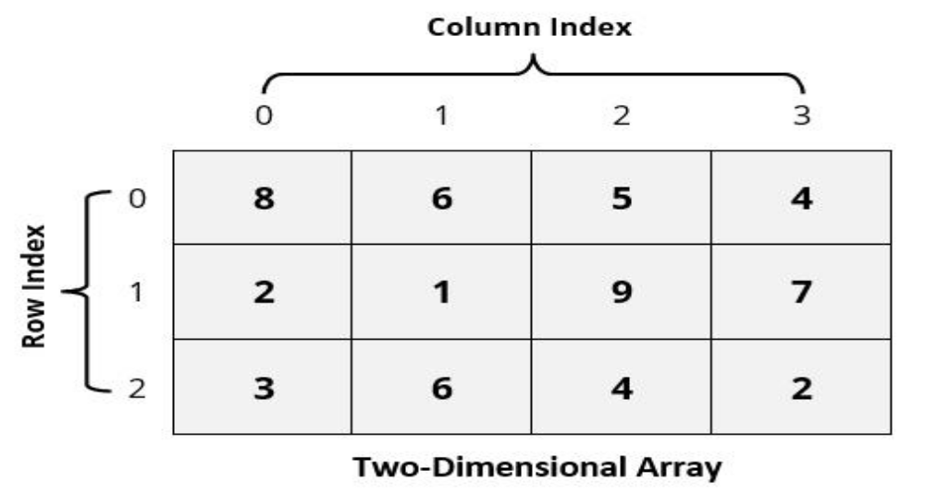
Address Calculation in Double (Two) Dimensional Array:
While storing the elements of a 2-D array in memory, these are allocated contiguous memory locations. Therefore, a 2-D array must be linearized so as to enable their storage.
There are two alternatives to achieve linearization:
Row-Major and Column-Major.
Dept. of AIML DS

Slide 76
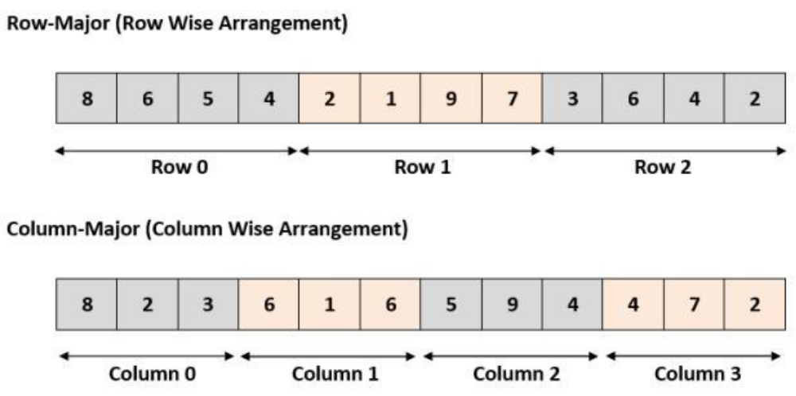
Dept. of AIML DS
C allows for arrays of two or more dimensions. A two-dimensional (2D) array is an array of arrays.
Address of an element of any array say “A[ I ][ J ]” is calculated in two forms as given:
(1) Row Major System (2) Column Major System

Slide 77
Row Major System:
The address of a location in Row Major System is calculated using the following formula:
Address of A [ I ][ J ] = B + W * [ N * ( I – Lr ) + ( J – Lc ) ]
Column Major System:
The address of a location in Column Major System is calculated using the following formula:
Address of A [ I ][ J ] Column Major Wise = B + W * [( I – Lr ) + M * ( J – Lc )]
Dept. of AIML DS
Where,
B = Base address
I = Row subscript of element whose address is to be found
J = Column subscript of element whose address is to be found
W = Storage Size of one element stored in the array (in byte)
Lr = Lower limit of row/start row index of matrix, if not given assume 0 (zero)
Lc = Lower limit of column/start column index of matrix, if not given assume 0 (zero)
M = Number of row of the given matrix
N = Number of column of the given matrix

Slide 78
Important : Usually number of rows and columns of a matrix are given ( like A[20][30] or A[40][60] ) but if it is given as A[Lr- – – – – Ur, Lc- – – – – Uc].
In this case number of rows and columns are calculated using the following methods:
Number of rows (M) will be calculated as = (Ur – Lr) + 1
Number of columns (N) will be calculated as = (Uc – Lc) + 1
And rest of the process will remain same as per requirement (Row Major Wise or Column Major Wise).
Dept. of AIML DS

Slide 79
Q 1. An array X [-15……….10, 15……………40] requires one byte of storage. If beginning location is 1500 determine the location of X [8][20].
Solution:
As you see here the number of rows and columns are not given in the question. So they are calculated as:
Number or rows say M = (Ur – Lr) + 1 = [10 – (- 15)] +1 = 26
Number or columns say N = (Uc – Lc) + 1 = [40 – 15)] +1 = 26
(i) Column Major Wise Calculation of above equation
The given values are: B = 1500, W = 1 byte, I = 8, J = 20, Lr = -15, Lc = 15, M = 26
Address of A [ I ][ J ] = B + W * [ ( I – Lr ) + M * ( J – Lc ) ]
= ?
Dept. of AIML DS

Slide 80
(ii) Row Major Wise Calculation of above equation
The given values are: B = 1500, W = 1 byte, I = 8, J = 20, Lr = -15, Lc = 15, N = 26
Address of A [ I ][ J ] = B + W * [ N * ( I – Lr ) + ( J – Lc ) ]
= ? [Ans]
Dept. of AIML DS

Slide 81
FIBONACCI SERIES
The Fibonacci sequence is the sequence of integers, where each number in this sequence is the sum of two preceding elements.
A formal definition is
a.If n=0 or 1,then F(n)=n
b.If n>1,then F(n)=F(n-1)+F(n-2)
Dept. of AIML DS

Slide 82

Dept. of AIML DS

