Slide 1


Department of AIML - CSE(DS)
Dept. of AIML CSE(DS)

Slide 2
Data Structure and Applications
1BCS305
Dept. of AIML CSE(DS)

Slide 3
TOPICS
Stacks: Definition, Stack Operations, Array Representation of Stacks, Stacks using Dynamic Arrays, Stack Applications: Polish notation, Infix to Postfix Conversion, Evaluation of Postfix Expression. Queues: Definition, Array Representation, Queue Operations.
Dept. of AIML CSE(DS)

Slide 4
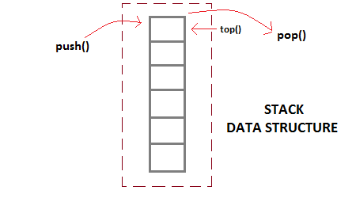
STACK
It is a simple data structure that allows adding and removing elements in a particular order. Every time an element is added, it goes on the top of the stack and the only element that can be removed is the element that is at the top of the stack
Dept. of AIML CSE(DS)

Slide 5
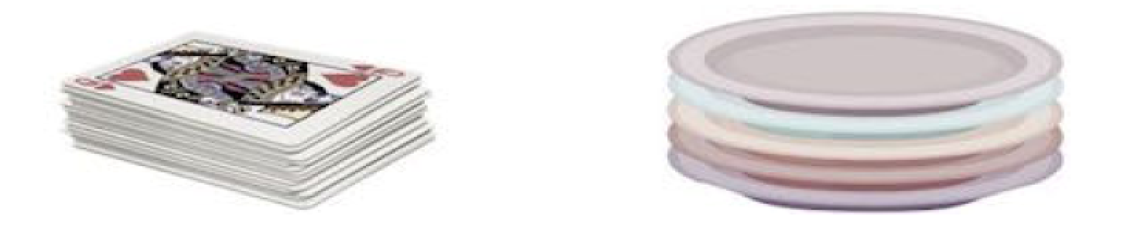
Example:stack of cards and plates
Dept. of AIML CSE(DS)

Slide 6
Basic features of Stack
Stack is an ordered list of similar data type.
Stack is a LIFO(Last in First out) structure or we can say FILO(First in Last out).
push() function is used to insert new elements into the Stack and pop() function is used to remove an element from the stack. Both insertion and removal are allowed at only one end of Stack called Top.
Stack is said to be in Overflow state when it is completely full and is said to be in Underflow state if it is completely empty.
Dept. of AIML CSE(DS)

Slide 7
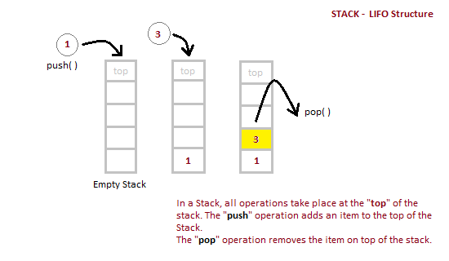
Implementation of Stack Data Structure
Stack can be easily implemented using an Array
Dept. of AIML CSE(DS)

Slide 8
Algorithm for PUSH operation
Check if the stack is full or not.
If the stack is full, then print error of overflow and exit the program.
If the stack is not full, then increment the top and add the element.
Algorithm for POP operation
Check if the stack is empty or not.
If the stack is empty, then print error of underflow and exit the program.
If the stack is not empty, then print the element at the top and decrement the top.
Dept. of AIML CSE(DS)

Slide 9
void push() //Inserting element into the stack
{
int item,n;
if(top==(max_size-1))
{
printf("\nStack Overflow:");
}
else
{
printf("Enter the element to be inserted:\t");
scanf("%d",&item);
top=top+1;
stack[top]=item;
}
}
Dept. of AIML CSE(DS)

Slide 10
void pop() //deleting an element from the stack
{
int item;
if(top==-1)
{
printf("Stack Underflow:");
}
else
{
item=stack[top];
top=top-1;
printf("\nThe poped element: %d\t",item);
}
}
Dept. of AIML CSE(DS)

Slide 11
void display()
{
int i;
if(top==-1)
{
printf("\nStack is Empty:");
}
else
{
printf("\nThe stack elements are:\n" );
for(i=top;i>=0;i--)
{
printf("%d\n",stack[i]);
}
}
}
Dept. of AIML CSE(DS)

Slide 12
APPLICATIONS OF STACKS
1. Stack is used by compilers to check for balancing of parentheses, brackets and braces.
2.Stack is used to evaluate a postfix expression.
3.Stack is used to convert an infix expression into postfix/prefix form.
4.In recursion, all intermediate arguments and return values are stored on the processor’s stack.
5.During a function call the return address and arguments are pushed onto a stack and on return they are popped off.
Dept. of AIML CSE(DS)

Slide 13
Expressions
An algebraic expression is a legal combination of operators and operands. Operand isthe quantity on which a mathematical operation is performed. Operand may be a variable like x, y, z or a constant like 5, 4, 6 etc. Operator is a symbol which signifies a mathematical or logical operation between the operands. Examples of familiar operators include +, -, *, /, ^ etc.
Dept. of AIML CSE(DS)

Slide 14
Types of Expressions:
The different types of expressions are
Infix expression – Here an operator is in between 2 operands
EX: (a+b) / (c-d)
Postfix (Suffix or Reverse Polish) expression – Here an operator follows the 2 operands.
EX: ab+cd-/
Prefix (Polish) expression – Here an operator precedes the 2 operands.
EX: /+ab-cd
In both postfix and prefix expression operator and operands define correctly the order of operation.
Dept. of AIML CSE(DS)

Slide 15
In both postfix and prefix expression operator and operands define correctly the order of operation.
The three important features of postfix expression are:
The operands maintain the same order as in the equivalent infix expression.
The parentheses are not needed to designate the expression unambiguously.
While evaluating the postfix expression the priority of the operators is no longer relevant.
Dept. of AIML CSE(DS)

Slide 16
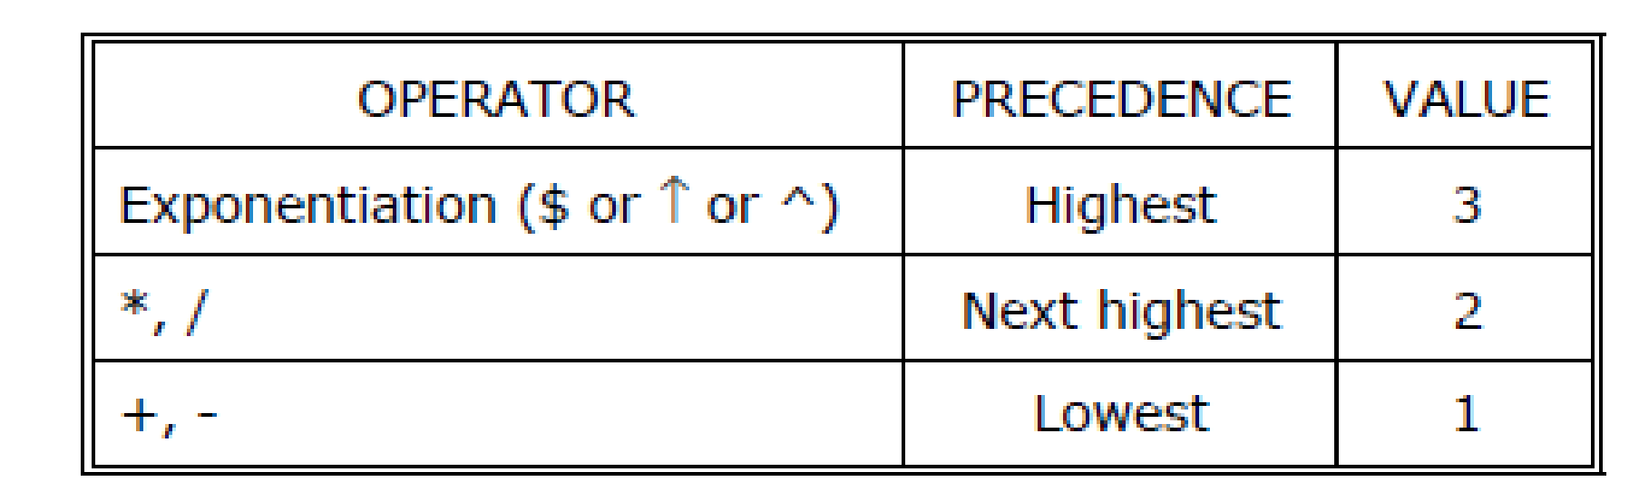
We consider five binary operations: +, -, *, / and $ or ↑ (exponentiation). For these binary operations, the following in the order of precedence (highest to lowest):
Dept. of AIML CSE(DS)

Slide 17
Problem 1
Convert the following infix expression to postfix and prefix
( ( 6 + ( 3 – 2 ) * 4 ) ^ 5 + 7 )
Postfix Conversion
( ( 6 + ( 3 – 2 ) * 4 ) ^ 5 + 7 ) // T1 = 3 2 -
( ( 6 + T1 * 4 ) ^ 5 + 7 ) // T2 = T1 4 *
( ( 6 + T2 ) ^ 5 + 7 ) // T3 = 6 T2 +
( T3 ^ 5 + 7 ) // T4 = T3 5 ^
( T4 + 7 ) // T5 = T4 7 +
T5
T4 7 +
T3 5 ^ 7 +
6 T2 + 5 ^ 7 +
6 T1 4 * + 5 ^ 7 +
6 3 2 - 4 * + 5 ^ 7 + (Postfix Expression)
Dept. of AIML CSE(DS)

Slide 18
Problem 1
Convert the following infix expression to postfix and prefix
( ( 6 + ( 3 – 2 ) * 4 ) ^ 5 + 7 )
Prefix Conversion
( ( 6 + ( 3 – 2 ) * 4 ) ^ 5 + 7 ) // T1 = - 3 2
( ( 6 + T1 * 4 ) ^ 5 + 7 ) // T2 = * T1 4
( ( 6 + T2 ) ^ 5 + 7 ) // T3 = + 6 T2
( T3 ^ 5 + 7 ) // T4 = ^ T3 5
( T4 + 7 ) // T5 = + T4 7
T5
+T4 7
+ ^ T3 5 7
+ ^ + 6 T2 5 7
+ ^ + 6 * T1 4 5 7
+ ^ + 6 * - 3 2 4 5 7 (Prefix Expression)
Dept. of AIML CSE(DS)

Slide 19
Converting expressions using Stack:
Let us convert the expressions from one type to another. These can be done as follows(Refer class notes)
1. Infix to postfix
2. Infix to prefix
3. Postfix to infix
4. Postfix to prefix
5. Prefix to infix
6. Prefix to postfix
Dept. of AIML CSE(DS)

Slide 20
CONVERSION FROM INFIX TO POSTFIX
Procedure to convert from infix expression to postfix expression is as follows:
1.Scan the infix expression from left to right.
2.a) If the scanned symbol is left parenthesis, push it onto the stack.
b) If the scanned symbol is an operand, then place directly in the postfix expression (output).
c) If the symbol scanned is a right parenthesis, then go on popping all the items from the stack and place them in the postfix expression till we get the matching left parenthesis.
d) If the scanned symbol is an operator, then go on removing all the operators from the stack and place them in the postfix expression, if and only if the precedence of the operator which is on the top of the stack is greater than (or greater than or equal) to the precedence of the scanned operator and push the scanned operator onto the stack otherwise.
Dept. of AIML CSE(DS)

Slide 21
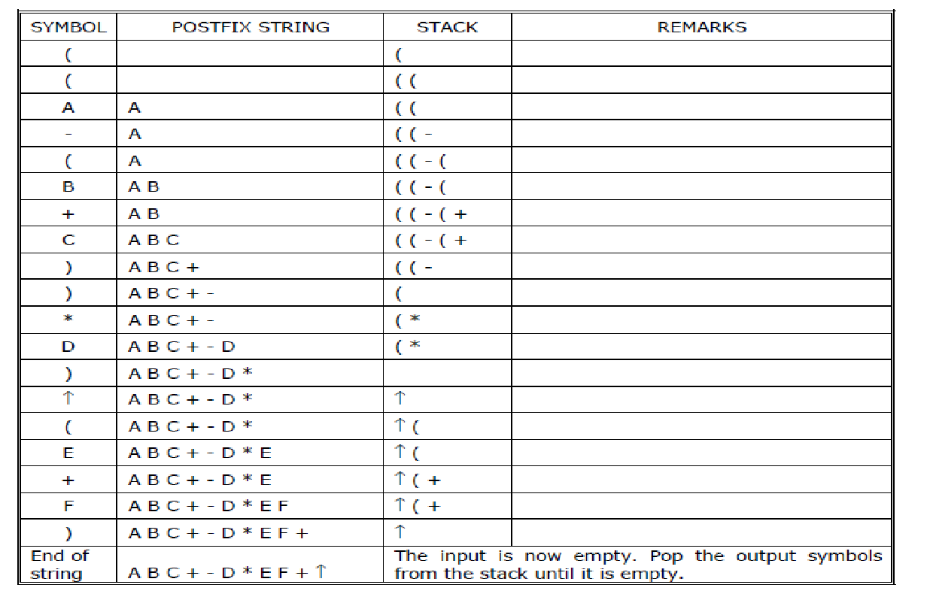
Example 1:
Convert ((A – (B + C)) * D) ↑ (E + F) infix expression to postfix form:
Dept. of AIML CSE(DS)

Slide 22
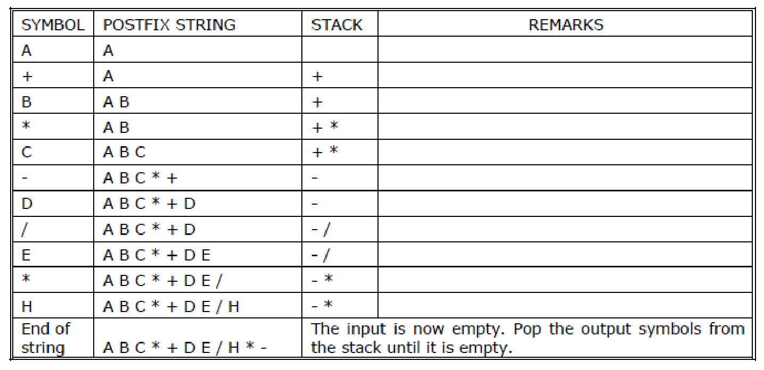
Example 2:
Convert the following infix expression A + B * C – D / E * H into its equivalent postfix
Expression
Dept. of AIML CSE(DS)

Slide 23
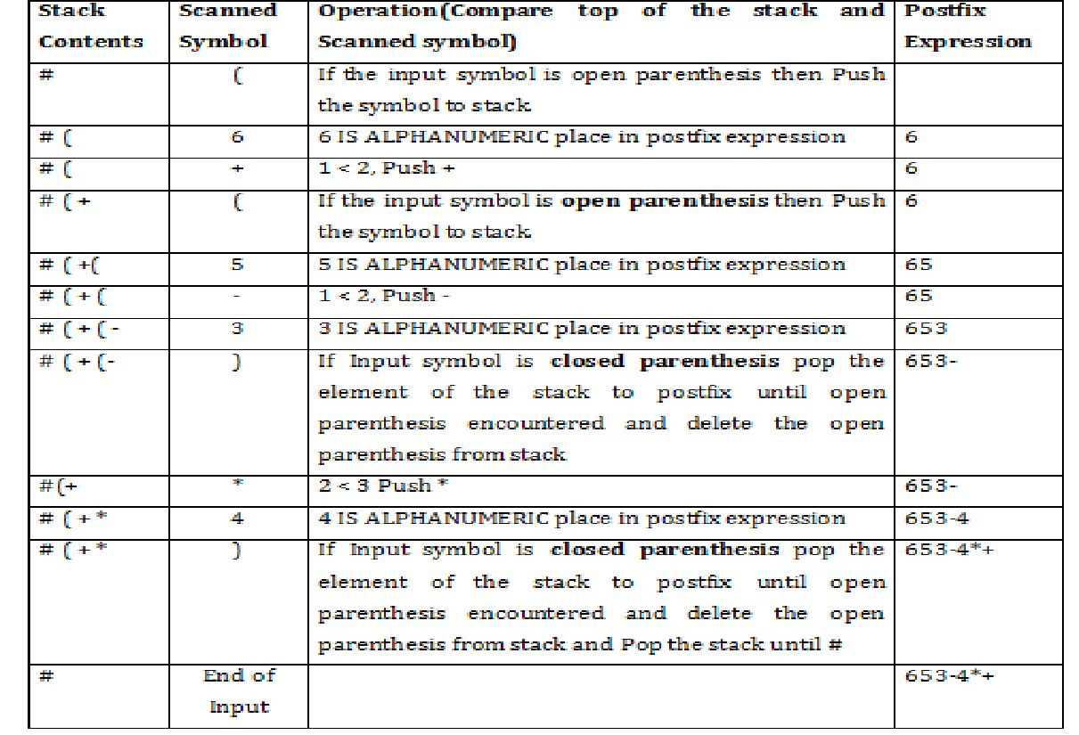
Convert the expression ( 6 + ( 5 – 3 ) * 4 ) to postfix
Dept. of AIML CSE(DS)

Slide 24
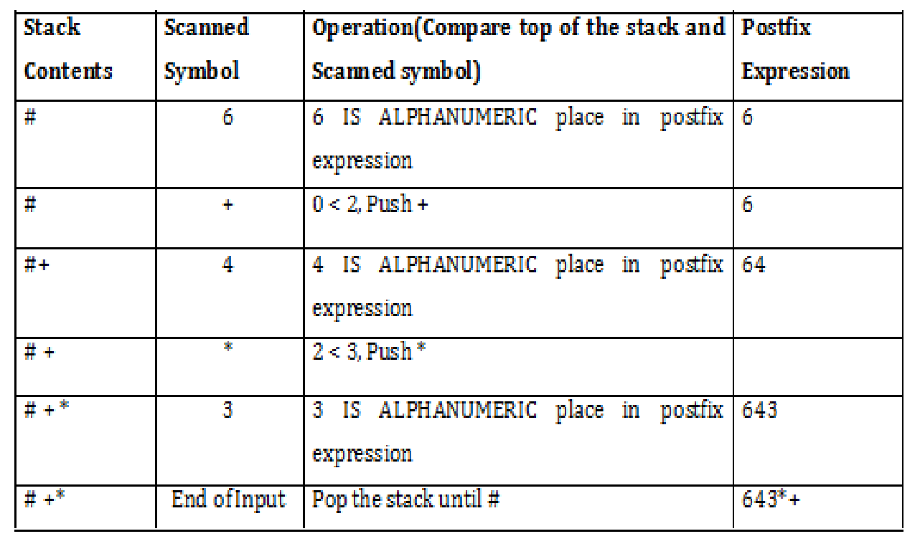
Convert the expression 6 + 4 * 3 to postfix
Dept. of AIML CSE(DS)

Slide 25
EVALUATION OF POSTFIX EXPRESSION
The evaluation of infix expression is not recommended because of the following reasons:
Evaluation of infix expression requires the knowledge of precedence of operators and the associativity of operators.
The problem becomes complex, if there are parantheses in the expression because they change the order of precedence.
During evaluation, we may have to scan from left to right and right to left repeatedly therby complexity of the program increases.
Dept. of AIML CSE(DS)

Slide 26
All these problems can be avoided if the infix expression is converted to its corresponding postfix or prefix expression and then evaluate.
Evaluation of a postfix expression or prefix expression is very simple.
Steps for evaluating postfix expression
1) Scan the symbol from left to right.
2) If the scanned-symbol is an operand, push it on to the stack.
3) If the scanned-symbol is an operator, pop 2 elements from the stack. The first popped element is operand2 and the second popped element is operand1.this can be achieved using the statements.And perform the indicated operation.
4) Push the result on to the stack.
5) Repeat the above procedure till the end of input is encountered
Dept. of AIML CSE(DS)

Slide 27
Pseudocode for Evaluation of Postfix Expression
While( not end of input)
{
Obtain the next input symbol
if(symbol is an operand)
push(symbol, top, s)
else
{
op2 = pop(top, s);
op1 = pop(top, s);
res = op1 op op2;
push(res, top, s);
}
}
return( pop(top, s));
Dept. of AIML CSE(DS)

Slide 28
Example: Consider the postfix expression 6 3 2 – 5 * + for the infix expression ( 6 + ( 3 – 2 ) * 5 ). It is evaluated as shown below.
6 3 2 – 5 * + 3 – 2 = 1
6 1 5 * + 1 * 5 = 5
6 5 + 6 + 5 = 11
Dept. of AIML CSE(DS)

Slide 29
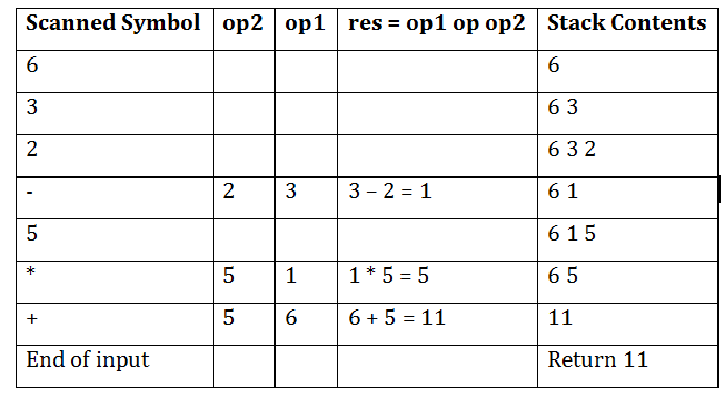
Example 1: Tracing the Evaluation of the postfix expression 6 3 2 – 5 * + is as shown below
Dept. of AIML CSE(DS)

Slide 30
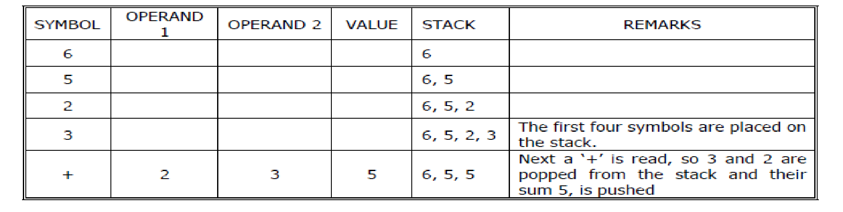
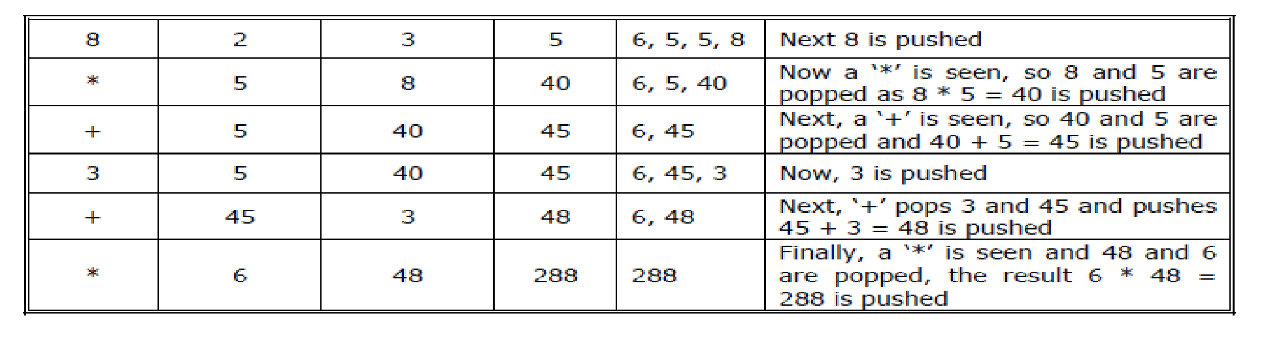
Example 2: Tracing the Evaluation of the postfix expression: 6 5 2 3 + 8 * + 3 + *
Dept. of AIML CSE(DS)

Slide 31
Evaluate the postfix expression 632-5*+1^7+
Result:18
Dept. of AIML CSE(DS)

Slide 32
1.POSTFIX TO INFIX
2.POSTFIX TO PREFIX
Scan the expression from L to R
top of the stack is always op2.
3.PREFIX TO INFIX
4.PREFIX TO POSTFIX
Scan the expression from R to L
top of the stack is always op1
Dept. of AIML CSE(DS)

Slide 33
STACK USING DYNAMIC ARRAYS
Shortcoming of static stack implementation: is the need to know at compile-time, a good bound (MAX_STACK_SIZE) on how large the stack will become.
This shortcoming can be overcome by using a dynamically allocated array for the elements & then increasing the size of the array as needed Initially, capacity=1 where capacity=maximum no. of stack-elements that may be stored in array.
Once the stack is full, realloc() function is used to increase the size of array. In array-doubling, we double array-capacity whenever it becomes necessary to increase the capacity of an array.
REFER NOTES FOR PROGRAMS
Dept. of AIML CSE(DS)

Slide 34
RECURSION
Recursion is the process of repeating items in a self-similar way. In programming languages, if a program allows you to call a function inside the same function, then it is called a recursive call of the function.
void recursion()
{
recursion(); /* function calls itself */
}
void main()
{
recursion();
}
Dept. of AIML CSE(DS)

Slide 35
The C programming language supports recursion, i.e., a function to call itself. But while using recursion, programmers need to be careful to define an exit condition from the function; otherwise it will go into an infinite loop.
Recursive functions are very useful to solve many mathematical problems, such as calculating the factorial of a number, generating Fibonacci series, etc.
Dept. of AIML CSE(DS)

Slide 36
RECURSION PROPERTIES
A recursive function can go infinite like a loop. To avoid infinite running of recursive function, there are two properties that a recursive function must have −
Base criteria − There must be at least one base criteria or condition, such that,when this condition is met the function stops calling itself recursively.
Progressive approach − The recursive calls should progress in such a way thateach time a recursive call is made it comes closer to the base criteria.
Analysis of recursion-One may argue that why to use recursion as the same task can be done with iteration. The first reason is recursion makes a program more readable and because of today's enhance CPU systems, recursion is more efficient than iterations.
Dept. of AIML CSE(DS)

Slide 37
FACTORIAL NUMBER
The product of the positive integers from 1 to n, inclusive is called n factorial and is usually denoted by n!
n!=1*2*3*4*………*(n-2)*(n-1)*n.
Factorial function may be defined as
a. if n=0 then n!=1
b. if n>0, then n!=n*(n-1)!
Dept. of AIML CSE(DS)

Slide 38
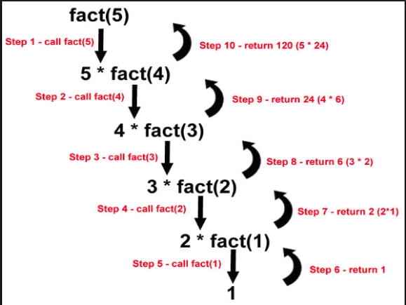
Dept. of AIML CSE(DS)

Slide 39
The following example calculates the factorial of a given number using a recursive function
#include <stdio.h>
int factorial(unsigned int n)
{
if(n <= 1)
{
return 1;
}
return n * factorial(n - 1);
}
void main()
{
int n = 15;
printf("Factorial of %d is %d\n", n, factorial(n));
}
When the above code is compiled and executed, it produces the following result −
Factorial of 15 is 2004310016
Dept. of AIML CSE(DS)

Slide 40
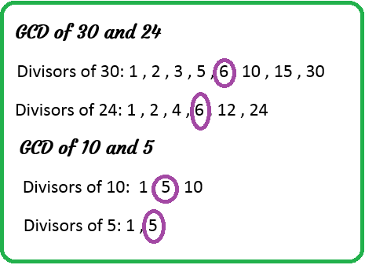
GCD OF TWO NUMBERS:-is the largest positive integer that divides the numbers without remainder.
Dept. of AIML CSE(DS)

Slide 41
The recursive definition to compute GCD of two numbers M and N using EUCLID's algorithm can be written as shown below:
M IF N=0 Base case
GCD(M,N)=
GCD(N,M%N) OTHERWISE General Case
Dept. of AIML CSE(DS)

Slide 42
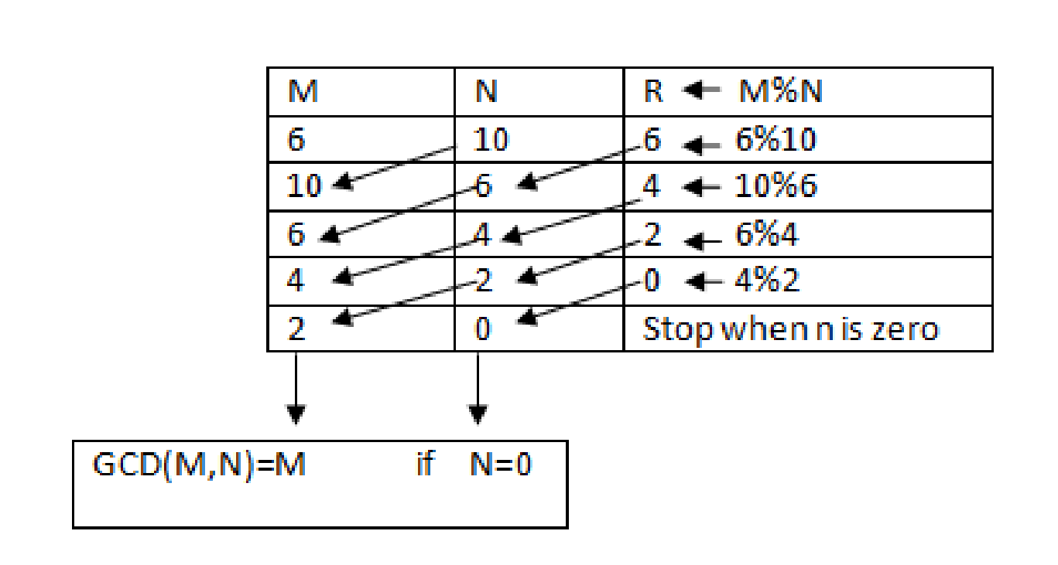
The procedure to obtain GCD(6,10) USING Euclid's algorithm is shown below
Dept. of AIML CSE(DS)

Slide 43
GCD is calculated by using GCD(a,b)=GCD(b,a mod b).
#include <stdio.h>
int gcd(int m, int n);
void main()
{
int n1, n2;
printf("Enter two positive integers: ");
scanf("%d %d", &n1, &n2);
printf("G.C.D of %d and %d is %d.", n1, n2, gcd(n1,n2));
}
int gcd(int m, int n)
{
if (n!=0)
return gcd(n, m%n);
else
return m;
}
Output
Enter two positive integers:
12 16
G.C.D of 12 and 16 is 4
Dept. of AIML CSE(DS)

Slide 44
FIBONACCI SERIES
The Fibonacci sequence is the sequence of integers, where each number in this sequence is the sum of two preceding elements.
A formal definition is
a.If n=0 or 1,then F(n)=n
b.If n>1,then F(n)=F(n-1)+F(n-2)
Dept. of AIML CSE(DS)

Slide 45
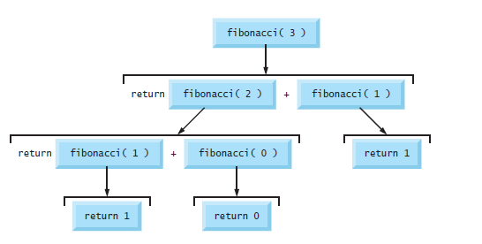
Dept. of AIML CSE(DS)

Slide 46
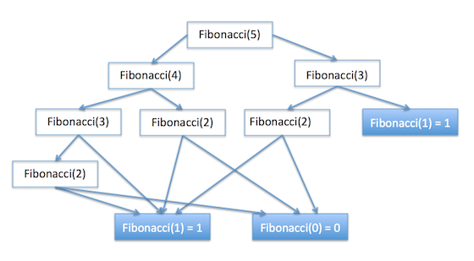
Dept. of AIML CSE(DS)

Slide 47
#include <stdio.h>
int fib(int i)
{
if(i == 0)
{
return 0;
}
if(i == 1)
{
return 1;
}
return fib(i-1) + fib(i-2);
}
void main()
{
int i;
for (i = 0; i < 10; i++)
{
printf("%d\t", fib(i));
}
}
When the above code is compiled and executed, it produces the following result −
0 1 1 2 3 5 8 13 21 34
Dept. of AIML CSE(DS)

Slide 48
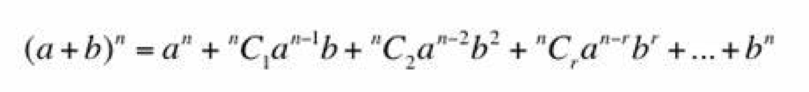
Binomial Co-efficient
A Binomial formula is given below:-
Here ^{n}c₀,^{n}c₁,.......^{n}c_{n} are called binomial coefficients.
the two useful properties of binomial coefficients are:
C(n,k)= 1 if k=0 or n=k
C(n-1,k-1)+C(n-1,k)
Dept. of AIML CSE(DS)

Slide 49
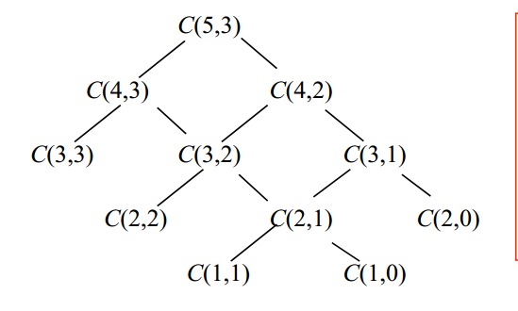
Dept. of AIML CSE(DS)

Slide 50
int C(int n,in k)
{
if(k==0||k==n)
return 1;
return C(n-1,k-1)+C(n-1,k);
}
void main()
{
int n,k,res;
printf(Enter N and K value\n”);
scanf(%d %d”,&n,&k); // 5 3
res=C(n,k); //res=10
printf(“%d C %d=%d\n”,n,k,res); //5C3=10
}
Dept. of AIML CSE(DS)

Slide 51
Ackermann's Function
The Ackermann's function is recursively defined as shown below:
N+1 if M=0 case 1
A(M,N)= A(M-1,1) if N=0 case 2
A(M-1,A(M,N-1)) OTHERWISE case 3
In the above recursive relation,case 1 is the base case and case 2 and case 3 are general cases.
Dept. of AIML CSE(DS)

Slide 52
Using Ackermann's function ,A(1,2) can be evaluated as shown below:
A(1,2) (case 3)A(M-1,A(M,N-1)) OTHERWISE
=A(0,A(1,1)) (case 3)A(M-1,A(M,N-1)) OTHERWISE
=A(0,A(0,A(1,0))) (case 2)A(M-1,1) if N=0
=A(0,A(0,A(0,1))) (case 1)N+1 if M=0
=A(0,A(0,2)) (case 1)N+1 if M=0
=A(0,3) (case 1)N+1 if M=0
=4
Dept. of AIML CSE(DS)

Slide 53
int A(int m,int n)
{
if(m==0) return n+1; //case 1
if(n==0) return A(m-1,1); //case 2
retrun A(m-1,A(m,n-1)); //case 3
}
void main()
{
int m,n,res;
printf(“Enter M and N\n”);
scanf(“%d %d”,&m,&n); // 1 2
res=A(m,n); //res=4
printf(“A(%d,%d)=%d\n”,m,n,res); //A(1,2)=4
}
Dept. of AIML CSE(DS)

Slide 54
Example Programs:
1. Sum of Natural Numbers using recursion
2.Sum of Array Elements using recursion
3.Print Array Elements using recursion
Dept. of AIML CSE(DS)

Slide 55
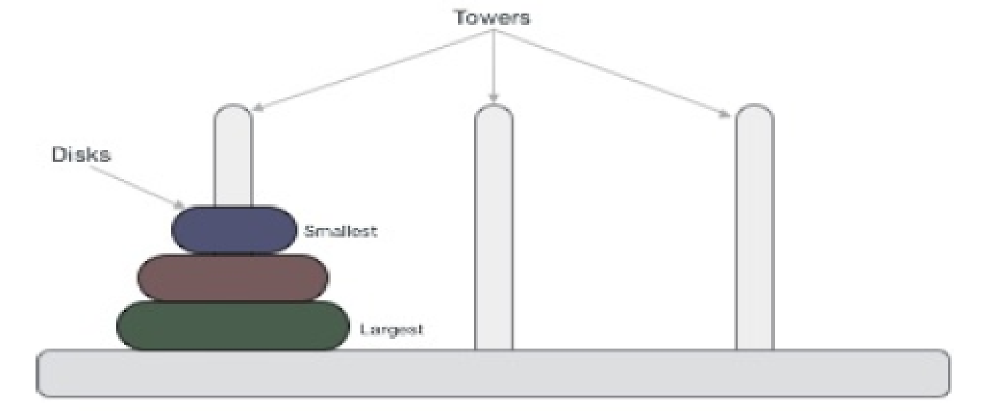
TOWER OF HANOI PROBLEM
Tower of Hanoi, is a mathematical puzzle which consists of three tower (pegs) and more than one rings; as depicted in below figure
These rings are of different sizes and stacked upon in ascending order i.e. the smaller one sits over the larger one. There are other variations of puzzle where the number of disks increase, but the tower count remains the same.
Dept. of AIML CSE(DS)

Slide 56
Rules: The mission is to move all the disks to some another tower without violating the sequence of arrangement. The below mentioned are few rules which are to be followed for tower of hanoi −
Only one disk can be moved among the towers at any given time.
Only the "top" disk can be removed.
No large disk can sit over a small disk.
For solving a tower of hanoi puzzle with three disks −Tower of hanoi puzzle with n disks can be solved in minimum 2^{n}−1 steps. This presentation shows that a puzzle with 3 disks has taken 2³−1 = 7 steps.
.
Dept. of AIML CSE(DS)

Slide 57
Algorithm
To write an algorithm for Tower of Hanoi, first we need to learn how to solve this problem with lesser amount of disks, say → 1 or 2. We mark three towers with name, source, destination and aux (only to help moving disks). If we have only one disk, then it can easily be moved from source to destination peg.
If we have 2 disks −
First we move the smaller one (top) disk to aux peg
Then we move the larger one (bottom) disk to destination peg
And finally, we move the smaller one from aux to destination peg.
Dept. of AIML CSE(DS)

Slide 58
So now we are in a position to design algorithm for Tower of Hanoi with more than two disks. We divide the stack of disks in two parts. The largest disk (nthdisk) is in one part and all other (n-1) disks are in second part. Our ultimate aim is to move disk n from source to destination and then put all other (n-1) disks onto it. Now we can imagine to apply the same in recursive way for all given set of disks.
So steps to follow are −
Step 1 − Move n-1 disks from source to aux
Step 2 − Move nth disk from source to dest
Step 3 − Move n-1 disks from aux to dest
Dept. of AIML CSE(DS)

Slide 59
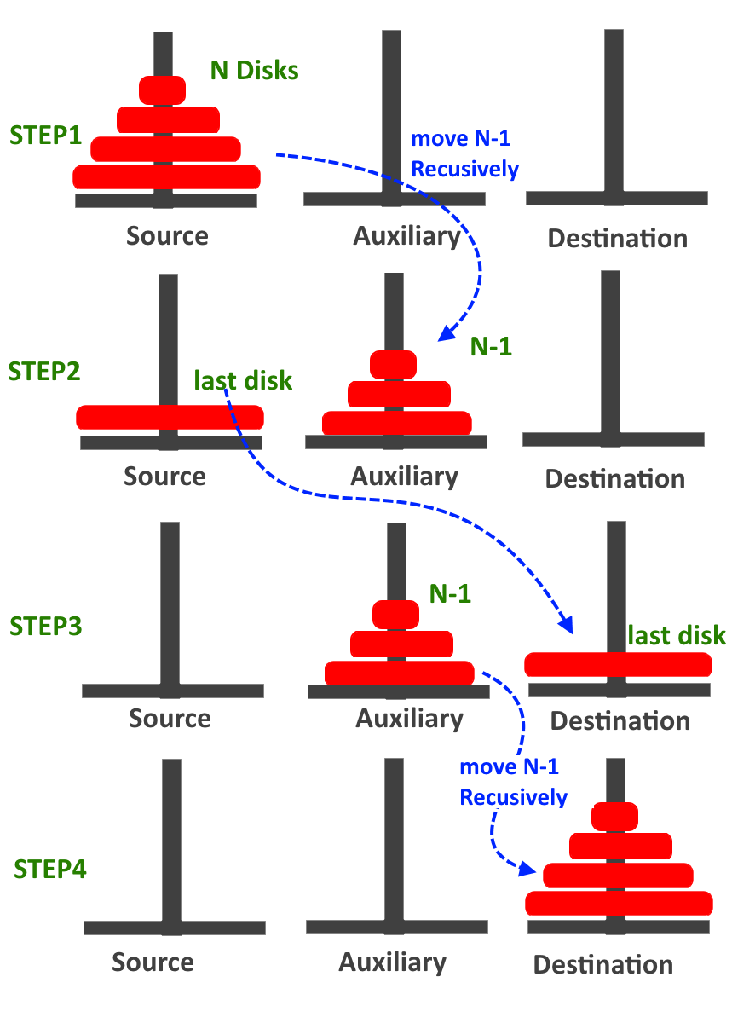
Dept. of AIML CSE(DS)

Slide 60
A recursive algorithm for Tower of Hanoi can be driven as follows −
START
Procedure Hanoi(disk, source, dest, aux)
IF disk == 0, THEN
move disk from source to dest
ELSE
Hanoi(disk - 1, source, aux, dest) // Step 1
move disk from source to dest // Step 2
Hanoi(disk - 1, aux, dest, source) // Step 3
END IF
END Procedure
STOP
Dept. of AIML CSE(DS)

Slide 61
PROGRAM:
#include<stdio.h>
#include<conio.h>
void tower(int n, char source, char temp,char destination)
{
if(n == 1)
return;
tower(n-1, source, destination, temp);
printf("\nMove disc %d from %c to %c", n, source, destination);
tower(n-1, temp, source, destination);
}
Dept. of AIML CSE(DS)

Slide 62
void main()
{
int n;
clrscr();
printf("\nEnter the number of discs: \n");
scanf("%d", &n);
tower(n, 'A', 'B', 'C');
printf("\n\nTotal Number of moves are: %d", (int)pow(2,n)-1);
getch();
}
Dept. of AIML CSE(DS)

Slide 63
SAMPLE OUTPUT:
Enter the number of discs:
3
Move disc 1 from A to C
Move disc 2 from A to B
Move disc 1 from C to B
Move disc 3 from A to C
Move disc 1 from B to A
Move disc 2 from B to C
Move disc 1 from A to C
Total Number of moves is: 7
Dept. of AIML CSE(DS)

Slide 64
QUEUES
Basic Operations:
A queue is basically a waiting line, for example, a line of customers in front of a counter in a bank or a ticket counter. Here,
Customers join the queue at the end of line (rear or tail).
Customer who is at the front gets the service and leaves the line (front or head).
This indicates that a customer gets service in FCFS (First Come First Serve) or FIFO (First In First Out) basis.
Dept. of AIML CSE(DS)

Slide 65
As a data structure, a queue is an ordered list of elements from which an element may be removed at one end called front of the queue, and into which an element may be inserted at the other end called the rear of the queue.
These restrictions ensure that data are processed through the queue in the order in which they are received. So a queue is also called FIFO data structure.
Dept. of AIML CSE(DS)

Slide 66
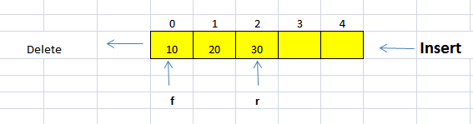
Pictorial representation of the queue is as shown below.
Dept. of AIML CSE(DS)

Slide 67
The various types of queues are
Ordinary queue
Double ended queue
Circular queue
Priority queue
Dept. of AIML CSE(DS)

Slide 68
Ordinary Queue or Linear Queue or Queue
This queue operates on a first come serve basis. Items will be inserted from one end and they are deleted at the other end in the same order in which they are inserted.
The various operations that can be performed on a ordinary queue are
1.Insert Rear – Here elements are inserted from rear end of the queue.
2.Delete Front – Here elements are deleted from the front end.
3.Display – Here contents of queue are displayed.
Dept. of AIML CSE(DS)

Slide 69
Observations
Initially when there are no elements f = 0 and r = -1
Whenever f > r there are no elements in the queue i.e. the queue is empty.
f = r means there is only one element in the queue.
Dept. of AIML CSE(DS)

Slide 70
Insert element into the Queue:
void insert_rear(int item, int r, int q[])
{
if(r = = queuesize-1)
{
printf("queue overflow\n");
return;
}
r = r + 1;
q[r] = item;
}
Dept. of AIML CSE(DS)

Slide 71
Delete element from the Queue:
void delete_front(int f, int r, int q[])
{
int item;
if(f > r)
{
printf("queue is empty\n");
return;
}
item = q[f];
printf("\nthe item deleted is %d",item);
f = f+1;
if(f > r)
{
f = 0;
r = -1;
}
}
Dept. of AIML CSE(DS)

Slide 72
Display contents of Queue:
void display(int f, int r, int q[])
{
int i;
if(f > r)
{
printf("queue is empty\n");
return;
}
printf("the contents of the queue are\n");
for(i=f; i<=r; i++)
{
printf("%d\n",q[i]);
}
}
Dept. of AIML CSE(DS)

Slide 73
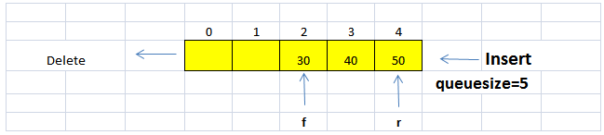
Disadvantages of ordinary queues
The disadvantage of ordinary queue is that once rear reaches (queuesize -1 ) it is not possible to insert any element into the queue even though the queue is not full. This situation is depicted in the following figure.
Dept. of AIML CSE(DS)

Slide 74
Even though there are 2 free locations, since the value of r has reached queuesize – 1, we will not be able to insert rear.
Solution 1: Shift data to previous locations such that the elements start from the beginning of the queue. This method proves to be costly in terms of computer time if the data being stored is very large.
Solution 2: Use circular queue to overcome this situation.
Dept. of AIML CSE(DS)

Slide 75
Circular Queue
As the name suggests, this queue is not straight but circular; meaning, the last element of the array is logically followed by the first element of the array (element with index 0). It has a structure as shown below.
Dept. of AIML CSE(DS)
q[3]
q[0]
q[2]
q[1]
// Initially r = -1 and f = 0

Slide 76
After inserting 4 elements and then deleting 2 elements we have the queue structure as shown below.
r
f
q[3]
40
10
q[0]
30
20
q[2]
q[1]
Dept. of AIML CSE(DS)

Slide 77
If we try to insert an element to the queue we follow 2 steps
Increment rear pointer.
Insert item to q[ ] pointed by rear.
Since this is a circular queue, once rear pointer reaches the end position the next one will be the first position. To attain this we use the statement r = ( r + 1 ) % queuesize.
EX: ( 3 + 1 ) % 4 = 4 % 4 = 0 (first position)
If this approach is used, to check for queue overflow and underflow, we use a variable called as ‘count’. Count contains the number of items or elements present in the queue at any instant. Therefore, count = 0 means the queue is empty and count = queuesize means the queue is full.
Dept. of AIML CSE(DS)

Slide 78
Note:
1.In a queue (circular or linear), if we want to insert we follow insert rear and if we want to delete we follow delete front.
2.When an item is inserted and if rear points to the last position, we can insert one more item if and only if the queue does not contain any item in the first position, otherwise it will be queue overflow state.
3.For a circular queue to
Insert we follow
r = ( r + 1 ) % queuesize
q[r] = item
count = count + 1
Delete we follow
item = q[f]
f = ( f + 1 ) % queuesize
count = count – 1
Dept. of AIML CSE(DS)

Slide 79
Queue empty and full we follow
count = 0 for queue is empty
count = queuesize for queue is full
Dept. of AIML CSE(DS)

Slide 80
void insert_rear(int item, int r, int count, int q[])
{
if(count = = queuesize)
{
printf("queue overflow\n");
return;
}
rear = (rear+1) % queuesize;
q[rear] = item;
count = count + 1;
}
Dept. of AIML CSE(DS)

Slide 81
void delete_front(int f, int count, int q[])
{
int item;
if(count = = 0)
{
printf("queue is empty\n");
return;
}
item = q[front];
printf("\nthe item deleted is %d",item);
front = (front+1) % queuesize;
count = count - 1;
}
Dept. of AIML CSE(DS)

Slide 82
void display(int f, int count, int q[])
{
int i;
if(count = = 0)
{
printf("queue is empty\n");
return;
}
printf("the contents of the queue are\n");
for(i=1,f=front;i<=count;i++)
{
printf("%d\n",q[f]);
f = (f+1) % queuesize;
}
}
Dept. of AIML CSE(DS)

Slide 83
Applications of Queues
One major application of queue is in simulation which is studied as queuing theory in operation research. The main objective of this simulation is to study the real life situation (problem) under the control of various parameters (waiting time, input flow rate, servicing time etc) which affects the queuing problem.
Queues are used in time sharing systems in which processes form a queue while waiting to be executed.
They are used in network communication systems.
They are used in operating system to handle i/o request, while waiting for a specific device to get the service.
Dept. of AIML CSE(DS)

Slide 84
Circular Queues using Dynamic Arrays (with the concept of array doubling)
The Disadvantage of using arrays to implement queue are shown below:
If arrays are used to implement queues,the maximum size of the queue(QUE_SIZE) should be known during compilation.
Once the Size of the queue is fixed during compilation ,it is not possible to alter the size of the queue during execution.
This disadvantage can overcome using dynamic arrays.
Dept. of AIML CSE(DS)

Slide 85
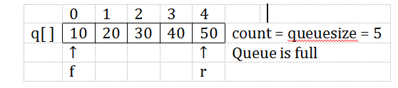
In this case just doubling the array size is not sufficient because as ordering of elements and re-initialization of front and rear pointers need to be done.
For example consider a circular queue with queue size 5, after inserting 5 elements the structure is as shown below.
Dept. of AIML CSE(DS)

Slide 86
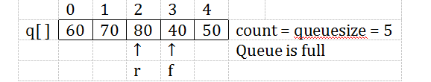
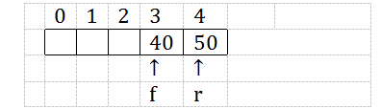
After deleting 3 elements we obtain the following structure,
Now insert 3 elements into the queue we get the following structure.
Dept. of AIML CSE(DS)

Slide 87
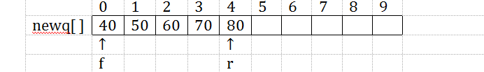
At this point, just doubling the array size is not sufficient, the elements need to be copied in correct order, and the front and rear pointers need be re-initialized appropriately.
Dept. of AIML CSE(DS)

Slide 88
Multiple Stacks
If we have to represent 2 stacks in a single array, then we can use
s[0] to represent the bottom element of stack 1 and s[stack_size] to represent the bottom element of stack 2.
top1 corresponding to stack 1 will be initialized to -1 and top2 corresponding to stack 2 will be initialized to stack_size-1.
stack 1 will grow towards stack_size -1
Dept. of AIML CSE(DS)

Slide 89
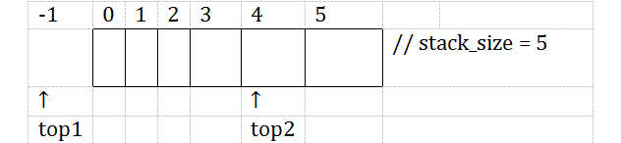
With this representation, we can efficiently use all the available space and the idea is as shown in the below figure.
Dept. of AIML CSE(DS)

Slide 90
Representing more than 2 stacks in a single array poses problems since we no longer have an obvious point for the bottom element of each stack. Two possible solutions for ‘n’ stacks in a single array are
Divide the array into ‘n’ segments based on the expected sizes of various stacks.
Divide the array into ‘n’ equal segments.
Dept. of AIML CSE(DS)

Slide 91
For dividing the array into ‘n’ equal segments the following pseudocode can be used.
#define stack_size 100 // memory size
#define max_stacks 10 // maximum number of stacks
int s[stack_size]; // stack array
int n; // number of stacks
int top[max_stacks]; // variable top for each of the ‘n’ stacks
int boundary[max_stacks]; // to check for boundary conditions
Dept. of AIML CSE(DS)

Slide 92
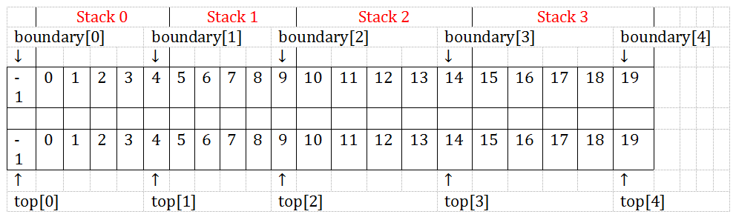
for(j = 0; j <= n; j + + )
{
top[j] = boundary[j] = stack_size / n * j – 1;
}
The diagrammatic representation of this is as shown below.
Dept. of AIML CSE(DS)

Slide 93
Dequeue: is a special type of data structure in which insertions are done from both ends and deletions are done at both ends.
The operations that can be performed on dequeue are:
Insert an item from front end
Insert an item from rear end
Delete an item from front end
Delete an item from rear end
Display the contents of queue
Dept. of AIML CSE(DS)

Slide 94
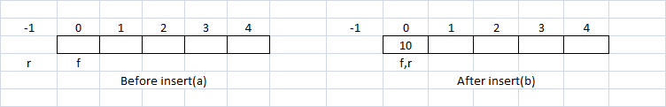
Insert at the front end:
case 1: Queue empty: When queue is empty ,an item can be inserted at the front end first by incrementing r by 1 and then insert an item.
The equivalent code for this can be written as shown below:
if(f==0&&r==-1)
{
q[++r]=item;
return;
}
Dept. of AIML CSE(DS)

Slide 95
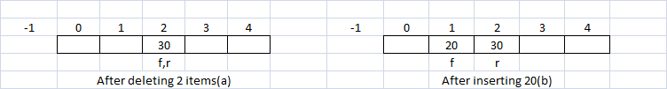
case 2: Some items are deleted: Consider the following situation where 10,20 and 30 were inserted earlier and 10 and 20 have been deleted from the front end.Now,there is only one item in queue.Here an item can be inserted by decrementing the front index f by 1 and then inserting an item at that position as shown below:
The equivalent code for this can be written as shown below:
if(f!=0)
{
q[--f]=item;
return;
}
Dept. of AIML CSE(DS)

Slide 96

case 3: Some items are inserted(not deleted):Consider the following situation where 10,20 and 30 were inserted into queue.
Now,Observe that, in the above situation it is not possible to insert an any item at the front end and we should display the appropriate message .
this is achieved using the following statement:
printf(“front insertion not possible\n”);
Dept. of AIML CSE(DS)

Slide 97
The complete C function to insert an item at the front end
void Insert_Front()
{
if(f==0&&r==-1)
{
q[++r]=item;
return;
}
if(f!=0)
{
q[--f]=item;
return;
}
printf(“front insertion not possible\n”);
}
Dept. of AIML CSE(DS)

Slide 98
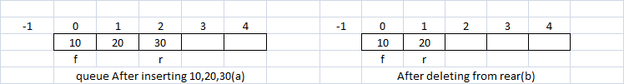
Delete from the Rear End:
Consider the following situation where 3 items are already inserted into queue and one item is deleted.
Dept. of AIML CSE(DS)

Slide 99
int Delete_Rear()
{
int item;
if(f>r) /*Queue is empty*/
return -1;
item=q[r--];
if(f>r) f=0,r=-1; /*Reset to initial state of empty queue*/
return item;
}
Dept. of AIML CSE(DS)

Slide 100
Priority Queue:
A queue in which we are able to insert items or remove items from any position based on some priority is often referred to as a priority queue.
Always an element with highest priority is processed before processing any of the lower priority elements.
If the elements in the queue are of same priority,then the element,which is inserted first into the queue ,is processed .
priority queues are used in job scheduling algorithms in the design of operating system where the jobs with highest priorities have to be processed first.
Dept. of AIML CSE(DS)

Slide 101
The priority queues are classified into two groups:
Ascending Priority queue:
In an ascending priority queue elements can be inserted in any order.but while deleting an element from queue ,only the smallest element is removed first.
Descending Priority queue:
In descending priority also elements can be inserted in any order.but while deleting an element from the queue,only the largest element is deleted first.
Dept. of AIML CSE(DS)

Slide 102
There are various methods of implementing priority queues using arrays.
Implentation is as follows:
Insert the items based on the priority.
Assume the item to be inserted itself denotes the priority.
so,the items with least value can be considered as the items with highest priority and items with highest value can be considered as the items with least priority.
To implement priority queue,we insert the elements into queue in such a way that they are always ordered in increasing order.
with this technique the highest priority elements are at the front end of the queue and lowest priority elements are at the rear end of the queue.
Dept. of AIML CSE(DS)

Slide 103
Hence,while deleting an item,always delete from the front end so that highest priority element is deleted first.
The function to insert an item at the appropriate place is shown below:
Note:To insert an element into appropriate place so that elements are arranged in ascending order,insertion sort technique is used.
Dept. of AIML CSE(DS)

Slide 104
void Insert_item(int item,int q[],int *r)
{
int j;
if(*r==queue_size-1)
{
printf("Q is full\n");
return;
}
j=*r;
while(j>=0&&item<q[j])
{
q[j+1]=q[j];
j--;
}
q[j+1]=item;
*r=*r+1;
}
Dept. of AIML CSE(DS)

Slide 105
Note:To implement priority queue,insert an item such that items are arranged in ascending order.But always delete an item from the front end.The functions delete_front() and display() remains unaltered.
Dept. of AIML CSE(DS)

Slide 106

Dept. of AIML CSE(DS)

