Slide 1


Dept of AIML

Slide 2


Overveiw
Acharya stands as a beacon of excellence in higher education, boasting a legacy of academic distinction since its establishment in 1990. We offer a transformative educational experience, fostering holistic development, nurturing innovation and providing world-class facilities to ensure an enriching journey for our students.
Dept of AIML

Slide 3

11 Institutions, Infinite Possibilities
We provide 100+ programs across 50 academic streams.
Dept of AIML

Slide 4
Lecture 1:
NOSQL Databases
Dept of AIML

Slide 5
Introduction to NoSQL
NoSQL can be defined as a database which is employed for managing the massive collection of unstructured data and when your data is not piled up in a tabular format or relations like that of relational databases.
NoSQL databases (aka "not only SQL") are non-tabular databases and store data differently than relational tables.
The term NoSQL came from the word non SQL or nonrelational. (“Not Only SQL” or “Not SQL)
NoSQL Database is a non-relational Data Management System, that does not require a fixed schema.
Dept of AIML

Slide 6
Introduction to NoSQL
It avoids joins, and is easy to scale.
The major purpose of using a NoSQL database is for distributed data stores with humongous data storage needs.
NoSQL is used for Big data and real-time web apps. For example, companies like Twitter, Facebook and Google collect terabytes of user data every single day.
Traditional RDBMS uses SQL syntax to store and retrieve data for further insights. Instead, a NoSQL database system encompasses a wide range of database technologies that can store structured, semi-structured, unstructured and polymorphic data.
Dept of AIML

Slide 7
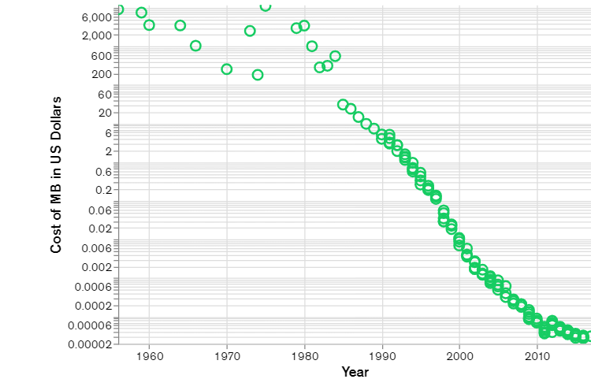
Brief history of NoSQL
NoSQL databases emerged in the late 2000s as the cost of storage dramatically decreased.
Figure: Cost Per MB of Data Over Time (Log Scale)
Dept of AIML

Slide 8
Brief history of NoSQL
As storage costs rapidly decreased, the amount of data that applications needed to store and query increased.
This data came in all shapes and sizes — structured, semi-structured, and polymorphic — and defining the schema in advance became nearly impossible.
NoSQL databases allow developers to store huge amounts of unstructured data, giving them a lot of flexibility.
Dept of AIML

Slide 9
Brief history of NoSQL
Additionally, the Agile Manifesto was rising in popularity, and software engineers were rethinking the way they developed software.
They were recognizing the need to rapidly adapt to changing requirements.
They needed the ability to iterate quickly and make changes throughout their software stack — all the way down to the database. NoSQL databases gave them this flexibility.
Dept of AIML

Slide 10
Brief history of NoSQL
Cloud computing also rose in popularity, and developers began using public clouds to host their applications and data.
They wanted the ability to distribute data across multiple servers and regions to make their applications resilient, to scale out instead of scale up, and to intelligently geo-place their data.
Some NoSQL databases like MongoDB provide these capabilities.
Dept of AIML

Slide 11
NoSQL Database Features
Each NoSQL database has its own unique features. At a high level, many NoSQL databases have the following features:
  Flexible schemas
  Horizontal scaling
  Fast queries due to the data model
  Ease of use for developers
Dept of AIML

Slide 12
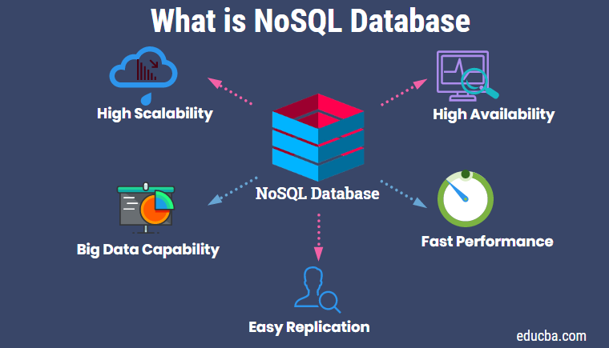
NoSQL Database Features
Dept of AIML

Slide 13
NoSQL Database Features
Flexible Schema
Unlike SQL databases, where you must determine and declare a table's schema before inserting data, MongoDB's collections, by default, do not require their documents to have the same schema.
That is:
  The documents in a single collection do not need to have the same set of fields and the data type for a field can differ across documents within a collection.
  To change the structure of the documents in a collection, such as add new fields, remove existing fields, or change the field values to a new type, update the documents to the new structure.
  This flexibility facilitates the mapping of documents to an entity or an object.
Dept of AIML

Slide 14
NoSQL Database Features
  Horizontal scaling
Horizontal scaling, also known as scale-out, refers to bringing on additional nodes to share the load.
This is difficult with relational databases due to the difficulty in spreading out related data across nodes.
With non-relational databases, this is made simpler since collections are self-contained and not coupled relationally.
Dept of AIML

Slide 15
Types of NoSQL Databases
Four major types of NoSQL databases emerged:
  document databases,
  key-value databases,
  wide-column stores, and
  graph databases.
Dept of AIML

Slide 16
Types of NoSQL Databases
Document databases store data in documents similar to JSON (JavaScript Object Notation) objects. Each document contains pairs of fields and values. The values can typically be a variety of types including things like strings, numbers, booleans, arrays, or objects.
Key-value databases are a simpler type of database where each item contains keys and values.
Wide-column stores store data in tables, rows, and dynamic columns.
Graph databases store data in nodes and edges. Nodes typically store information about people, places, and things, while edges store information about the relationships between the nodes.
Dept of AIML

Slide 17
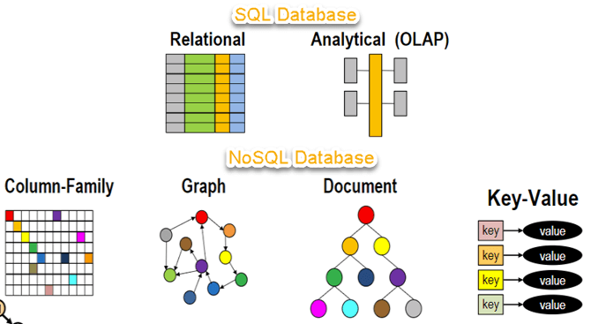
Types of NoSQL Databases
Dept of AIML

Slide 18
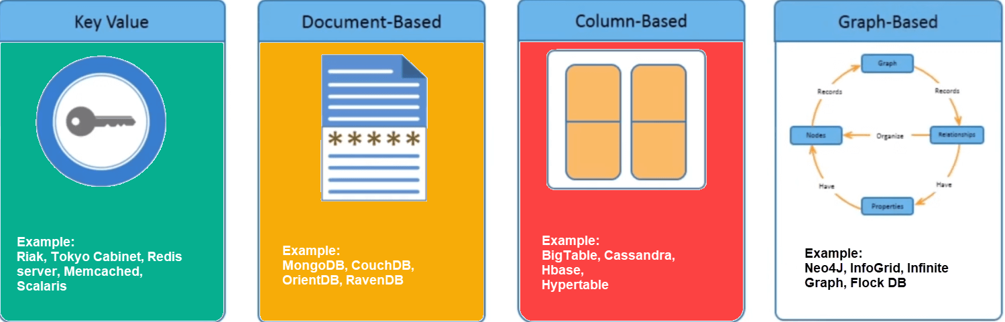
Types of NoSQL Databases
Dept of AIML

Slide 19
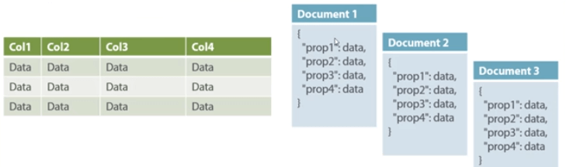
Document Oriented
Document-Oriented NoSQL DB stores and retrieves data as a key value pair but the value part is stored as a document.
The document is stored in JSON or XML formats. The value is understood by the DB and can be queried.
Relational Vs. Document
Dept of AIML

Slide 20
Document Oriented
The document type is mostly used for CMS systems, blogging platforms, real-time analytics & e-commerce applications.
Amazon SimpleDB, CouchDB, MongoDB, Riak, Lotus Notes, MongoDB, are popular Document originated DBMS systems.
Dept of AIML

Slide 21
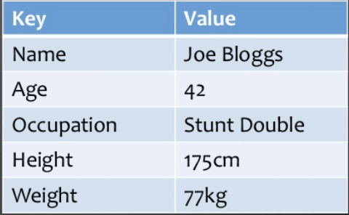
Key Value Pair Based
Data is stored in key/value pairs. It is designed in such a way to handle lots of data and heavy load.
Key-value pair storage databases store data as a hash table where each key is unique, and the value can be a JSON, BLOB(Binary Large Objects), string, etc.
Dept of AIML

Slide 22
Key Value Pair Based
Data is stored in key/value pairs. It is designed in such a way to handle lots of data and heavy load.
Key-value pair storage databases store data as a hash table where each key is unique, and the value can be a JSON, BLOB(Binary Large Objects), string, etc.
Dept of AIML

Slide 23
Key Value Pair Based
It is one of the most basic NoSQL database example.
They work best for shopping cart contents.
Redis, Dynamo, Riak are some NoSQL examples of key-value store DataBases. They are all based on Amazon’s Dynamo paper.
Dept of AIML

Slide 24
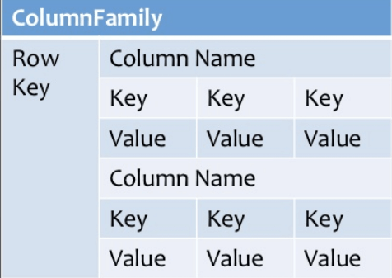
Column Based
Column-oriented databases work on columns and are based on BigTable paper by Google.
Every column is treated separately.
Values of single column databases are stored contiguously.
Dept of AIML

Slide 25
Column Based
Column-oriented databases work on columns and are based on BigTable paper by Google.
Every column is treated separately.
Values of single column databases are stored contiguously.
Dept of AIML

Slide 26
Column Based
They deliver high performance on aggregation queries like SUM, COUNT, AVG, MIN etc. as the data is readily available in a column.
Column-based NoSQL databases are widely used to manage data warehouses, business intelligence, CRM, Library card catalogs,
HBase, Cassandra, HBase, Hypertable are NoSQL query examples of column based database.
Dept of AIML

Slide 27
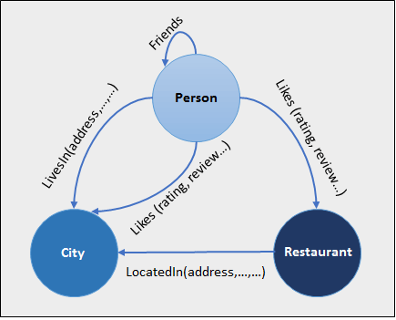
Graph Based
A graph type database stores entities as well the relations amongst those entities.
The entity is stored as a node with the relationship as edges. An edge gives a relationship between nodes.
Every node and edge has a unique identifier.
Dept of AIML

Slide 28
Graph Based
Compared to a relational database where tables are loosely connected, a Graph database is a multi-relational in nature.
Traversing relationship is fast as they are already captured into the DB, and there is no need to calculate them.
Graph base database mostly used for social networks, logistics, spatial data.
Neo4J, Infinite Graph, OrientDB, FlockDB are some popular graph-based databases.
Dept of AIML

Slide 29
Difference between RDBMS and NoSQL Databases
While a variety of differences exist between relational database management systems (RDBMS) and NoSQL databases, one of the key differences is the way the data is modeled in the database.
In this section, we'll work through an example of modeling the same data in a relational database and a NoSQL database.
Then, we'll highlight some of the other key differences between relational databases and NoSQL databases.
Dept of AIML

Slide 30
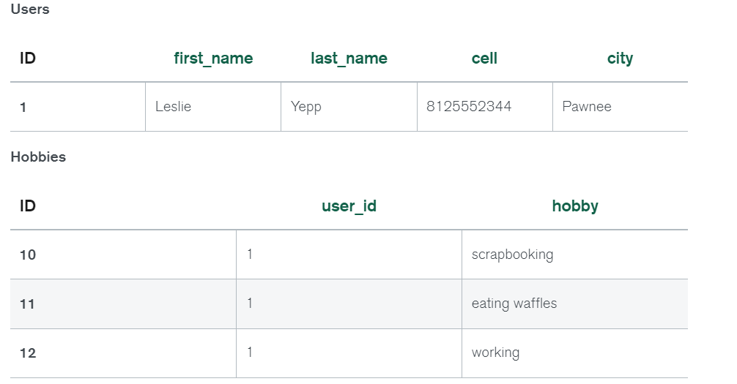
RDBMS vs NoSQL: Data Modelling Example
Let's consider an example of storing information about a user and their hobbies. We need to store a user's first name, last name, cell phone number, city, and hobbies.
In a relational database, we'd likely create two tables: one for Users and one for Hobbies.
In order to retrieve all of the information about a user and their hobbies, information from the Users table and Hobbies table will need to be joined together.
Dept of AIML

Slide 31
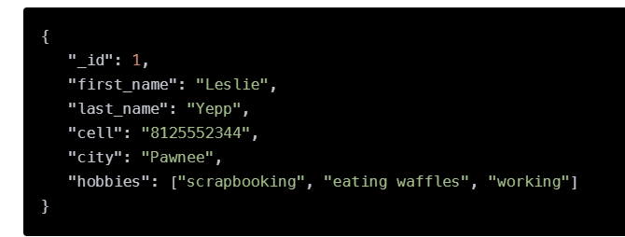
RDBMS vs NoSQL: Data Modelling Example
The data model we design for a NoSQL database will depend on the type of NoSQL database we choose.
Let's consider how to store the same information about a user and their hobbies in a document database like MongoDB.
In order to retrieve all of the information about a user and their hobbies, a single document can be retrieved from the database.
No joins are required, resulting in faster queries.
Dept of AIML

Slide 32
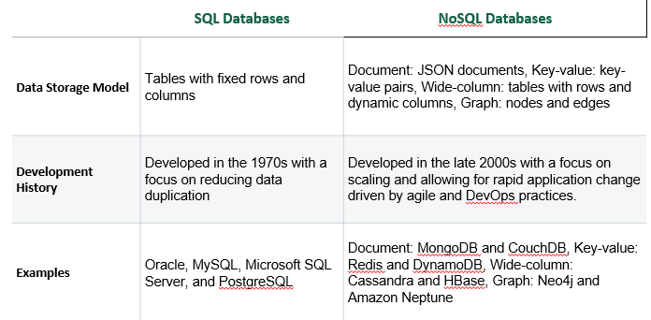
Differences between SQL and NoSQL
The table below summarizes the main differences between SQL and NoSQL databases.
Dept of AIML

Slide 33
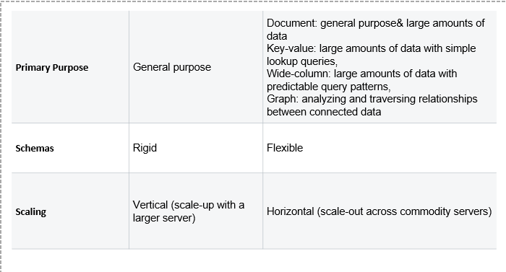
Differences between SQL and NoSQL
Dept of AIML

Slide 34
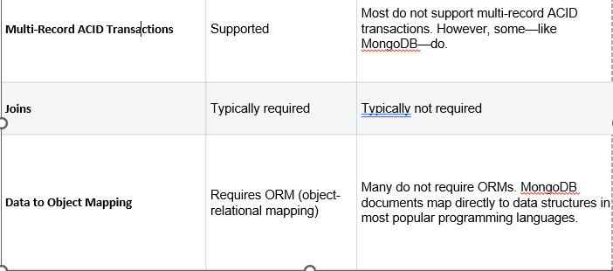
Differences between SQL and NoSQL
Dept of AIML

Slide 35
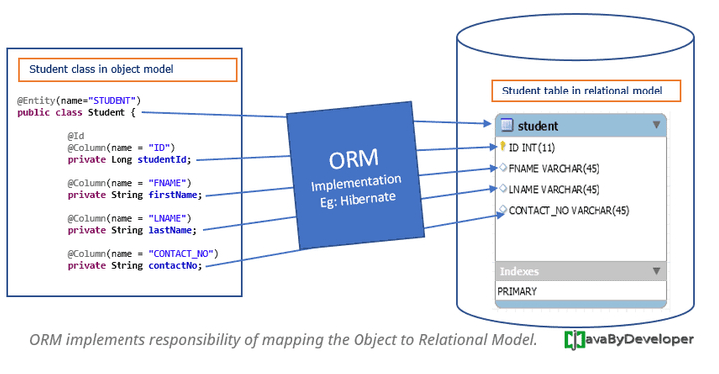
ORM
ORM or Object Relational Mapping is a system that implements the responsibility of mapping the Object to Relational Model.
That means it is responsible to store Object Model data into Relational Model and further read the data from Relational Model into Object Model.
Dept of AIML

Slide 36
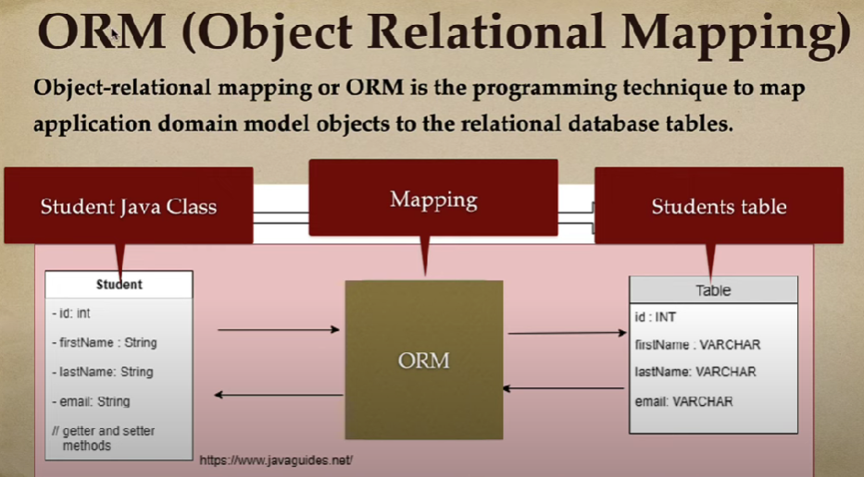
ORM
Dept of AIML

Slide 37
What are ACID Properties in Database Management Systems?
Most databases offer transactional guarantees for operations that impact a single record. However, not all databases support transactions that work across multiple records, which can be concerning to developers who are familiar to using them.
MongoDB's data model allows related data to be stored together in a single document.
We estimate that 80%-90% of applications that model their data in a way that leverages the document model will not require multi-document transactions. However, MongoDB supports multi-document ACID transactions for the use cases that require them.
Dept of AIML

Slide 38
What are ACID Properties in Database Management Systems?
Atomicity(all or nothing rule)
Entire transaction takes place at once or doesn’t happen at all.
Consistency
The database must be consistent before and after the transaction.
There is no midway i.e. transactions do not occur partially.
Transaction are treated as a single unit and either succeed or fail together.
It involves abort and commit transaction.
Consistency guarantees that changes made within a transaction are consistent with database constraints.
This includes all rules, constraints, and triggers.
If the data gets into an illegal state, the whole transaction fails.
Dept of AIML

Slide 39
What are ACID Properties in Database Management Systems?
Durability guarantees that once the transaction completes and changes are written to the database, they are persisted.
Durability
It ensures that multiple transactions can occur concurrently without leading to the inconsistency of the database state.
Isolation
Transactions occur independently without interference with each other
This ensures that data within the system will persist even in the case of system failures like crashes or power outages.
Dept of AIML

Slide 40
Horizontal Scaling
What is Scaling In MongoDB?
As your application grows, each piece of the application must scale along with the size of your user base and your data needs.
Historically, database scaling has been a major pain point for large applications or applications with above average throughput, and options have been either limited in number or costly to implement.
In contrast, MongoDB has a full range of scaling options available, and they are built into MongoDB Atlas, MongoDB’s database-as-a-service offering.
Let’s look at a few different ways MongoDB can scale.(Next slide)
Dept of AIML

Slide 41

Vertical vs Horizontal Scaling
Vertical scaling
Vertical scaling is the property to increase the capacity of a machine/system by adding more processing power.(like Increasing power, CPU, memory and other resources).
It refers to increasing the processing power of a single server or cluster.
Both relational and non-relational databases can scale up, but eventually, there will be a limit in terms of maximum processing power and throughput.
Dept of AIML

Slide 42

Vertical vs Horizontal Scaling
Horizontal Scaling
Horizontal scaling, also known as scale-out, refers to bringing on additional nodes to share the load.
This is difficult with relational databases due to the difficulty in spreading out related data across nodes.
With non-relational databases, this is made simpler since collections are self-contained and not coupled relationally.
Dept of AIML

Slide 43
Horizontal Scaling
This allows them to be distributed across nodes more simply, as queries do not have to “join” them together across nodes.
Scaling MongoDB horizontally is achieved through sharding (preferred) and replica sets.
Dept of AIML

Slide 44
Dept of AIML

