Slide 1
Abstraction Function
Understanding how internal data represents an abstract concept

Slide 2
Invariants
Invariant, quite literally, means something that does not change or vary.
In the context of computer programming, it can be seen as a set of assumptions a piece of code takes before it is able to perform any computation of importance. And if those assumptions aren’t actually true the result of the computation is meaningless, or more appropriately, it cannot be guaranteed that the result is correct.
An invariant is a condition that always holds true during the execution of a program (or for a data structure/class).
It stays unchanged no matter what operations you perform — as long as your program is correct.

Slide 3
example
string s = "Hello";
string t = s;
s = s + " World";

Slide 4
using System;
class Program
{
static void Main()
{
string s = "Hello";
string t = s;
s = s + " World";
Console.WriteLine("s = " + s); // Output: Hello World
Console.WriteLine("t = " + t); // Output: Hello
}
}

Slide 5
Types of Invariants
Class Invariant – a rule that must always be true for an object of a class.
Loop Invariant – a condition that remains true before and after every loop iteration.
Representation Invariant (Rep Invariant) – ensures that the internal state of an Abstract Data Type (ADT) is valid.

Slide 6
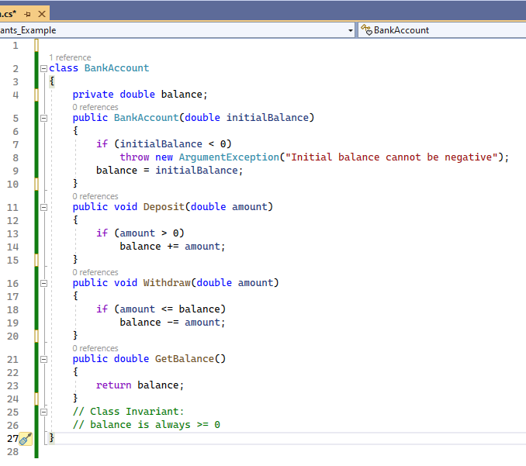
Class Invariants

Slide 7
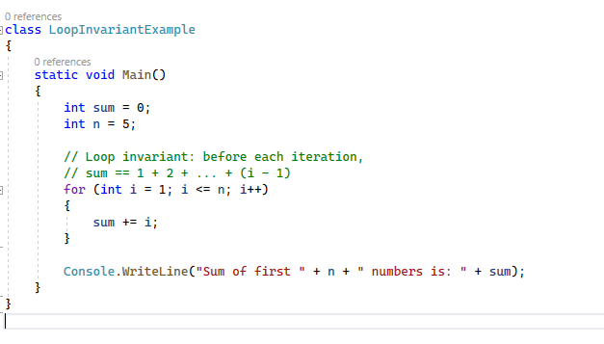
Loop Invariants

Slide 8
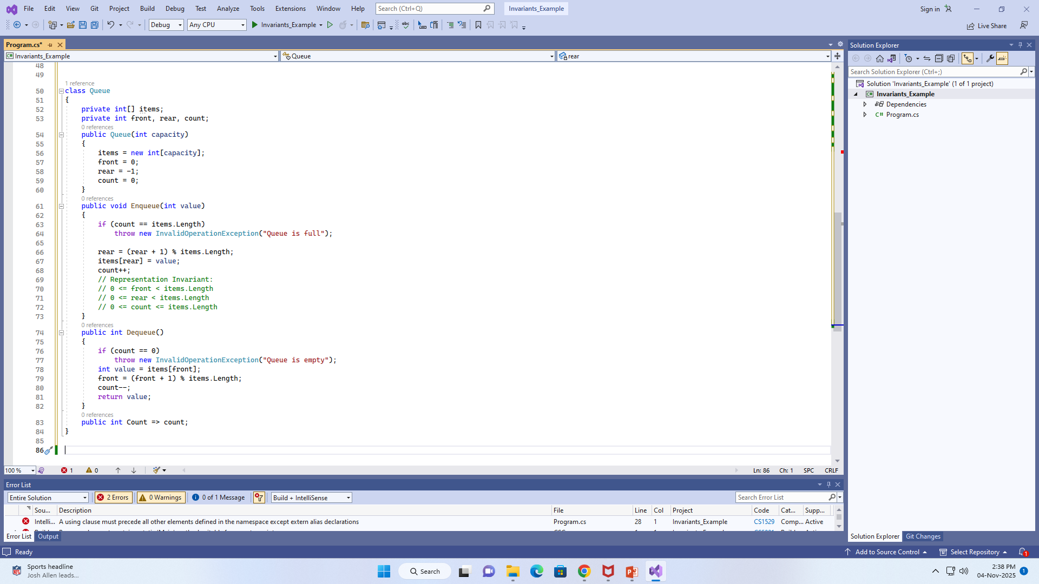
Rep Invariants

Slide 9
Summary
• Invariants help ensure program correctness.
• Class Invariants guarantee object validity.
• Loop Invariants help prove algorithm correctness.
• Representation Invariants maintain valid internal states in data structures.

Slide 10
What is an Abstraction Function?
• An abstraction function connects internal data (representation) to the abstract idea it represents.
• It answers: 'What does this data mean in the real world?'
• Helps us understand the logical meaning of data stored in our program.

Slide 11
Example in C#
Example: Stack class using List<int>
  class Stack {
  private List<int> elements = new List<int>();
  public void Push(int value) => elements.Add(value);
  public int Pop() {
  int top = elements[elements.Count - 1];
  elements.RemoveAt(elements.Count - 1);
  return top;
  }
  }
Abstraction Function: 'The list represents a stack whose top is the last element in the list.'

Slide 12
Why It’s Important
• Helps separate how data is stored from what it represents.
• Makes your program easier to understand and maintain.
• Ensures your implementation correctly represents the abstract idea.
• Used in Abstract Data Types (ADTs) to define their logical meaning.

Slide 13
In Simple Words
Representation → How data is stored (e.g., List, Array)
Abstraction Function → Explains what that data means logically
Example → List [1,2,3] = Stack with 3 on top
Abstraction Function connects the code to the concept!

Slide 14
Why It Matters
The Abstraction Function helps you:
Connect the implementation (how data is stored) with the concept (how users think about it).
Reason about correctness: does the code really represent what it’s supposed to?
Maintain or debug code: you can see where representation and concept might diverge.

Slide 15
Task
Rep Invariant for a Student Class
Class: Student(name, age, marks)
age must be between 5 and 100
marks must be 0–100
Task:
Write the rep invariant.
Write a constructor that enforces it.
Write a test that breaks it (e.g., negative marks).

