Slide 1

HACKATHON PITCH
CausalCare AI
Root-Cause Health Intelligence Engine
"Most AI predicts disease. CausalCare AI explains why — and shows you how to change it."
Predict
Explain
Simulate
ML-powered condition detection
Why your risk is elevated
What if you changed a habit?

Slide 2
THE PROBLEM
MOST
❓ No Explanation
Tools say 'You might have X' but never explain why your lifestyle makes it worse.
⚡ No Actionability
people who use symptom checkers
leave without knowing WHAT to do next.
Zero guidance on which habit to change first or what impact it would have.
🕐 No Prioritization
Users can't tell: should I just rest, or go to a doctor right now?
Result: Delayed action, confusion, and missed opportunities for prevention.

Slide 3
OUR SOLUTION
CausalCare AI is a smart health assistant that doesn't just predict — it explains and empowers.
🧠 Predict
🔍 Explain
Random Forest ML classifies likely conditions from your symptoms with confidence scoring.
Causal-style engine breaks down how smoking, sleep, and pollution each raise your risk.
🎛️ Simulate
🚨 Guide
'What if I quit smoking?' — see exact risk reduction before making a decision.
Clear urgency tiers: self-care, consult soon, or seek immediate attention.
Not just data output — behavior-focused, prevention-first guidance.

Slide 4
HOW IT WORKS
1
2
3
4
5
Input
Predict
Adjust
Simulate
Guide
Select symptoms
Set lifestyle factors
(smoking, sleep, pollution)
ML model identifies
likely condition +
base probability
Causal engine applies
lifestyle multipliers
to final risk score
What-if scenarios
show risk impact of
each habit change
Urgency level,
recommendations &
disclaimer shown
⚕️ This is early risk awareness — not a clinical diagnosis. Always consult a qualified healthcare provider.

Slide 5
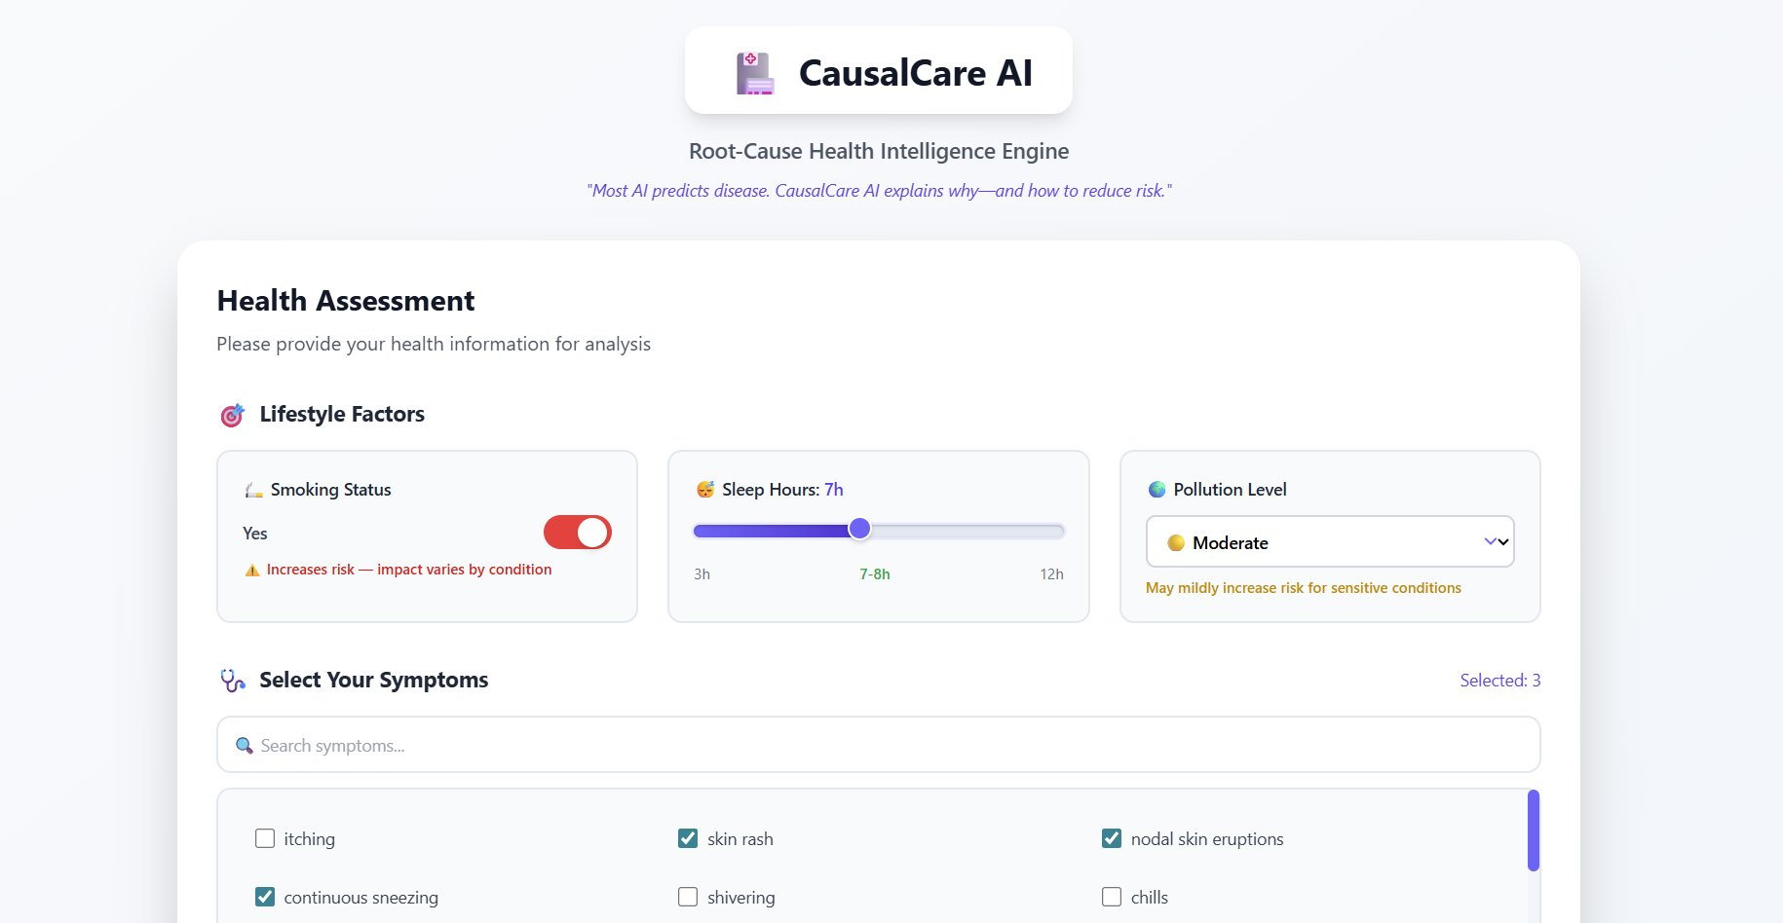
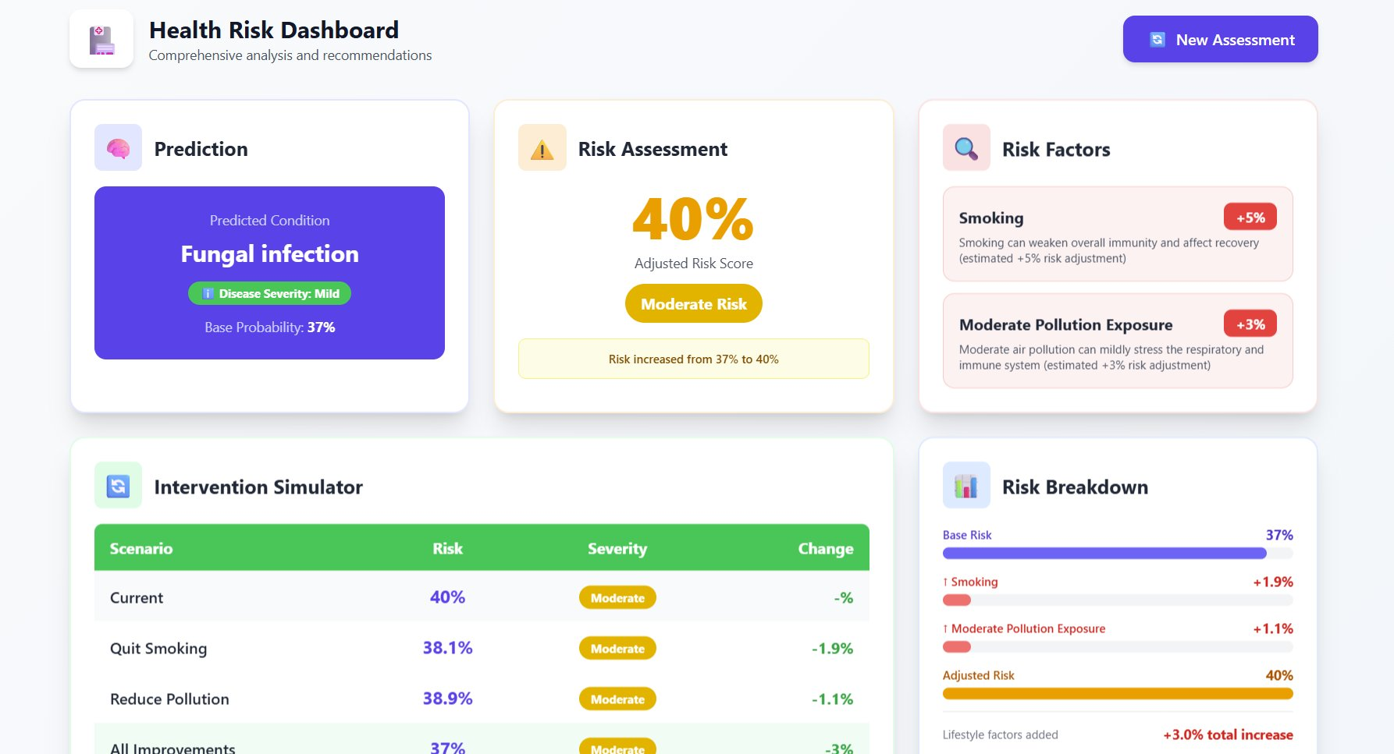
LIVE DEMO WALKTHROUGH
① Health Assessment
② Risk Dashboard + Simulator
Full working prototype: React frontend · FastAPI backend · ML model · SQLite persistence

Slide 6
BUSINESS PROSPECTS
🌍 Global digital health market: $659 billion by 2030 · Preventive care & explainable AI are fastest-growing segments
🏥 B2B SaaS
👤 B2C Freemium
🏢 Enterprise Wellness
→ Telehealth providers
→ Free risk checks
→ Employer health programs
→ Clinics & hospitals
→ Paid coaching plans
→ Insurance risk scoring
→ API / white-label dashboard
→ Premium symptom history
→ HR wellness platforms
PHASE 1: Pilot with telehealth partners · PHASE 2: API ecosystem + feedback loop · PHASE 3: Scale to wellness networks

Slide 7
SCALABILITY ROADMAP
NOW (Prototype)
SHORT-TERM
MID-TERM
LONG-TERM
▸ End-to-end working prototype
▸ Top-3 differential diagnoses
▸ Calibrated risk multipliers
▸ EHR + telehealth integration
▸ 3 lifestyle factors, 1 prediction
▸ Test suite + API validation
▸ SHAP-based feature attribution
▸ Regional population models
▸ SQLite persistence
▸ Auth + HTTPS security
▸ Clinician-in-the-loop mode
▸ Clinical validation studies
▸ Rule-based risk engine
▸ Fix training pipeline defects
▸ PostgreSQL + multi-user
▸ HIPAA / compliance controls
Architecture is modular — swap ML model, risk engine, or frontend independently.

Slide 8
RESPONSIBLE AI & SAFETY
✅ Not a Diagnosis Tool
⚠️ Urgency Communication
Every output includes a medical disclaimer. The app supports self-awareness, not clinical decisions.
Three clear tiers: self-care, consult soon, seek immediate attention. No ambiguity.
🔒 Privacy by Design
🏥 Clinician-First Philosophy
Current: no PII stored. Roadmap includes encryption at rest, strict CORS, and audit logs.
AI supports the consultation — never replaces it. Designed to increase healthcare engagement.
📊 Explainable by Default
🌍 Honest Limitations
Every risk score has a visible breakdown. No black-box outputs. Users always see why.
We openly state: heuristic multipliers, one-condition output, no clinical calibration yet.

Slide 9
IMPACT POTENTIAL
4.7B
40%
3×
People with no access to
preventive health screening
Of ER visits are potentially
avoidable with early awareness
Better treatment outcomes
with early-stage detection
For Users
For Healthcare
For Society
✓ Understand what is driving their risk
✓ Reduce avoidable ER overcrowding
✓ Earlier intervention = lower cost
✓ Make informed, confident decisions
✓ Better-prepared pre-consultation patients
✓ Empower low-resource communities
✓ Know exactly when to escalate care
✓ Scalable first-layer health triage
✓ Shift culture: reactive → preventive

Slide 10
Conclusion
"Every second, someone Googles their symptoms and gets a disease name — but no answer to the only question that matters: what do I do now?
CausalCare AI answers that question."
Predict:
ML classifier
Explain:
Causal risk engine
Simulate:
What-if scenarios
Guide:
Urgency tiers
Stack:
React · FastAPI · RF
Status:
Full working prototype
CausalCare AI — from prediction to prevention, one habit at a time.

