Slide 1
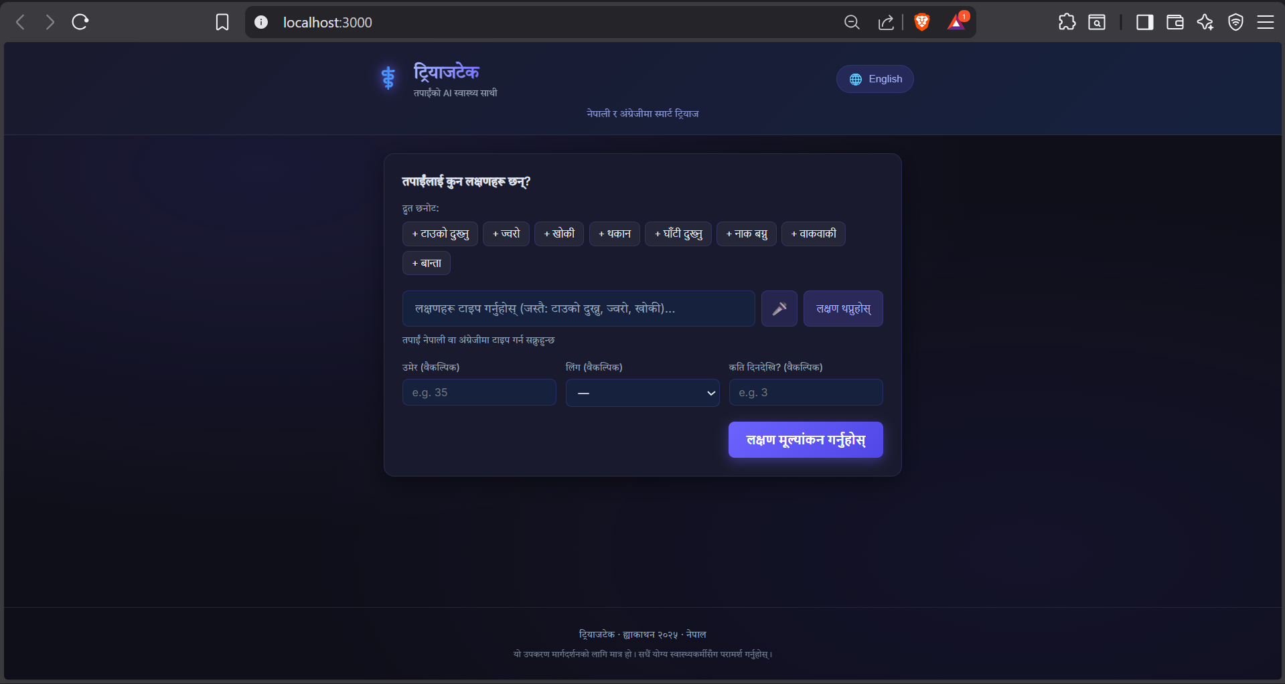
⚕
HACKATHON 2026 — HEALTHCARE TRACK
TriageTech
AI-Powered Symptom Checker
& Patient Triage System
Right patient. Right place. Right time.
Nepal's public hospitals are overwhelmed — no system tells people how sick they are before they arrive.

Slide 2
MEET THE TEAM
Slide 7 / 7
S
Sonam Acharya
Lead / Backend Engineer
FastAPI triage engine, Nepali NLP, clinic API
D
Dammaru Ballav Koirala
Frontend Developer
React PWA, bilingual UI, Leaflet maps
A
Akash Dhimal
AI / ML Lead
Rule engine design, bias audit, responsible AI
G
Aaska Ghimere
UX / Documentation
Architecture, clinical references, API spec
Built together for Nepal's patients — CareDevi Hackathon 2025
Built for CareDevi Innovation Lab · Hackathon 2025 · Healthcare Track

Slide 3
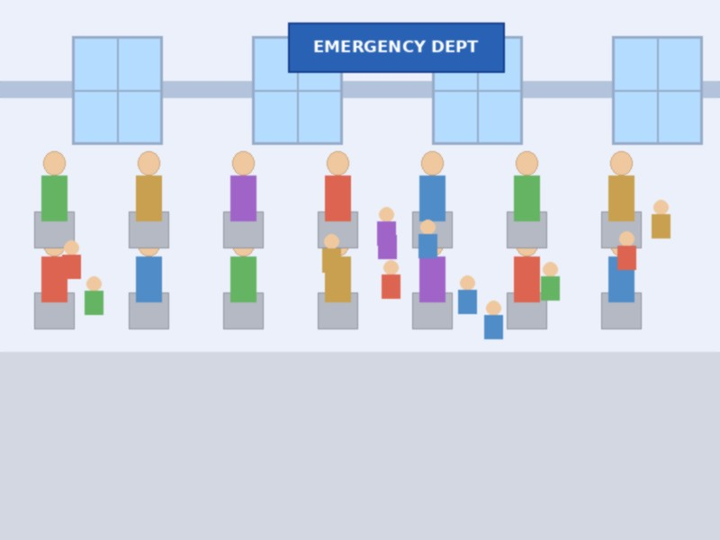
THE PROBLEM
Slide 2 / 6
3x
Nepal's hospitals are 3× over capacity
72%
Of ER visits are non-urgent cases
48 km
Average distance to hospital in rural Nepal
Without a triage system, mild cases clog the ER and serious cases wait too long.

Slide 4
OUR SOLUTION
Slide 3 / 6
🟢
🟡
🔴
HOW IT WORKS
1. Describe symptoms
(text or voice)
HOME REST
SEE DOCTOR
EMERGENCY
↓
2. NLP extracts
key signals
Mild symptoms.
Rest & monitor
at home.
Moderate symptoms.
Visit clinic within
24–48 hours.
Severe symptoms.
Go to hospital ER
immediately.
↓
3. Rule engine
scores severity
↓
4. Get instant
clear advice
One question. Three answers. Instant clarity.

Slide 5
TECHNICAL ARCHITECTURE
Slide 4 / 6
FRONTEND
BACKEND
DATA
React + Tailwind
FastAPI (Python)
Symptom KB
PWA (mobile-first)
NLP extractor
Nepal clinics GeoJSON
⟷
⟷
Voice input
Rule engine
WHO ICD-10 refs
EN / नेपाली
Clinic lookup
Bias audit logs
Tech Stack:
Python 3.11
FastAPI
spaCy NLP
React 18
Leaflet.js
PWA

Slide 6
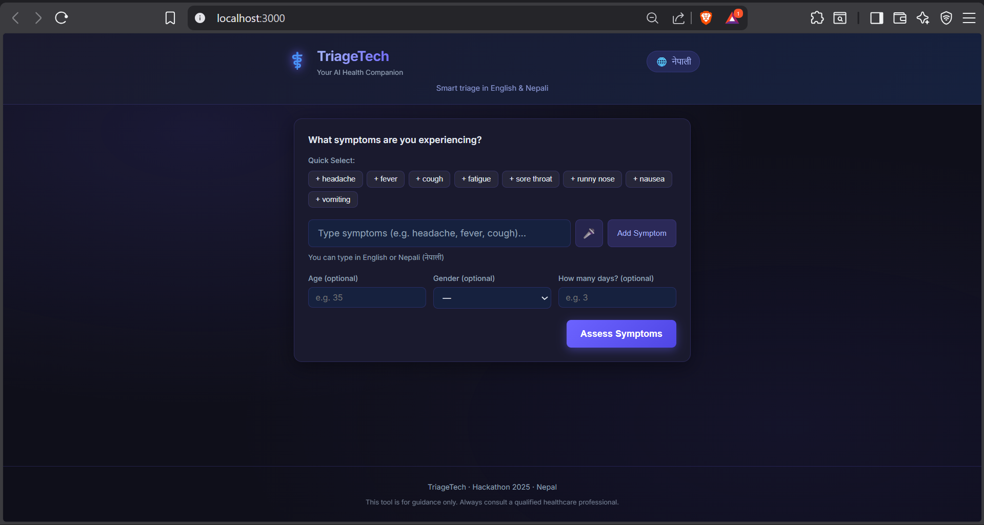
DEMO & REAL-WORLD IMPACT
Slide 5 / 6
USER JOURNEY
PROJECTED IMPACT
1
Patient describes symptoms in plain English (or Nepali)
60%
Reduction in
non-urgent ER visits
2
AI extracts signals & scores severity in < 1 second
< 1s
Triage decision
time
3
Three-level result shown with clear action steps
4
Nearest clinic map shown if doctor/ER needed
Works
Offline on
basic smartphones
Responsible AI: All outputs carry medical disclaimers. Bias audited across gender, age & rural/urban splits.

Slide 7

TriageTech
Right patient. Right place. Right time.
✅ Rule-based AI — explainable, fast, no black box
✅ Built for Nepal's PHC network
✅ Works offline on basic Android phones
✅ English today — Nepali next sprint
✅ Open source & auditable
Try the live demo → github.com/Acharya-Sonam/TriageTech

