Slide 1


Development of Hotel Management System
IUBAT– International University of Business Agriculture and Technology

Slide 2
Prepared by:
Supervisor:
MD. Mohiuddin Rakib
Id- 20103077
Student of
Department of Computer
Science and Engineering
Toyeer-E-Ferdous
Assistant Professor,
Department of Computer
Science and Engineering

Slide 3
Contents to be covered
Introduction of Organization
Project Overview
Process Model
Requirement Engineering
Analysis Modeling
Risk Management
System Planning
Demonstration
Limitation
Future Plan
Conclusion

Slide 4
About Organization

Slide 5

Organization
Name :
NEXTGEN INNOVATION LTD.
Address :
Flat: A1 (First floor),
House-17, Road-17/A,
Block-E, Banani Dhaka-1213

Slide 6
Organization Overview
prominent IT solution maker for Healthcare , Enterprise Mobile apps and web application.
Services :
• Software Development
• Web Design and Development
• Custom Software Development
• Mobile Application Development
• Enterprise Resource and Planning (ERP)
• E-commerce Solution
• IT Consultancy
• Off Shore Development
• Graphic Design

Slide 7
Project Overview

Slide 8
Introduction
What is donation portal ?
Why we use this system?
What is the beneficial side of this portal?

Slide 9
Objectives
Provide a desktop based system for hotel management.
Provide a room booking service.
Easy check in/check out service.
Provide a pickup service.

Slide 10
System Benefits
Desktop based application
Saves time and money
Provides easy solution
Faster and Full responsive
Easy Accessibility
Roles based authorization system

Slide 11
Process Model

Slide 12
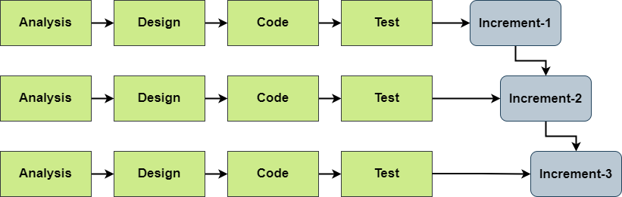
Incremental Process Model

Slide 13
Why Incremental Process Model ?
Major requirements must be defined.
Construct a partial implementation of a total system.
Then slowly add increased functionality.
The incremental model prioritizes requirements of the system and then implements them in group.
Errors are easy to be recognized
More flexible

Slide 14
Feasibility Study
Technical Feasibility
Java
Netbeans
MySQL
Economic Feasibility
Time Saving
Efficient cost
Operational Feasibility
Easy to operate
Easy to maintain

Slide 15
Requirement Engineering

Slide 16
Requirements
User Requirements.
System Requirements.
Functional Requirements.
Non-Functional Requirements.

Slide 17
User Requirements
Admin
Admin can login by admin username & password.
Admin can add employee.
Admin can add room.
Admin can add driver.
Admin can generate report.

Slide 18
User Requirements Cont...
Receptionist
Receptionist can login by username & password.
Receptionist can add customer.
Receptionist can provide pickup service .
Receptionist can update room status.
Receptionist can check out and check in.
Receptionist can view room update.

Slide 19
System Requirements
1. Admin can login by admin username & password.
1.1 There will a button in the navigation bar of the welcome page named “Login”.
1.2 A form for providing the user name and password will be a there.
1.3 There will be button at the bottom of the login form named “Login”.
2. Admin can add employee.
2.1 There will a button in the navigation bar of the welcome page named “Admin”.
2.2 In the “Admin” there will be submenu “Add Employee”.
2.3 A form will visible after click on Add Employee.
2.4 There will be two buttons Add and Cancel.

Slide 20
System Requirements Cont...
3. Admin can add driver.
3.1 In the “Admin” there will be submenu “Add Driver”.
3.2 A form will visible after click on Add Driver.
3.3 There will be two buttons Add and Cancel.
4. Admin can add room.
4.1 In the “Admin” there will be submenu “Add Room”.
4.2 A form will visible after click on Add Room.
4.3 There will be two buttons Add and Cancel.
5. Admin can generate report.
5.1 A report is generated by the system , admin can see that report.
5.2 Admin can search by the customer ID.

Slide 21
System Requirements Cont...
1. Receptionist can login by username & password.
1.1 There will a button in the navigation bar of the welcome page named ”Login”.
1.2 A form for providing the user name and password will be a there.
1.3 There will be button at the bottom of the login form named ”Login”.
2. Receptionist can add customer.
2.1 There will a button in the navigation bar of the welcome page named “Hotel Management”.
2.2 In that button there will be submenu “Reception”.
2.3 In the reception there will be a button “Add Customer”
2.4 A form will visible after click on Add Customer.
2.5 There will be two buttons Add and Cancel.
3. Receptionist can provide pickup service .
3.1 In the “Reception” there will be called “pickup service” .
3.2 In the “Pickup Service” all the driver data will be there.
3.3 Receptionist can search by car type.
3.4 Receptionist can also update the pickup service.

Slide 22
System Requirements Cont...
4. Receptionist can update room status.
4.1 Reception can view room status like in is clean or not .
4.2 Reception can also update room status
5. Receptionist can check out and check in.
5.1 Receptionist can confirm all the information.
5.2 Check in the customer and take deposited money.
5.3 Receptionist can also check out the customer.
6. Receptionist can view room update.
6.1 Receptionist can view room details.
6.2 Receptionist can view room status also.

Slide 23
Functional Requirements
Admin
Login
Admin Dashboard
Add Employee
Add Room
Add Driver
View Employee Info
View Customer Info
View Room Info
Generate Report
Logout
Receptionist
Login
Receptionist Dashboard
Add Customer
View Room Info
View Customer Info
Check Out
Update Room Status
Pickup Service
Logout

Slide 24
Nonfunctional Requirements
Security Requirements: Receptionist and Admin must be Authorized.
Reliability Requirements: The System should be consistent and should give the desired results.
Efficiency Requirements: The Software should be efficient enough to take less memory of the computer System.
Usability Requirements: The System should be easily usable by the Actors.

Slide 25
Analysis Modeling

Slide 26
Analysis Modeling
Use case diagram
Activity diagram
Entity relationship diagram
Data flow diagram

Slide 27
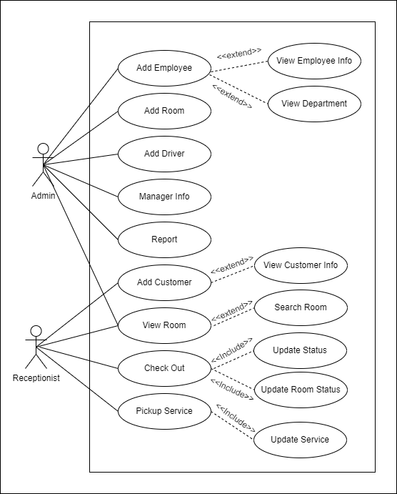
Use Case Diagram

Slide 28
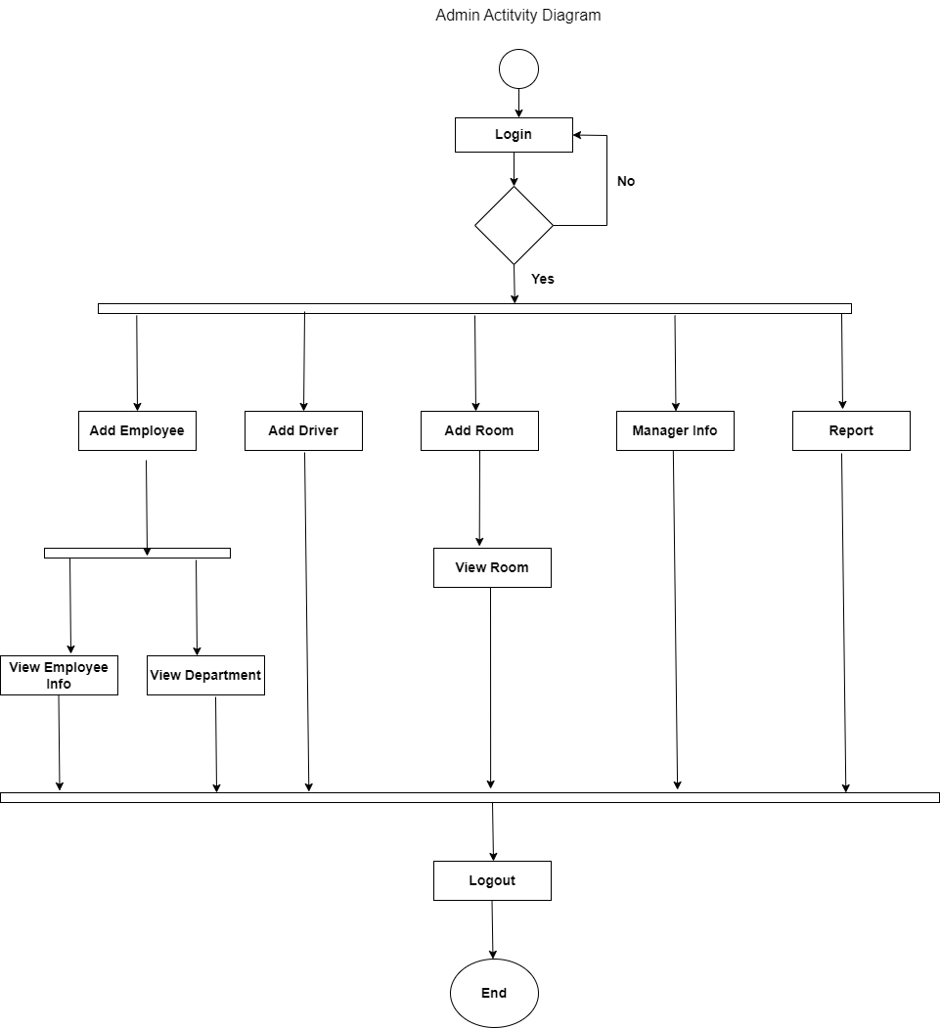
Activity Diagram of Admin

Slide 29
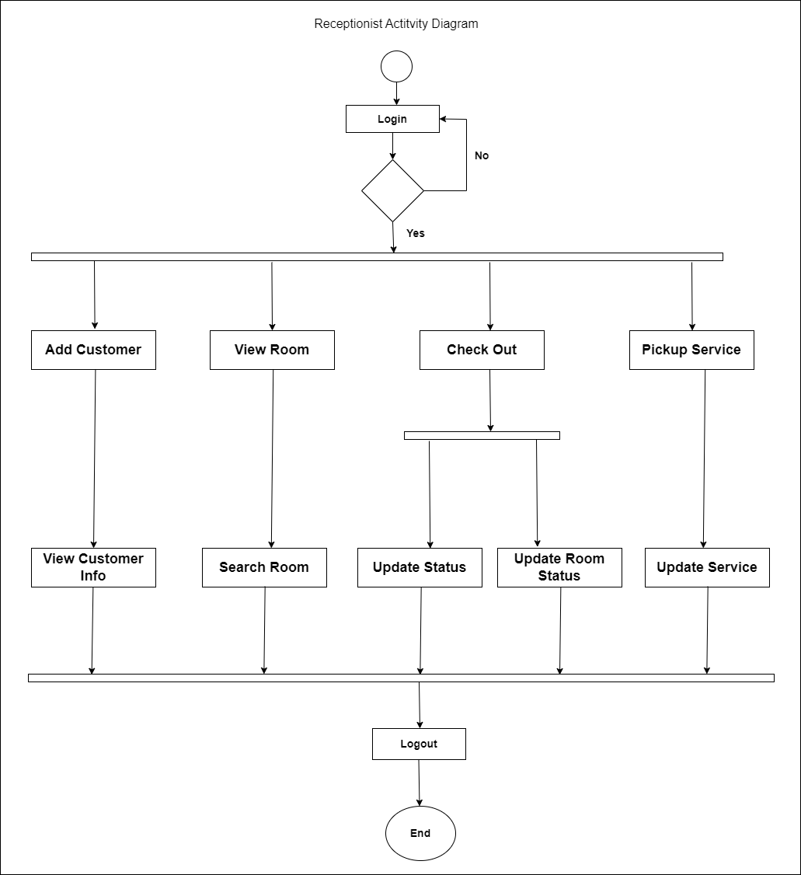
Activity Diagram of Receptionist

Slide 30
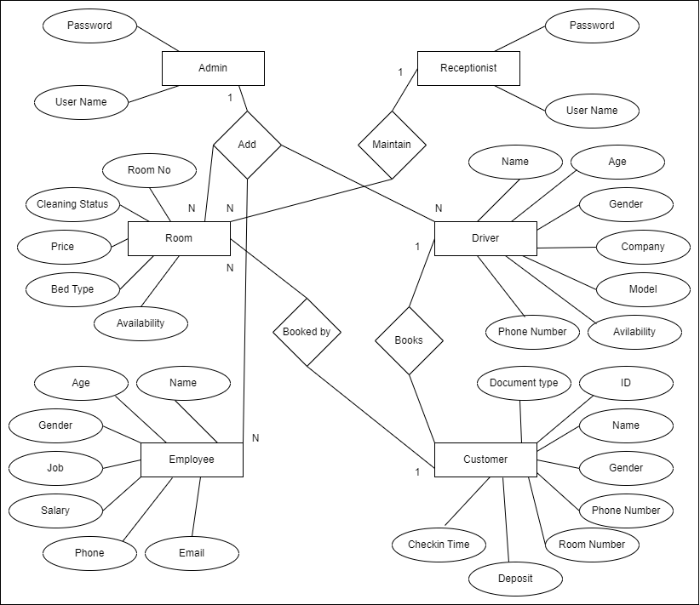
Entity Relationship Diagram

Slide 31
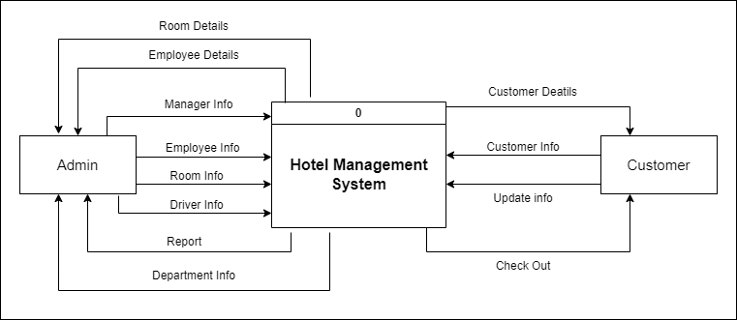
Data Flow Diagram (Level 0)

Slide 32
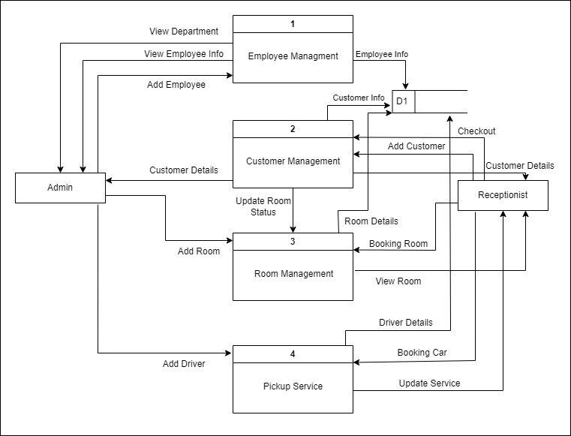
Data Flow Diagram (Level 1)

Slide 33
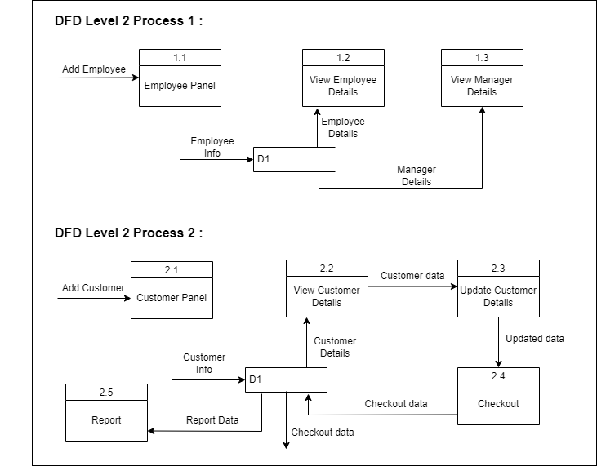
Data Flow Diagram (Level 2 Process 1 & 2)

Slide 34
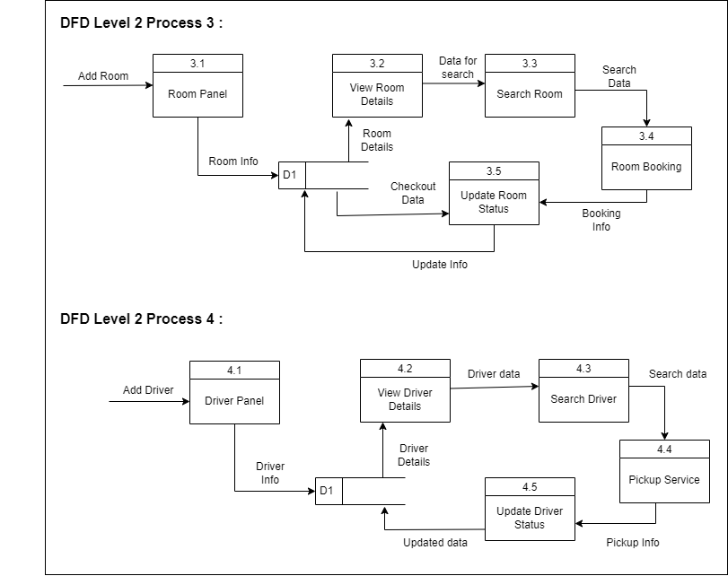
Data Flow Diagram (Level 2 Process 3 & 4)

Slide 35
Risk Management

Slide 36
The RMMM Plan
Risk Mitigation: Proactive planning for risk avoidance.
Risk Monitoring: Assessing whether predicted risks occur or not, ensuring preventive steps are being properly applied, collect information for future risk analysis, attempt to determine which risks caused which problem.
Risk Management: Actions to be taken in the event that mitigation steps have failed and the risk has become a live problem.

Slide 37
Project Risk
Project Risk
Name | Changes the requirements
Probability | Low
Impact | Marginal
Description | Customer may change their requirements
Mitigation & Monitoring | Requirements are redefined by the company due to time or business needs. Meeting will be held with the company regularly. This ensures that the product we are producing solves a problem.
Management | Emergency meeting between both parties to identify new project
Status | Not occur.

Slide 38
Technical Risk
Technical Risk
Name | Poor Training Skill in Team Members.
Probability | Moderate
Impact | Catastrophic
Description | Poor Training Skill in Team Members to Train the Client.
Mitigation & Monitoring | The training team should have a clear knowledge about the entire functionality of the software. System analyst need to ensure and monitor it while training session start.
Management | We should arrange a meeting with the train team and come to a point to solve this problem.
Status | We have not encountered such issue yet

Slide 39
Business Risk
Business Risk
Name | Insufficient Budget
Probability | Low
Impact | Marginal
Description | If the budget is low project may not complete.
Mitigation & Monitoring | We find several alternative streaming services to reduce the budget risk.
Management | A new plan for regulate the budget.
Status | Not encountered

Slide 40
System Planning

Slide 41
Cost Estimation
Personnel cost
Software cost
Hardware cost
Other cost
Total system Development Cost

Slide 42
Personal Cost

Slide 43
Hardware Cost

Slide 44
Software Cost

Slide 45
Others Cost

Slide 46
Total System Development Cost

Slide 47
Function Point Estimation

Slide 48
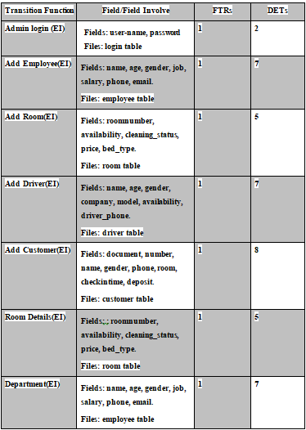
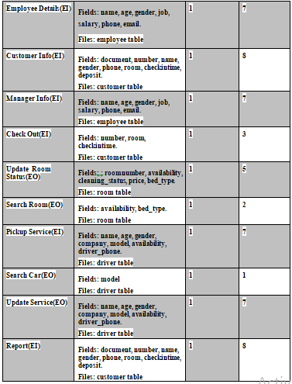

Slide 49
Identifying Complexity (Data Function)

Slide 50
Unadjusted Function Point Contributions (Transaction Function)

Slide 51
Unadjusted Function Point Contribution (Data Function)

Slide 52
Total Degree of Influence
General System Characteristics (GSC) | DI
Data Communications | 4
Distributed Data Processing | 2
Performance | 3
Heavily Used Configuration | 1
Transaction Rate | 1
Online Data Entry | 1
End User Efficiency | 3
Online Update | 1
Complex Processing | 1
Reusability | 3
Installation Ease | 2
Operational Ease | 1
Multiple Sites | 1
Facilitate Charge | 1
Total Degree of Influence (TDI) | 25

Slide 53
Final Calculation
Value Adjustment Factor (VAF) = (0.75+ (0.01*TDI))
= (0.75 + (0.01*25))
= 1
Total UFP = UFP (TF) + UFP (DF)
= 55 + 49 = 104
Adjusted Function Point (AFP) = Total UFP * VAF
= 104*1 = 104
Effort for Java = 104 * 10.6
= 1081.2 Person Hours
= 1081.2 / 8 Person Days (Working 8 Hours in a day)
= 135.2 Person Days
= 135.2 / 25 Man Months (25 working days in a month)
= 5.4 Man Months
Approximately 5.4 months required for 1 persons to finish the project.

Slide 54
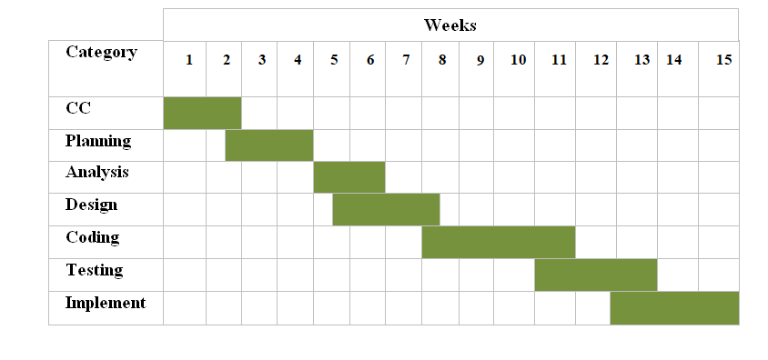
Project Scheduling Chart

Slide 55
System Testing

Slide 56
System Testing
Testing Scenario No:1
Scenario | Login testing scenario of our system
Input | Username and password of all users for login
Desired Output | When enter username, password then get access level define.
Actual Output’s | For login our system works properly.
Verdict | Getting result from desired outputs and actual outputs decided this system is successful for login.

Slide 57
System Testing Cont…
Testing Scenario No:2
Scenario | Employee Info insert testing scenario of the system
Input | Receptionist insert their details during registration
Desired Output | Show in the employee details
Actual Output’s | For employee details our system works properly.
Verdict | Our system is worked correctly and successfully.

Slide 58
Project Demonstration

Slide 59
Limitations
There is inventory management system.
In the pickup service location cannot be detected.
In the employee management there is no stuff task panel .
No way for mobile banking.
Reservation is not implemented.

Slide 60
Future Plan
Inventory management system will be implemented.
Stuff task panel will be created.
A password recovery system through email will be implemented.
Mobile Banking options will be implemented.
Reservation will be implemented.

Slide 61
Conclusion

Slide 62
Thank You!!!

