Slide 1
Git or Github

Slide 2
What is Git? Why do we need it?
Git is a version control system
Easily recover files.
Track of the file.
Who introduced an issue and when?
Can rollback to the previously working state.

Slide 3
History of Version Control System (VCS)
Local VCS: Database to keep track of the file. This is stored in local computer harddisk.
Pros: can track file & rollback.
Cons: If you lose your harddisk everything is lost.
Centralized VCS: Here there is one central server which can be used by many users. User can use it to push and pull to the server.
Distributed VCS: Here every user has backup of their project. If the server is damaged user can use backup file to recover their project.
So Git is a distributed Version control system.

Slide 4

Git three stage architecture

Slide 5
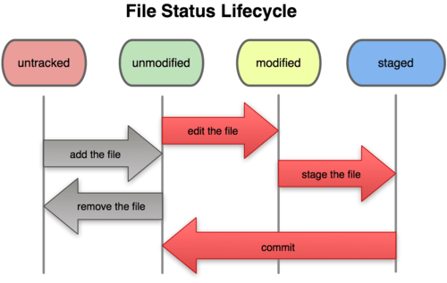
File status lifecycle

