Slide 1
Deadlocks
Course Code: CSC 2209
Course Title: Operating Systems
Dept. of Computer Science
Faculty of Science and Technology
Lecturer No: | 10 | Week No: | 10 | Semester:
Lecturer: | Name & email

Slide 2
Lecture Outline
System Model
Deadlock in Multithreaded Applications
Deadlock Characterization
Methods for Handling Deadlocks
Deadlock Prevention
Deadlock Avoidance
Deadlock Detection
Recovery from Deadlock

Slide 3
System Model
System consists of resources
Resource types R₁, R₂, . . ., R_{m}
CPU cycles, memory space, I/O devices
Each resource type R_{i} has W_{i} instances.
Each process utilizes a resource as follows (Sequence of use):
request (ask OS for a resource instance)
use (if granted)
Release (done with the instance)

Slide 4
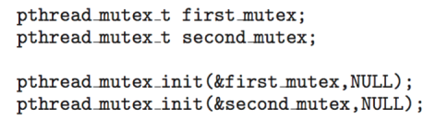
Deadlock in Multithreaded Application
Two mutex locks are created an initialized:

Slide 5
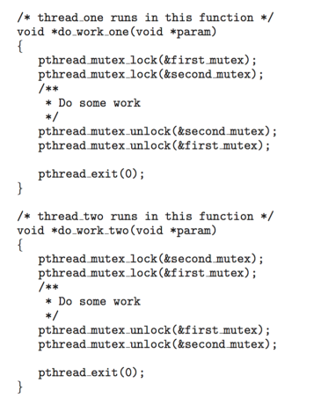
Deadlock in Multithreaded Application

Slide 6
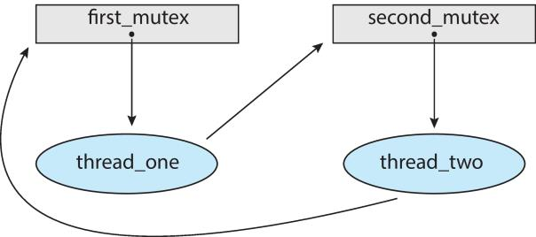
Deadlock in Multithreaded Application
Deadlock is possible if thread 1 acquires first_mutex and thread 2 acquires second_mutex. Thread 1 then waits for second_mutex and thread 2 waits for first_mutex.
Can be illustrated with a resource allocation graph (RAG):
Notes:
Resource = First mutex and second mutex
Process/Thread = Thread one and thread two
Thread one = Using first mutex and requesting second mutex
Thread two = Using second mutex and requesting first mutex

Slide 7
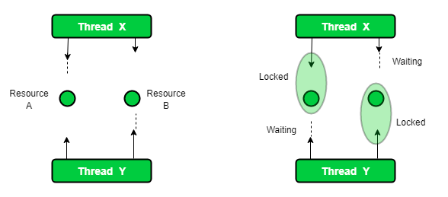
Deadlock in Multithreaded Application
Notes:
Now, both threads are in wait state, waiting for each other to release locks.
Now there is a race around condition that who will release the lock first.
As none of them is ready to release lock, so this is the DeadLock condition.
When we run this kind of program, it will be look like execution is paused.
(Figure and Text Curtesy: geeksforgeeks.org)

Slide 8
Deadlock Characterization
Deadlock can arise if four conditions hold simultaneously.
Mutual exclusion: only one process at a time can use a resource
Hold and wait: a process holding at least one resource is waiting to acquire additional resources held by other processes
No preemption: a resource can be released only voluntarily by the process holding it, after that process has completed its task
Circular wait: there exists a set {P₀, P₁, …, P_{n}} of waiting processes such that P₀ is waiting for a resource that is held by P₁, P₁ is waiting for a resource that is held by P₂, …, P_{n–1} is waiting for a resource that is held by P_{n}, and P_{n} is waiting for a resource that is held by P₀.

Slide 9
Resource-Allocation Graph (RAG)
A set of vertices V and a set of edges E.
V is partitioned into two types:
P = {P₁, P₂, …, P_{n}}, the set consisting of all the processes in the system
R = {R₁, R₂, …, R_{m}}, the set consisting of all resource types in the system
request edge (WANT TO USE) – directed edge P_{i} → R_{j}
assignment edge (USING) – directed edge R_{j} → P_{i}

Slide 10
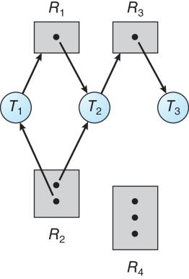
Resource Allocation Graph Example
One instance of R1
Two instances of R2
One instance of R3
Three instance of R4
T1 holds one instance of R2 and is waiting for an instance of R1
T2 holds one instance of R1, one instance of R2, and is waiting for an instance of R3
T3 is holds one instance of R3
Notes:
UPTO THIS SLIDE E SUMMER 21

Slide 11
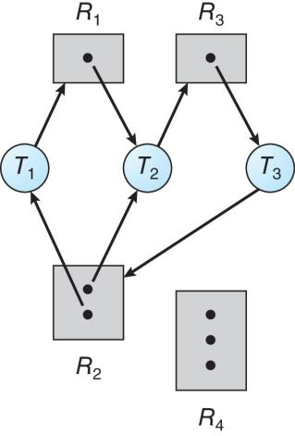
Resource Allocation Graph With A Deadlock
Notes:
T1 using R2 requesting R1
T2 using R2 R1 requesting R3
T3 using R3 requesting R2
So deadlock situation

Slide 12
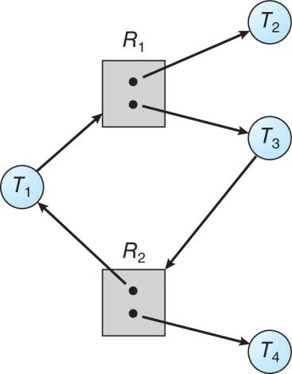
Graph With A Cycle But No Deadlock
Notes:
T2 is holding / using one instance of R1
T4 is holding / using one instance of R2
Are T2 and T4 requesting for any other resources? No.. So, both T2 and T4 can be removed/ finished their task
R1 and R2 each will gain one additional resource
T1 and T3 will get their desired resources..
No deadlock

Slide 13
Basic Facts
If graph contains no cycles ⇒ no deadlock
If graph contains a cycle ⇒
if only one instance per resource type, then deadlock
if several instances per resource type, possibility of deadlock

Slide 14
Methods for Handling Deadlocks
Ensure that the system will never enter a deadlock state:
Deadlock prevention
Deadlock avoidance
Allow the system to enter a deadlock state and then recover (Detection and recovery)
Ignore the problem and pretend that deadlocks never occur in the system. (ignorance)
Notes:
Ignorance (Ostrich Method).. Performance / Speed > Correctness (extra code).. Windows stuck but does not add extra code
Prevention
Avoidance
Detection and Recovery

Slide 15
Deadlock Prevention
Invalidate one of the four necessary conditions for deadlock:
Mutual Exclusion – not required for sharable resources (e.g., read-only files); must hold for non-sharable resources
Hold and Wait – must guarantee that whenever a process requests a resource, it does not hold any other resources
Require process to request and be allocated all its resources before it begins execution, or allow process to request resources only when the process has none allocated to it.
Low resource utilization; starvation possible
Notes:
OS E SECTION FROM HERE

Slide 16
Deadlock Prevention (cont’d)
No Preemption –
If a process that is holding some resources requests another resource that cannot be immediately allocated to it, then all resources currently being held are released
Preempted resources are added to the list of resources for which the process is waiting
Process will be restarted only when it can regain its old resources, as well as the new ones that it is requesting
Circular Wait – impose a total ordering of all resource types, and require that each process requests resources in an increasing order of enumeration

Slide 17
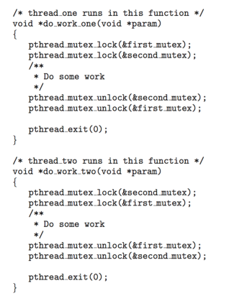
Circular Wait
Invalidating the circular wait condition is most common.
Simply assign each resource (i.e. mutex locks) a unique number.
Resources must be acquired in order.
If: first_mutex = 1 second_mutex = 5 code for thread_two could not be written as follows:
Notes:
Can not request a lower rank/numbered resource
OS B ..will start from here //not

Slide 18
Deadlock Avoidance
Requires that the system has some additional a priori information available
Simplest and most useful model requires that each process declare the maximum number of resources of each type that it may need
The deadlock-avoidance algorithm dynamically examines the resource-allocation state to ensure that there can never be a circular-wait condition
Resource-allocation state is defined by the number of available and allocated resources, and the maximum demands of the processes
Notes:
1. RAG scheme
2. Bankers Algo
OS E/D SUMMER 21 Starts from here (After EID VAC)

Slide 19
Basic Facts
If a system is in safe state ⇒ no deadlocks
If a system is in unsafe state ⇒ possibility of deadlock
Avoidance ⇒ ensure that a system will never enter an unsafe state.

Slide 20
Safe State
When a process requests an available resource, system/OS must decide if immediate allocation leaves the system in a safe state
System is in safe state if there exists a sequence <P₁, P₂, …, P_{n}> of ALL the processes in the systems such that for each P_{i}, the resources that P_{i} can still request can be satisfied by currently available resources + resources held by all the P_{j}, with j < I
That is:
If P_{i} resource needs are not immediately available, then P_{i} can wait until all P_{j} have finished
When P_{j} is finished, P_{i} can obtain needed resources, execute, return allocated resources, and terminate
When P_{i} terminates, P_{i +1} can obtain its needed resources, and so on

Slide 21
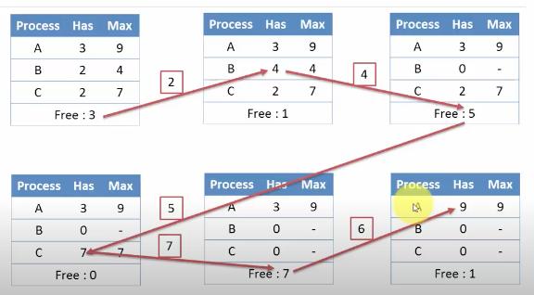
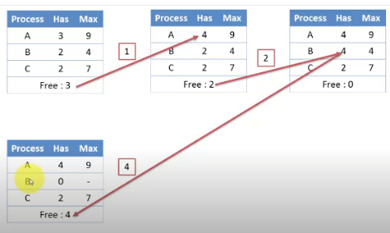
Safe & Unsafe State Cont. (Example)
Unsafe
Safe
Notes:
A,B,C process
Has-> resource already in use/using/holding
Max->Total number of resources required/needed to finish the whole task
Free-> Available resources / free
A---6…6=9… task done A terminated ..return all resources
B---2..2=4.. Task done B terminated.. Return all resources..
C---5…5=7..task done C terminated. Return all resources
Available-3-2=1+4=5-5=0+7=7-6=1+9=10
Safe Sequence= B->C->A
2nd Sequence=A->B->..wrong order.. system is in deadlock
They had to wait but ultimately all of them got their required resources.. So no deadlock happened ..each process were satisfied ..safe
Safe: A sequence (scheduling order) in which each process finish / run till end
Unsafe: Wrong sequence (scheduling order) in which some process stuck/ deadlock happen.
( Figure Source: Prof. Firoz Sherasiya at Computer Engineering Department of Darshan Institute of Engineering & Technology, Rajkot. )

Slide 22
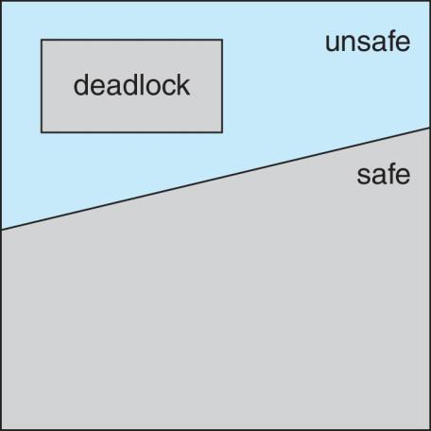
Safe, Unsafe, Deadlock State

Slide 23
Avoidance Algorithms
Single instance of a resource type
Use a resource-allocation graph
Multiple instances of a resource type
Use the Banker’s Algorithm
Notes:
Start E section

Slide 24
Resource-Allocation Graph Scheme
Claim edge P_{i} → R_{j} indicated that process P_{j} may request resource R_{j}; represented by a dashed line
Claim edge converts to request edge when a process requests a resource
Request edge converted to an assignment edge when the resource is allocated to the process
When a resource is released by a process, assignment edge reconverts to a claim edge
Resources must be claimed a priori in the system

Slide 25
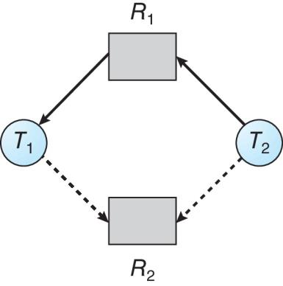
Resource-Allocation Graph

Slide 26
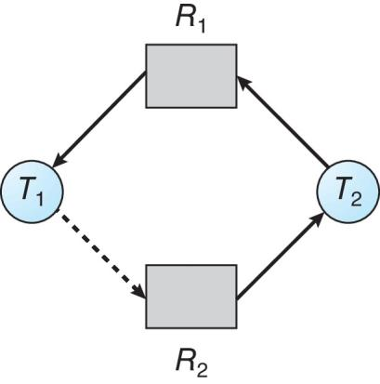
Unsafe State In Resource-Allocation Graph

Slide 27
Resource-Allocation Graph Algorithm
Suppose that process P_{i} requests a resource R_{j}
The request can be granted only if converting the request edge to an assignment edge does not result in the formation of a cycle in the resource allocation graph
Notes:
If Claim edge to request edge does not create a cycle then all the requests can be granted

Slide 28
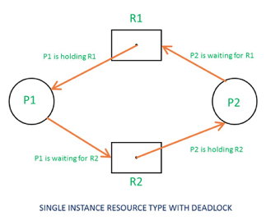
Resource-Allocation Graph Algorithm (Example- Single Instance)
Process | Allocate/Hold | Request
 | R1 ----------- R2 | R1 ------------- R2
P1 | 1---------------0 | 0------------------1
P2 | 0---------------1 | 1------------------0
 | R1 ----------- R2
Check Availability | 0-----------------0
P1(0,1) | Can not satisfy
P2(1,0) | Can not satisfy
No available resource so deadlock
Notes:
Check Request of each process with the available resources and try to fulfill any request.
P1 request (0,1)
P2 request (1,0)
Available (0,0)
System can not fulfill request of P1, P2

Slide 29
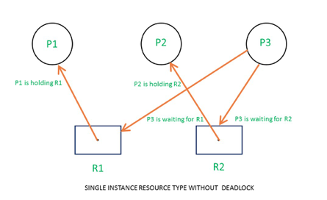
Resource-Allocation Graph Algorithm (Example- Single Instance)
Process | Allocate/Hold | Request
 | R1 ----------- R2 | R1 ------------- R2
P1 | 1---------------0 | 0------------------0
P2 | 0---------------1 | 0------------------0
P3 | 0---------------0 | 1------------------1
Process | Need/Request | Availability | Executed and Terminated
 | R1 ----------- R2 | R1 -------------- R2
 | Check Availability | 0-----------------0
P1 | 0-----------------0 | 0-----------------0 | Done and resource release P1
P2 | 0-----------------0 | 1-----------------0 | Done and resource release P2
P3 | 1-----------------1 | 1-----------------1 | Done and resource release P3
Notes:
So, No deadlock
RAG -> Cycle -> Always deadlock if single instacne resources
Available resource (0,0).. (1,0)
P1 (0,0) (Done)
P2 (0,0) (Done)
P3 (1,1) (Done)
Safe Sequence: P1-> P2->P3
Safe Sequence: P2 -> P1 -> P3

Slide 30
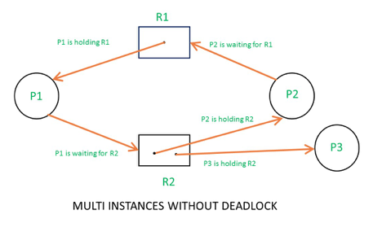
Resource-Allocation Graph Algorithm (Example- Multiple Instance) Exercise
Deadlock or not? Identify. Do at home.

Slide 31
Banker’s Algorithm
Multiple instances of resources
Each process must a priori claim maximum use
When a process requests a resource it may have to wait
When a process gets all its resources it must return them in a finite amount of time

Slide 32
Data Structures for the Banker’s Algorithm
Let n = number of processes, and m = number of resources types.
Available: Vector of length m. If available [j] = k, there are k instances of resource type R_{j} available
Max: n x m matrix. If Max [i,j] = k, then process P_{i} may request at most k instances of resource type R_{j}
Allocation: n x m matrix. If Allocation[i,j] = k then P_{i} is currently allocated k instances of R_{j}
Need: n x m matrix. If Need[i,j] = k, then P_{i} may need k more instances of R_{j} to complete its task
Need [i,j] = Max[i,j] – Allocation [i,j]
Notes:
Allocation_{i} specifies the resources currently allocated to process P_{i} and Need_{i} specifies the additional resources that process P_{i} may still request to complete its task.
Banker’s algorithm consists of Safety algorithm and Resource request algorithm.

Slide 33
Safety Algorithm
1. Let Work and Finish be vectors of length m and n, respectively. Initialize:
Work = Available
Finish [i] = false for i = 0, 1, …, n- 1
2. Find an i such that both:
(a) Finish [i] = false
(b) Need_{i} ≤ Work
If no such i exists, go to step 4
3. Work = Work + Allocation_{i} Finish[i] = true go to step 2
4. If Finish [i] == true for all i, then the system is in a safe state

Slide 34
Resource-Request Algorithm for Process P_{i}
Request_{i} = request vector for process P_{i}. If Request_{i} [j] = k then process P_{i} wants k instances of resource type R_{j}
1. If Request_{i} ≤ Need_{i} go to step 2. Otherwise, raise error condition, since process has exceeded its maximum claim
2. If Request_{i} ≤ Available, go to step 3. Otherwise P_{i} must wait, since resources are not available
3. Pretend to allocate requested resources to P_{i} by modifying the state as follows:
Available = Available – Request_{i};
Allocation_{i} = Allocation_{i} + Request_{i};
Need_{i} = Need_{i} – Request_{i};
If safe ⇒ the resources are allocated to P_{i}
If unsafe ⇒ P_{i} must wait, and the old resource-allocation state is restored

Slide 35
Example of Banker’s Algorithm
5 processes P₀ to P₄;
3 resource types:
A (10 instances), B (5 instances), and C (7 instances)
Snapshot at time T₀:
Process Allocation Max Available
A B C A B C A B C
P₀ 0 1 0 7 5 3 3 3 2
P₁ 2 0 0 3 2 2
P₂ 3 0 2 9 0 2
P₃ 2 1 1 2 2 2
P₄ 0 0 2 4 3 3
Notes:
OS E/D SUMMER WILL START FROM HERE
Need
ABC
P₀ 7 4 3
P₁ 1 2 2
P₂ 6 0 0
P₃ 0 1 1
P₄ 4 3 1
Need Matrix ? Max-Alloc
Is it safe state ?
If yes then find safe sequence..
Total infor resource and instances – allocation total = available

Slide 36
Example (cont’d)
The content of the matrix Need is defined to be Max – Allocation
Need
A B C
P₀ 7 4 3
P₁ 1 2 2
P₂ 6 0 0
P₃ 0 1 1
P₄ 4 3 1
The system is in a safe state since the sequence < P₁, P₃, P₄, P₂, P₀> satisfies safety criteria
Notes:
//Available resource A(3) B(3) C(2) – 1 2 2 = 2 1 0 + 3 2 2 = 5 3 2 – 0 1 1 = 5 2 1 + 2 2 2 = 7 4 3- 4 3 1 = 3 1 2 + 4 3 3 = 7 4 5 – 7 4 3 = 0 0 2 + 7 5 3 = 7 5 5-6 0 0 = 1 5 5+ 9 0 2 = 10 5 7
A B C
3 3 2 (Available)
1 2 2 (P1)
2 1 0 (Available)
3 2 2 (P1 is leaving and releasing all its resources to the system)
5 3 2 (Available after P1 leaves the system)
0 1 1 (P3)
5 2 1 (Available)
2 2 2 (P3 is leaving and releasing all its resources to the system)
7 4 3 (Available)
7 4 3 (P0)
0 0 0 (Available)
7 5 3 (P0 is leaving and releasing all its resources to the system)
7 5 3 (Available)
6 0 0 (P2)
1 5 3 (Available)
9 0 2(P2 is leaving and releasing all its resources to the system)
10 5 5 (Available)
4 3 1 (P4)
6 2 4 (Available)
4 3 3 (P4 is leaving and releasing all its resources to the system)
10 5 7 (Final Available)
Safe sequence= P1, P3, P0, P2, P4 (possible safe sequence 1)
Available Resources 332-122=210+322=532-011=521+222=743
Safe Sequence: P1 -> P3 -> P4->P0 ->P2

Slide 37
Example: P₁ Request (1,0,2)
Check that Request ≤ Available (that is, (1,0,2) ≤ (3,3,2) ⇒ true
Allocation Need Available
A B C A B C A B C
P₀ 0 1 0 7 4 3 2 3 0
P₁ 3 0 2 0 2 0
P₂ 3 0 2 6 0 0
P₃ 2 1 1 0 1 1
P₄ 0 0 2 4 3 1
Executing safety algorithm shows that sequence < P₁, P₃, P₄, P₀, P₂> satisfies safety requirement
Can request for (3,3,0) by P₄ be granted immediately? (Home task)
Can request for (0,2,10) by P₀ be granted immediately? (Home task)
Notes:
Can request (1, 0 , 2) by P1 be granted immediately?
Available = Available - Request 3 3 2 – 1 0 2 = 2 3 0
Allocation = Allocation + Request 2 0 0 + 1 0 2 = 3 0 2 (P1)
Need = Need – Request 1 2 2 – 1 0 2 = 0 2 0
2 3 0 – 0 2 0 = 2 1 0+3 2 2 = 5 3 2
Safe sequence : P1 - > P3…

Slide 38
Deadlock Detection
Allow system to enter deadlock state
Detection algorithm
Recovery scheme
Notes:
Upto this

Slide 39
Single Instance of Each Resource Type
Maintain wait-for graph
Nodes are processes
P_{i} → P_{j} if P_{i} is waiting for P_{j}
Periodically invoke an algorithm that searches for a cycle in the graph. If there is a cycle, there exists a deadlock
An algorithm to detect a cycle in a graph requires an order of n² operations, where n is the number of vertices in the graph

Slide 40
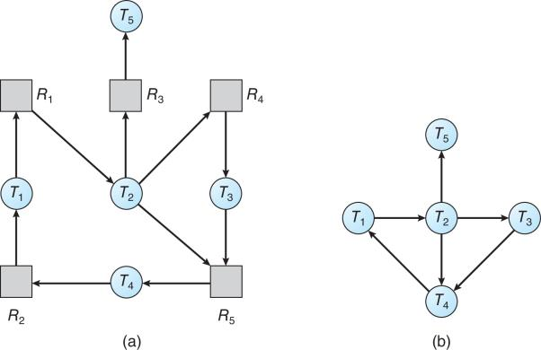
Resource-Allocation Graph and Wait-for Graph
Resource-Allocation Graph
Corresponding wait-for graph

Slide 41
Several Instances of a Resource Type
Available: A vector of length m indicates the number of available resources of each type
Allocation: An n x m matrix defines the number of resources of each type currently allocated to each process
Request: An n x m matrix indicates the current request of each process. If Request [i][j] = k, then process P_{i} is requesting k more instances of resource type R_{j}.

Slide 42
Detection Algorithm
1. Let Work and Finish be vectors of length m and n, respectively Initialize:
(a) Work = Available
(b) For i = 1,2, …, n, if Allocation_{i} ≠ 0, then Finish[i] = false; otherwise, Finish[i] = true
2. Find an index i such that both:
(a) Finish[i] == false
(b) Request_{i} ≤ Work
If no such i exists, go to step 4

Slide 43
Detection Algorithm (cont’d)
3. Work = Work + Allocation_{i} Finish[i] = true go to step 2
4. If Finish[i] == false, for some i, 1 ≤ i ≤ n, then the system is in deadlock state. Moreover, if Finish[i] == false, then P_{i} is deadlocked
Algorithm requires an order of O(m x n²) operations to detect whether the system is in deadlocked state

Slide 44
Example of Detection Algorithm
Five processes P₀ through P₄; three resource types A (7 instances), B (2 instances), and C (6 instances)
Snapshot at time T₀:
Allocation Request Available
A B C A B C A B C
P₀ 0 1 0 0 0 0 0 0 0
P₁ 2 0 0 2 0 2
P₂ 3 0 3 0 0 0
P₃ 2 1 1 1 0 0
P₄ 0 0 2 0 0 2
Sequence <P₀, P₂, P₃, P₁, P₄> will result in Finish[i] = true for all i

Slide 45
Example (cont’d)
P₂ requests an additional instance of type C
Request
A B C
P₀ 0 0 0
P₁ 2 0 2
P₂ 0 0 1
P₃ 1 0 0
P₄ 0 0 2
State of system?
Can reclaim resources held by process P₀, but insufficient resources to fulfill other processes; requests
Deadlock exists, consisting of processes P₁, P₂, P₃, and P₄

Slide 46
Detection-Algorithm Usage
When, and how often, to invoke depends on:
How often a deadlock is likely to occur?
How many processes will need to be rolled back?
one for each disjoint cycle
If detection algorithm is invoked arbitrarily, there may be many cycles in the resource graph and so we would not be able to tell which of the many deadlocked processes “caused” the deadlock.

Slide 47
Recovery from Deadlock: Process Termination
Abort all deadlocked processes
Abort one process at a time until the deadlock cycle is eliminated
In which order should we choose to abort?
Priority of the process
How long process has computed, and how much longer to completion
Resources the process has used
Resources process needs to complete
How many processes will need to be terminated
Is process interactive or batch?

Slide 48
Recovery from Deadlock: Resource Preemption
Selecting a victim – minimize cost
Rollback – return to some previous safe state, restart process for that state
Starvation – same process may always be picked as victim, include number of rollback in cost factor (define number of rollback)

Slide 49
Books
Operating Systems Concept
Written by Galvin and Silberschatz
Edition: 9th

Slide 50
References
Operating Systems Concept
Written by Galvin and Silberschatz
Edition: 9th

