Slide 1
Spare Parts Market
GROUP-1
Mock UI Design

Slide 2
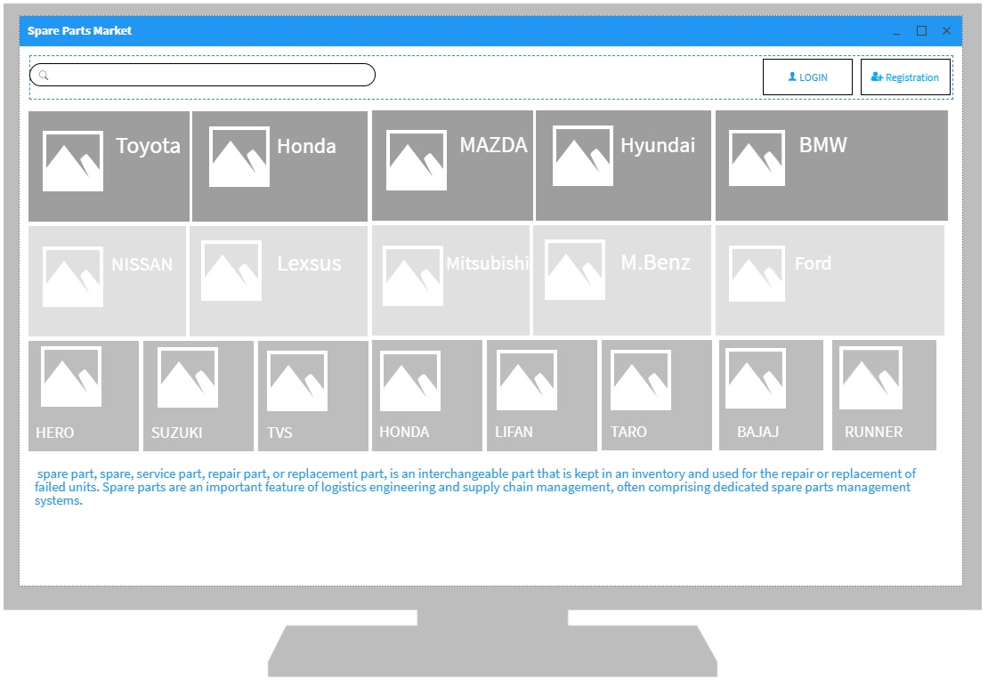

Slide 3
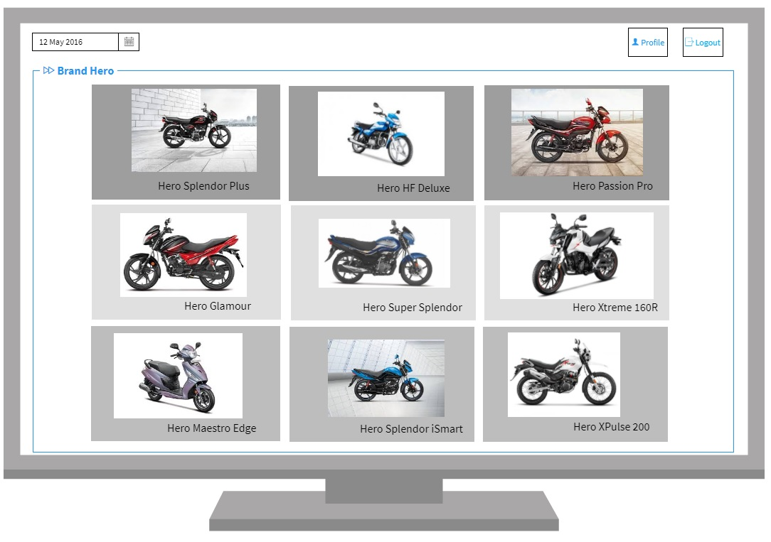

Slide 4
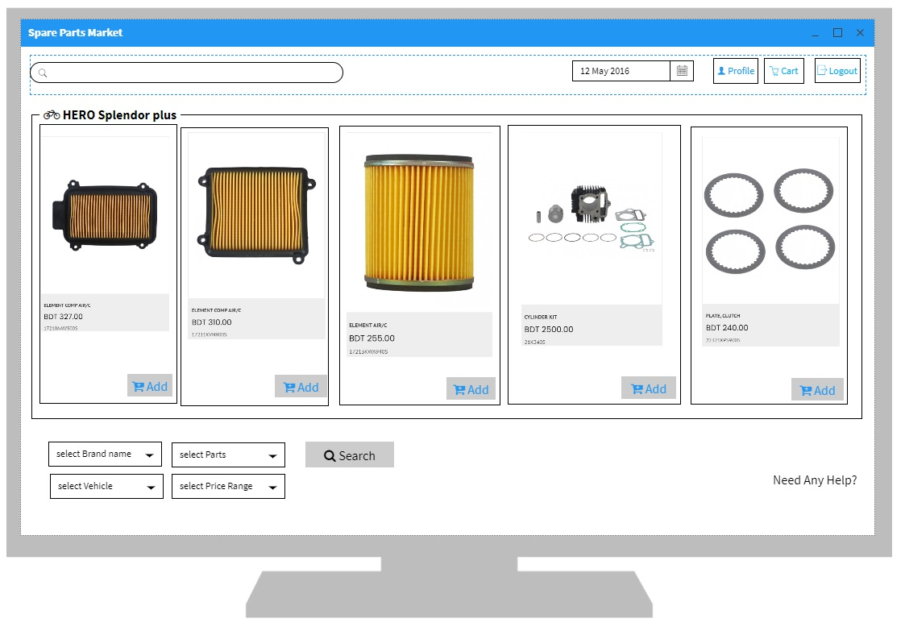

Slide 5
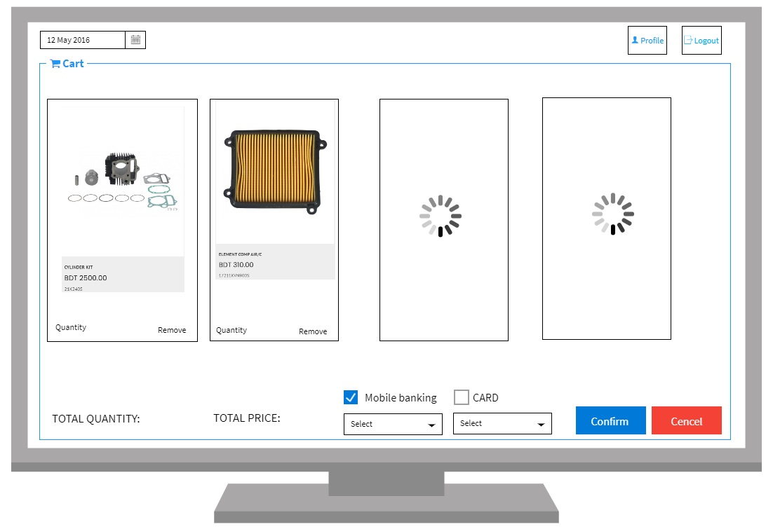

Slide 6






THANK
YOU

