Slide 1
London and South Data Request
Research and Evaluation Team

Slide 2
Summary
This presentation provides a comprehensive analysis of data from the London and South regions, focusing on key metrics and outcomes.

Slide 3
Data Overview
The data overview slide provides a summary of the key data points collected from various sources across the London and South regions.

Slide 4
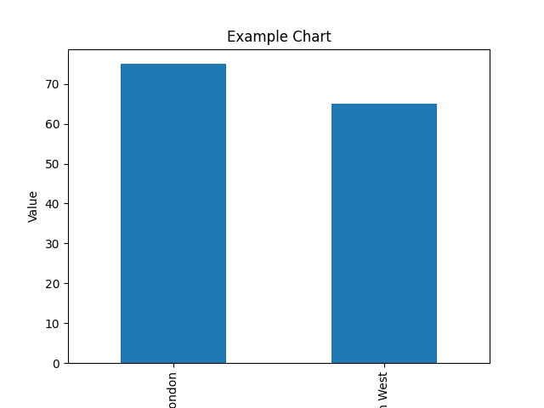
Example Chart

