Slide 1




API Security
Intro to APIs – Class 11

Slide 2

What is API Security?
API security is the protection of the integrity of APIs—both the ones you own and the ones you use. But what does that really mean?

Slide 3

Broken, exposed, or hacked APIs are behind many major data breaches. They expose sensitive medical, financial, and personal data for public consumption. That said, not all data is the same nor should be protected in the same way. How you approach API security will depend on what kind of data is being transferred.

Slide 4
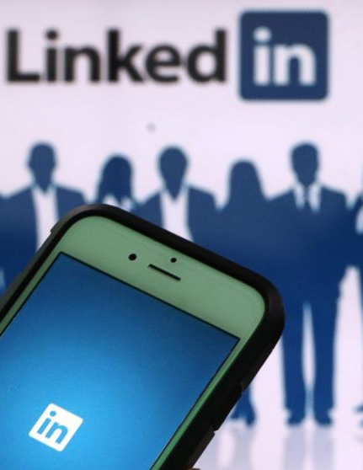
In June 2021, hackers scraped data belonging to over 700 million LinkedIn users and offered that data for sale on the dark web. LinkedIn is the world’s largest professional social networking platform, and the 700 million exposed users represent over 90% of the site’s user base.
The hackers behind this attack were able to download the data using LinkedIn’s API. The technical API flaws that facilitated the LinkedIn attack remain unclear. However, what is clear is that the platform did not pay enough attention to API security practices, which resulted in threat actors being able to make an unlimited number of data requests without being flagged or stopped.

Slide 5
The data examined by the site did not include login credentials or financial information, but it did include a wealth of personal information that could be used to assume someone’s identity, including:
Full names
Phone numbers
Physical addresses
Email addresses
Geolocation records
LinkedIn usernames and profile URLs
Personal and professional experiences and backgrounds
Genders
If your information was part of the cyber incident, you could see a rise in spam (as spammers now have your email address), phishing attempts, or even more troubling cybercrimes, like identity theft.

Slide 6
“Our teams have investigated a set of alleged LinkedIn data that has been posted for sale,” the company said. “We want to be clear that this is not a data breach and no private LinkedIn member data was exposed. Our initial investigation has found that this data was scraped from LinkedIn and other various websites and includes the same data reported earlier this year in our April 2021 scraping update…When anyone tries to take member data and use it for purposes LinkedIn and our members haven’t agreed to, we work to stop them and hold them accountable.”

Slide 7
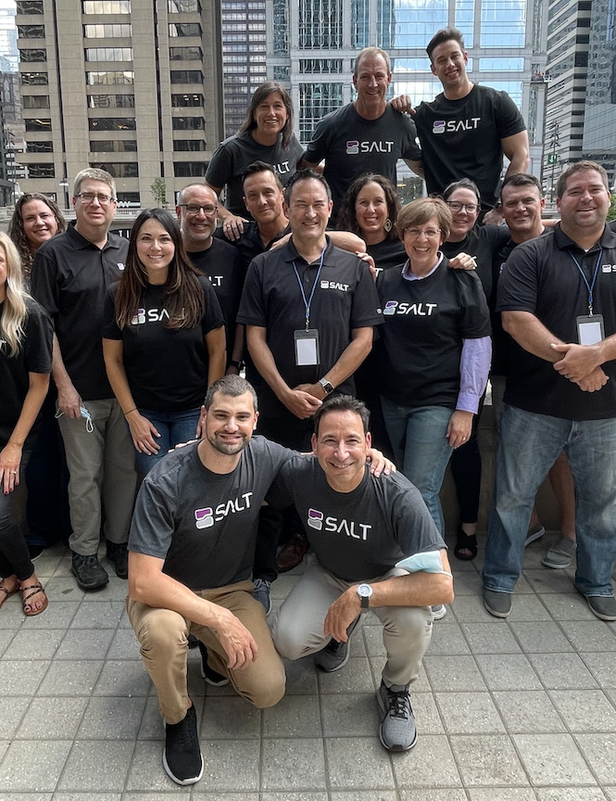
"While social media platforms are standing firm that these scraping incidents are not data breaches, the compiled data sets have clear privacy impacts for end users... A single piece of data by itself may not be classified as private, but this classification quickly changes as data is correlated or identity of an individual can be inferred," says Michael Isbitski, Technical Evangelist at Salt Security, a Palo Alto, Calif.-based provider of API security.

Slide 8
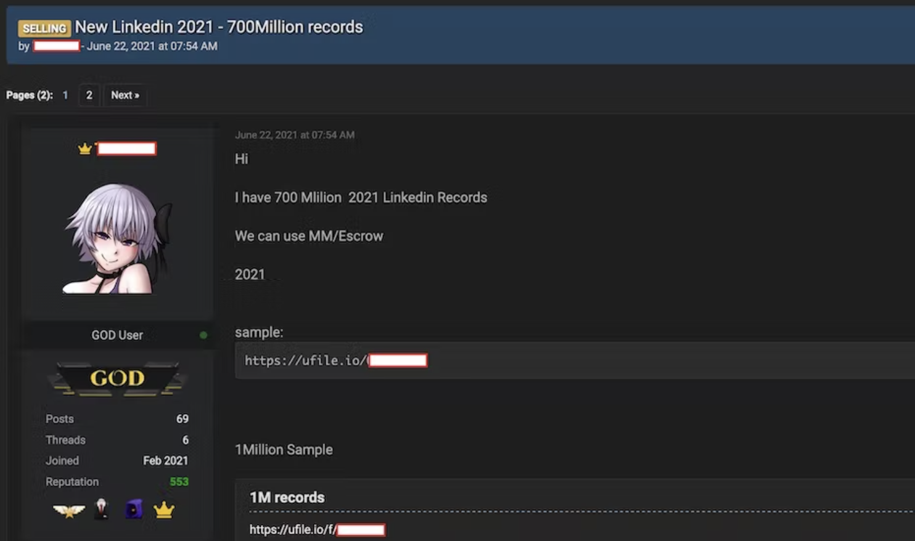
The forum listing in question.

Slide 9
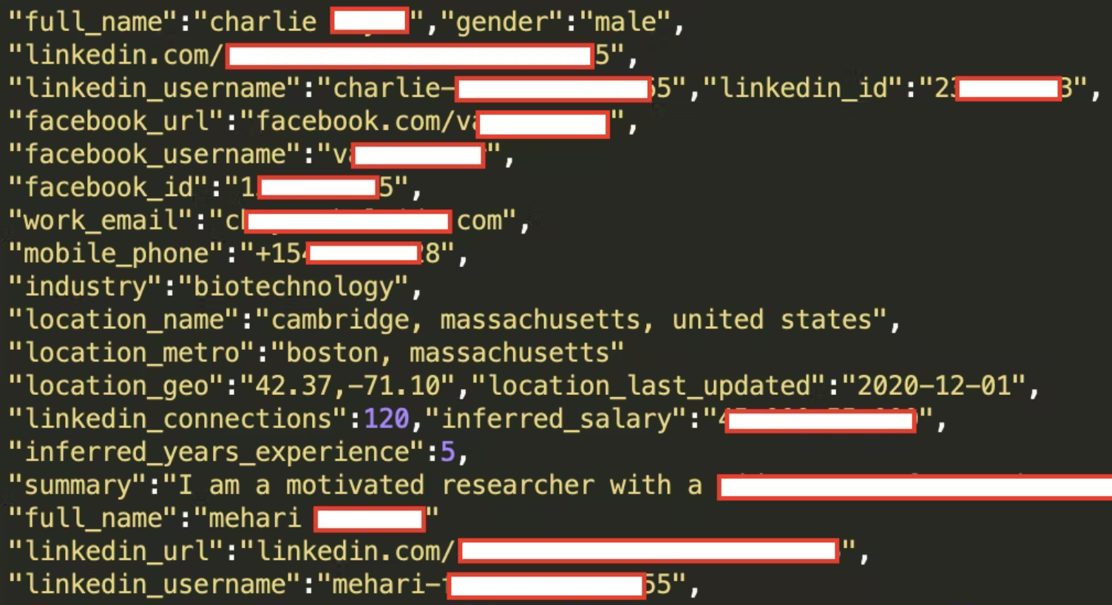
The hacker– who goes by the name Tom Liner– said, "It took me several months to do. It was very complex… If you do too many requests for user data in one time then the system will permanently ban you."
An example of the leaked data, courtesy of LinkedIn’s own API.

Slide 10
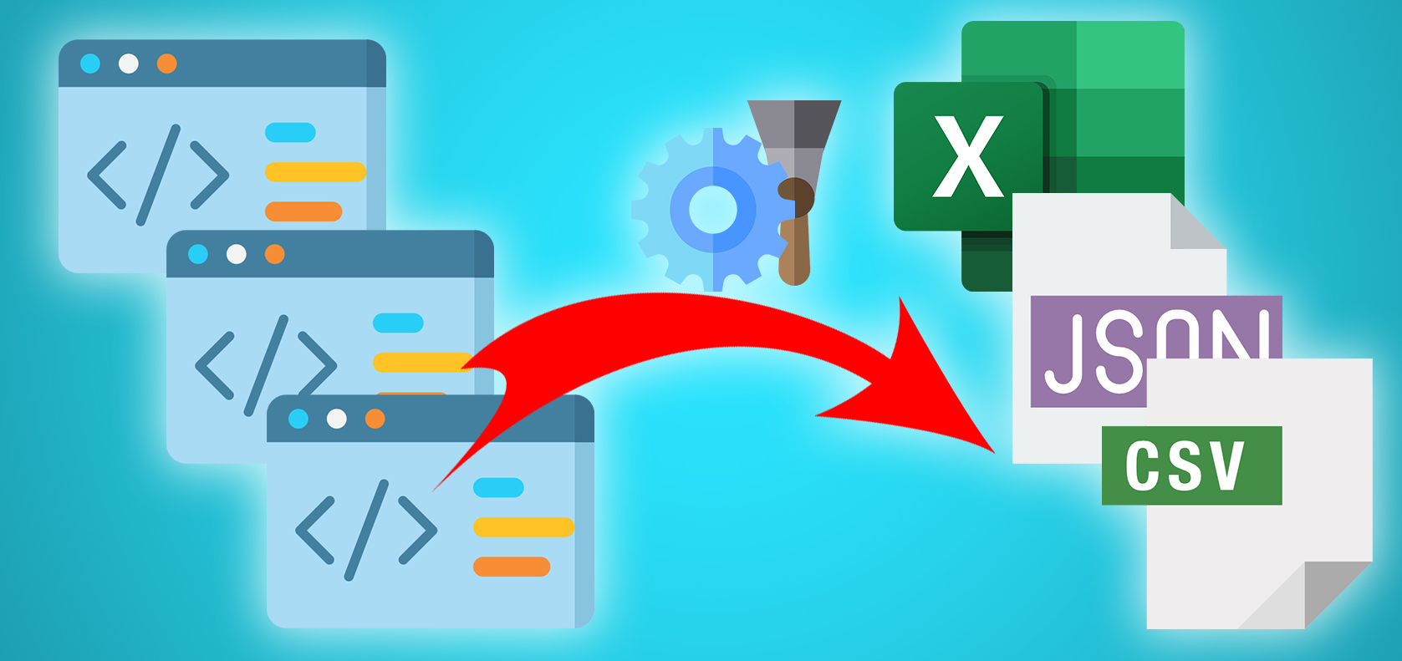
Data Scraping
The LinkedIn hack was technically a data scrape.
In a data scrape, data is extracted from publicly available information—as all the information users have on their LinkedIn profile in this case. Data scrapes are not always nefarious in their intent. It can be used to extract and compile data in large numbers for a valuable purpose.
This is unlike a data breach, which is an incident wherein information is stolen or taken from a system without the knowledge or authorization of the system's owner.
In theory, most of the data being compiled could be found by simply picking through individual social media profile pages one-by-one. Although of course it would take multiple lifetimes to gather as much data together, as the hackers are able to do.

Slide 11
Types of API Attacks
z

Slide 12
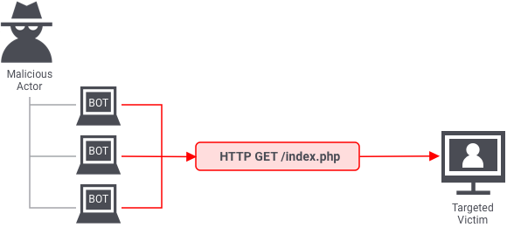
DDoS Attack
DDoS, short for Distributed Denial-of-Service, is a malicious attempt to disrupt the normal traffic of a targeted server, service or network by overwhelming the target or its surrounding infrastructure with a flood of Internet traffic.
In a DDoS attack, an attacker tries to overwhelm an API with a lot of requests in a short amount of time. These requests often come from multiple sources.
To prevent a massive amount of API requests that can cause a DDoS attack or other misuse of the API service, one must find a way to apply a limit to the number of requests in a given time interval for each API endpoint and/or for each API.

Slide 13
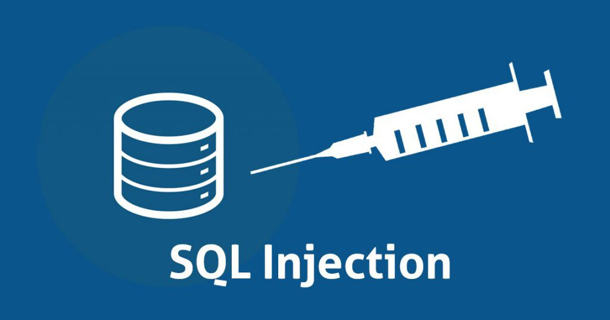
SQL Injection Attack
A SQL Injection attack consists of insertion or “injection” of a SQL query via the input data from the client to the application. A successful SQL injection exploit can read sensitive data from the database, modify database data (Insert/Update/Delete), execute administration operations on the database (such as shutdown the DBMS), and more.
Avoid placing user-provided input directly into SQL statements. You should always use parameterized statements where available, they are your number one protection against SQL injection.
A parameterized statement (also known as a prepared statement) is a means of pre-compiling a SQL statement so that all you need to supply are the "parameters" (think "variables") that need to be inserted into the statement for it to be executed. It's commonly used as a means of preventing SQL injection attacks. (We’ve done this!)

Slide 14

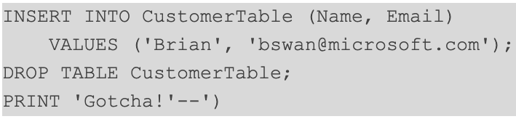
SQL Ingestion Attack Example

Slide 15
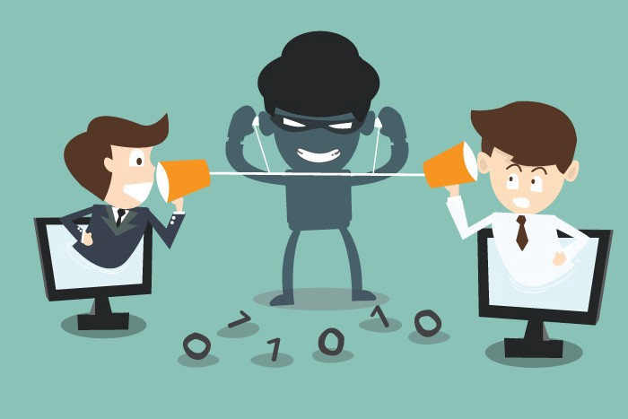
Man in the Middle Attack
A Man in the Middle attack is exactly what it sounds like; an attacker discreetly alters, relays, and intercepts data (messages, requests, and more) between two parties in order to obtain sensitive information.
In order to prevent this, use SSL!
Remember, SSL stands for Secure Sockets Layer and it's the standard technology for keeping an internet connection secure and safeguarding any sensitive data that is being sent between two systems, preventing criminals from reading and modifying any information transferred, including potential personal details.
It does this by making sure that any data transferred between users and sites, or between two systems remain impossible to read. It uses encryption algorithms to scramble data in transit, preventing hackers from reading it as it is sent over the connection. This information could be anything sensitive or personal which can include credit card numbers and other financial information, names and addresses.

Slide 16
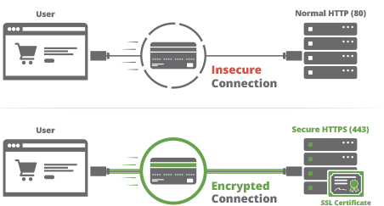
HTTPS
Hypertext Transfer Protocol Secure (HTTPS) is an extension of the Hypertext Transfer Protocol (HTTP). It is used for secure communication over a computer network, and is widely used on the Internet. In HTTPS, the communication protocol is encrypted using Transport Layer Security (TLS) or, formerly, Secure Sockets Layer (SSL).
Transport Layer Security (TLS) is the successor protocol to SSL. TLS is an improved version of SSL. It works in much the same way as the SSL, using encryption to protect the transfer of data and information. The two terms are often used interchangeably in the industry although SSL is still widely used.

Slide 17
HTTPS
HTTPS (Hyper Text Transfer Protocol Secure) appears in the URL when a website is secured by an SSL or TLS certificate. The details of the certificate, including the issuing authority and the corporate name of the website owner, can be viewed by clicking on the lock symbol on the browser bar.

Slide 18
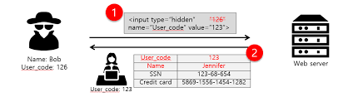
Parameter Tampering Attack
A Parameter Tampering attack is based on the manipulation of parameters exchanged between client and server in order to modify application data, such as user credentials and permissions.
Parameter tampering is a simple attack targeting the application business logic. This attack takes advantage of the fact that many programmers rely on hidden or fixed fields (such as a hidden tag in a form or a parameter in a URL) as the only security measure for certain operations.

Slide 19
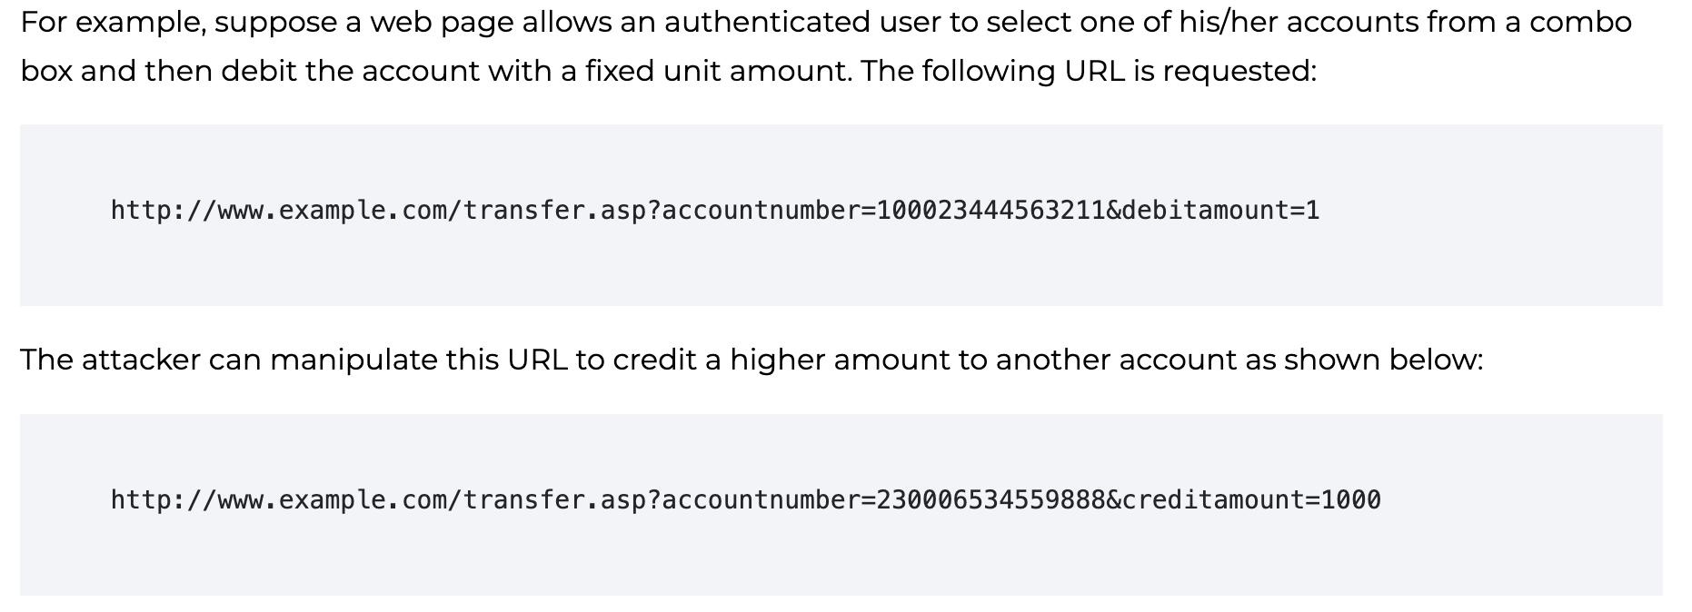
Parameter Tampering Attack

Slide 20
Best Practices
Prioritize security. API security shouldn’t be an afterthought or considered “someone else’s problem.” Organizations have a lot to lose with unsecured APIs, so make security a priority and build it into your APIs as they’re being developed.
Inventory and manage your APIs. Whether an organization has a dozen or hundreds of publicly available APIs, it must first be aware of them in order to secure and manage them. Surprisingly, many are not. Conduct perimeter scans to discover and inventory your APIs, and then work with DevOps teams to manage them.

Slide 21
Best Practices
Use a strong authentication and authorization solution. Poor or non-existent authentication and authorization are major issues with many publicly available APIs. Broken authentication occurs when APIs do not enforce authentication (as is often the case with private APIs, which are meant for internal use only) or when an authentication factor (something the client knows, has, or is) can be broken into easily. Since APIs provide an entry point to an organization’s databases, it’s critical that the organization strictly controls access to them. When feasible, use solutions based on solid, proven authentication and authorization mechanisms such as OAuth2.0.
Practice the principle of least privilege. This foundational security principle holds that subjects (users, processes, programs, systems, devices) be granted only the minimum necessary access to complete a stated function. It should be applied equally to APIs.

Slide 22
Best Practices
Encrypt traffic using TLS. Some organizations may choose not to encrypt API payload data that is considered non-sensitive (for example, weather service data), but for organizations whose APIs routinely exchange sensitive data (such as login credentials, credit card, social security, banking information, health information), TLS encryption should be considered essential.
Remove information that’s not meant to be shared. Because APIs are essentially a developer’s tool, they often contain keys, passwords, and other information that should be removed before they’re made publicly available. But sometimes this step is overlooked. Organizations should incorporate scanning tools into their DevSecOps processes to limit accidental exposure of secret information.

Slide 23
Best Practices
Don’t expose more data than necessary. Some APIs reveal far too much information, whether it’s the volume of extraneous data that’s returned through the API or information that reveals too much about the API endpoint. This typically occurs when an API leaves the task of filtering data to the user interface instead of the endpoint. Ensure that APIs only return as much information as is necessary to fulfill their function. In addition, enforce data access controls at the API level, monitor data, and obfuscate if the response contains confidential data.
Validate input. Never pass input from an API through to the endpoint without validating it first.
Use rate limiting. Setting a threshold above which subsequent requests will be rejected (for example, 10,000 requests per day per account) can prevent denial-of-service attacks.

Slide 24
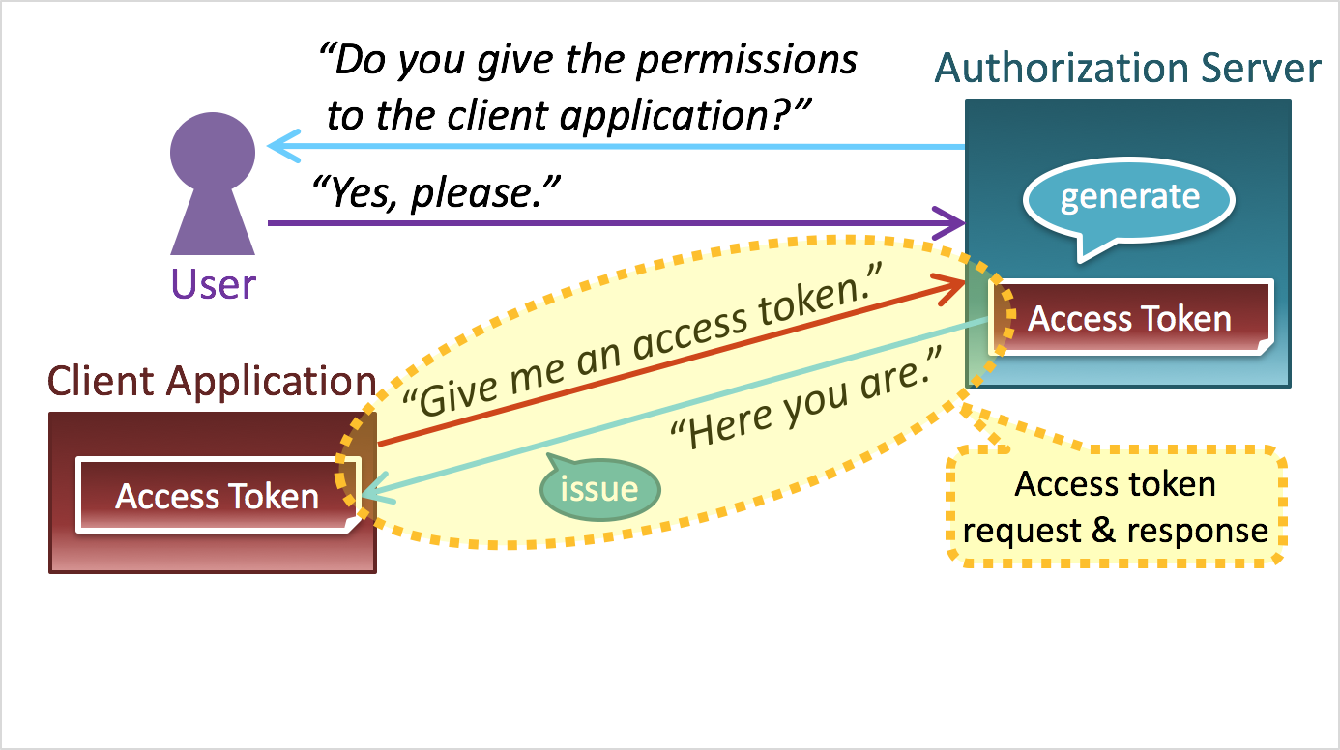
OAuth
OAuth is an open-standard authorization protocol or framework that provides applications the ability for “secure designated access.” For example, you can tell Facebook that it’s OK for ESPN.com to access your profile or post updates to your timeline without having to give ESPN your Facebook password. This minimizes risk in a major way: In the event ESPN suffers a breach, your Facebook password remains safe.
OAuth is about authorization and not authentication. Authorization is asking for permission to do stuff. Authentication is about proving you are the correct person because you know things. OAuth doesn’t pass authentication data between consumers and service providers – but instead acts as an authorization token of sorts.

Slide 25
