Slide 1


SQL
Intro to APIs – Class 6

Slide 2

what is sql?
This video from Khan Academy sums it up nicely…

Slide 3
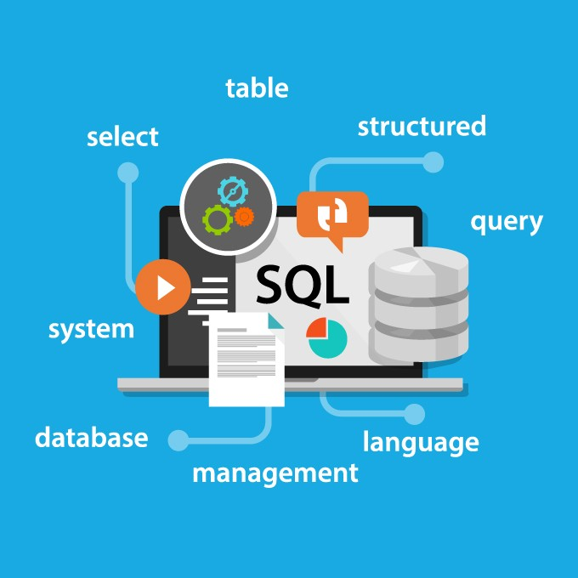
sql
SQL stands for Structured Query language, pronounced as “S-Q-L” or sometimes as “See-Quel.”
SQL is the standard language for dealing with relational databases. SQL can be used to insert, search, update, and delete database records. SQL can do lots of other operations, including optimizing and maintenance of databases.
A relational database is a type of database that focuses on the relationships between stored data elements. It allows users to establish links between different sets of data within the database and allows them to use these links to manage and reference related data.

Slide 4




relational database management systems
SQL is an integral part of many modern RDBMS (relational database management systems) like Oracle, Db2 Database, Microsoft SQL Server, MySQL, etc.
A relational database management system (RDBMS) is a program that allows you to create, update, and administer a relational database.
many public and private agencies use different database products from different vendors, and each develop a system based on vendor-dependent SQL syntax, which can vary. ANSI (American National Standards Institute) developed a common standard for SQL which runs in all modern vendor databases.
The American National Standards Institute is a private non-profit organization that oversees the development of voluntary consensus standards for products, services, processes, systems, and personnel in the United States.
Every brand of SQL RDBMS adds some features to the language that are not in the ANSI SQL specification-- each brand implements features in its own way, not necessarily compatible with the others.

Slide 5

what are sql scripts?
A SQL script is a set of SQL commands, usually saved in a .sql-extension file.

Slide 6
Let’s say we want to get all rows and columns from our existing Customers table…

Slide 7
Let’s say we want to get all rows and columns from our existing Customers table…
SELECT * FROM Customers;

Slide 8
Let’s say we want to get everything in the FirstName column from our existing Customers table…

Slide 9
Let’s say we want to get everything in the FirstName column from our existing Customers table…
SELECT FirstName FROM Customers;

Slide 10
What if we don’t want any duplicates when getting everything in the Country column from our existing Customers table?

Slide 11
What if we don’t want any duplicates when getting everything in the Country column from our existing Customers table?
SELECT DISTINCT Country FROM Customers;

Slide 12
Let’s say we want to get the whole row from our Customers table for our customer who is named Serra (FirstName column) Canca (LastName column)…

Slide 13
Let’s say we want to get the whole row from our Customers table for our customer who is named Serra (FirstName column) Canca (LastName column)…
SELECT * FROM Customers WHERE FirstName = “Serra” AND LastName = “Canca”;
* You can also use OR just like this!

Slide 14
Let’s say we want to get every row from our Customers table in descending order of AmountSpent.

Slide 15
Let’s say we want to get every row from our customers table in descending order of AmountSpent.
SELECT * FROM Customers ORDER BY AmountSpent DESC;
* The ORDER BY keyword sorts the records in ascending order by default. ASC is still an option that you can use, though!
* You can order by multiple columns! ORDER BY Col1, Col2, Col3…

Slide 16
Okay… now what if we want to get everything from our Customers table and our Orders table at the same time...?

Slide 17
Okay… now what if we want to get everything from our Customers table and our Orders table at the same time...?
SELECT * FROM Customers
UNION
SELECT * FROM Orders;
SELECT * FROM Customers
UNION ALL
SELECT * FROM Orders;
* UNION ALL includes duplicate values!

Slide 18
What if you want to delete every row from the Customers table where the customer’s country is Norway? Or delete everything from the Customers table?

Slide 19
What if you want to delete every row from the Customers table where the customer’s country is Norway? Or delete everything from the Customers table? Or maybe just change a value rather than deleting?
DELETE FROM Customers WHERE Country = ”Norway”;
TRUNCATE Customers;
UPDATE Customers SET FirstName = ”Steve”, MiddleName = NULL WHERE CustomerID = 15;
* You might not initially be able to update and delete every type of field that you want to. Find your “Preferences…” from the menu bar (it will be located differently based on your operating system.) Under the “SQL Editor” menu, uncheck “Safe Updates.” Click “OK.” Then, under “Query” in the menu bar, select “Reconnect to Server.”
* Truncate deletes the entire table and re-creates it as though it is empty.

Slide 20
What if you would like the count of customers from our Customers table who have a first name that starts with J?
SELECT count(*) FROM Customers WHERE FirstName LIKE ‘J%’;

Slide 21
And what if would like to insert a row into your table manually?

Slide 22
And what if would like to insert a row into your table manually?
INSERT INTO Customers (CustomerID, FirstName, MiddleName, LastName)
VALUES (1, “Michael”, “Gary”, “Scott”);
INSERT INTO Customers VALUES (1, “Michael”, “Gary”, “Scott”);
* The second command only works if you fill in every column. Order matters!

Slide 23
DATABASE commands
Creating a database for your tables: CREATE DATABASE Customers;
Select a database to perform operations on; this selection remains default (active) until end of session or execution of a USE statement with some other database: USE Customers;
Dropping (deleting) a database: DROP DATABASE Customers;

Slide 24
table commands
Creating a table: CREATE TABLE Customers ( CustomerID int, FirstName varchar(30), ... );
Dropping (deleting) a table: DROP TABLE Customers;

Slide 25
column commands
Adding a column to a table: ALTER TABLE Customers ADD Email varchar(300);
Modifying a column: ALTER TABLE Customers MODIFY Email varchar(200);
Dropping (deleting) a column from a table: ALTER TABLE Customers DROP COLUMN Email;

Slide 26
constraint commands: when making a table
Adding constraints while creating a table: CREATE TABLE Customers ( CustomerID int NOT NULL UNIQUE, FirstName varchar(30) NOT NULL, ... Email varchar(100) NOT NULL UNIQUE, CONSTRAINT UniqueName UNIQUE (FirstName, MiddleName, LastName));
SQL constraints are used to specify rules for the data in a table. Constraints are used to limit the type of data that can go into a table. This ensures the accuracy and reliability of the data in the table.

Slide 27
constraint commands: NOT NULL
Ensures that a column can not have a NULL value.
ALTER TABLE Customers MODIFY Email varchar(100) NOT NULL;
ALTER TABLE Customers MODIFY Email varchar(100);

Slide 28
constraint commands: UNIQUE
Ensures that every column or set of columns specified are unique.
ALTER TABLE Customers ADD CONSTRAINT UniqueEmail UNIQUE (Email);
ALTER TABLE Customers ADD CONSTRAINT UniqueName UNIQUE (FirstName, MiddleName, LastName);
ALTER TABLE Customers DROP INDEX UniqueName;
* When a unique constraint is created, a corresponding unique index is automatically created on the column(s) on which the constraint is created.
* A unique index ensures that the value(s) in the index key columns is/are a unique combination.

Slide 29
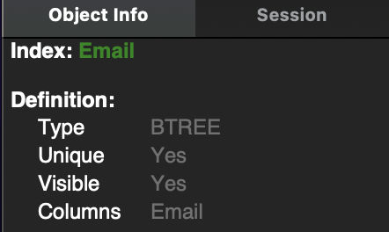
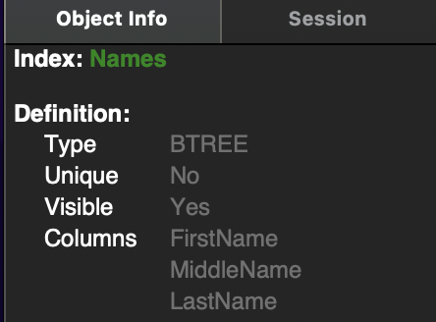
Indexes
A unique index for email addresses
A database index is a data structure that the database uses to find records within a table more quickly. Indexes can be created using one or more columns, providing the basis for both rapid random lookups and efficient ordering of access to records. Without indexes, MySQL must scan the whole table to locate the relevant rows.
Unique indexes are a type of index. Not all indexes require every member to be unique!
(As seen on MySQL Workbench)
(The B-Tree, which is a self-balancing tree data structure, is the basic index structure for most MySQL storage engines.)
A (non-unique) index for names

Slide 30
constraint commands: Primary Key
Uniquely identifies each record in a table.
Only works if CustomerID is an existing column, add another column if need be!
ALTER TABLE Customers ADD PRIMARY KEY (CustomerID);
ALTER TABLE Customers DROP PRIMARY KEY;
* Incrementing integers with “ID” in its name are usually used as a primary key.

Slide 31
constraint commands: foreign Key
Used to prevent actions that would destroy links between tables.
The AddressID foreign key in the Customers table and the AddressID in the Addresses table must be of the same type.
ALTER TABLE Customers ADD CONSTRAINT FK_CustomerAddress FOREIGN KEY (AddressID) REFERENCES Addresses(AddressID);
ALTER TABLE Customers DROP FOREIGN KEY FK_CustomerAddress;
* A foreign key must reference either the primary key or another unique key of the other table.

Slide 32
constraint commands: check
Used to limit the value range that can be placed in a column.
ALTER TABLE Customers ADD CONSTRAINT CHK_CustomerAge CHECK (CustomerAge >= 18);
ALTER TABLE Customers DROP CONSTRAINT CHK_CustomerAge;

Slide 33
constraint commands: indexes (Unique and regular)
Used to retrieve data from the database more quickly than otherwise.
CREATE INDEX Customer_Name ON Customers (FirstName, MiddleName, LastName);
CREATE UNIQUE INDEX Customer_PhoneNumber ON Customers (PhoneNumber);
ALTER TABLE Customers DROP INDEX Customer_Name;

Slide 34
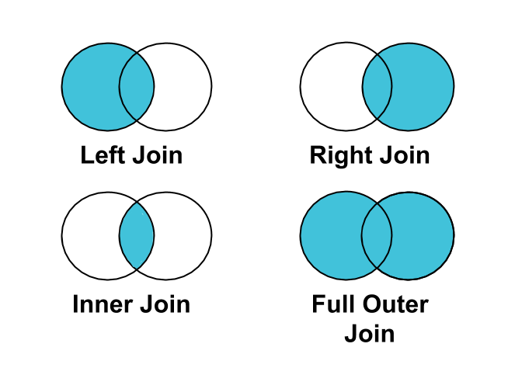
JOINs
A JOIN clause is used to combine rows from two or more tables, based on a related column between them.
Here are the different types of the JOINs in SQL:
Left (Outer) Join: Returns all records from the left table, and the matched records from the right table.
Right (Outer) Join: Returns all records from the right table, and the matched records from the left table.
(Inner Join): Returns records that have matching values in both tables.
Full (Outer) Join: Returns all records when there is a match in either left or right table.

Slide 35
sql JOINs
Inner Join: SELECT * FROM Orders INNER JOIN Customers ON Orders.CustomerID = Customers.CustomerID;
Left (Outer) Join: SELECT * FROM Orders LEFT JOIN Customers ON Orders.CustomerID = Customers.CustomerID;

Slide 36
sql JOINs
Right (Outer) Join: SELECT * FROM Orders RIGHT JOIN Customers ON Orders.CustomerID = Customers.CustomerID;

Slide 37
sql JOINs
Full (Outer) Join: SELECT * FROM Orders LEFT JOIN Customers ON Orders.CustomerID = Customers.CustomerID
UNION SELECT * FROM Orders RIGHT JOIN Customers ON Orders.CustomerID = Customers.CustomerID;
(We actually don't have full joins in MySQL, but we sure can emulate them!)

Slide 38
aliases
Used to give a table, or a column in a table, a temporary name.
SELECT CustomerID AS ID FROM Customers;
SELECT CONCAT (FirstName, ‘ ’, MiddleName, ‘ ’, LastName) AS FullName FROM Customers;

Slide 39
subqueries/ nested queries
Used for more complicated queries/commands.
SELECT * FROM Customers WHERE CustomerID In (SELECT CustomerID FROM Orders WHERE IsInTransit = TRUE);
UPDATE Customers SET IsLocalCustomer = TRUE WHERE CustomerID = (SELECT CustomerID FROM Addresses WHERE ZipCode = “10004”);
DELETE FROM Addresses WHERE CustomerID In (SELECT CustomerID FROM Customers WHERE YEAR(LastActive) <= 1980);

Slide 40

No activity today, take a break. Try to think of ideas for your api final project!

