Slide 1
Creating an api
Intro to APIs – Class 8

Slide 2

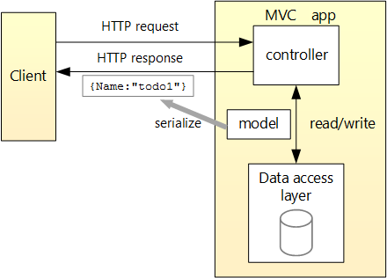

This is going to be the design of our API.

Slide 3
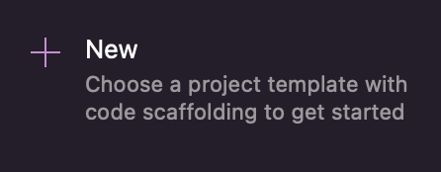
Create a new project!

Slide 4
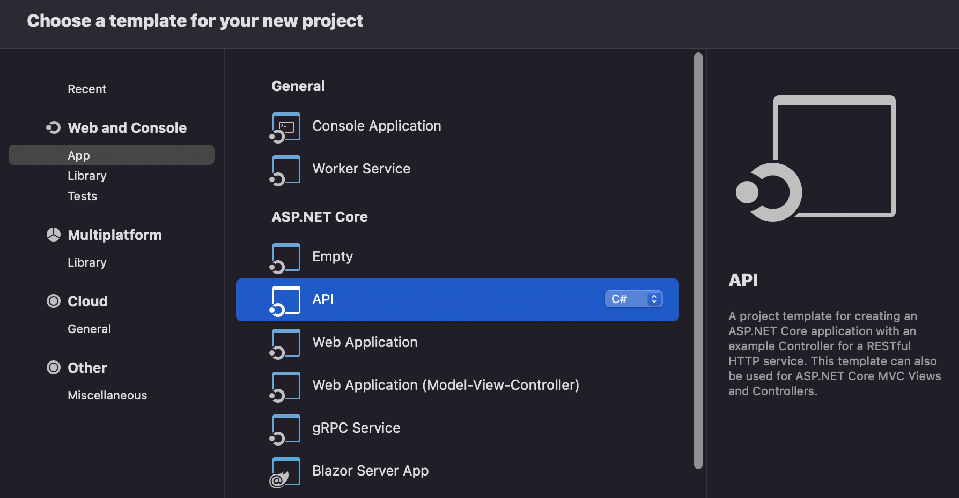
We’ll start with this template.

Slide 5
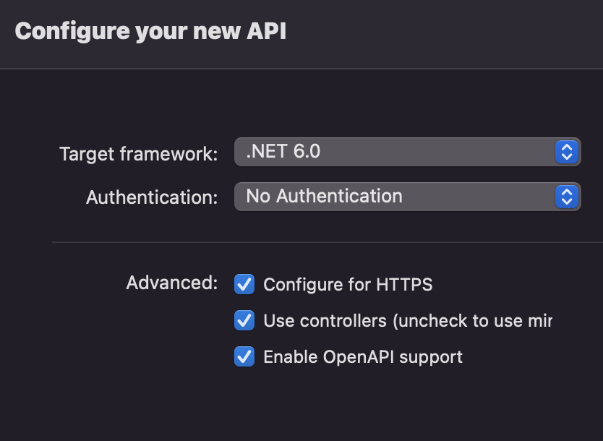
Set configurations for your new API.

Slide 6
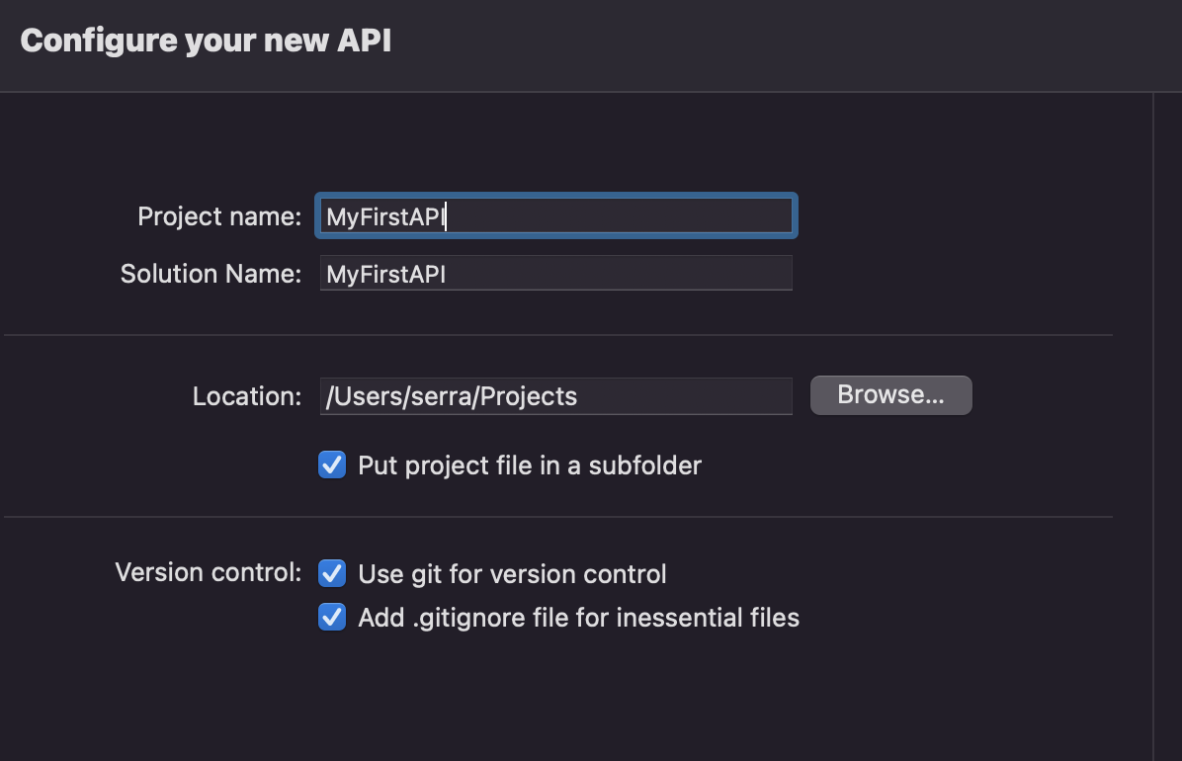
Set configurations for your new API.

Slide 7
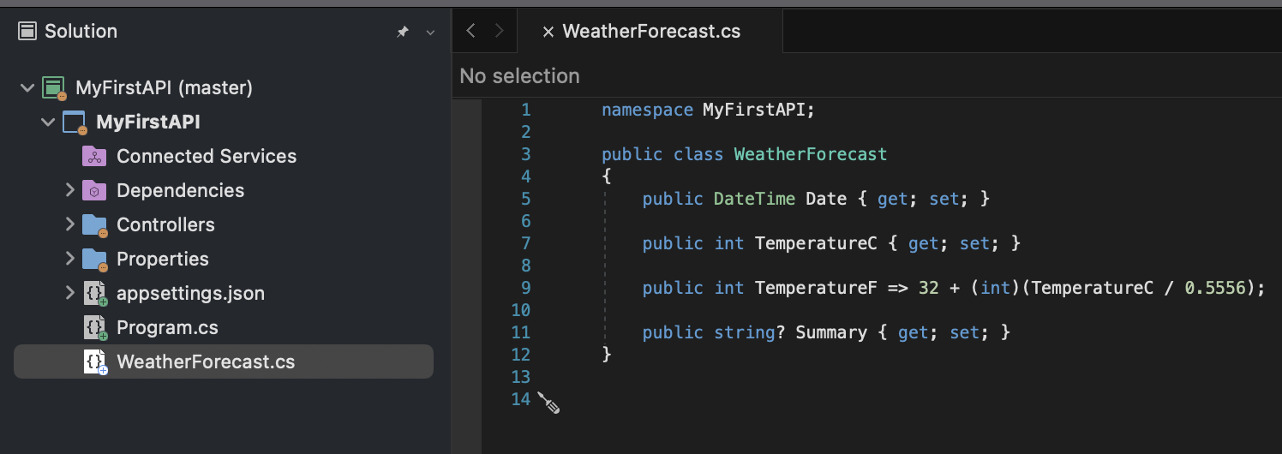
The project template creates a WeatherForecast API with support for Swagger.
Swagger is an Interface Description Language for describing RESTful APIs expressed using JSON.
IDL (Interface Definition Language) is a declarative language used to define the interfaces that objects expose to the public (so that client objects can call them).
Swagger UI generates an interactive API console for users to quickly learn about your API and experiment with requests.

Slide 8
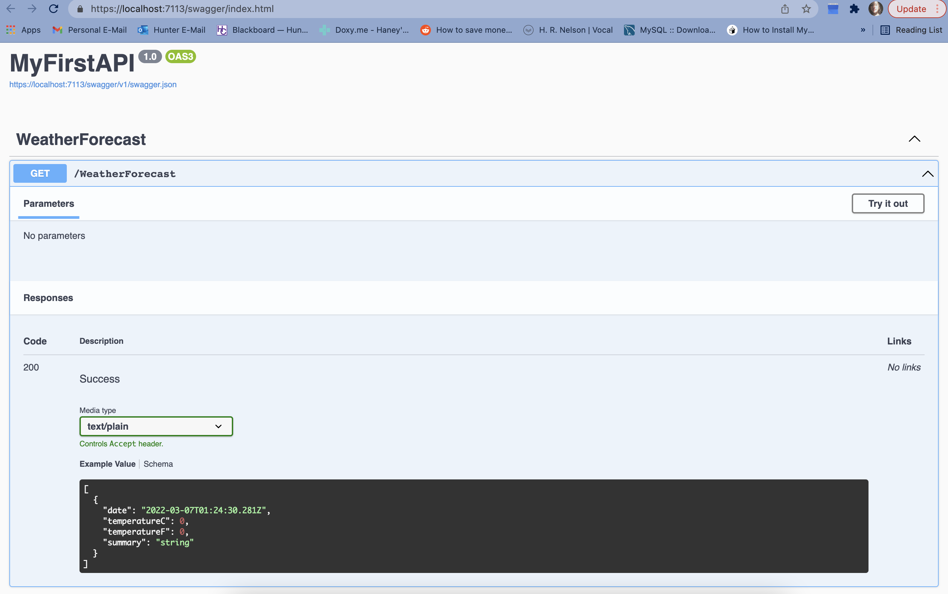
Run your API in Release mode. A web browser window should pop up.
If you don’t get the pop-up window…
Go to Properties > launchSettings.json in your Solution Explorer.
In the profiles object, under MyFirstAPI, find the first localhost URL from the applicationUrl semi-colon delimited list. Go to that localhost URL + /swagger/index.html on your web browser.
Hit the GET button, then Try it out, then Execute. Note the fast response. Try it a few times. What do you think it might be doing?

Slide 9
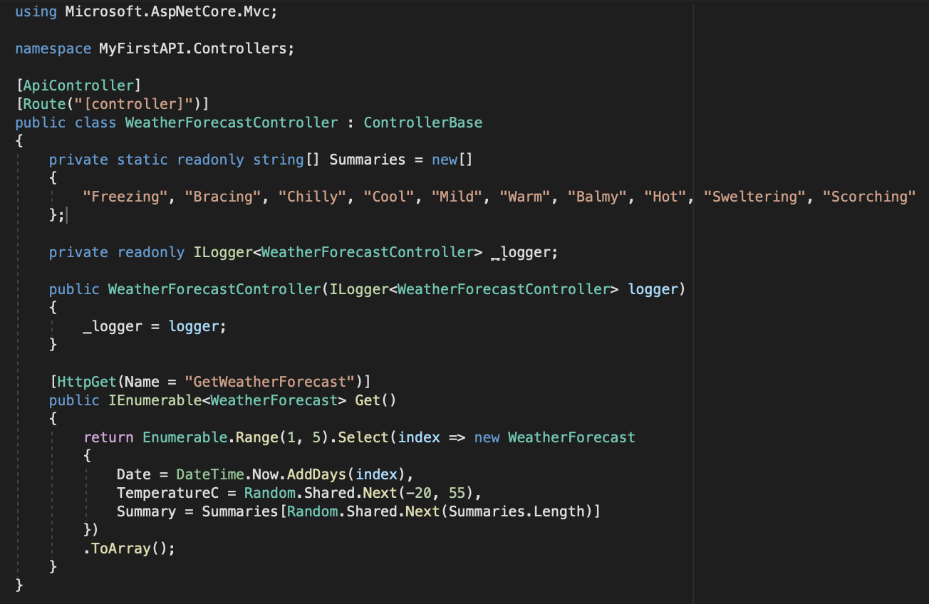
Let’s look at Controllers > WeatherForecastController.cs
This explains a lot, doesn’t it?
An in API, the controller handles receiving client requests and also handles sending back responses. Note how we’re creating a list of randomized WeatherForecast objects to send back– you can find that class in elsewhere in the code.

Slide 10
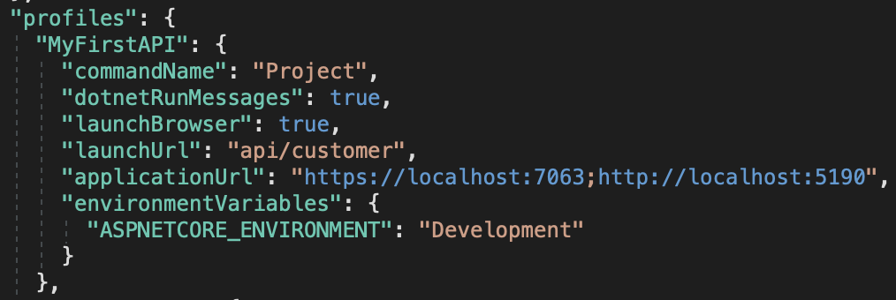
In Properties > launchSettings.json, under profiles, in MyFirstAPI, update launchUrl from "swagger" to "api/customer”.
Because Swagger will be removed, the preceding markup changes the URL that is launched to the GET method of the controller added later.

Slide 11
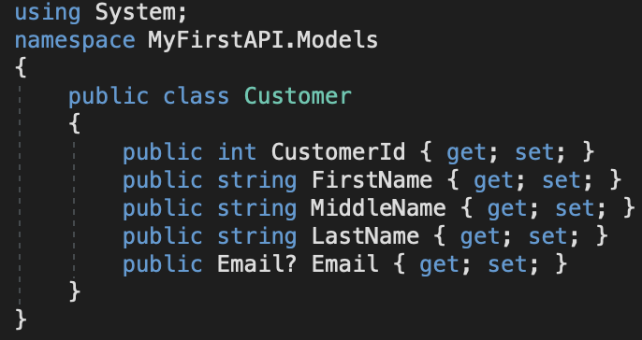
Right-click on the MyFIrstAPI project (not solution!) in your Solution Explorer and select Add, then New Folder… name it Models.
Right-click on the Models folder, select Add, then New Class… name it Customer.
Define the Customer class as shown here.
Notice that we have a one-to-one relationship with Email, meaning every customer has one e-mail address. If we wanted to set up a one-to-many relationship, where a customer has many e-mails, this would be a list.

Slide 12
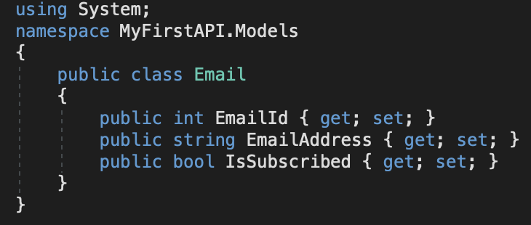
Follow the same set of steps for your Email class.

Slide 13
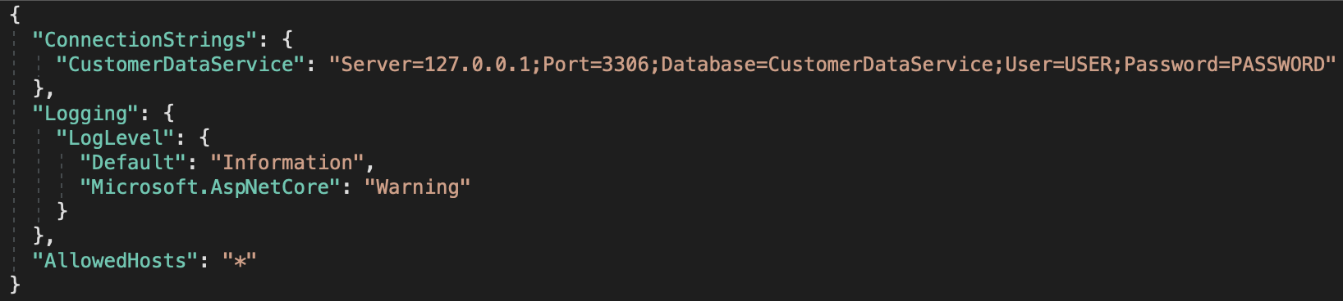
Add your database information to your appsettings.json file.
“CustomerDataService” would be the name of your connection on MySQL Workbench (the variable name as well as inside of the string right after Database=).
USER would be the username that has permission to access your connection. Same idea goes for PASSWORD!

Slide 14
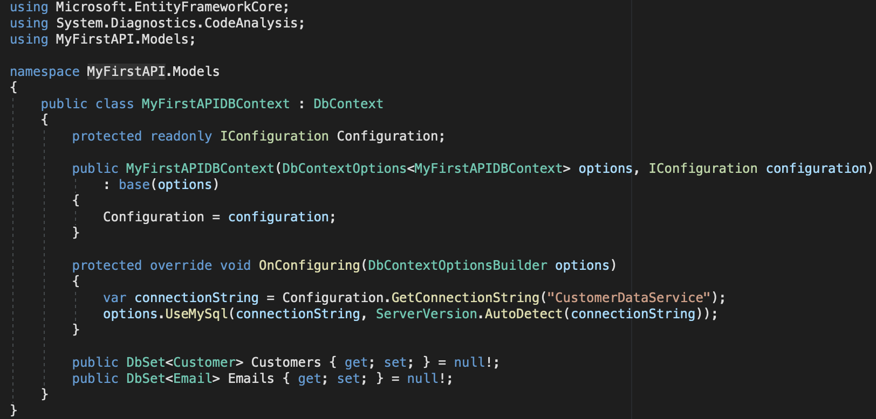
Now, follow the same steps for your models another time to make your database context (class that inherits from the DbContext class in Entity Framework).
The database context is the main class that coordinates Entity Framework functionality for a data model.
= null!; is just a way of promising that this non-nullable property will eventually have a value before it is used, even though it is null upon initialization.
Now, if you try to run your app, you’ll notice a number of errors. Try to look at them and tell me what you think. Looks like we need to download some NuGet packages. Download the Microsoft.EntityFrameworkCore NuGet Package, as well as Microsoft.EntityFrameworkCore.InMemory and Pomelo.EntityFrameworkCore.MySql.

Slide 15
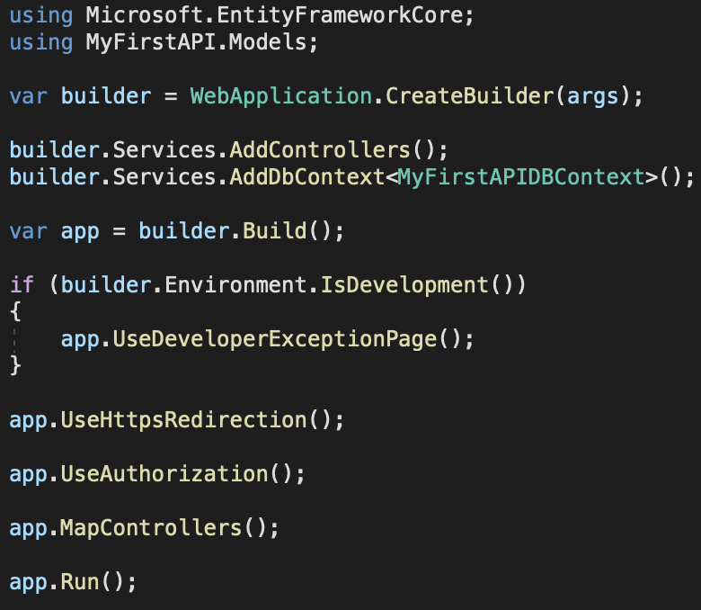
Now, go back to your Program.cs file. Make it look like this.
This code:
Removes the Swagger calls.
Properly sets up using directives.
Registers our DbContext.

Slide 16
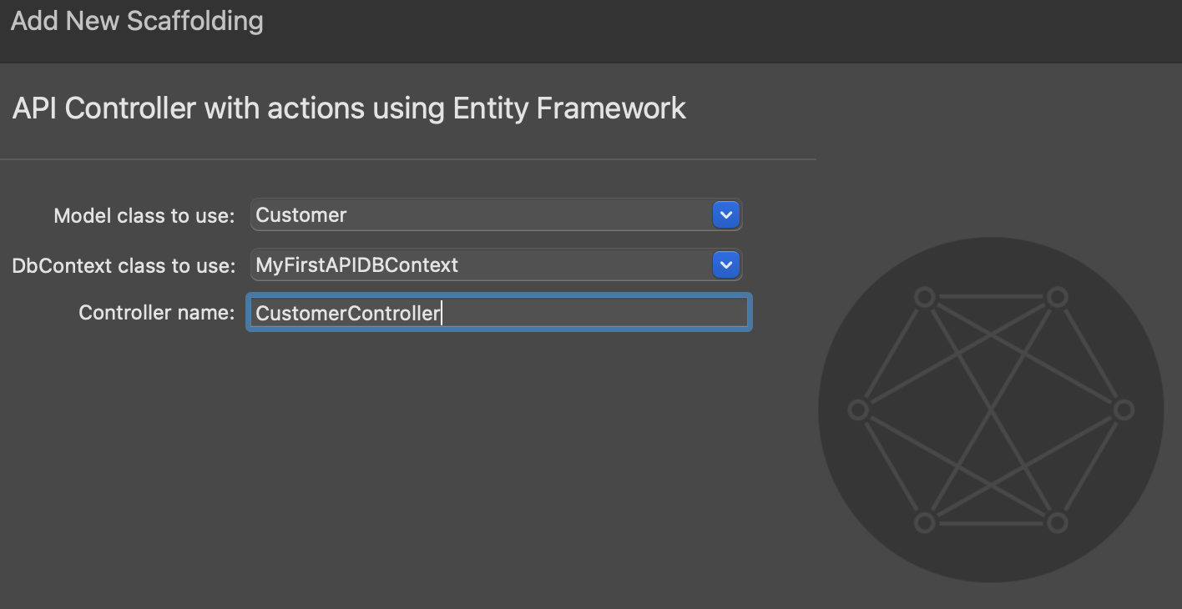
Next, right-click your Controller folder and select Add > New Scaffolding…
Select API Controller with actions using Entity Framework. Set your API controller values as shown here.

Slide 17
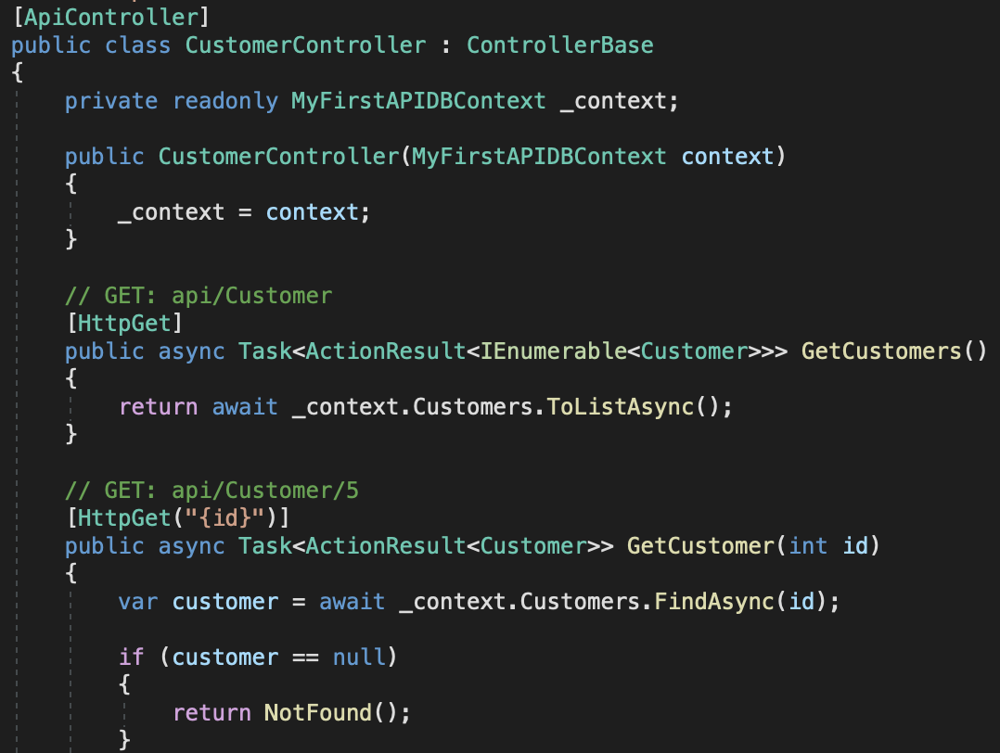
The generated code in Controllers > CustomerController:
Marks the class with the [ApiController] attribute. This attribute indicates that the controller responds to web API requests.
Uses DI to inject the database context (MyFirstAPIDBContext) into the controller. The database context is used in each of the methods in the controller to interact with the database.

Slide 18
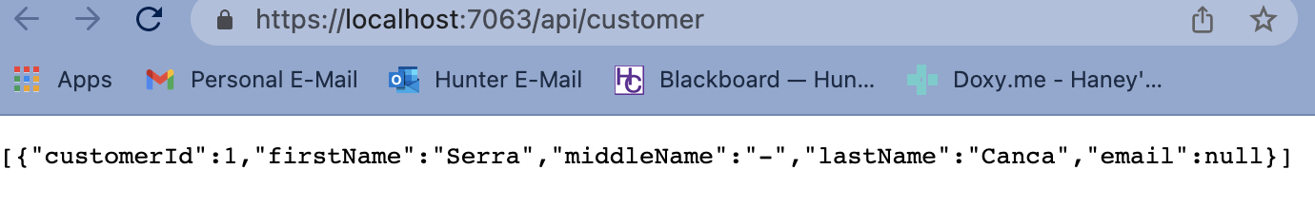
Run your app. Your web browser should be able to run GET queries on your API now! Try both GET queries in your controller, with and without an id number added to the end (so, https://localhost:7063/api/customer/1 in my case)
Your API is officially up and running locally! Typically, you’d still need to add additional logic for handling validation as well as the Email children of Customers (all of this could be done in your controller or in other files, depending on what additional frameworks you want to or don’t want to use, as well as how simple your logic really is.)

