Slide 1

Assignment 6A: VAR model and multiperiod forecast
Chengyu.Wang(2253811)
Sheng.Bi (2254760)
Jinfan.Zhang(2253970)
Zhuoran.Wang (2253847)
2025.4.30

Slide 2
Presentation Content
1.1 The definition of IRF
1.2 Interpretation of the IRF
1.3 Stata implementation of this analysis
Introduce the relevant commands
2.1 Estimate a VAR(1) model
2.2 Plot the IRF function for 4 steps
2.3 Show the numeric values of this IRF function
3.1 Reproduce the numeric values of the IRF function

Slide 3
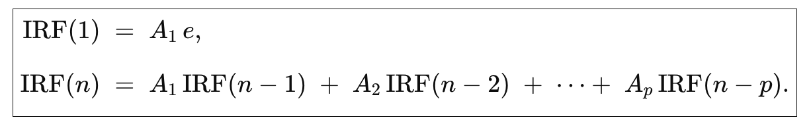
The definition of IRF.
In the VAR model, the impulse response function measures: when a certain variable is subjected to a unit shock at a certain period, the magnitude and direction of the response of other variables to that shock in subsequent periods. It is often used to analyze the dynamic causal relationships among macroeconomic variables.
Impulse Response Function (IRF) in VAR(n) model：
A_{p} (k×k matrix): The pth‐lag autoregressive coefficient matrix, captures how each variable at time t depends linearly on all variables at time t−p.
e (k×1 vector): A unit structural shock, typically a basis vector that applies a “one‐unit” shock to one variable while holding all others at zero.

Slide 4
The definition of IRF.
IRF(n) (k×1 vector): The system’s response at horizon n to the initial shock e. Each element measures the deviation of a variable from its baseline path.
p: The VAR’s lag order, indicating how many past periods’ effects are included in the propagation.
Direct Impact (n=1): IRF(1)=A₁e quantifies the immediate effect of the shock in the next period.
Cumulative Transmission (n>1): Each subsequent response is a weighted sum of past responses via A₁,...,A_{p}, reflecting the shock’s propagation through multiple dynamic channels.
Decay & Persistence: In a stationary VAR, IRF(n) typically decays toward zero as n increases—indicating transitory effects. Slower decay or non‐zero long‐run values suggest more persistent or permanent impacts.

Slide 5
Interpretation of the IRF
Duration of the Effect
The IRF shows how long the effect lasts. A short-lived response indicates that the shock has a transitory effect on the economy, while a longer response might indicate that the shock has a more lasting or permanent effect. The decay of the IRF over time shows whether the system returns to equilibrium or whether the shock has long-lasting consequences.
Conclusion: IRFs are indispensable tools in macroeconomics, especially for forecasting and policy analysis. They help:
Quantify the dynamic effects of shocks.
Explain the transmission mechanisms of shocks across the economy.
Allow policymakers to predict how policy interventions (e.g., changes in interest rates) will affect economic variables over time.
IRFs provide a clear, interpretable view of how variables in an economy respond to external shocks, making them far more useful than autoregressive coefficients for answering policy-relevant questions like the effects of demand shocks on GDP or inflation over time.

Slide 6
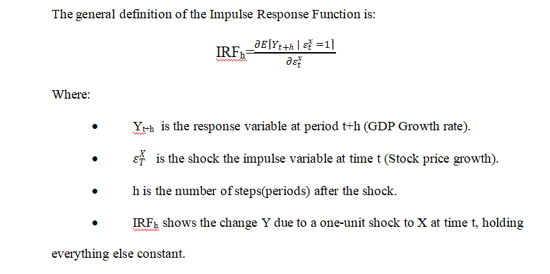
Interpretation of the IRF
An Impulse Response Function (IRF) analyses the relationship between time series variables and is particularly derived from a vector autoregressive model (VAR) (Lütkepohl, H. 2010). The vector autoregressive model is used to understand the linear interdependencies between the variables and assumes the variables depend on the past values of the variables in a system.

Slide 7
Interpretation of the IRF
The function not only shows the reactions of the variables to a shock, but also quantifies the effect of the shock in terms of both magnitude and direction in a system. In this macroeconomic context, the IRF shows how a shock to the stock price growth affects the GDP growth over subsequent quarters.

Slide 8
Interpretation of the IRF
The above equation will give a series of shock coefficients by variable coefficients. In our case, the VAR model will have the two variables, namely, GDP Growth and Stock Price Growth, and the IRF will show the expected changes in the GDP Growth following the shock at various quarters. The IRF will either be positive or negative; a positive IRF implies that the response variable increases after a shock in the shock variable. On the other hand, a negative IRF shows that the response variable decreases after the shock on the shock variable.
To implement the Impulse Response Function in Stata, the following commands were used to create the IRF from a VAR model and call the IRF. (Attached in the .do file)

Slide 9
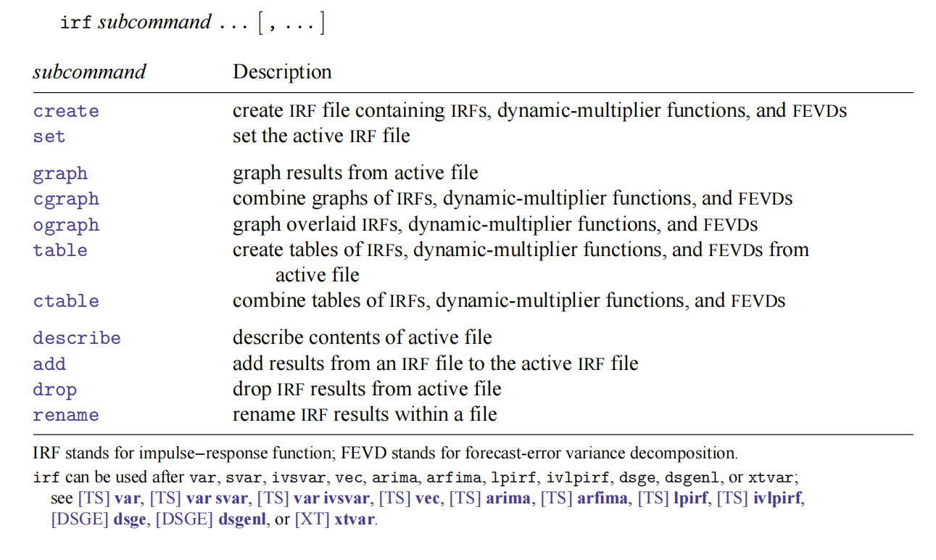
Stata implementation

Slide 10
Step 1: Calculating GDP Growth Rate and Stock Price Growth Rate:
Q(b) part1:
Stata Code:
gen gdpgr = (ln(gdpc1) - ln(L.gdpc1)) * 400
gen shagr = (ln(share) - ln(L.share)) * 400
Explanation:
1.GDP growth rate calculated as the difference between the natural logs of current and previous period GDP, multiplied by 400 to annualize the growth rate.
2.Stock price growth rate calculated similarly for the stock prices.

Slide 11
Step 2: Estimating VAR(1) Model
Stata Code:
var gdpgr shagr if tin(1970q1,2024q4), lags(1)
Explanation:
1. Command used to estimate the Vector Autoregressive model with 1 lag.
2. The model includes two variables: gdpgr (GDP growth rate) and shagr (Stock price growth rate).
3. Specifies a lag length of 1, meaning the model uses one previous period’s data to predict the current period.

Slide 12
Step 3: Generating the Impulse Response Function (IRF)
Stata Code:
irf create model_irf, replace
irf graph oirf, impulse(shagr) response(gdpgr)
Explanation:
1.Creates an IRF object named "model_irf" to store the IRF results.
2.Generates the IRF graph, with shagr as the impulse variable and gdpgr as the response variable.

Slide 13
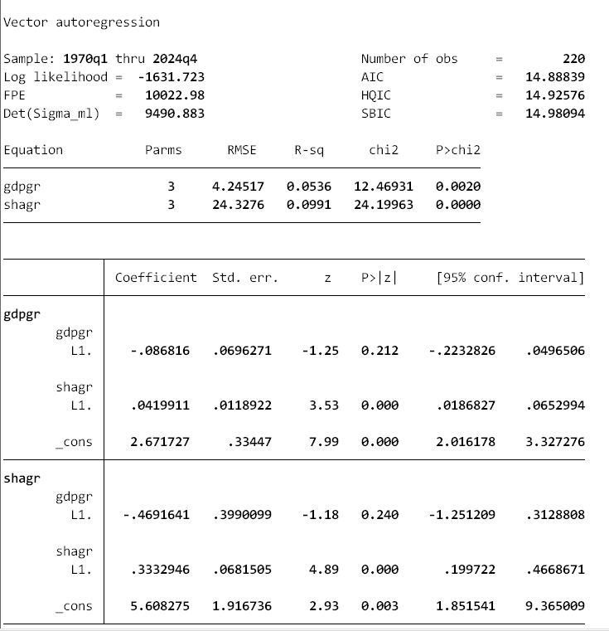
Table:

Slide 14
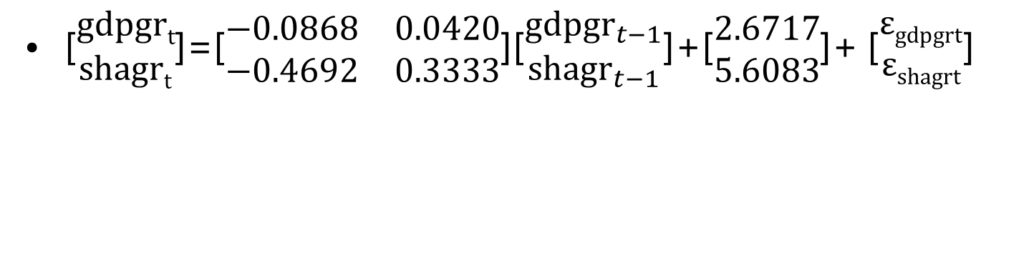
Final function
[$\begin{matrix}gdpgrt \\ shagrt\end{matrix}$]=[$\begin{matrix}−0.0868 & 0.0420 \\ −0.4692 & 0.3333\end{matrix}$][$\begin{matrix}{gdpgr}_{t−1} \\ {shagr}_{t−1}\end{matrix}$]+[$\begin{matrix}2.6717 \\ 5.6083\end{matrix}$]+ [$\begin{matrix}εgdpgrt \\ εshagrt\end{matrix}$]
Meaning of coefficient：
-0.086816 represents the impact of gdpgr at time t-1 on gdpgr at time t, indicating that changes in gdpgr from the previous period have a negative effect on the current period's gdpgr.
0.0419911 represents the impact of shagr at time t-1 on gdpgr at time t, indicating that changes in stock prices positively influence the economic growth rate.

Slide 15
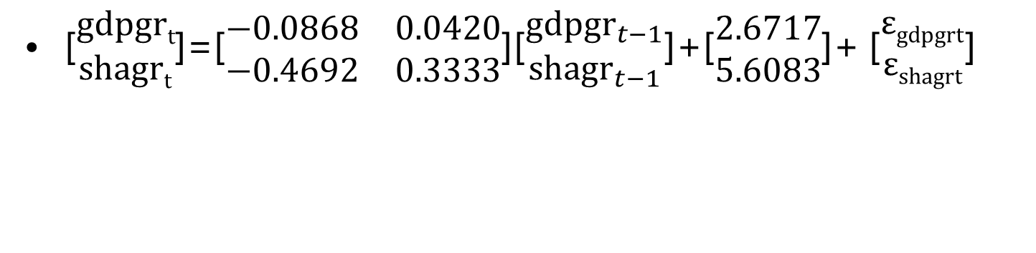
Final function
[$\begin{matrix}gdpgrt \\ shagrt\end{matrix}$]=[$\begin{matrix}−0.0868 & 0.0420 \\ −0.4692 & 0.3333\end{matrix}$][$\begin{matrix}{gdpgr}_{t−1} \\ {shagr}_{t−1}\end{matrix}$]+[$\begin{matrix}2.6717 \\ 5.6083\end{matrix}$]+ [$\begin{matrix}εgdpgrt \\ εshagrt\end{matrix}$]
Meaning of coefficient：
-0.4691641 represents the impact of gdpgr at time t-1 on shagr at time t, indicating that changes in the economic growth rate negatively affect stock price changes.
0.3332946 represents the impact of shagr at time t-1 on shagr at time t, indicating that changes in stock prices positively affect the current period's stock price.

Slide 16
Plot the IRF function
Plot the IRF function for 4 steps, with 𝑠ℎ𝑎𝑔𝑟𝑡 as the impulse and 𝑔𝑑𝑝𝑔𝑟𝑡 as the response.
//Generate the IRF for 4 steps (steps = 4 periods)
irf set myirf, replace
irf create model_irf, replace step(4)
Set up an impulse response function (IRF) file named myirf. Then, create an IRF set named model_irf and calculate the impulse responses for 4 periods. If there are existing files or function sets with the same names, they will be replaced with the new content

Slide 17
Plot the IRF function
Plot the IRF function for 4 steps, with 𝑠ℎ𝑎𝑔𝑟𝑡 as the impulse and 𝑔𝑑𝑝𝑔𝑟𝑡 as the response.
//Draw the Impulse Response Function
irf graph irf, impulse(shagr) response(gdpgr)
Use this command to draw the Impulse Response Function (IRF) graph. The impulse response (shagr) is used to demonstrate the response of gdpgr in the system at different time points when an endogenous variable is subjected to a unit impulse (impact) in a vector autoregressive (VAR) model.

Slide 18
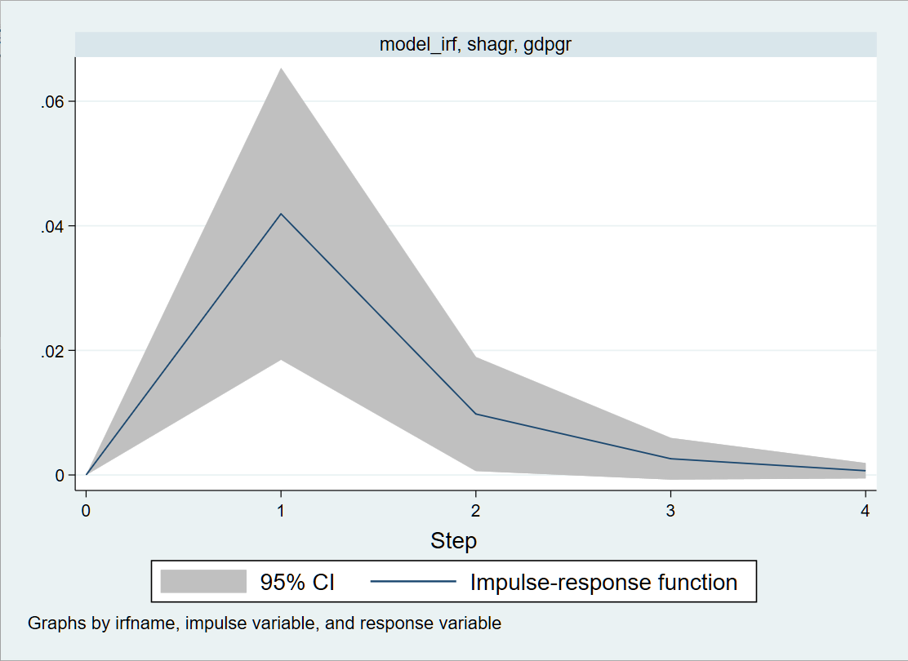
Plot the IRF function
irf graph irf, impulse(shagr) response(gdpgr)
The blue solid line represents the impulse - response function, which is the response degree of the response variable at 4 step lengths after receiving a unit impulse(shagr).
The gray shaded area represents the 95% confidence interval, which is used to measure the uncertain range of the impulse - response estimation.

Slide 19
Plot the IRF function
irf graph irf, impulse(shagr) response(gdpgr)
From the plot above, the immediate impact is when the step is 0. As seen on step 0, there is no immediate impact of a share price shock on the GDP growth, because the response of GDP growth in the same period as the shock is zero.
In step 1, known as the short-run response, the real GDP has a significant growth of approximately 0.042.

Slide 20
Plot the IRF function
irf graph irf, impulse(shagr) response(gdpgr)
At the 2-4 steps, there are diminishing effects, this is because the shock effect diminishes over time.
At step 2, the effect drops to 0.0098, at step 3, the response is approximately 0.0026, and at step 4, the response further declines to 0.00068. This implies that the positive effect of the share price shocks on the GDP has short-run effects and diminishing with time.

Slide 21
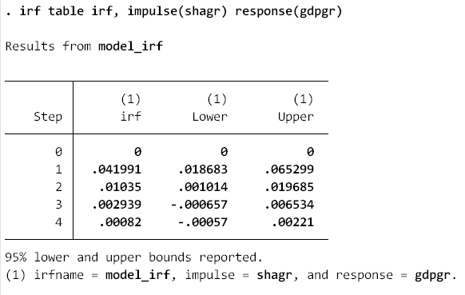
The Numeric Values of the IRF Function
In step 1, the value of IRF is 0.041991, and the confidence interval does not include 0. The real GDP growth is statistically significant.
The IRF value in step 2 is 0.01035, and the effect is slightly significant as the lower number of the confidence interval is 0.001014, which is near 0.

Slide 22
The Numeric Values of the IRF Function
On the other hand, the numeric value of IRF in step 3 is 0.02939, The numeric value of IRF in step 4 is 0.00082, and these two values are not statistically significant because the confidence interval includes 0.

Slide 23
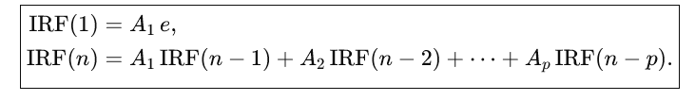

Use the model to reproduce the numeric values
//Generate matrix A1 and e
matrix A = e(b)
matrix A1 =(A[1,1], A[1,2] \ A[1,4],A[1,5])
matrix e = (0, 1)'

Slide 24
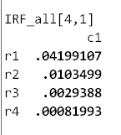
Use the model to reproduce the numeric values
//Obtain the values of IRF
matrix A_power = A1
forval t = 1/4 {
matrix IRF = A_power * e
matrix IRF_all[`t', 1] = IRF[1,1]
matrix A_power = A_power * A1
}
matrix list IRF_all
Through these stata codes, the four-period values of IRF are obtained

Slide 25
Use the model to reproduce the numeric values
Compared with the IRF result in question b, the results are the same. Therefore, the values of IRF are successfully reproduced through the model

Slide 26
Reference List
Stock, J.H. and Watson, M.W. (2001) ‘Vector Autoregressions’, The Journal of Economic Perspectives, 15(4), pp. 101–115. Available at: https://elink-xjtlu-edu-cn-s.elink.xjtlu.edu.cn:443/go?url=https://search-ebscohost-com-s.elink.xjtlu.edu.cn:443/login.aspx?direct=true&db=edsjsr&AN=edsjsr.2696519&site=eds-live&scope=site.
Kilian, L. (2001) ‘Impulse Response Analysis in vector Autoregressions with Unknown Lag Order’, Journal of Forecasting, 20(3), pp. 161–179. doi:10.1002/1099-131X(200104)20:3<161::AID-FOR770>3.0.CO;2-X.
Zivot, E. and Wang, J. (2003) Vector Autoregressive Models for Multivariate Time Series. New York, NY: Springer New York. doi:10.1007/978-0-387-21763-5_11.

Slide 27
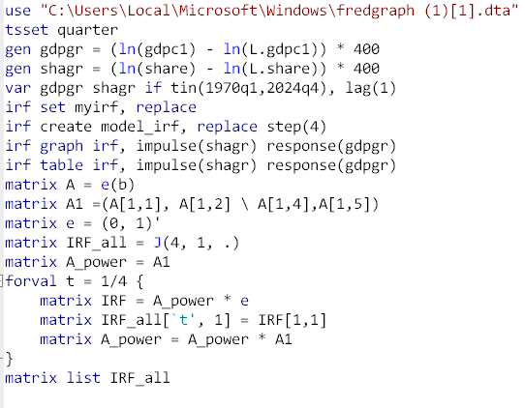
Appendix

Slide 28
Thanks

