Slide 1
ECO214 Group Presentation
Assignment 2B:
Theory
ADL model
AIC vs BIC
Granger test
ADL Model and Information Criteria
Data
Inflation forecasting with U.S. quarterly data, 1970Q1-2019Q4
CPIAUCSL
UNRATE
1970Q1-2019Q4
Evidence
AR(3)
ADL(3,1)
ADL(3,3)
Group members: [Name 1], [Name 2], [Name 3], [Name 4]
Date: [Add your presentation date]
ECO214 | Assignment 2B
01

Slide 2
Presentation Content
Roadmap
1.1 Research question and data
1.2 ADL, AIC/BIC, and Granger causality
What are we forecasting, over which sample, and how is inflation constructed?
Why lag selection matters and what the tests mean economically.
2.1 Stata implementation
2.2 Empirical results
How we generate variables, estimate models, and compare information criteria.
AR selection, ADL selection, coefficient interpretation, and Granger test.
3.1 Final answers
A clear slide that answers parts (a) to (d) directly for the marker.
Presentation design logic
We follow the same strong structure as the previous high-scoring deck: theory first, implementation second, evidence third, and direct assignment answers at the end.
ECO214 | Assignment 2B
02

Slide 3
The Definition of ADL
Theory
ADL specification
infl_t = a + sum_{i=1}^p b_i infl_{t-i} + sum_{j=0}^q g_j unrate_{t-j} + u_t
The model combines inflation persistence with current and lagged unemployment information.
AR block
Distributed lags
Assignment link
The lagged inflation terms capture inertia and persistence in price dynamics.
The unemployment terms let the model test whether labor-market conditions help forecast inflation.
Part (b) selects AR(p).
Part (c) adds unemployment and selects ADL(p,q).
Why use ADL here?
Inflation is persistent, but the Phillips-curve intuition suggests unemployment may add predictive information with lags. ADL is a natural forecasting framework for that question.
ECO214 | Assignment 2B
03

Slide 4
Interpretation of AIC and BIC
Theory
AIC
BIC
AIC = -2 ln(L) + 2k
AIC rewards fit and uses a lighter penalty for extra parameters.
BIC = -2 ln(L) + k ln(n)
BIC penalizes model size more heavily when n is large.
Same sample
Penalty gap
Expected outcome
All candidate models are compared on the same 200-quarter sample.
Here, ln(200) is about 5.30, much larger than the AIC penalty of 2.
AIC usually keeps more lags. BIC usually prefers a smaller model.
How to interpret disagreement
If AIC and BIC choose different models, that does not mean one is wrong. It means the fit gain from extra lags is real, but BIC judges that gain too small relative to the added complexity.
ECO214 | Assignment 2B
04

Slide 5
Interpretation of Granger Causality
Theory
Predictive causality, not structural causality
In this assignment, unemployment Granger-causes inflation if lagged unemployment improves inflation forecasts after controlling for lagged inflation.
Null hypothesis
Decision rule
H0: gamma_1 = gamma_2 = gamma_3 = 0
The lagged unemployment terms do not add predictive power.
If the joint F-test rejects H0, we conclude that unemployment helps forecast inflation in the ADL(3,3) specification.
Economic meaning
The test asks whether labor-market slack contains incremental forecasting information. It does not prove a deep structural Phillips curve by itself, but it is useful evidence for short-run prediction.
ECO214 | Assignment 2B
05

Slide 6
Data and Variable Construction
Empirics
Series
Role in analysis
CPIAUCSL
Used to construct inflation
UNRATE
Predictor in the ADL model
infl_t
Annualized quarterly inflation rate
Inflation formula
Sample
Lag handling
infl_t = (ln(cpiaucsl_t) - ln(cpiaucsl_{t-1})) * 400
1970Q1 to 2019Q4
200 quarterly observations
Pre-1970 data are used only as initial values for lagged regressors.
Empirical goal
Forecast inflation, choose lag lengths with AIC/BIC, and test whether unemployment Granger-causes inflation.
ECO214 | Assignment 2B
06

Slide 7
Stata Implementation
Workflow
Data preparation
Model comparison and test
tsset quarter_date
gen infl = (ln(cpiaucsl) - ln(L.cpiaucsl)) * 400
forvalues i = 1/4 {
gen infl_lag`i' = L`i'.infl
gen unrate_lag`i' = L`i'.unrate
}
keep if tin(1970q1, 2019q4)
forvalues p = 0/4 {
regress infl infl_lag1 ... infl_lag`p'
estat ic
}
regress infl infl_lag1 infl_lag2 infl_lag3 \
unrate unrate_lag1 unrate_lag2 unrate_lag3
test unrate_lag1 unrate_lag2 unrate_lag3
Important implementation detail
We generate lagged variables before restricting the sample. That keeps the comparison sample fixed at 200 observations, exactly as the assignment instructions require.
ECO214 | Assignment 2B
07

Slide 8
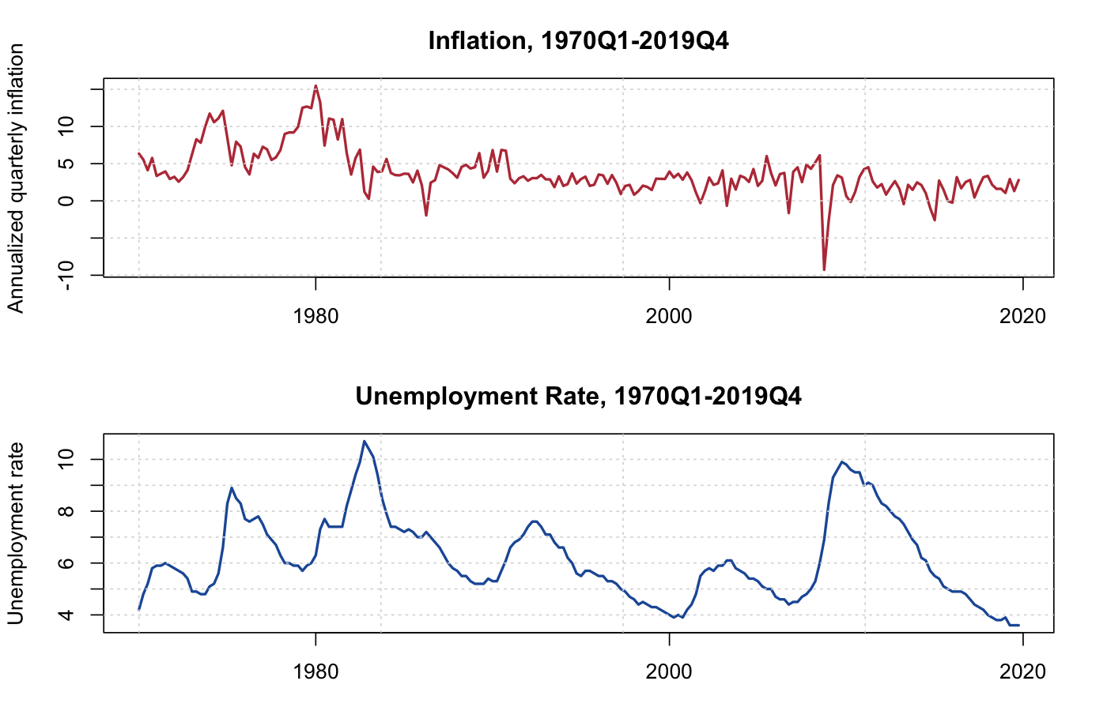
Data Overview
Plots
Pattern 1
Inflation is high and volatile in the 1970s and early 1980s, then becomes lower and more stable.
Pattern 2
Unemployment shows strong business-cycle variation, especially in the early 1980s and after 2008.
Pattern 3
The contemporaneous Phillips-curve relationship is not stable; lagged dynamics matter more.
ECO214 | Assignment 2B
08

Slide 9
AR(p) Model Results
Part (b)
p
AIC
BIC
Comment
0
1028.16
1031.46
No dynamics
1
863.35
869.95
Large improvement
2
860.17
870.07
Better fit
3
842.13
855.32
Selected by AIC and BIC
4
843.94
860.43
Extra lag not needed
Selected model
Interpretation
Both AIC and BIC choose AR(3).
Inflation contains substantial serial dependence, and three lags capture most of that persistence.
ECO214 | Assignment 2B
09

Slide 10
ADL(p,q) Model Results
Part (c)
Main result
BIC selects ADL(3,1), while AIC selects ADL(3,3). This is exactly the pattern we expect when AIC is more willing to keep extra lags.
Best by BIC
BIC
Comment
Best by AIC
AIC
Comment
ADL(3,1)
857.64
Most parsimonious winner
ADL(3,3)
832.97
Best overall fit
ADL(3,0)
858.55
Close second
ADL(4,3)
834.91
Very close
ADL(3,3)
859.36
Better fit, but more parameters
ADL(3,4)
834.92
Very close
ADL(3,2)
860.17
Still competitive
ADL(4,4)
836.87
Adds more lags
Economic interpretation
The richer ADL(3,3) improves fit enough for AIC, but BIC judges the extra unemployment lags too expensive relative to its stronger penalty term.
ECO214 | Assignment 2B
10

Slide 11
ADL(3,3) Estimation Results
Part (d)
Variable
Coef.
p-value
Interpretation
infl_lag1
0.576
0.000
Strong inflation persistence
infl_lag2
-0.009
0.910
Not significant
infl_lag3
0.344
0.000
Additional persistence at lag 3
unrate
-0.654
0.243
Current unemployment not significant
unrate_lag1
-1.173
0.256
No first-lag effect
unrate_lag2
3.022
0.004
Positive delayed effect
unrate_lag3
-1.330
0.016
Negative delayed effect
Model fit
Key message
Adj. R-squared = 0.636
Root MSE = 1.904
Inflation remains persistent, while unemployment affects inflation with delayed rather than immediate dynamics.
ECO214 | Assignment 2B
11

Slide 12
Interpreting ADL(3,3)
Results
Inflation persistence
No immediate unemployment effect
infl_lag1 and infl_lag3 are positive and highly significant, which means inflation is not memoryless.
The contemporaneous unemployment rate is not significant once lagged inflation is controlled for.
Delayed transmission
Diagnostics
unrate_lag2 and unrate_lag3 are significant, so unemployment influences inflation mainly through lags.
Ljung-Box p-values at lags 4 and 8 are above 0.5, so residual autocorrelation is not an obvious concern.
Overall interpretation
The evidence fits a dynamic, lagged Phillips-curve type story better than a simple contemporaneous trade-off story.
ECO214 | Assignment 2B
12

Slide 13
Granger-Causality Test
Part (d)
Null hypothesis
H0: unrate_lag1 = unrate_lag2 = unrate_lag3 = 0
Main Granger test
Joint test with current unrate
F(3,192) = 5.02
p-value = 0.0023
Reject H0 at the 1% level.
F(4,192) = 4.30
p-value = 0.0024
The full unemployment block is jointly significant.
Conclusion
Within this linear ADL(3,3) specification and this sample, unemployment Granger-causes inflation because lagged unemployment adds statistically significant forecasting information.
ECO214 | Assignment 2B
13

Slide 14
Why AIC and BIC Disagree
Interpretation
AIC lens
BIC lens
AIC focuses more on predictive fit. It is willing to keep the extra unemployment lags because ADL(3,3) lowers the objective enough to justify a richer model.
BIC punishes complexity more harshly, so it stops at ADL(3,1). The gain from adding more unemployment lags is judged too small relative to the penalty.
Criterion
Penalty per extra parameter
Preferred model
AIC
2
ADL(3,3)
BIC
ln(200) about 5.30
ADL(3,1)
Bottom line
Both criteria tell the same broad story: lagged unemployment matters. They simply disagree on how much complexity is worth keeping.
ECO214 | Assignment 2B
14

Slide 15
Final Answers to the Assignment
Summary
(a) Plot pattern
(b) AR selection
Inflation is high and volatile in the 1970s/early 1980s, then lower and more stable. Unemployment is cyclical, and the contemporaneous relationship is not stable.
Both AIC and BIC choose AR(3).
(c) ADL selection
(d) Granger causality
BIC chooses ADL(3,1), while AIC chooses ADL(3,3). Yes, this is consistent with the idea that AIC tends to choose a more complex model.
Yes. In ADL(3,3), we reject H0 that the lagged unemployment terms are jointly zero.
One-sentence takeaway
Inflation is persistent, unemployment adds delayed predictive content, and model selection becomes more conservative under BIC than under AIC.
ECO214 | Assignment 2B
15

Slide 16
Reference List
References
Akaike, H. (1974) A new look at the statistical model identification.
Schwarz, G. (1978) Estimating the dimension of a model.
Granger, C.W.J. (1969) Investigating causal relations by econometric models and cross-spectral methods.
Stock, J.H. and Watson, M.W. Introductory Econometrics / course materials on dynamic models and forecasting.
FRED data series used in fredgraph.dta: CPIAUCSL and UNRATE.
Note
The empirical results in this deck were reproduced in StataSE using the do-file prepared for the assignment.
ECO214 | Assignment 2B
16

Slide 17
Appendix: Core Stata Code
Appendix
Lag construction and sample definition
ADL estimation and Granger test
gen infl = (ln(cpiaucsl) - ln(L.cpiaucsl)) * 400
forvalues i = 1/4 {
gen infl_lag`i' = L`i'.infl
gen unrate_lag`i' = L`i'.unrate
}
keep if tin(1970q1, 2019q4)
forvalues p = 0/4 {
regress infl infl_lag1 ... infl_lag`p'
estat ic
}
forvalues p = 0/4 {
forvalues q = 0/4 {
regress infl infl_lag* unrate unrate_lag*
estat ic
}
}
regress infl infl_lag1 infl_lag2 infl_lag3 \
unrate unrate_lag1 unrate_lag2 unrate_lag3
test unrate_lag1 unrate_lag2 unrate_lag3
ECO214 | Assignment 2B
17

Slide 18
Thanks
Closing
Thank you
Questions and suggestions are welcome.
You can replace the placeholders with your group names and date before presenting.
ECO214 | Assignment 2B
18

