Slide 1
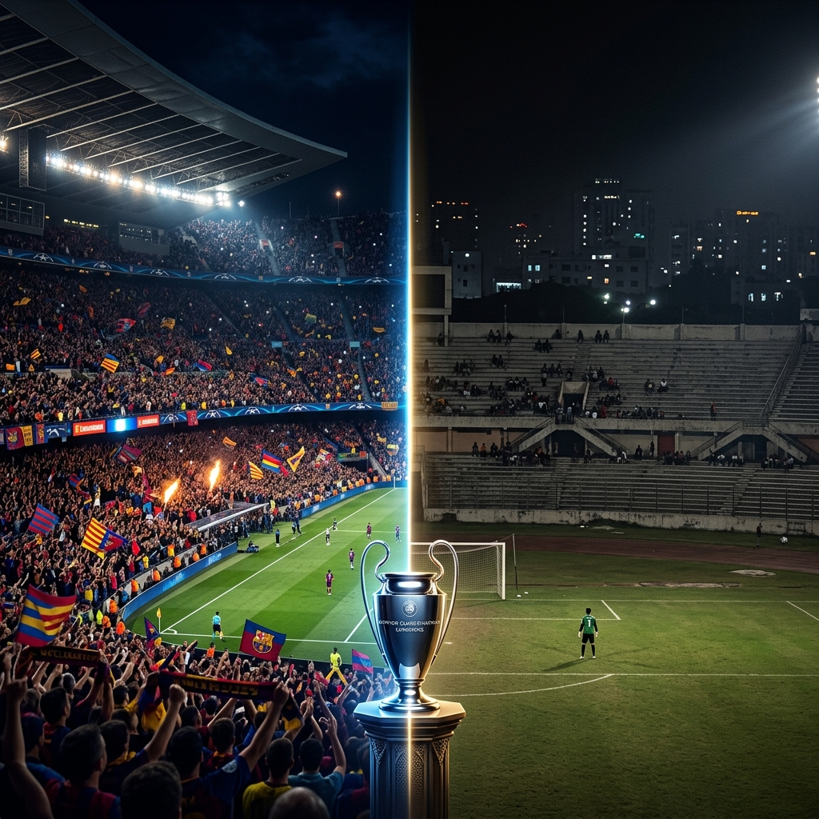
Why Bangladesh Premier League
Fails to Attract Urban Youth
A Research Presentation on BPL Fan Engagement & Youth Disconnect
Batch 232 — Textile Department
PRESENTED BY
TOPIC OVERVIEW
◆ 2230800230 — Mahmudul Hasan
⚽ BPL Fan Engagement
◆ 2230800231 — Md. Rahat
📊 Statistical Comparison
◆ 2230800232 — Md. Rifat
🎯 Root Causes & Analysis
◆ 2230800233 — Md. Tanvir
💡 Actionable Recommendations
◆ 2230800234 — Md. Towhid
🏆 Vision for BPL's Future
© Copyright by Tahorim Somrat • Why BPL Fails to Attract Urban Youth | Batch 232 — Textile Department

Slide 2
THE REALITY
02
Bangladesh Loves Football ❤️
B U T . . .
Bangladesh Doesn't Watch Local Football ❌
🌍 European Football
🇧🇩 Bangladesh Premier League
✔ Millions of Bangladeshi Fans watching
❌ Very low stadium attendance
✔ Enormous Social Media Buzz daily
VS
❌ Minimal social media presence
✔ Packed stadiums & electric atmosphere
❌ Limited broadcast coverage
✔ Global superstars & brand power
❌ No internationally known star players
✔ High-quality TV production & coverage
❌ Weak marketing & fan engagement
© Copyright by Tahorim Somrat • Why BPL Fails to Attract Urban Youth | Batch 232 — Textile Department

Slide 3
KEY STATISTICS
03
The Numbers Don't Lie 📊
Bangladesh vs. European Football — Viewership & Engagement Data
90%
12%
3M+
Bangladeshis follow at least one European club
Follow BPL clubs actively on social media
Bangladeshis watch EPL live every week
8,000
60,000
< 5%
Average BPL stadium attendance per match
Stadium capacity rarely used — only 13% filled
Youth aged 18–30 who watch BPL regularly
* Sources: Bangladesh Football Federation (BFF), Statista, Sports Research BD
© Copyright by Tahorim Somrat • Why BPL Fails to Attract Urban Youth | Batch 232 — Textile Department

Slide 4
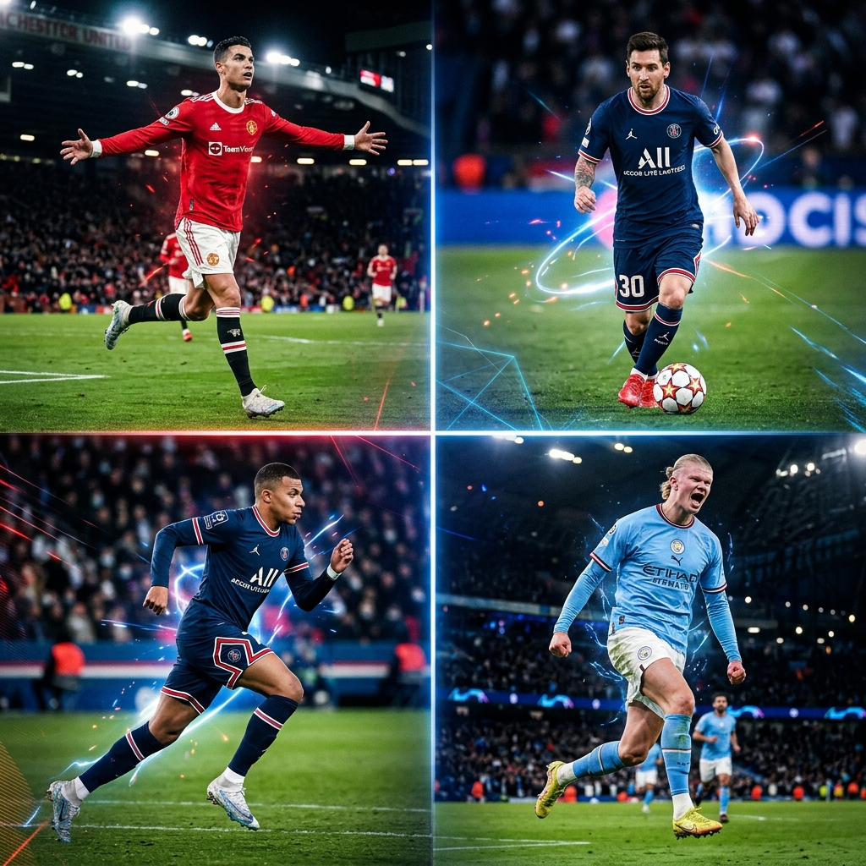
WHY EUROPEAN FOOTBALL?
04
5 Reasons Youth Prefer European Football
1
⚡ Superstar Power
Ronaldo, Messi, Mbappé — icons with 500M+ social followers
2
🎬 World-Class Broadcast
4K coverage, expert commentary, UEFA app & highlights
3
🏟️ Electrifying Atmosphere
50,000+ packed stadiums, ultras, flares, chants worldwide
4
📱 Digital & Social Media
Viral clips, TikTok, YouTube — content available 24/7
5
🌐 Global Brand Identity
Club shirts, merchandise, FIFA games — culture & lifestyle
© Copyright by Tahorim Somrat • Why BPL Fails to Attract Urban Youth | Batch 232 — Textile Department

Slide 5
BPL STRUGGLES
05
Why Bangladesh Premier League Struggles ⚠️
📣
Poor Marketing
📺
Weak Broadcasting
No star promotions, no hype campaigns, no youth outreach programs
Inconsistent TV schedule, poor stream quality, no streaming app
🌟
No Star Players
🏟️
Stadium Experience
Local players lack global recognition; no foreign marquee signings
Outdated venues, poor facilities, security concerns deter attendance
💰
Financial Instability
📱
Digital Absence
Clubs face funding issues; salaries delayed; no investor confidence
Almost zero social media strategy; no highlight reels or shorts
© Copyright by Tahorim Somrat • Why BPL Fails to Attract Urban Youth | Batch 232 — Textile Department

Slide 6
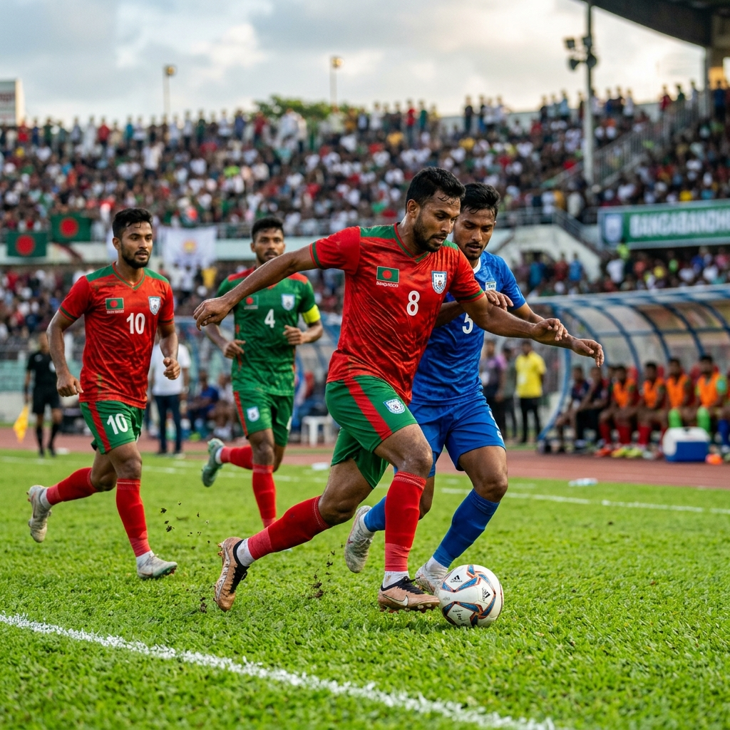
BANGLADESHI FOOTBALL STARS
06
Bangladesh Has Talented Players — But Lacks Exposure 🇧🇩
🟢
Hamza Choudhury
British-Bangladeshi midfielder, Leicester City FC First Bangladeshi-origin player in Premier League
🟢
Jamal Bhuyan
Bangladesh national team captain & midfielder Played in professional leagues in Denmark & Spain
🟢
Sheikh Morsalin
Top scorer of Bangladesh national team Known for explosive speed and clinical finishing
🟢
Biplu Ahmed
Experienced winger for national team BFF Player of the Year multiple times
🟢
Rakib Hossain
Young talent from Abahani FC Considered the next big prospect of Bangladeshi football
© Copyright by Tahorim Somrat • Why BPL Fails to Attract Urban Youth | Batch 232 — Textile Department

Slide 7
INTERNATIONAL STARS
07
Why Global Stars Drive Fan Engagement 🌟
⭐ Cristiano Ronaldo
635M+ Instagram followers Global brand worth $1.5 billion
⭐ Lionel Messi
500M+ followers; Inter Miami Argentina World Cup hero 2022
⭐ Kylian Mbappé
Real Madrid star; fastest in EPL era France's golden generation leader
⭐ Erling Haaland
52 goals/season — Man City striker Most watched striker in the world
💡 BPL needs a similar star culture to attract youth viewers!
© Copyright by Tahorim Somrat • Why BPL Fails to Attract Urban Youth | Batch 232 — Textile Department

Slide 8
MARKETING FAILURE
08
BPL's Marketing vs. European Football Marketing 📣
BPL Marketing ❌
European Football ✔
❌ No official promotion on social media
✅ 100M+ ad spend per club per season
❌ Zero youth ambassador programs
✅ Global ambassador partnerships
❌ No jersey culture or merchandise stores
✅ Official jerseys sold in 180+ countries
❌ Matches not promoted on mainstream TV
✅ Prime time slots + dedicated channels
❌ No fan zones or pre-match events
✅ Fan experience zones in every stadium
© Copyright by Tahorim Somrat • Why BPL Fails to Attract Urban Youth | Batch 232 — Textile Department

Slide 9
BROADCASTING FAILURE
09
The Broadcasting Gap 📺
📺
No Streaming Platform
BPL has no official app or OTT platform; European leagues have Prime Video, DAZN, Peacock, Disney+
🎙️
Poor Commentary
Local broadcasting lacks professional commentary; no English or multilingual options
📷
Camera Quality
Single-camera coverage vs. UEFA's 30+ camera, VR, 4K drone coverage
⏰
Irregular Scheduling
Match times change last minute; no fixed schedule disrupts fan planning
🌍
No International Feed
BPL matches unavailable outside Bangladesh; zero global audience growth
© Copyright by Tahorim Somrat • Why BPL Fails to Attract Urban Youth | Batch 232 — Textile Department

Slide 10
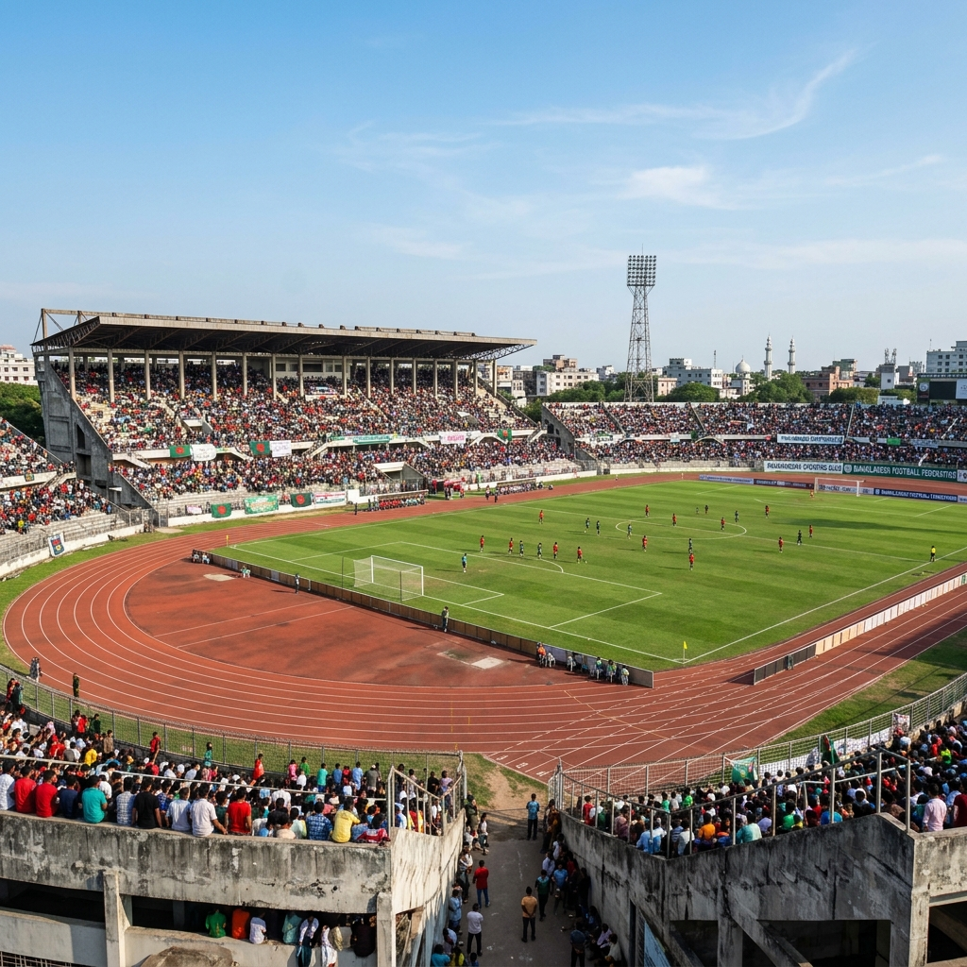
STADIUM EXPERIENCE
10
Stadium Experience: Night & Day Difference 🏟️
🚧
Poor Infrastructure
Old, poorly maintained stands with broken seats
🔒
Security Concerns
Crowd management issues scare away families & women
🍔
No Food/Entertainment
No food courts, fan zones, or entertainment areas
🚌
Transport Access
Lack of easy transport to stadiums in major cities
🌧️
Weather Exposure
No covered seating areas; fans leave in rain
💡
Poor Lighting
Outdated lighting fails night broadcast standards
© Copyright by Tahorim Somrat • Why BPL Fails to Attract Urban Youth | Batch 232 — Textile Department

Slide 11
YOUTH DISCONNECT
11
Why Urban Youth Are Disconnected from BPL 📱
"I watch UCL highlights the moment they drop — BPL? I don't even know when the season starts."
— Urban Bangladeshi Youth (Survey Response, 2024)
📱
No Social Media Content
BPL clubs barely post; no reels, highlights, or memes
🎮
Gaming & FIFA Culture
Youth identify with EPL/LaLiga clubs through FIFA video games
🧢
No Fan Identity
BPL clubs have no cool jersey, badge, or fan culture youth relate to
📺
Content Unavailability
No YouTube channel, Shorts, or TikTok presence for BPL
🤷
No Role Model Players
Youth can't name a BPL star the way they name Messi or Ronaldo
© Copyright by Tahorim Somrat • Why BPL Fails to Attract Urban Youth | Batch 232 — Textile Department

Slide 12
RECOMMENDATIONS
12
How to Fix BPL & Attract Urban Youth 💡
1
Digital Revolution
2
Star Player Signings
Launch official OTT app, YouTube channel, TikTok, Instagram reels for highlights
Bring in 2-3 international marquee players to spark excitement and media attention
3
Youth Engagement
4
Upgrade Stadiums
Free student tickets, campus fan clubs, BPL gaming tournaments & fantasy leagues
Modern covered stands, fan zones, food courts, LED screens, proper security
5
Marketing Campaigns
6
Professional Broadcasting
Billboard, TV, social media campaigns targeting 18–30 year old urban demographic
Partner with international broadcasters; 4K coverage, multi-language commentary
© Copyright by Tahorim Somrat • Why BPL Fails to Attract Urban Youth | Batch 232 — Textile Department

Slide 13
THE VISION
13
A Future Where BPL Inspires a Nation 🏆
🏟️ 30,000+ average stadium attendance per match
📱 1 Million+ BPL social media followers by 2026
🌍 International broadcast deals with Al Jazeera, Willow TV
⚽ Bangladeshi players competing in Asian Champions League
👕 BPL jersey culture among youth across Dhaka, Chittagong
💰 Major brand sponsorships: Grameenphone, Bashundhara, bKash
"Football is not just a sport — it is the heartbeat of a nation."
© Copyright by Tahorim Somrat • Why BPL Fails to Attract Urban Youth | Batch 232 — Textile Department

Slide 14
CONCLUSION
14
Conclusion
Bangladesh Premier League's failure to attract urban youth
is not a football problem — it is a MANAGEMENT & MARKETING problem.
✅ With proper digital marketing, quality broadcasting, modern stadiums, and star-player culture — BPL CAN become the pride of Bangladeshi youth.
🇧🇩 BPL — From Local League to National Pride 🇧🇩
Thank You for Your Attention!
© Copyright by Tahorim Somrat • Why BPL Fails to Attract Urban Youth | Batch 232 — Textile Department

