Slide 1
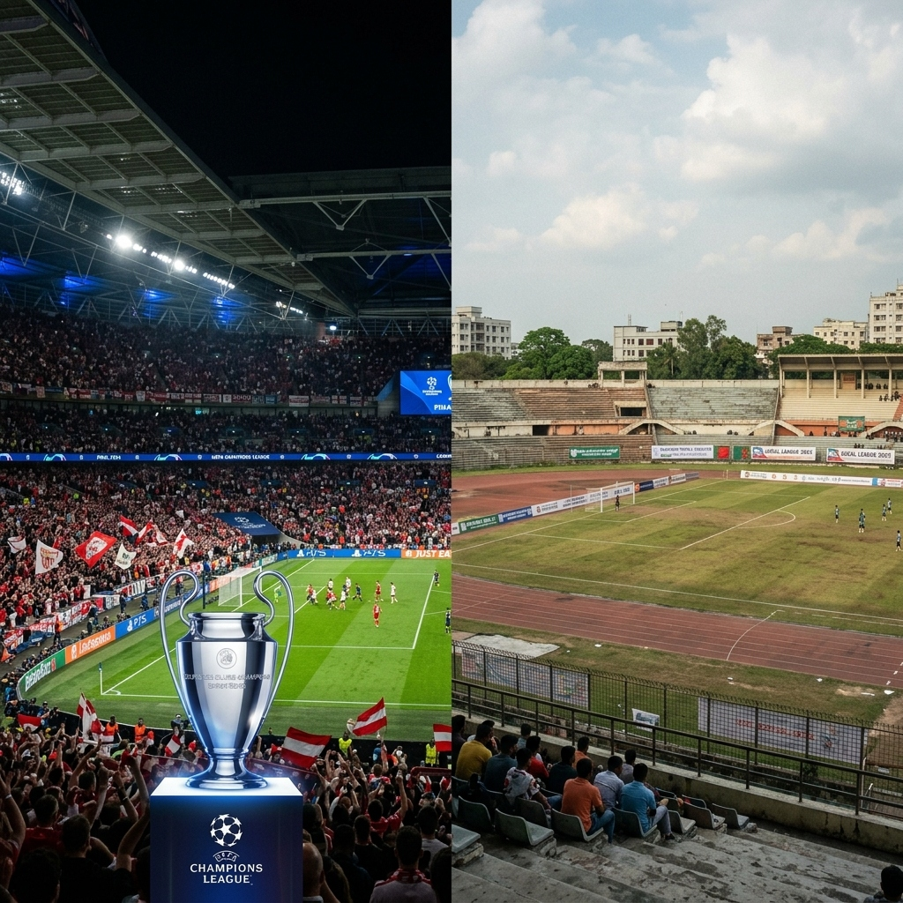
⚽ 🏆
Why Bangladesh Premier League
Fails to Attract Urban Youth
A Research-Based Presentation on Football Culture & Fan Behavior
Presented by
Textile Department | Batch 232
▸ ID: 232-093-801
▸ ID: 232-171-801
▸ ID: 232-172-801
▸ ID: 232-236-801
▸ ID: 232-282-801
© Copyright by Tahorim Somrat | BPL Football Presentation

Slide 2
THE REALITY
02
Bangladesh Loves Football ❤️
BUT…
Bangladesh Doesn't Watch Local Football ❌
🌍 European Football
🇧🇩 Bangladesh Premier League
✔ Millions of Bangladeshi Fans
❌ Low Stadium Attendance
✔ Huge Social Media Buzz
VS
❌ Limited Media Attention
✔ Packed Stadiums
❌ Less Excitement
✔ Global Star Players
❌ No Star Promotion
✔ Premium Broadcasting
❌ Weak Broadcasting

Slide 3
Main Reasons
Why Urban Youth Choose European Football Over BPL

Slide 4
Why Youth Prefer European Football
04
Key factors driving youth engagement with European clubs
⚽
Better Quality Football
High-level skills, tactics & competitive matches
⭐
World-Famous Players
Mbappe, Haaland, Vinicius Jr – global icons
🎉
Electric Stadium Atmosphere
Chants, fan culture, sold-out arenas worldwide
📺
Superior Broadcasting
HD telecasts, multiple camera angles, analytics
🌐
Global Brand Power
Massive merchandise, documentaries & digital reach

Slide 5
Why Bangladesh Premier League Struggles
05
Core problems holding back BPL's growth & popularity
📣
Poor Marketing
No aggressive campaigns; clubs unknown outside hardcore fans
📡
Weak Broadcasting
Low-quality streams, no international coverage or distribution
🌟
No Star Promotion
Local players not built into media personalities or heroes
🏟️
Poor Match Experience
Uncomfortable stadiums, lack of fan zones & entertainment
📢
Lack of Awareness
Youth simply don't know fixtures, standings, or club stories

Slide 6
Digital Media & Fan Psychology
How Online Platforms Shape Football Preferences

Slide 7
Social Media Influence on Football Preference
07
📷
📘
🎵
▶️
🐦
Instagram
Facebook
TikTok
YouTube
X (Twitter)
🌍 European Clubs
🇧🇩 Bangladesh Clubs
📈 Daily Content Uploads
📉 Limited Content Output
VS
🎬 Reels, Shorts & Highlights
😴 Outdated Posts & Graphics
💬 Millions of Comments & Shares
🔇 Almost No Online Presence
🌐 Global Viral Campaigns
🚫 No Viral Campaigns
⚡ Real-time Engagement
❄️ Very Low Fan Interaction

Slide 8
Fan Psychology: What Drives People to Support a Club?
08
Understanding what fans truly seek in football
⭐
Heroes & Role Models
❤️
Emotional Connection
Fans follow players they admire & aspire to be like. Bangladesh needs local football heroes.
Club identity, city pride & community create belonging. BPL clubs lack strong fan identities.
🏆
Winning Culture
📱
Entertainment Value
People love to associate with winners & champions. European clubs have trophies & history.
Football must compete with Netflix, gaming & YouTube. BPL needs to be more thrilling & accessible.

Slide 9
Financial & Structural Challenges
Deep-Rooted Problems in BPL Organization

Slide 10
Financial Challenges: A Vicious Cycle
10
💰
📉
🏚️
Low Revenue
→
Less Investment
→
Poor Facilities
↓
⬇️
👎
🔁
←
Lower Quality
←
Less Audience
Again Low Revenue
🔄 This cycle repeats — breaking it requires bold structural reform!

Slide 11
Management Challenges Holding BPL Back
11
Structural reforms are needed at every level of the league
📋
League Management
Professional league governance & transparent operations
📅
Match Scheduling
Consistent, well-planned fixtures avoiding conflicts
🤝
Sponsorship Deals
Corporate partnerships to inject capital into clubs
🧒
Youth Academies
Long-term player development pipelines for future stars
🎨
Club Branding
Professional logos, kits, identity & fan merchandise

Slide 12
Solutions & Conclusion
A Roadmap to Reviving Bangladesh Football

Slide 13
How Can Bangladesh Football Improve? 🚀
13
✓
📣
Better Marketing
Run digital campaigns, influencer collaborations & PR drives
✓
🏟️
Better Stadium Experience
Fan zones, music, food & family-friendly match day events
✓
📱
Strong Social Media
Daily content, player features, BTS videos & live engagement
✓
🏃
Youth Development
Grassroots football programs, school leagues & academies
✓
🎨
Club Branding
Build club identity, merchandise, anthems & loyal fan bases

Slide 14
⚽ 🌟 🇧🇩
"If We Want Global Success,
We Must First Build Strong Local Football."
🔑 Key Takeaway
▸ Bangladesh has the passion — it needs the structure, promotion & investment.
▸ BPL can grow if youth are engaged through smart digital strategies & quality football.
▸ A strong local league is the foundation of every great footballing nation.
Thank You! 🙏
© Copyright by Tahorim Somrat | BPL Football Presentation

