Slide 1
Scheduling parameters
From ROSACE, Rihani 2016 and Kim 2016

Slide 2
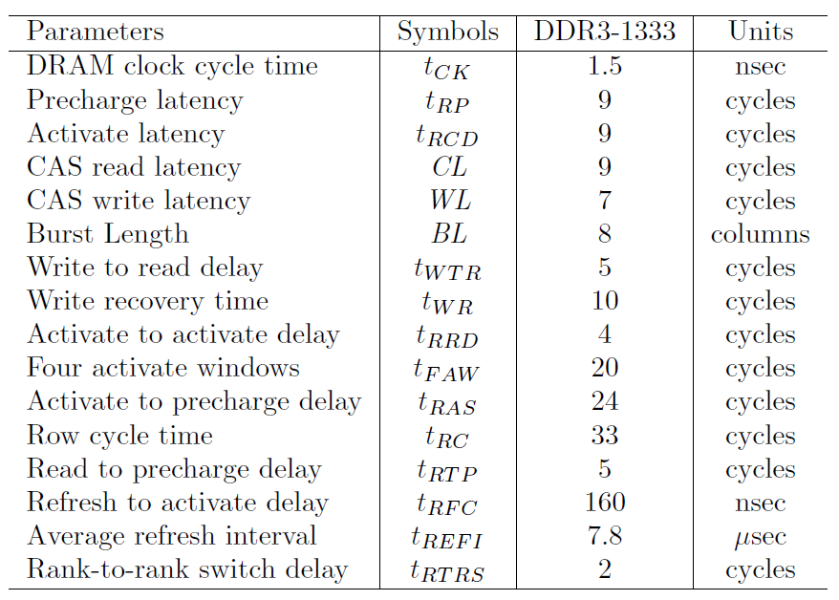

Slide 3



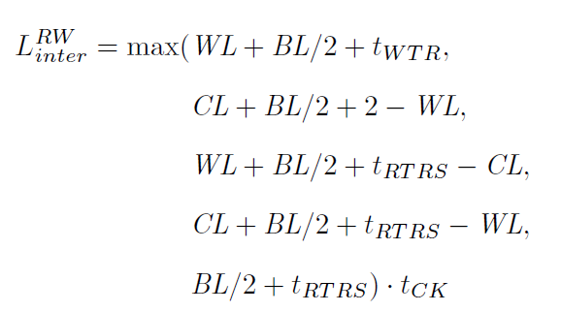



Slide 4
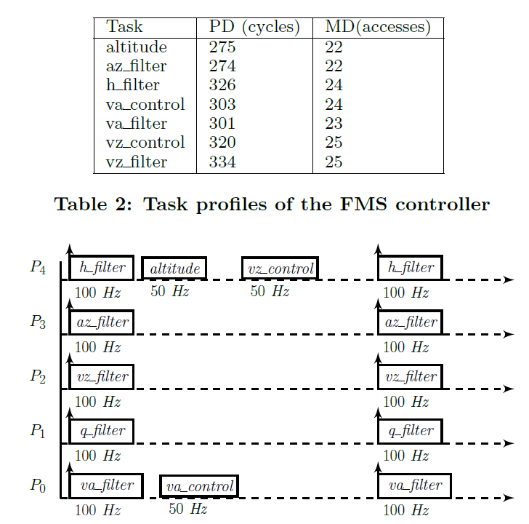

Slide 5
