Slide 1
CASE STUDY ON SATYAM COMPUTER

Slide 2
INTRODUCTION
Satyam Computer was formed in 1987 in Hyderbad, India by B. Ramalinga Raju.
Satyam Computer Services, Ltd. was a rising star in the Indian outsourced IT services industry.
The firm began with 20 employees and grew rapidly as a global business.

Slide 3

CLIENTS
Notes:
CLIENTS

Slide 4
COMPANY AT GLANCE:
.
Satyam Company Services Ltd. was incorporated on June 24, 1987 • Promoters holding of the shares in 1992 was 18.78% • Main business of the company was IT related fields and it came into prominence after Y2K problem • In 1991, it was in a rented house having 10 Engineers. • Company was listed in Bombay Stock Exchange in 1992 • company bags its first fortune 500 client John Deere & Co
‘Humpty Dumpty had a great fall’, Satyam computer image got severe hit that can never be mended when its promoter accepted in writing to SEBI about the fudging of books of account of the company for showing inflated profit. Investor lost all out faith in the working of the company and dumped the share of the company. Satyam share price had a free fall on Wednesday and it closed about 80% down from the previous day close price at Rs40.

Slide 5
RISE OF SATYAM
Notes:
RISE OF SATYAM

Slide 6
RISE OF SATYAM
1991: Satyam gets listed on the Bombay Stock Exchange, IPO oversubscribed 17 times.
By 2003, Satyam’s IT services businesses included 13,120 technical associates servicing over 300 customers worldwide.
At that time, the worldwide IT services market was estimated at nearly $400 billion, with an estimated annual compound growth rate of 6.4%.

Slide 7
GROWTH
The company demonstrated an annual compound growth rate of 35% over that period.
Earnings per share similarly grew at a compound annual growth rate of 40%.
Satyam stock improvement in share price.
The company was a leading star in a global IT marketplace.

Slide 8
Milestone
2006: Revenues cross $1 billion. Raju becomes Nasscom chairman.
2007: Raju named Ernst & Young Entrepreneur of the year.
September 23: Satyam gets Golden Peacock Award for Corporate Governance and Compliance.

Slide 9
DOWNFALL OF SATYAM
Notes:
FALL OF SATYAM

Slide 10
Fraud Of Satyam
Improper Benefits Of Bank Staff.
Lack Of Documentation on Invoices.
Invested In “Maytas”.
Helped Maytas in getting major contracts.
Question raised by E.Shreedharan regarding
Hyderabad Metro Project being allocated to Maytas Infra.

Slide 11
WHAT ACTUALLY HAPPENED??
.Inflated figures for cash and bank balances of INR 5,040 cr. (as against INR 5,361 crore reflected in the books).
• Operating Profit were artificially boosted from the actual 61 cr. to 649 cr.
• Satyam also showed an interest earning of Rs. 376 cr. that was fictitious. Satyam development center.

Slide 12
IMPACT ON STOCK MARKET
SATYAM SHARES- BIGGEST SIGNLE DAY FALL FOR A STOCK IN STOCK MARKET.
Rs 175(JAN 6TH) 77%
BSE sensex fell by 749.05 i.e 7.25 %
NSE fell by 192.40 points i.e. 6.18 %
All time low of Rs11.50 on 9th jan and closed at Rs23.75

Slide 13
FACTORS CONTRIBUTING TO FRAUD
Greed Of Money
Lack Of Transparency.
Ambitious Corporate Growth.
High interest in maintaining stock prices.
Audit failures‐ Internal & External (PWC)
Aggressiveness of investment banks, commercial banks.
Weak Independent directors and Audit committee.

Slide 14
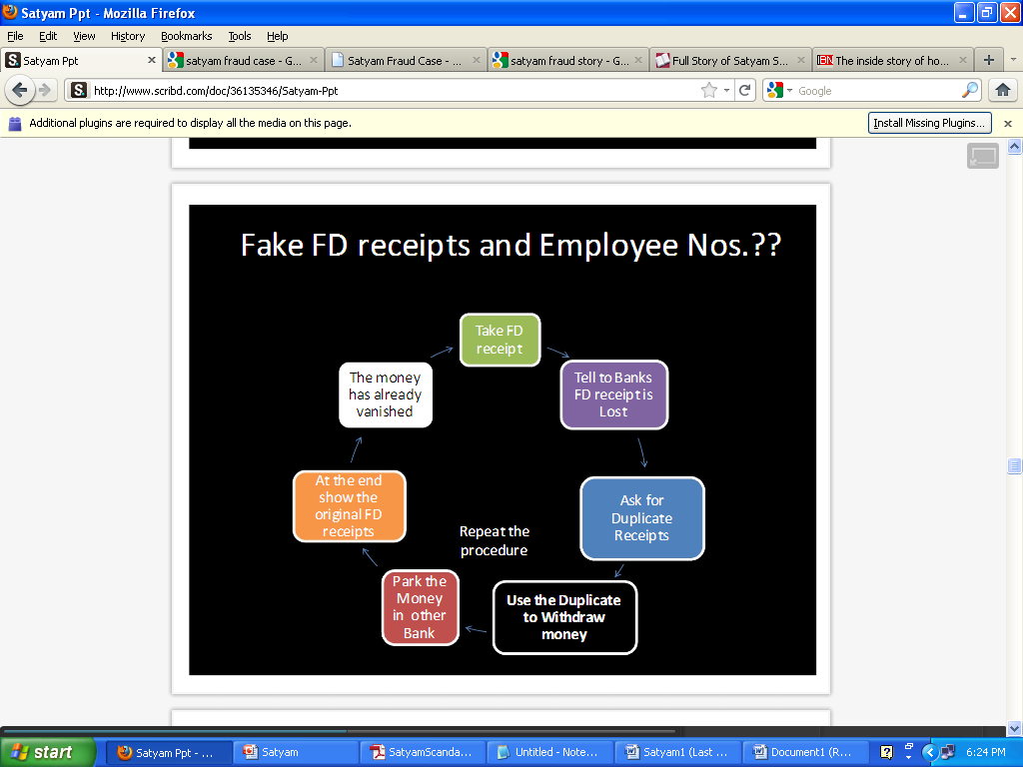

Slide 15
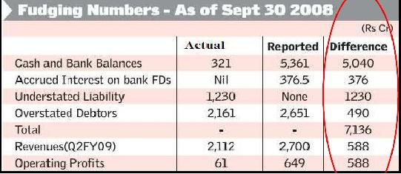

Slide 16
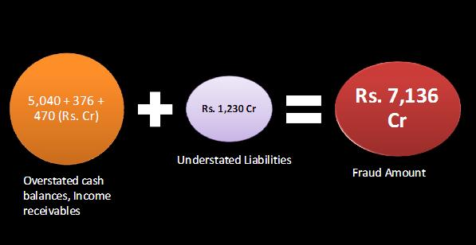

Slide 17


Slide 18
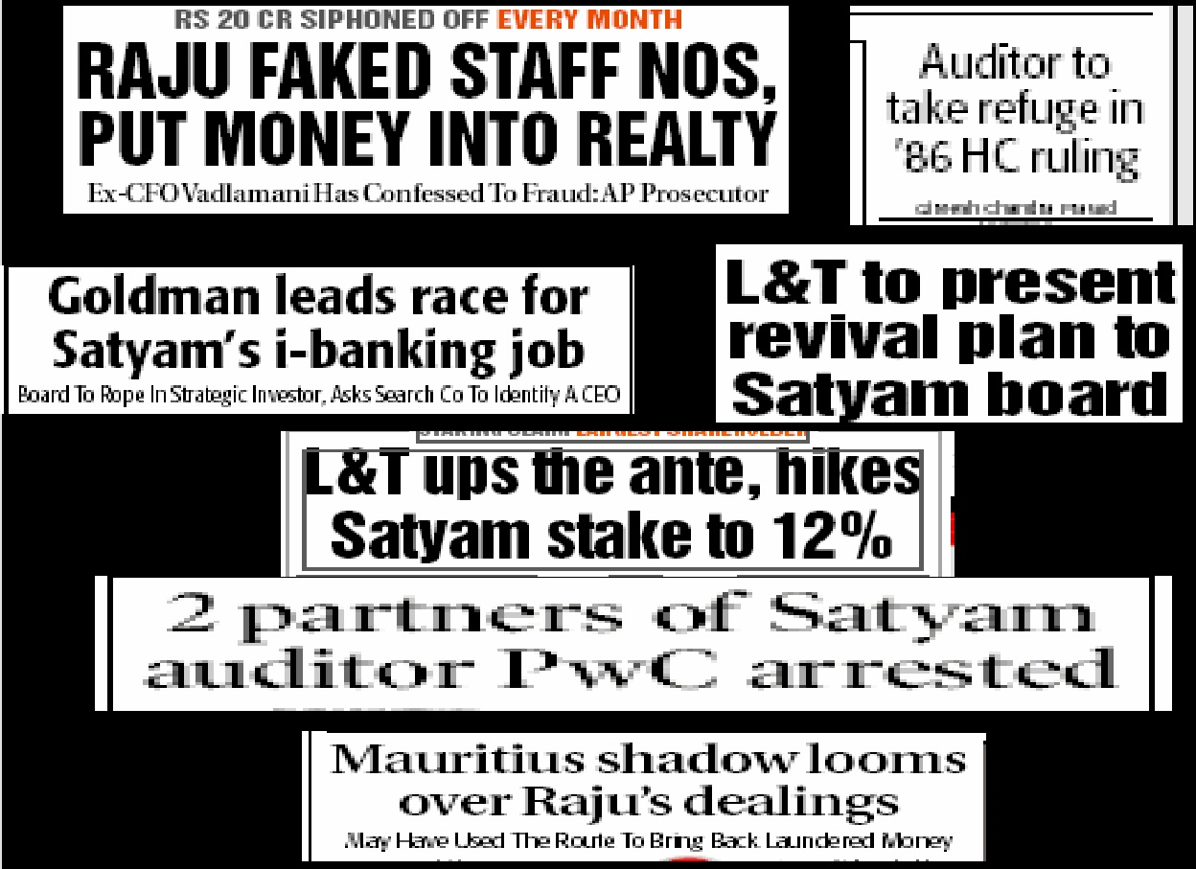

Slide 19
THANK YOU
Notes:
THANK YOU

