Slide 1
“A big problem with the justice system is that it doesn’t matter how much protection the law gives you, if you’re not aware of it. Unless, you studied law in college or are lucky enough to have friends working in the legal profession”

Slide 2

Our Solution-
নয়না
An end to end service to help women with legal support by matching them with lawyers using our deep learning based platform

Slide 3
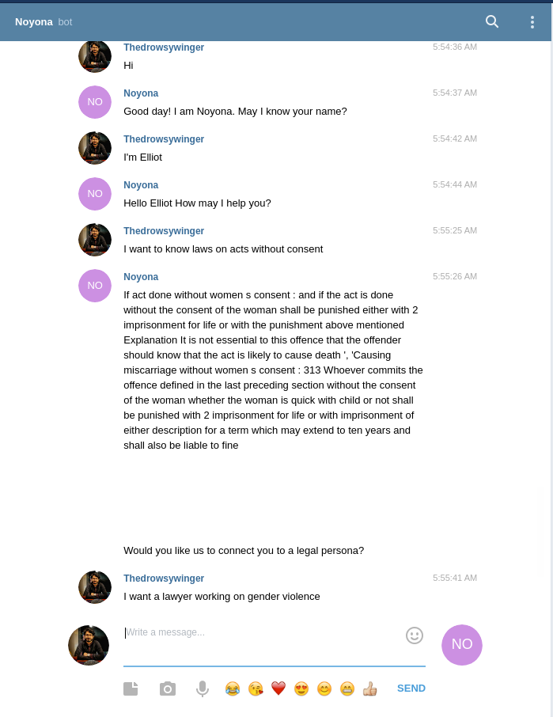
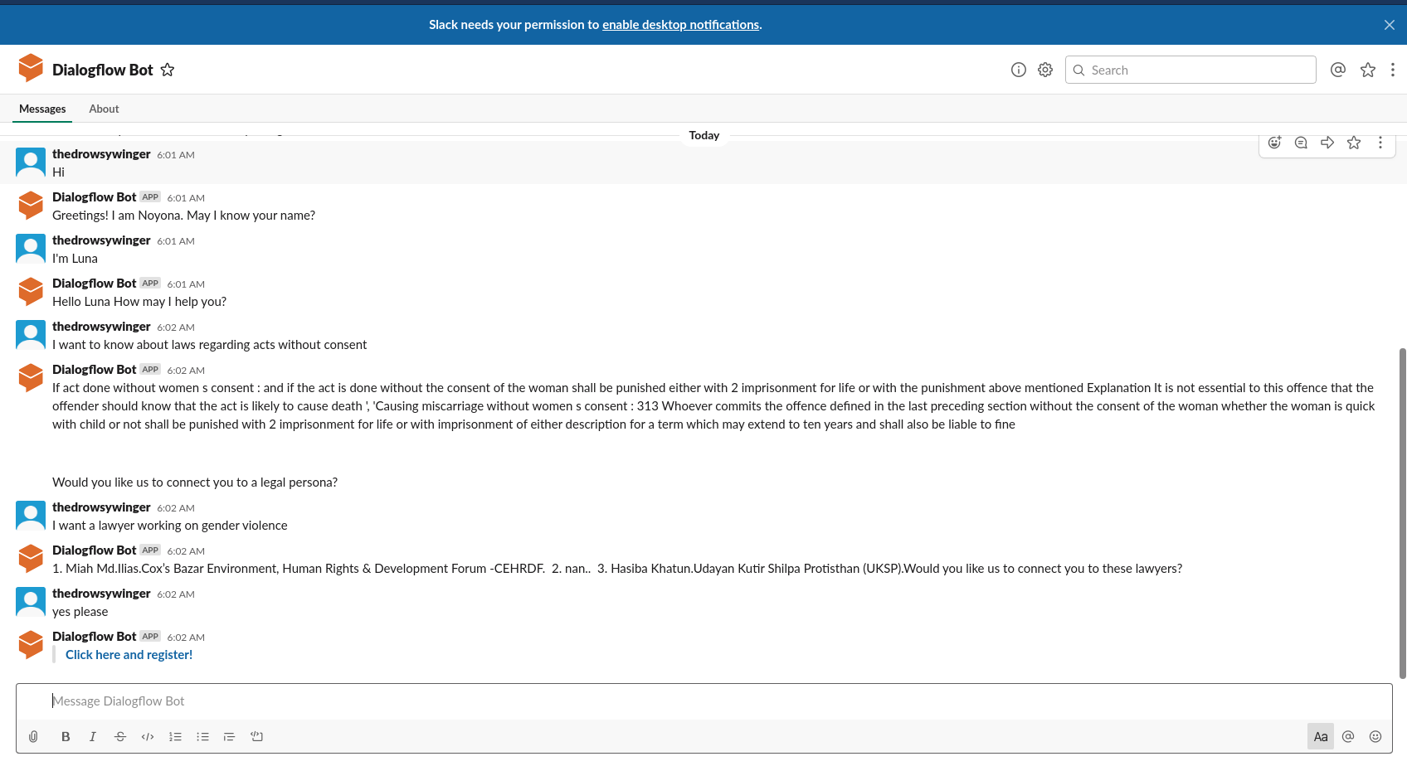
Access from multiple platforms-
Telegram
Slack

Slide 4
Offering
Monetization
Sustainability
Safe place for women
Free of cost for the user end
A market- place for finding clients
Access anywhere
Growth of quality proportional to growth of the platform
Charging partners commission based on their profit
Quality legal help

Slide 5
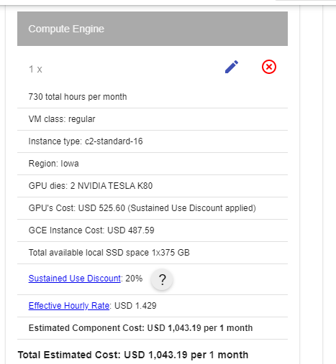
 | Monthly Salary (Per Person) | No. of Personnel | Total Salary(BDT)
Annotators | 5000 | 3 | 15000
Designer | 20000 | 2 | 40000
Cloud Engineer | 20000 | 2 | 40000
Deep Learning Engineer | 30000 | 3 | 90000
 |  |  | 185000
Cost of serving the backend app : 1000USD or 70,000BDT per month
Cost of operating dialogflow chatbot : 10 request per user * 10000 monthly user * 0.002 usd = 200 usd = 17,000tk
Cost of buying machines with appropriate GPU : 1.5 lakh per machine.

Slide 6
Technology Stack
Chatbot : Google Dialogflow
Backend ML App for recommending legal services : Flask, Python
Unsupervised machine learning model

Slide 7
Thank You!

