Slide 1
Solving visual pollution with deep learning: A new nexus in environmental management
Paper Presentation on
Group -6
20101581 Tahsin Zaman Jilan
RA: Md Sabbir Hossain ST: Ehsanur Rahman Rhythm

Slide 2
Introduction
This paper discusses the issue of visual pollution in urban areas, which includes any element in the landscape that is a misfit for the place and results in an unpleasant sight. The subjective nature of this problem makes it difficult to determine what constitutes visual pollution, and political and economic forces make it challenging to address. Manual data collection is currently the only option for visual pollution research, which is time-consuming and expensive.
Therefore, the paper proposes using deep learning as an efficient alternative for visual pollution data collection, which has not been done before. This study aims to open up a new field that focuses on the technical and scientific aspects of visual pollution detection and classification through machine-based (automated) methods.

Slide 3
Limitation of Previous Work
Visual pollution was initially defined as the degradation of the visual quality of places by advertisements and signage, but later expanded to include any element in the landscape that is a misfit for the place and results in an unpleasant, offensive sight.
Literature exists on the damaging effect of uncontrolled installation of commercial advertisements, mainly billboards, and signage on the landscape, especially scenic and historic sites.
Research was conducted on visual pollution due to cell phone towers, wind turbines, internal and external architecture of buildings, and other infrastructures.
Only four major visual pollutants were considered in this study, namely billboards and signage, telephone and communication wires, network and communication towers, and street litter.

Slide 4
Contribution of this paper
The paper identifies visual pollution as a new concern in environmental pollution and recommends the need for research to conceptualize, formalize, quantify and assess it.
The study proposes a new field of automated visual pollutant classification using deep learning technology.
The paper identifies four categories of visual pollutants: billboards and signage, telephone and communication wires, network and communication towers, and street litter.
The study employs a deep learning model that simulates human learning experience for image recognition in the context of visual pollutant classification.
The paper uses data augmentation and train-test split techniques to train and test the deep learning model, achieving training accuracy of 95% and validation accuracy of 85%.

Slide 5
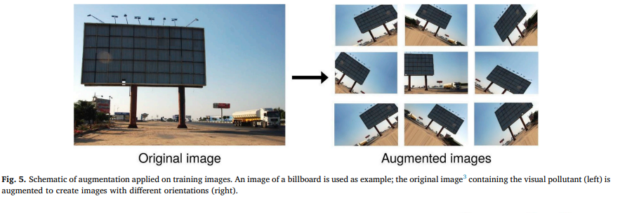
Methods
Image data collection: The authors collected images using Google Image Search engine using keywords such as 'visual pollution', 'billboard', 'telephone wire' and 'Bangladesh visual pollution billboard'. The collected images were pre-labeled.
Preprocessing and augmentation: After the collection of images, some outlier images that were not relevant were removed. Then, 200 images of each class were obtained, leading to 800 total images. Image augmentation was used to synthetically create several images from each image to increase the amount of data. Image processing algorithms such as translation, rotation, and flip were used for generating augmented images. A sample image augmentation process was also shown.

Slide 6
System architecture and experimental setup: A Convolutional Neural Network (CNN) was used, and the system architecture of the CNN was shown in the paper. The images were resized to a dimension of 150x150 pixels. The model was trained for a total of 50 epochs with a batch size of 16. The training size to testing size ratio was 80:20. The categorical cross entropy loss function was used for the learning problem, which was a multi-label supervised classification one. The RMSprop optimizer was used for weight optimization of the model. The Rectified Linear Unit (ReLU) activation function was used in all layers except for the last layer (softmax layer). The softmax activation function was used for generating the probability of the input images being members of a certain visual pollutant class.

Slide 7
Result
A sequential deep learning model was used, trained on a dataset of 640 images and tested on a validation set of 160 images.
Image augmentation was used to create new images by applying image processing algorithms to the existing images to improve the model's generalization ability.
The model achieved an accuracy of 87% on the validation set, which is good performance, but with some variability reflected in the standard deviation of the validation accuracy. Overall, the article demonstrates the potential of deep learning techniques for visual pollutant classification and highlights the importance of using image augmentation to improve the model's generalization ability.

