Slide 1
DeepSC-ST: A Semantic Communication System for Speech Recognition and Speech Synthesis
Paper Presentation on
20101581 Tahsin Zaman Jilan

Slide 2
Introduction
The concept of semantic communication is introduced as a means to exchange semantic information for improved transmission efficiency. The challenges of quantifying semantic information without a mathematical model are discussed, emphasizing the role of deep learning in overcoming this limitation. The paper's contribution, DeepSC-ST, is introduced as a solution for semantic communication in speech recognition and speech synthesis tasks.

Slide 3
Related Work
Several authors have grappled with the challenge of striking a balance between transmission efficiency and maintaining or enhancing system performance. This critical analysis provides the audience with insights into the current state-of-the-art and challenges faced by researchers in the field.
The selection of relevant papers reflects the evolution of thought in semantic communication, leading to a clear understanding of the contextual background against which DeepSC-ST is presented. The slide serves as a foundation for appreciating the unique contribution of the proposed system and positions it as a promising advancement within the broader landscape of semantic communication resea

Slide 4
System Model
The system model slide provides an overview of the proposed DeepSC-ST system. It details the components, including the transmitter and receiver, and explains the roles of the semantic encoder, channel encoder, channel decoder, and feature decoder. The slide emphasizes how the system processes input speech to extract and transmit text-related semantic features.

Slide 5
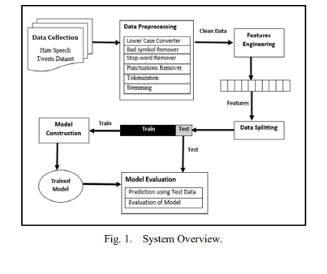
DeepSC-ST Overview
This slide gives a closer look at DeepSC-ST, focusing on its use of CNN and RNN-based semantic transmitters. The extraction of text-related semantic features from input speech is highlighted, along with the encoding and transmission of these features over physical channels. This slide serves as a bridge between the system model and the detailed methods used in DeepSC-ST.

Slide 6
Methods
The methods slide provides detailed information on the implementation of CNN and RNN in the semantic transmitters, elaborating on the joint semantic-channel coding scheme. The slide explains how input speech is processed, emphasizing the unique approach taken by DeepSC-ST in handling semantic information and communication resources.

Slide 7
Result
Here, It presents the simulation results, comparing DeepSC-ST with three benchmarks: a speech transceiver, a text transceiver, and a feature transceiver. The focus is on highlighting DeepSC-ST's superior performance in terms of speech recognition accuracy and speech synthesis quality, reinforcing the effectiveness of the proposed system.

Slide 8
Contribution of the Paper
Here, the presentation summarizes the significant contribution of the paper, emphasizing DeepSC-ST's potential to reduce transmission data and communication resources without compromising performance. This slide underscores the paper's impact on enhancing efficiency in speech recognition and synthesis tasks.

Slide 9
Limitations
The limitations slide acknowledges the areas where the proposed system might face challenges or require further improvement. This transparency is crucial for a comprehensive understanding of the system's capabilities and potential areas for future research.

Slide 10
Conclusion
The conclusion slide recaps the key points discussed throughout the presentation, reiterating the promise of DeepSC-ST as a semantic communication system. It highlights the demonstrated operable user interface and the system's ability to process real human speech input, leaving a lasting impression on the audience.

