Slide 1
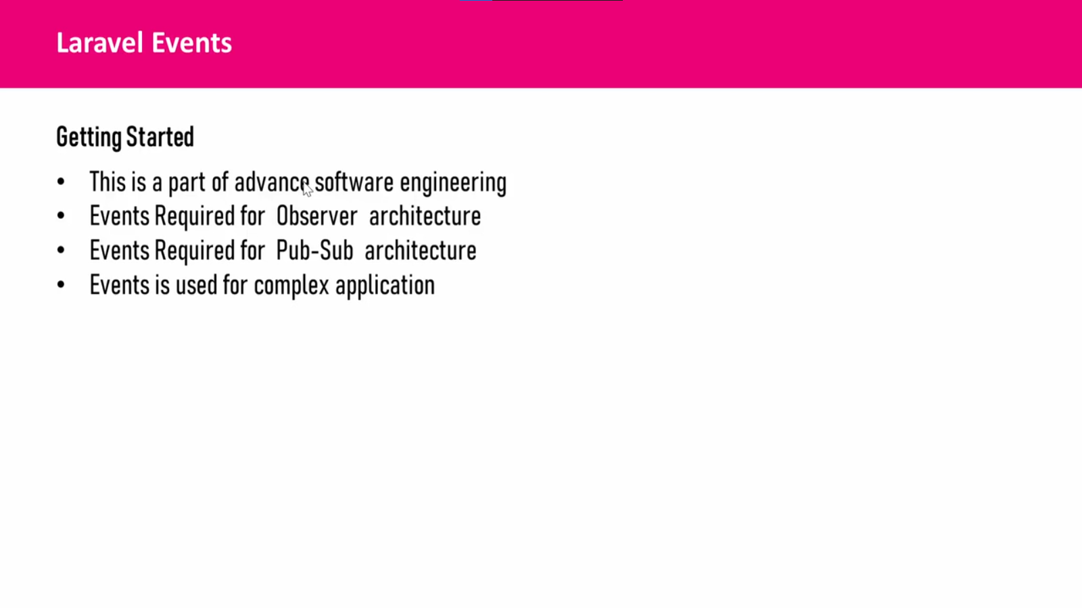

Slide 2
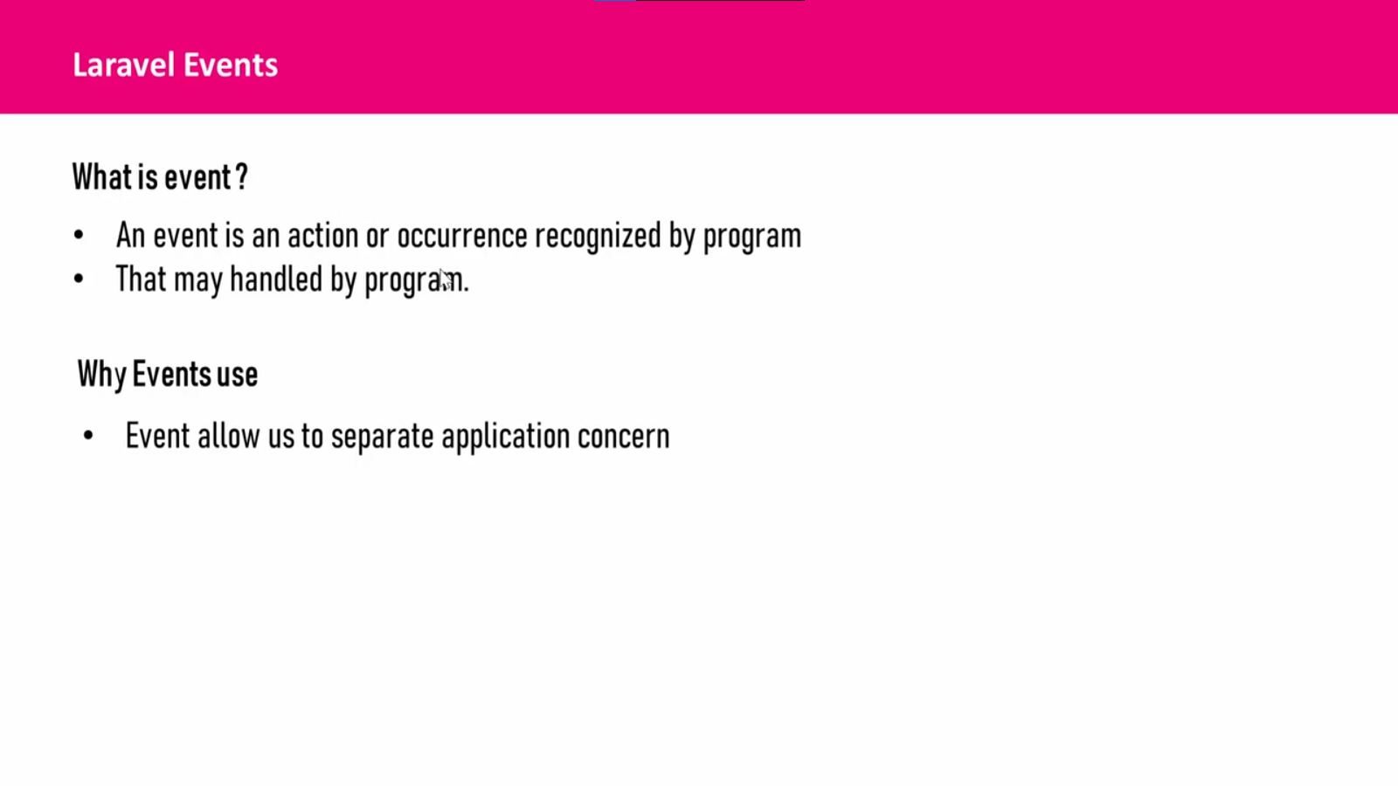

Slide 3
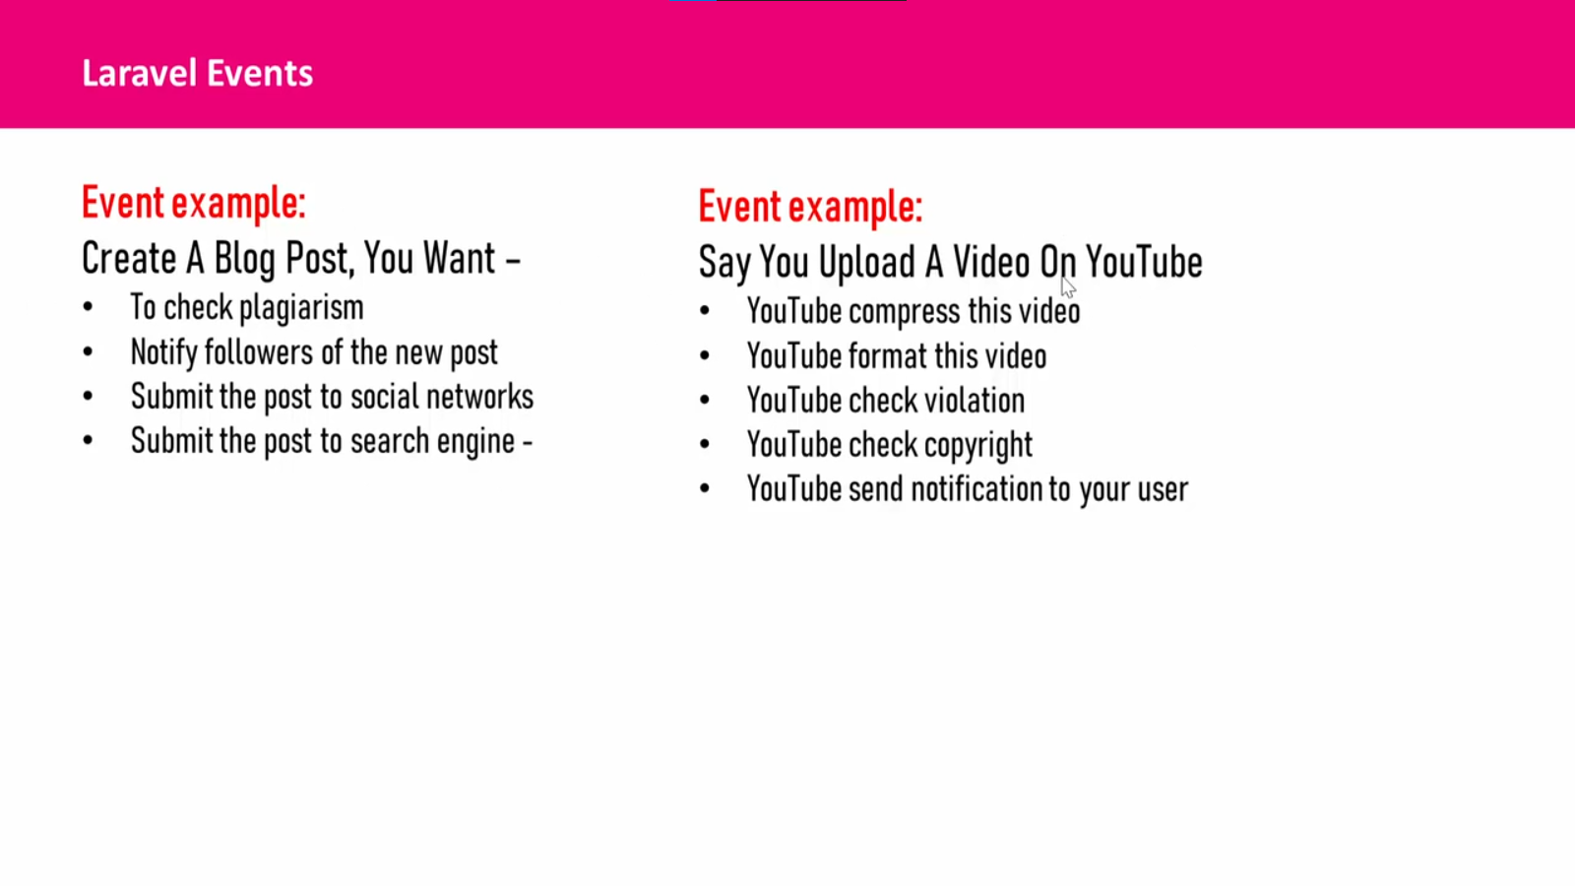

Slide 4
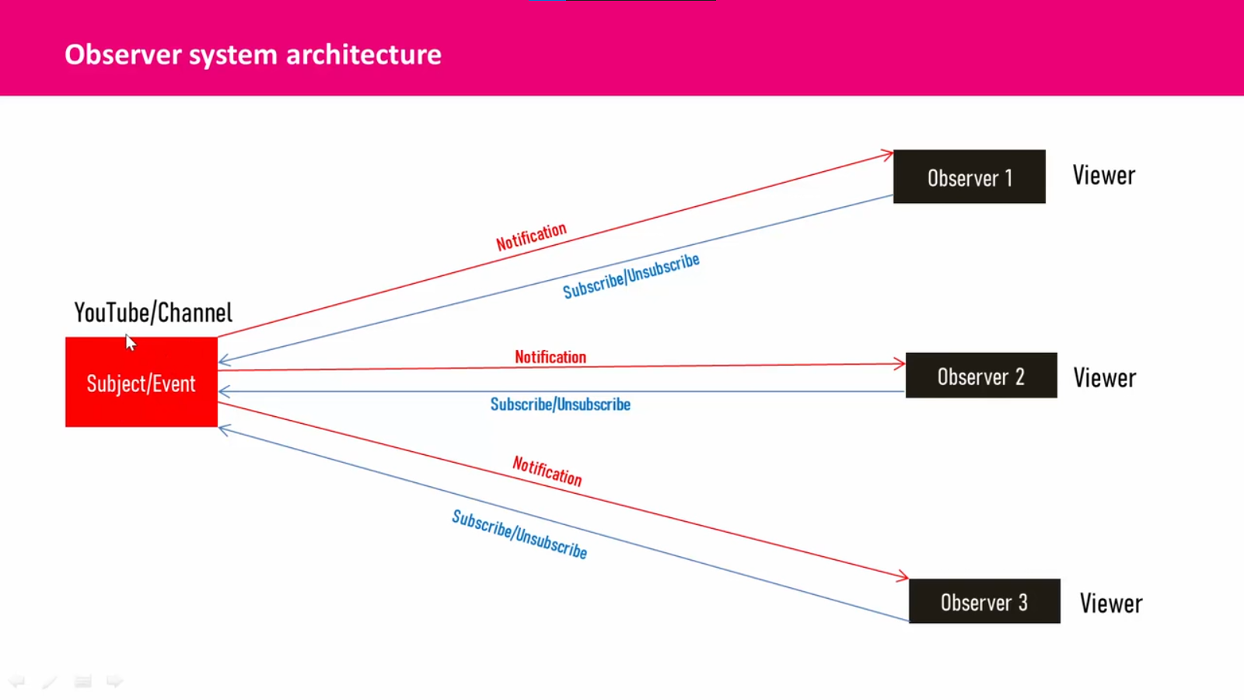

Slide 5
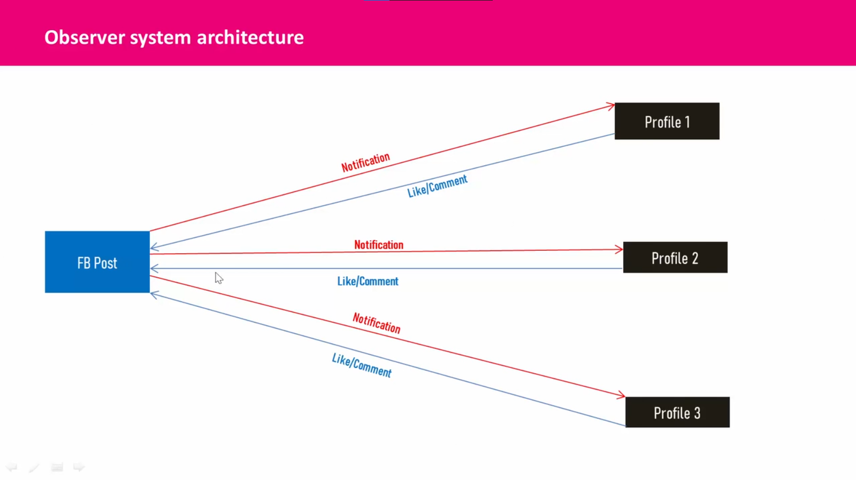

Slide 6
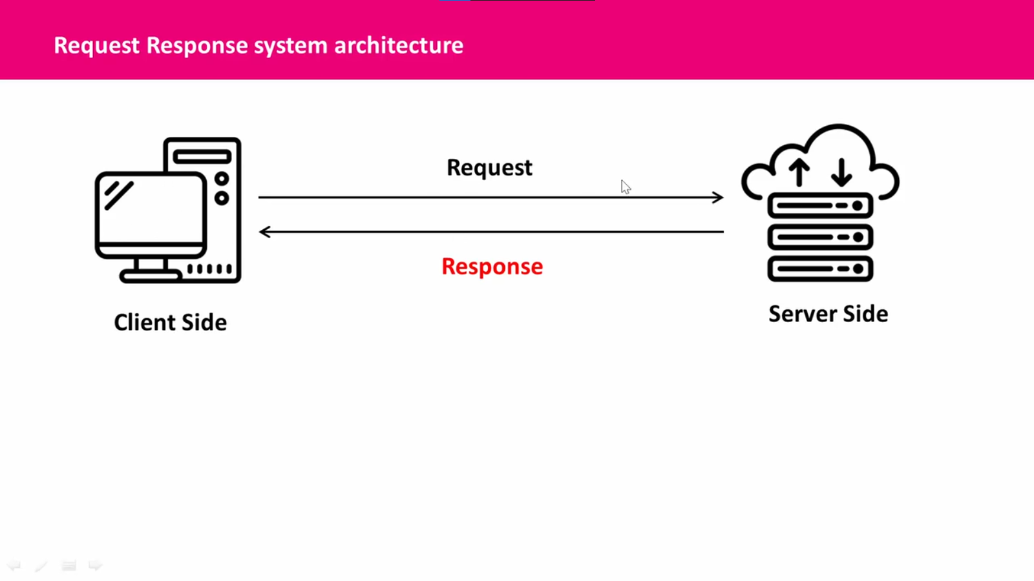

Slide 7
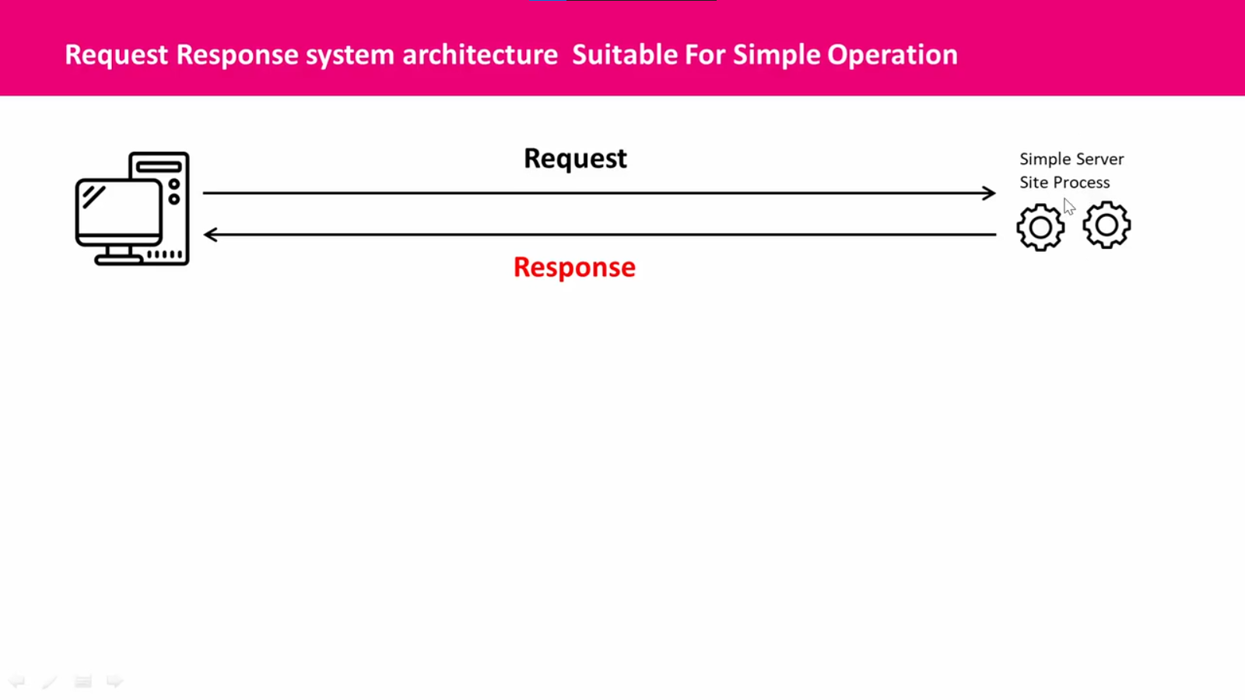

Slide 8
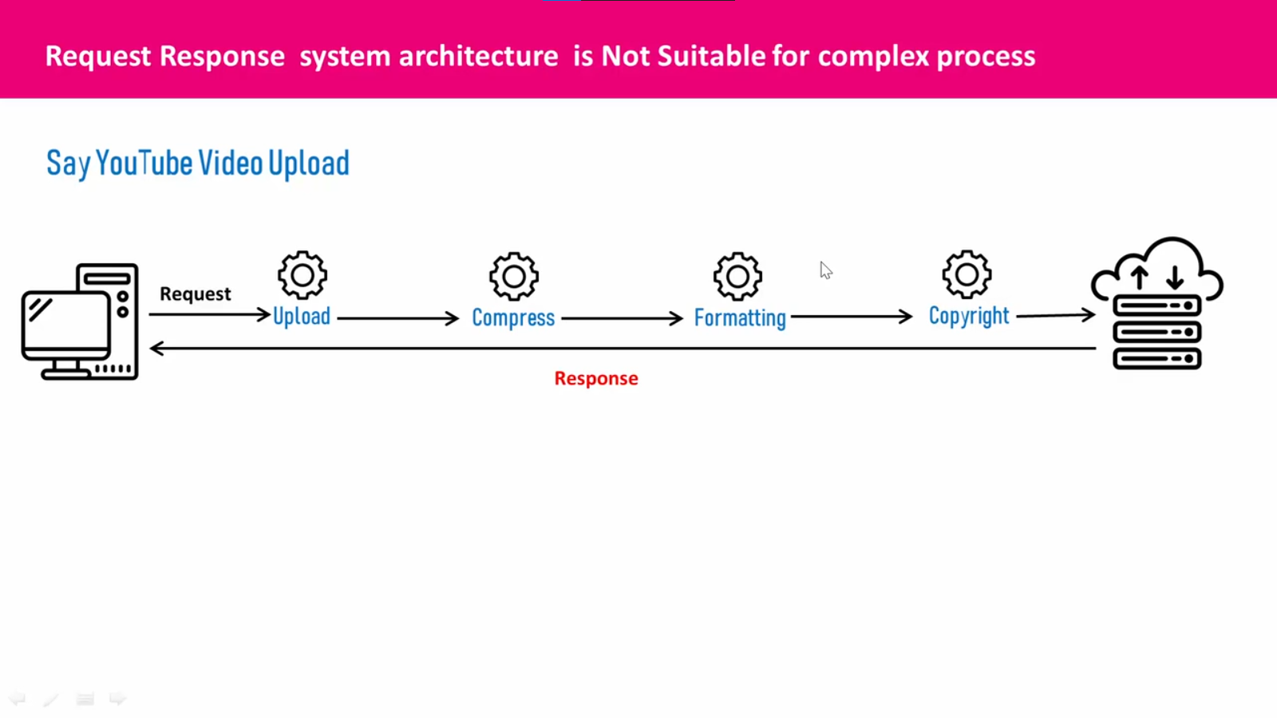

Slide 9
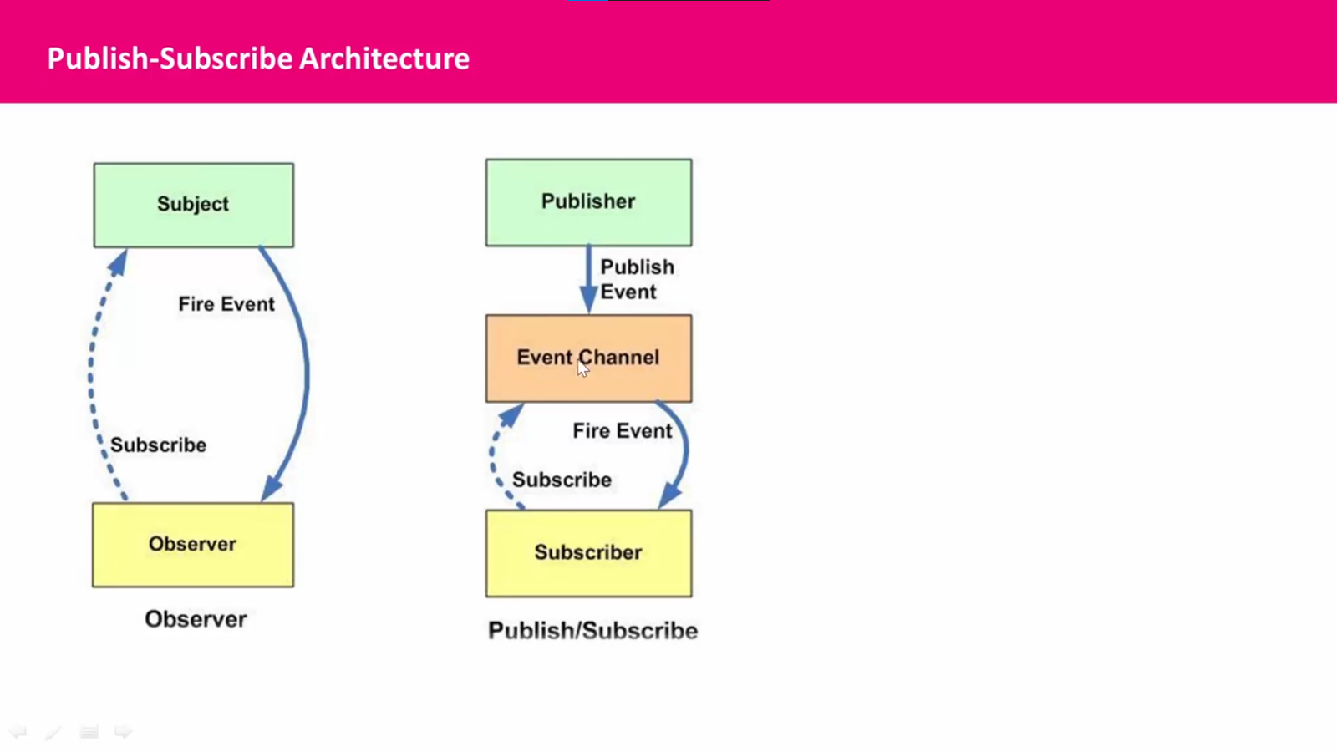

Slide 10
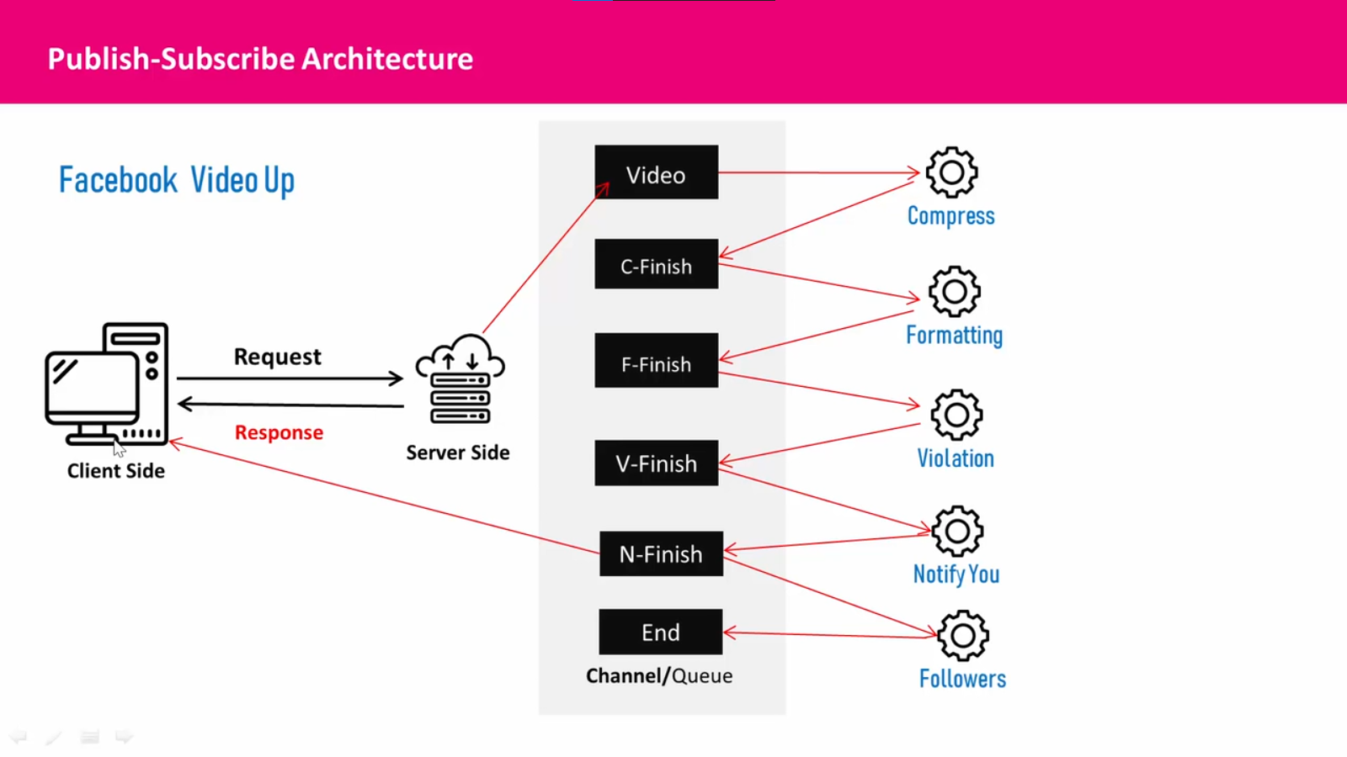

Slide 11
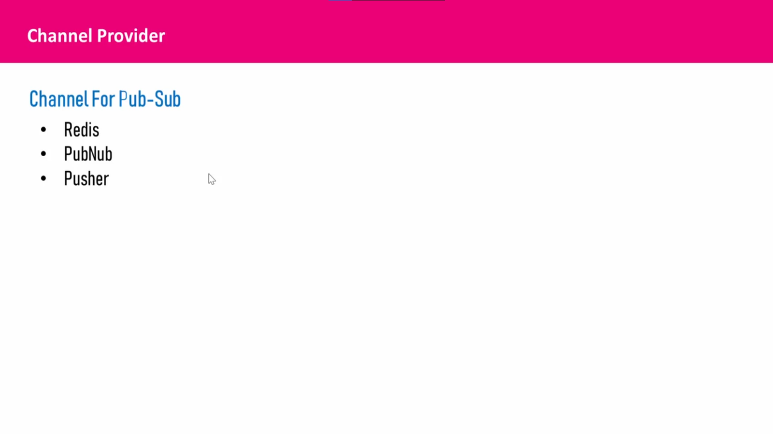

Slide 12
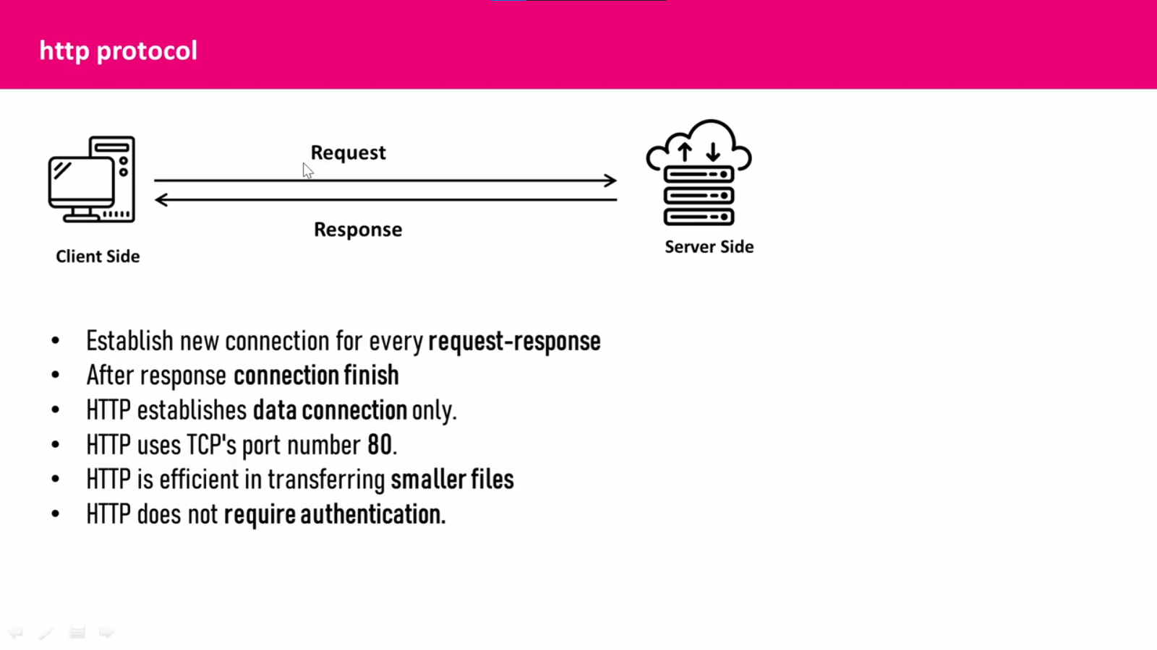

Slide 13
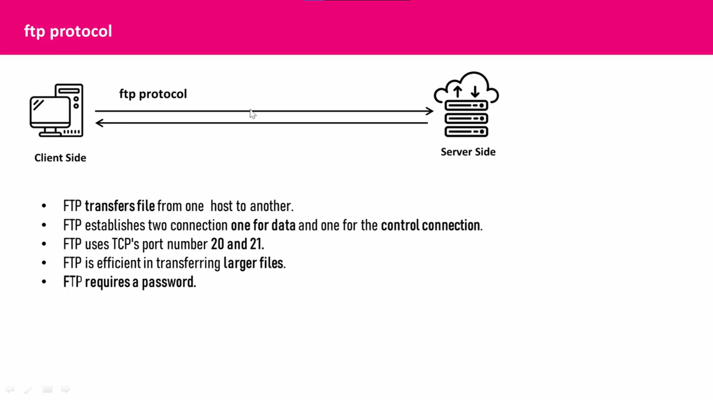

Slide 14
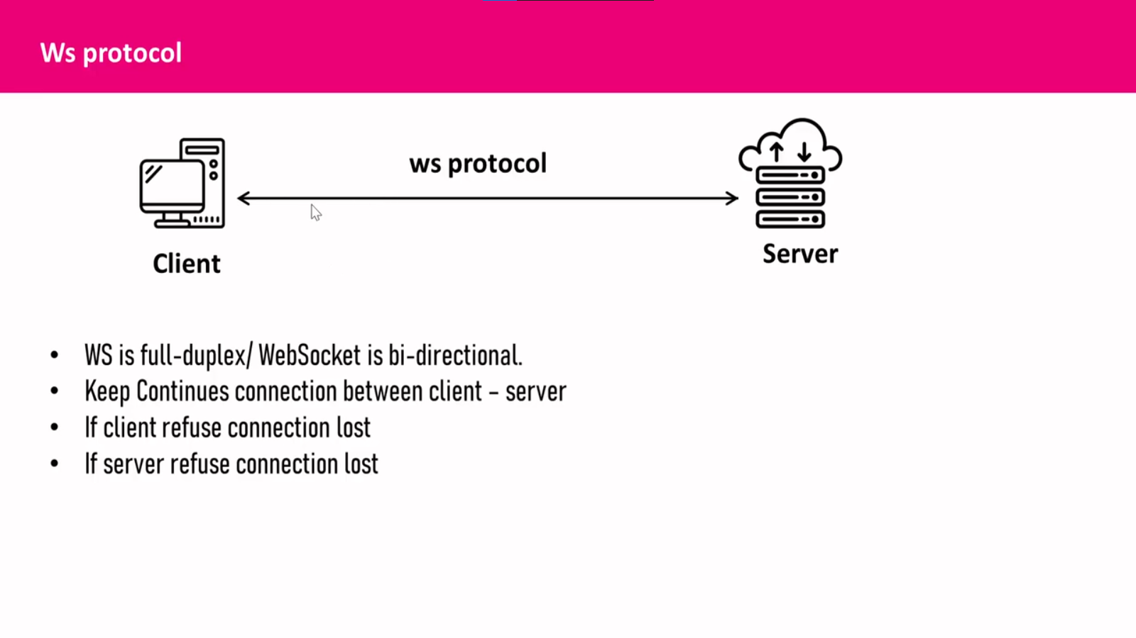

Slide 15
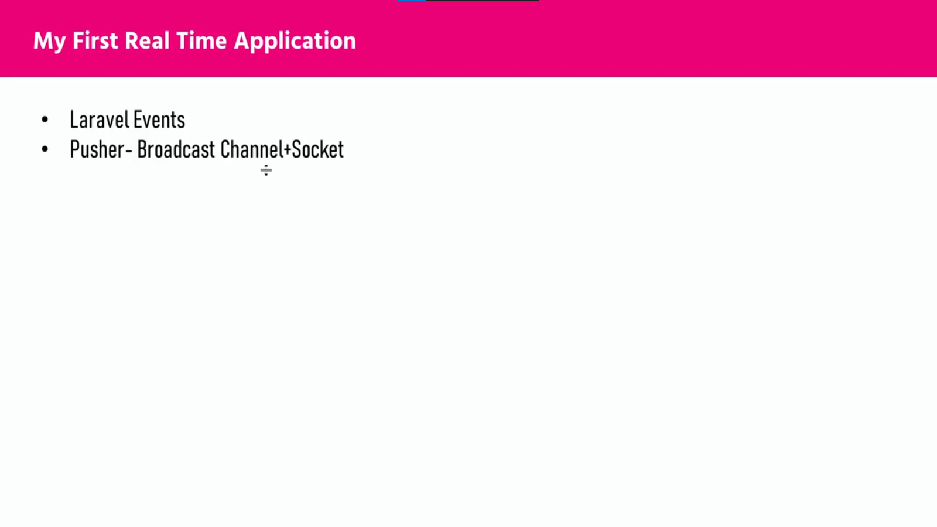

Slide 16
Install Laravel and pusher
→ Install laravel
composer create-project laravel/laravel Laravel-pusher-app
Install pusher
composer require pusher/pusher-php-server

Slide 17
Configuration ENV
BROADCAST_DRIVER=pusher
PUSHER_APP_ID=app-id
PUSHER_APP_KEY=app-key
PUSHER_APP_SECRET=app-secret
PUSHER_HOST=
PUSHER_PORT=443
PUSHER_SCHEME=https
PUSHER_APP_CLUSTER=mt1

Slide 18
Broadcast.php config
'pusher' => [
'driver' => 'pusher',
'key' => env('PUSHER_APP_KEY'),
'secret' => env('PUSHER_APP_SECRET'),
'app_id' => env('PUSHER_APP_ID'),
'options' => [
'cluster' => env('PUSHER_APP_CLUSTER'),
'host' => env('PUSHER_HOST') ?: 'api-'.env('PUSHER_APP_CLUSTER', 'mt1').'.pusher.com',
'port' => env('PUSHER_PORT', 443),
'scheme' => env('PUSHER_SCHEME', 'https'),
'encrypted' => true,
'useTLS' => env('PUSHER_SCHEME', 'https') === 'https',
],
'client_options' => [
// Guzzle client options: https://docs.guzzlephp.org/en/stable/request-options.html
],
],

Slide 19
Laravel/UI install
composer require laravel/ui
php artisan ui bootstrap
npm install

Slide 20
