Slide 1
Introduction to Environment

Slide 2
Overview of Lecture
Definition of Environment
Components of Environment
Types of Environment
Environmental Science
Current Environmental conditions
Causes of Environmental degradation
Goals of Environmental Science
Environmentalism
Sustainability
Environmental Management System
Spheres of Earth

Slide 3
Environment:
The complex of physical, chemical, and biotic factors (such as climate, soil, and living things) that act upon an organism or an ecological community and ultimately determine its form and survival
Environment is the aggregate of social and cultural conditions that influence the life of an individual or community
Environment: from the French word ‘environner ‘- to encircle or surround
Whatever is around us constitutes our Environment
The circumstances and conditions that surround an organism or group of organism.

Slide 4
Components of Environment:
Abiotic components
Biotic components

Slide 5
Types of Environment :
- Natural environment: all living and non-living things that occur naturally on Earth.
- Built environment: constructed surroundings that provide the setting for human activity, ranging from the large-scale civic surroundings to the personal places.
- Social environment: the culture that an individual lives in, and the people and institutions with whom they interact.

Slide 6
Environmental Science
Environmental science is the systematic study of our environment
Environmental science is the science of the relationship between man and the natural world in which he lives.
It is an interdisciplinary academic field that integrates physical and biological sciences (including physics, chemistry, biology, geology, soil science and geography) and social sciences (economics, demography, political science and humanities).
Environmental science provides an integrated, quantitative and interdisciplinary approach to the study of the environment.

Slide 7
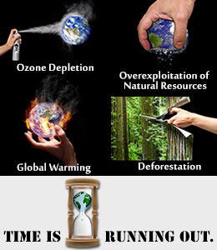

Slide 8
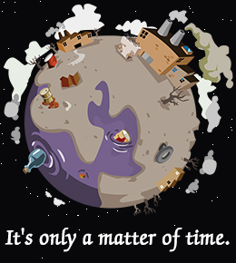
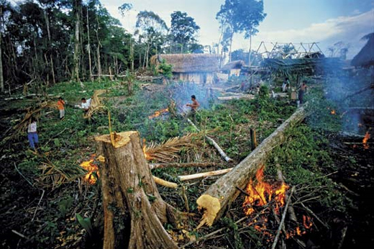
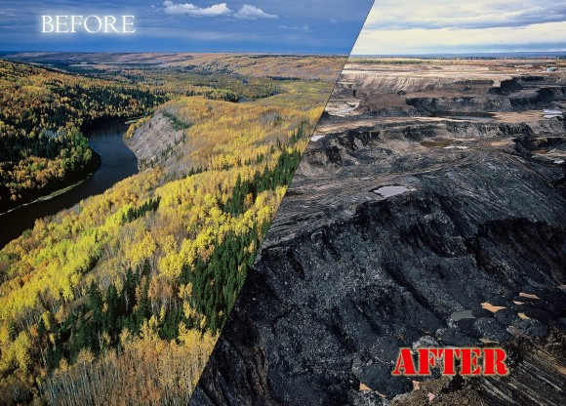
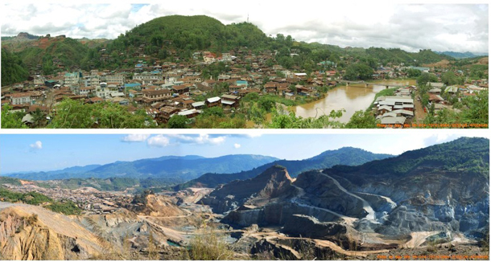

Slide 9
Current Environmental Conditions
Widespread decline in the ability of the ecosystem to produce goods and services
Land conversion have shrunk the world’s forest as much as half
Soil degradation has affected two-thirds of the world’s agricultural land
Marine fish stocks are over harvested
Causes of Environmental degradation
About 85 million people are added every year causing stress on resources and services
More land needed for housing and food production
More urbanization causes air pollution, hazardous waste generation
Extraction of ground water, fossil fuel and resources increase.
Surface and ground water pollution threatens natural water habitats

Slide 10
Goals of environmental science are to learn
how nature works
how the environment affects us
how we affect the environment and
how to deal with environmental problems and live more sustainably
Why learning Environmental Science is much more important now?
It directs attention towards the problems of population explosion, depletion of natural resources, pollution, the methods of solving such problems, food security and sustainable development
It demonstrates how man can derive benefits from environment without destroying it
To integrate environmental concerns in development planning and management

Slide 11
Environmentalism:
‘Environmentalism’ is a social movement dedicated to protect the earth’s life support systems for us and other species.
Environmentalism is a broad philosophy and social movement centered on a concern for the conservation and improvement of the natural environment, both for its own sake as well as its importance to civilization.
Sustainability:
‘Sustainability’ is the ability to meet the needs of the present, without compromising the ability of the future generation to meet their own needs.
It is the ability of the earth’s various systems, including human culture and economics, to survive and adapt the changing environmental conditions.

Slide 12
‘Environmental Management’ is the process by which environmental health is regulated.
Environmental Management System (EMS) refers to the management of an organization's environmental programs in a comprehensive, systematic, planned and documented manner.
It includes the organizational structure, planning and resources for developing, implementing and maintaining policy for environmental protection.

Slide 13
An EMS:
Serves as a tool to improve environmental performance
Provides a systematic way of managing an organization’s environmental affairs
Is the aspect of the organization’s overall management structure that addresses immediate and long-term impacts of its products, services and processes on the environment
Gives order and consistency for organizations to address environmental concerns through the allocation of resources, assignment of responsibility and ongoing evaluation of practices, procedures and processes

Slide 14
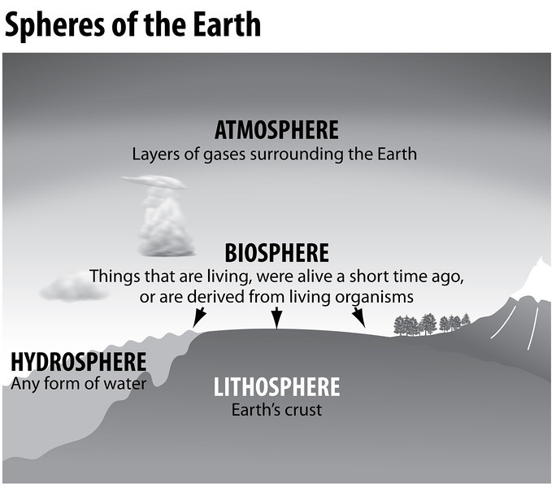

Slide 15
THANK YOU ALL

