Slide 1
Lecture 11: The Basic Rules of Counting
Section 6.1

Slide 2
Lecture Summary
The Product Rule
The Sum Rule
The Subtraction Rule

Slide 3
Basic Counting Principles: The Product Rule
The Product Rule: A procedure can be broken down into a sequence of two tasks. There are n₁ ways to do the first task and n₂ ways to do the second task. Then there are n₁∙n₂ ways to do the procedure.
Example: How many bit strings of length seven are there?
Solution: Since each of the seven bits is either a 0 or a 1, the answer is 2⁷ = 128.

Slide 4
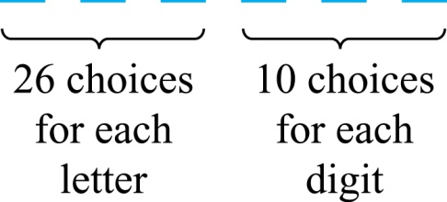
The Product Rule
Example: How many different license plates can be made if each plate contains a sequence of three uppercase English letters followed by three digits?
Solution: By the product rule,
there are 26 ∙ 26 ∙ 26 ∙ 10 ∙ 10 ∙ 10 = 17,576,000 different possible license plates.

Slide 5

Seating Arrangement
Example: We have 5 students, how many different seating arrangements are possible if we have 3 seats available?
Possible solution:
For the first chair, we have 5
students available to choose from
For the third chair, we have
remaining 3 students to choose from
For the second chair, we have 4
students available now to choose from
and all three events have to occur all at once, so we can use product rule.
And possible arrangement would be (5×4×3) = 60
We can later try to solve the same problem with permutation or combination concept.

Slide 6
Telephone Numbering Plan
Example: The North American numbering plan (NANP) specifies that a telephone number consists of 10 digits, consisting of a three-digit area code, a three-digit office code, and a four-digit station code. There are some restrictions on the digits.
  Let X denote a digit from 0 through 9.
  Let N denote a digit from 2 through 9.
  Let Y denote a digit that is 0 or 1.
  In the old plan (in use in the 1960s) the format was NYX-NNX-XXXX.
  In the new plan, the format is NXX-NXX-XXXX.
How many different telephone numbers are possible under the old plan and the new plan?
Solution: Use the Product Rule.
  There are 8 ∙2 ∙10 = 160 area codes with the format NYX.
  There are 8 ∙10 ∙10 = 800 area codes with the format NXX.
  There are 8 ∙8 ∙10 = 640 office codes with the format NNX.
  There are 10 ∙10 ∙10 ∙10 = 10,000 station codes with the format XXXX.
  Number of old plan telephone numbers: 160 ∙ 640 ∙ 10,000 = 1,024,000,000.
  Number of new plan telephone numbers: 800 ∙ 800 ∙ 10,000 = 6,400,000,000.

Slide 7
Counting Subsets of a Finite Set
Counting Subsets of a Finite Set: Use the product rule to show that the number of different subsets of a finite set S is 2^{|S|}.
Solution:
When the elements of S are listed in an arbitrary order,
there is a one-to-one correspondence between subsets of S and bit strings of length |S |, when the i th element is in the subset, the bit string has a 1 in the i th position and a 0 otherwise.
By the product rule, there are 2^{|S |} such bit strings, and therefore 2^{|S |} subsets.

Slide 8
Product Rule in Terms of Sets
If A₁, A₂, … , A_{m} are finite sets, then the number of elements in the Cartesian product of these sets is the product of the number of elements of each set.
The task of choosing an element in the Cartesian product A₁ ⨉ A₂ ⨉ ∙∙∙ ⨉ A_{m} is done by choosing an element in A₁, an element in A₂ , …, and an element in A_{m}.
By the product rule, it follows that:
|A₁ ⨉ A₂ ⨉ ∙∙∙ ⨉ A_{m} | = |A₁| ∙ |A₂| ∙ ∙∙∙ ∙ |A_{m}|.

Slide 9
Basic Counting Principles: The Sum Rule
The Sum Rule: If a task can be done either in one of n₁ ways or in one of n₂, where none of the set of n₁ ways is the same as any of the n₂ ways, then there are n₁ + n₂ ways to do the task.
Example: The mathematics department must choose either a student or a faculty member as a representative for a university committee. How many choices are there for this representative if there are 37 members of the mathematics faculty and 83 mathematics majors and no one is both a faculty member and a student.
Solution: By the sum rule it follows that there are
37 + 83 = 120 possible ways to pick a representative.

Slide 10
The Sum Rule in terms of sets
The sum rule can be phrased in terms of sets.
|A ∪ B|= |A| + |B| as long as A and B are disjoint sets.
Or more generally,
The case where the sets have elements in common will be discussed when we consider the subtraction rule (remember inclusion-exclusion principle?)
|A₁ ∪ A₂ ∪ ∙∙∙ ∪ A_{m} |= |A₁| + |A₂| + ∙∙∙ + |A_{m}|
when A_{i} ∩ A_{j} = ∅ for all i, j.

Slide 11
Combining the Sum and Product Rule
Example: Suppose variable names in a programming language can be either a single letter or a letter followed by a digit. Find the number of possible names.
Solution: Two ways to make a label.
Only one letter = 26,
1 Letter followed by a digit = 26*10 = 260 [product rule]
Total labels = 26 + 260 = 286 [sum rule]

Slide 12
Example: Counting Passwords
Example: Each user on a computer system has a password, which is six to eight characters long, where each character is an uppercase letter or a digit. Each password must contain at least one digit. How many possible passwords are there?
Solution: Let P be the total number of passwords, and let P₆, P₇, and P₈ be the passwords of length 6, 7, and 8.
  By the sum rule P = P₆ + P₇ +P₈.
  To find each of P₆, P₇, and P₈ , we find the number of passwords of the specified length composed of letters and digits and subtract the number composed only of letters. We find that:
    P₆ = 36⁶ − 26⁶ = 2,176,782,336 − 308,915,776 = 1,867,866,560.
    P₇ = 36⁷ − 26⁷ = 78,364,164,096 − 8,031,810,176 = 70,332,353,920.
    P₈ = 36⁸ − 26⁸ = 2,821,109,907,456 − 208,827,064,576
= 2,612,282,842,880.
  Consequently, P = P₆ + P₇ +P₈ = 2,684,483,063,360.

Slide 13
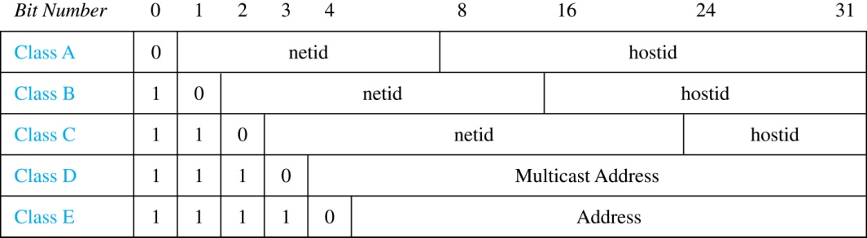
Internet Addresses
Version 4 of the Internet Protocol (IPv4) uses 32 bits.
Class A Addresses: used for the largest networks, a 0, followed by a 7-bit net_id and a 24-bit host_id.
Class B Addresses: used for the medium-sized networks, a 10, followed by a 14-bit net_id and a 16-bit host_id.
Class C Addresses: used for the smallest networks, a 110, followed by a 21-bit net_id and a 8-bit host_id.
  Neither Class D nor Class E addresses are assigned as the address of a computer on the internet. Only Classes A, B, and C are available.
  1111111 is not available as the net_id of a Class A network.
  Host_ids consisting of all 0s and all 1s are not available in any network.

Slide 14
Counting Internet Addresses
Example: How many different IPv4 addresses are available for computers on the internet?
Solution: Use both the sum and the product rule. Let x be the number of available addresses, and let x_{A}, x_{B}, and x_{C} denote the number of addresses for the respective classes.
  To find, x_{A}: 2⁷ − 1 = 127 net_ids. 2²⁴ − 2 = 16,777,214 host_ids.
x_{A} = 127∙ 16,777,214 = 2,130,706,178.
  To find, x_{B}: 2¹⁴ = 16,384 net_ids. 2¹⁶ − 2 = 16,534 host_ids.
x_{B} = 16,384 ∙ 16, 534 = 1,073,709,056.
  To find, x_{C}: 2²¹ = 2,097,152 net_ids. 2⁸ − 2 = 254 host_ids.
x_{C} = 2,097,152 ∙ 254 = 532,676,608.
  Hence, the total number of available IPv4 addresses is
  x = x_{A} + x_{B} + x_{C}
  = 2,130,706,178 + 1,073,709,056 + 532,676,608
  = 3, 737,091,842.
Not Enough Today !!
The newer IPv6 protocol solves the problem of too few addresses.

Slide 15
Basic Counting Principles: Subtraction Rule
Subtraction Rule: If a task can be done either in one of n₁ ways or in one of n₂ ways, then the total number of ways to do the task is n₁ + n₂ minus the number of ways to do the task that are common to the two different ways.
Also known as, the principle of inclusion-exclusion:

Slide 16
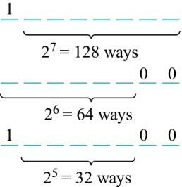
Counting Bit Strings
Example: How many bit strings of length eight either start with a 1 bit or end with the two bits 00?
Solution: Use the subtraction rule.
  Number of bit strings of length eight that start with a 1 bit: 2⁷ = 128
  Number of bit strings of length eight that end with bits 00: 2⁶ = 64
  Number of bit strings of length eight that
  start with a 1 bit and end with bits 00 : 2⁵ = 32
  Hence, the number is 128 + 64 − 32 = 160.

