Slide 1
Lecture 12: The Pigeonhole Principle
Section 6.2

Slide 2
Lecture Summary
The Pigeonhole Principle
The Generalized Pigeonhole Principle

Slide 3
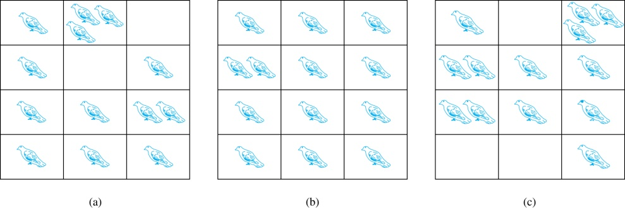
The Pigeonhole Principle
If a flock of 13 pigeons roosts in a set of 12 pigeonholes, one of the pigeonholes must have more than 1 pigeon.
Pigeonhole Principle: If k is a positive integer and k + 1 objects are placed into k boxes, then at least one box contains two or more objects.
Proof: We use a proof by contraposition. Suppose none of the k boxes has more than one object. Then the total number of objects would be at most k. This contradicts the statement that we have k + 1 objects.

Slide 4
Picking Object Blindfolded
Example: Suppose you are blindfolded and picking out balls from a box like below.
(a) Minimum how many balls to pick to get 2 balls of same color?
(b) Minimum how many balls to pick to get 2 red balls?
8 Red
5 blue
6 Black

Slide 5
Picking Object Blindfolded
Example: Suppose you are blindfolded and picking out balls from a box like below.
(a) Minimum how many balls to pick to get 2 balls of same color?
(b) Minimum how many balls to pick to get 2 red balls?
8 Red
5 blue
6 Black
(a) Worst case scenario would be, you pick 1 balls from each color = 3 balls. Then if you pick your 4th ball, it must match any of the color, and you will have your 2 same color balls.
So, solution is (1 Red+1 Blue + 1 Black) + 1 = 4 balls
(b) Worst case scenario would be, you pick all the blue and black balls. Then if you pick your next 2 balls, it must be of red color.
So, solution is (5 Blue + 6 Black + 1 Red) + 1 = 13 balls

Slide 6
Pigeonhole Principle
Example 1: Among any group of 367 people, there must be at least two with the same birthday, because there are only 366 possible birthdays.
Example 2: How many students must be in a class to guarantee that at least two students receive the same score on the final exam, if the exam is graded on a scale from 0 to 100 points?
Solution: There are 101 possible scores on the final. The pigeonhole principle shows that among any 102 students there must be at least 2 students with the same score.

Slide 7
Pigeonhole Principle
Example 3: Show that for every integer n there is a multiple of n that has only 0s and 1s in its decimal expansion.
Solution: Let n be a positive integer. Consider the n + 1 integers 1, 11, 111, …., 11…1 (where the last has n + 1 1s). There are n possible remainders when an integer is divided by n. By the pigeonhole principle, when each of the n + 1 integers is divided by n, at least two must have the same remainder. Subtract the smaller from the larger and the result is a multiple of n that has only 0s and 1s in its decimal expansion.

Slide 8
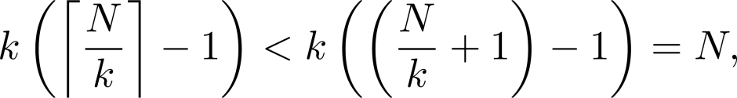
The Generalized Pigeonhole Principle
The Generalized Pigeonhole Principle: If N objects are placed into k boxes, then there is at least one box containing at least ⌈N/k⌉ objects.
Proof: We use a proof by contraposition. Suppose that none of the boxes contains more than ⌈N/k⌉ − 1 objects. Then the total number of objects is at most
where the inequality ⌈N/k⌉ < ⌈N/k⌉ + 1 has been used. This is a contradiction because there are a total of n objects.
Example: Among 100 people there are at least ⌈100/12⌉ = 9 who were born in the same month.

Slide 9
The Generalized Pigeonhole Principle
Example: a) How many cards must be selected from a standard deck of 52 cards to guarantee that at least three cards of the same suit are chosen?
b) How many must be selected to guarantee that at least three hearts are selected?
Solution: a) We assume four boxes; one for each suit. Using the generalized pigeonhole principle, at least one box contains at least ⌈N/4⌉ cards. At least three cards of one suit are selected if ⌈N/4⌉ ≥3. The smallest integer N such that ⌈N/4⌉ ≥3 is N = 2 ∙ 4 + 1 = 9.
b) A deck contains 13 hearts and 39 cards which are not hearts. So, if we select 41 cards, we may have 39 cards which are not hearts along with 2 hearts. However, when we select 42 cards, we must have at least three hearts. (Note that the generalized pigeonhole principle is not used here.)

Slide 10
Applications of Pigeonhole Principle
Example: During a month with 30 days, a baseball team plays at least one game a day, but no more than 45 games in total. Show that there must be a period of some number of consecutive days during which the team must play exactly 14 games in sum.
Solution: : Let a_{j} be the number of games played on or before the j-th day of the month. Then a₁, a₂, … , a₃₀ is an increasing sequence of distinct positive integers, with 1 ≤ a_{j} ≤ 45. Moreover, a₁ + 14, a₂ + 14, … , a₃₀ + 14 is also an increasing sequence of distinct positive integers, with 15 ≤ a_{j} + 14 ≤ 59. The 60 positive integers a₁, a₂, … , a₃₀, a₁ + 14, a₂ + 14, … , a₃₀ + 14 are all less than or equal to 59.
Hence, by the pigeonhole principle two of these integers are equal. Because the integers a_{j} , j = 1, 2, … , 30 are all distinct and the integers a_{j} + 14, j = 1, 2, … , 30 are all distinct, there must be indices i and j with a_{i} = a_{j} + 14. This means that exactly 14 games were played from day j + 1 to day i.

