Slide 1
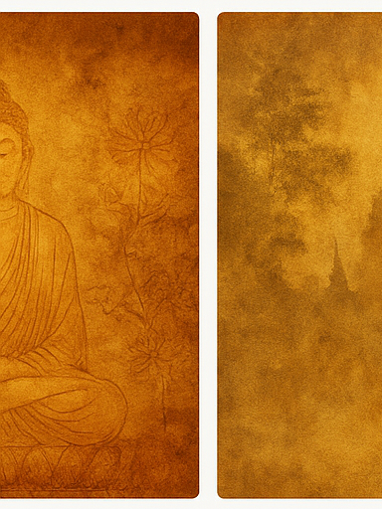
Introduction
This slide will later be enriched with full historical, cultural, and analytical text.

Slide 2

Why Study Buddhism
This slide will later be enriched with full historical, cultural, and analytical text.

Slide 3

India Before Buddhism
This slide will later be enriched with full historical, cultural, and analytical text.

Slide 4

Siddhartha Gautama
This slide will later be enriched with full historical, cultural, and analytical text.

Slide 5
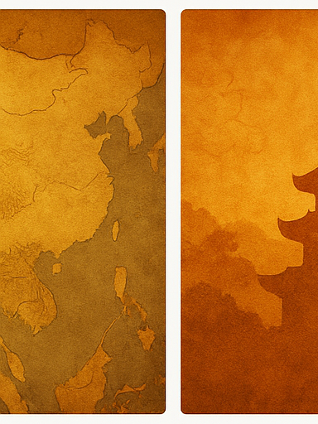
Four Noble Truths
This slide will later be enriched with full historical, cultural, and analytical text.

Slide 6

Eightfold Path
This slide will later be enriched with full historical, cultural, and analytical text.

Slide 7
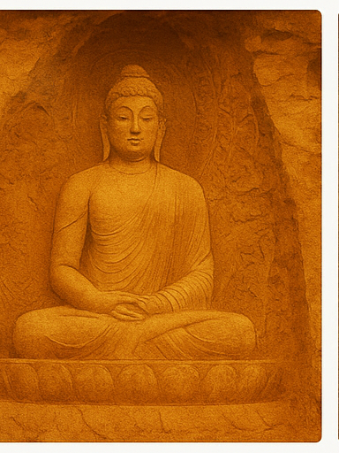
Sangha
This slide will later be enriched with full historical, cultural, and analytical text.

Slide 8
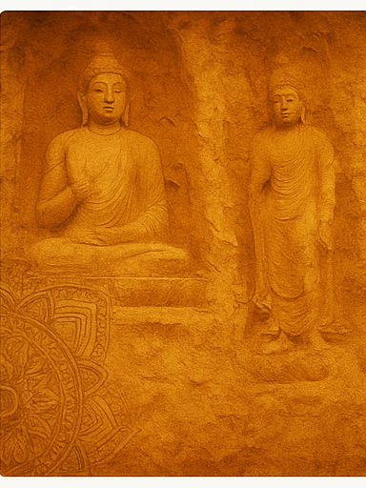
Ashoka
This slide will later be enriched with full historical, cultural, and analytical text.

Slide 9
Silk Road Spread
This slide will later be enriched with full historical, cultural, and analytical text.

Slide 10
Gandhara
This slide will later be enriched with full historical, cultural, and analytical text.

Slide 11
Oasis Kingdoms
This slide will later be enriched with full historical, cultural, and analytical text.

Slide 12
Kizil & Bamiyan
This slide will later be enriched with full historical, cultural, and analytical text.

Slide 13
China Entry
This slide will later be enriched with full historical, cultural, and analytical text.

Slide 14
Sinicization
This slide will later be enriched with full historical, cultural, and analytical text.

Slide 15
Chinese Schools
This slide will later be enriched with full historical, cultural, and analytical text.

Slide 16
Monasteries
This slide will later be enriched with full historical, cultural, and analytical text.

Slide 17
Art Role
This slide will later be enriched with full historical, cultural, and analytical text.

Slide 18
Indian Art
This slide will later be enriched with full historical, cultural, and analytical text.

Slide 19
Central Asian Art
This slide will later be enriched with full historical, cultural, and analytical text.

Slide 20
Chinese Art
This slide will later be enriched with full historical, cultural, and analytical text.

Slide 21
Religious Identity
This slide will later be enriched with full historical, cultural, and analytical text.

Slide 22
Political Identity
This slide will later be enriched with full historical, cultural, and analytical text.

Slide 23
Cultural Identity
This slide will later be enriched with full historical, cultural, and analytical text.

Slide 24
Decline
This slide will later be enriched with full historical, cultural, and analytical text.

Slide 25
Conclusion
This slide will later be enriched with full historical, cultural, and analytical text.

