Slide 1
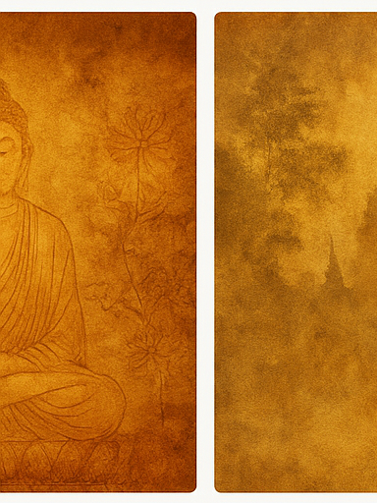
Introduction
Buddhism emerged in ancient India over 2500 years ago and transformed into a major trans-Asian tradition. It became a shared intellectual, spiritual, and cultural force connecting India, Central Asia, and China.

Slide 2

Why Study Buddhism
Tracing Buddhism’s spread reveals how ideas travel and adapt. It exposes ancient networks of trade, diplomacy, patronage, and creativity.

Slide 3

India Before Buddhism
Pre-Buddhist India was shaped by Vedic rituals, caste hierarchy, and rising urban centers. These shifts created new questions about suffering and ethics.

Slide 4

Siddhartha Gautama
Siddhartha renounced royal life, sought answers to suffering, practiced asceticism, and attained enlightenment under the Bodhi Tree.

Slide 5
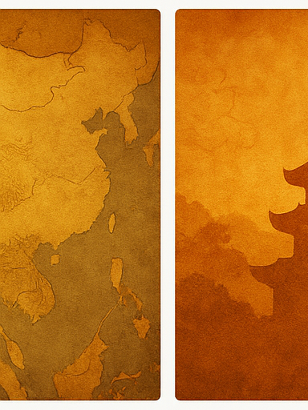
Four Noble Truths
Life contains suffering; suffering arises from craving; suffering can end; and liberation comes through the Eightfold Path.

Slide 6
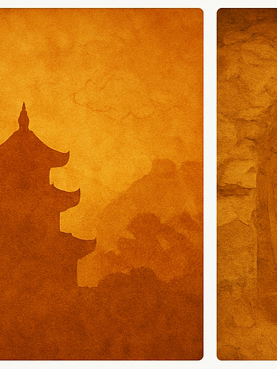
Eightfold Path
The path includes ethical conduct, mental discipline, and wisdom—guiding practitioners toward mindful, compassionate living.

Slide 7
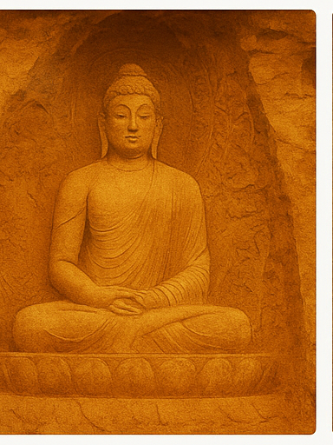
Sangha
The Sangha preserved teachings, practiced monastic discipline, and established monasteries along trade routes.

Slide 8
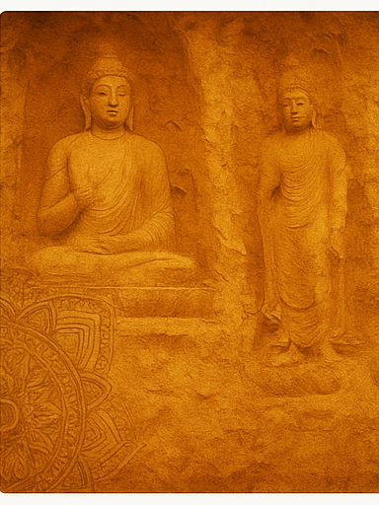
Ashoka
Ashoka promoted moral governance and sent missions abroad, helping Buddhism flourish beyond India.

Slide 9
Silk Road Spread
Monks, merchants, and travelers carried Buddhist texts, ideas, and images across the Silk Road.

Slide 10
Gandhara
Gandharan art blended Greek realism with Indian symbolism, shaping Buddhist imagery across Asia.

Slide 11
Oasis Kingdoms
Khotan, Kucha, and Turfan preserved Buddhist texts and acted as translation hubs linking India and China.

Slide 12
Kizil & Bamiyan
Kizil murals and Bamiyan Buddhas reflect mixed influences—Indian, Iranian, and Central Asian.

Slide 13
China Entry
Buddhism entered China along trade routes and was initially understood through Daoist concepts.

Slide 14
Sinicization
Chinese Buddhists adopted local vocabulary and ethics, blending Buddhism with Chinese worldviews.

Slide 15
Chinese Schools
Schools like Pure Land, Chan, Tiantai, and Huayan reshaped Buddhist philosophy.

Slide 16
Monasteries
Chinese monasteries became economic, political, and educational institutions influencing society.

Slide 17
Art Role
Buddhist art communicated teachings visually, aiding devotion and storytelling.

Slide 18
Indian Art
Indian Buddhist art evolved from symbolic forms to iconic Buddha statues during the Gupta era.

Slide 19
Central Asian Art
Central Asian art features multicultural influences, vivid colors, and donor portraits.

Slide 20
Chinese Art
Chinese Buddhist art includes Dunhuang murals and Longmen cave carvings, merging Chinese aesthetics with Buddhist themes.

Slide 21
Religious Identity
Shared practices like chanting, pilgrimage, and meditation shaped Buddhist communities.

Slide 22
Political Identity
Rulers used Buddhism for political legitimacy—Ashoka, oasis kings, and Chinese emperors.

Slide 23
Cultural Identity
Buddhism shaped literature, festivals, ethics, and artistic production across Asia.

Slide 24
Decline
Buddhism declined in India after invasions and loss of patronage; in Central Asia after Islamization.

Slide 25
Conclusion
Buddhism’s spread shows how ideas adapt, evolve, and shape civilizations over centuries.

