Slide 1

BANGLADESH STUDIES
SECTION : G
COURSE TEACHER: SHAIRA MATIN
TITLE : TOURISM AND DEVELOPMENT IN BANGLADESH
GROUP MEMBERS:
American International University-Bangladesh (AIUB)
NAME | ID
SHIL, DIPONKOR CHANDRA | 18-37790-2
MD. REFATUL ISLAM | 18-37818-2
HABIB, MD. TAHSINUR RAHMAN | 18-37837-2
KIBRIA, RASEL | 18-37797-2
MD. SAJID AL SAKIB | 18-38085-2

Slide 2
1. Introduction:
SHIL, DIPONKOR CHANDRA 18-37790-2
Tourism is the act of travel for predominantly recreational or leisure purposes for the people nowadays. Peoples of Urban areas in Bangladesh are generally getting more attracted towards tourism and take a break from this hefty and busy life for a while. Beyond for pleasure, tourism can also be for some other purposes like Business and Study. According to the World Tourism Organization, tourists are people who "travel and stay in places outside their usual environment for not more than one consecutive year for leisure, business and other purposes.
Bangladesh has also some tourist attractions Including Archeological Sites, Historical Mosques, Temples, Monuments, Rivers, Tea Gardens, Beaches, Forests, Mountains/Hill Tracks, Tribal areas, Wildlife Species etc. We also have many ancient artifacts and cities build on ancient civilization. Everything with beautiful and unforgettable natural tourist places to ancient artifacts, Bangladesh is rich for tourist attraction.

Slide 3
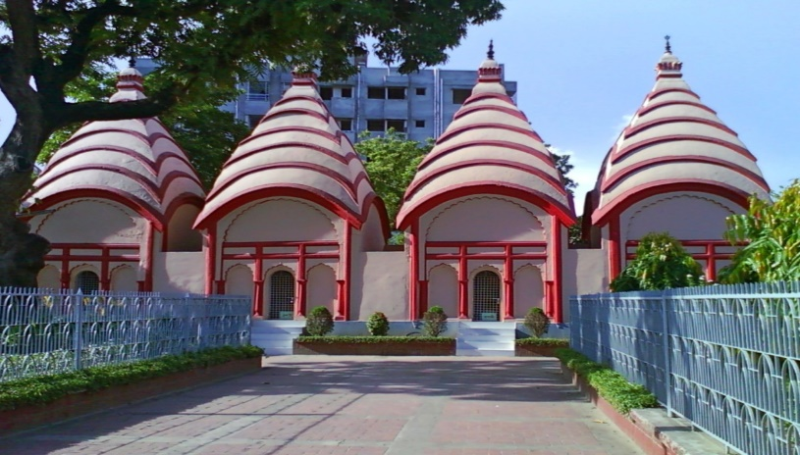
2.Tourist Spots in Bangladesh
2.1. Tourist Places in Dhaka
    2.1.1.Dhakeswari Temple:
This Temple is 1200 years old Hindu Temple built by Mangat Ray who was also known as Ballalsena, younger brother of Arakanese king Shree Sudharma, son of famous Arakanese king Raja Malhana. This is the centre of Hindu Religion in Dhaka. It is dedicated to Dhakeswari, the protector of Dhaka and an incarnation of the goddess Durga. Every year in September (exact dates vary according to the Hindu calendar), the temple and surrounding streets throng with thousands of celebrants for Durga Puja, the goddess' annual festival, a particularly colourful, noisy and joyful time to visit.
Visitors are welcome at any time (remove shoes on entering).
Figure: Dhakeswari Temple

Slide 4
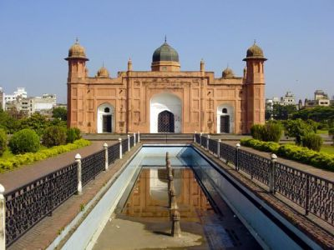
    2.1.2. Lalbagh Fort:
Lalbagh Fort is an incomplete Mughal fort. The construction was started in 1678 AD by Mughal Subahdar Muhammad Azam Shah, who was son of Emperor Aurangzeb and later emperor himself. His successor, Shaista Khan, did not continue the work, though he stayed in Dhaka up to 1688. The fort was never completed, and unoccupied for a long period of time. Much of the complex was built over and now sits across from modern buildings. The fort was considered to be a combination of three buildings : The mosque(West side), The tomb of Bibi Pari(In between The Mosque and The Diwan-i-Aam) and The Diwan-i-Aam(East side).
It is a great artifact from Mughal Period.
Figure: Lalbagh Fort

Slide 5
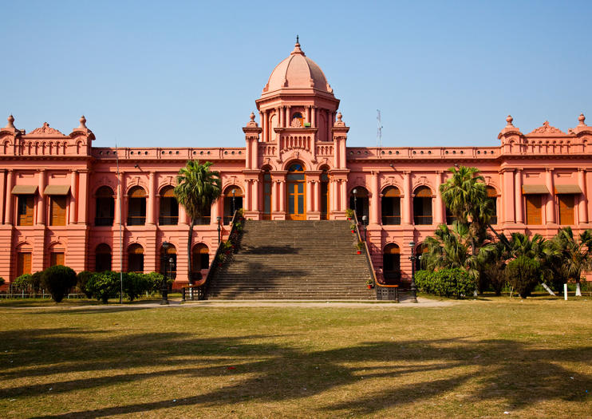
    2.1.3. Ahsan Manzil:
It was the residential palace and the kachari of the nawabs of Dhaka. It was said to be the Rang Mahal of Sheikh Enayetullah, a zamidar of Jamalpur pargana during the time of the Mughals. Ahsan Manzil is one of the significant architectural monuments of the country. There are porticos of the height of the ground floor, both on the northern and southern sides of the palace. An open spacious stairway has come down from the southern portico, extending upto the bank of the river through the front garden. There was once a fountain in the garden in front of the stairs, though it does not exist today. Ahsan Manzil, an architectural treasure, witnessed many historical events of Bangladesh. From the last part of the 19th century to the initial years of Pakistan, the Muslim leadership of East Bengal emerged from this palace.
It is a great artifact from Mughal Period.
Figure: Ahsan Manzil

Slide 6
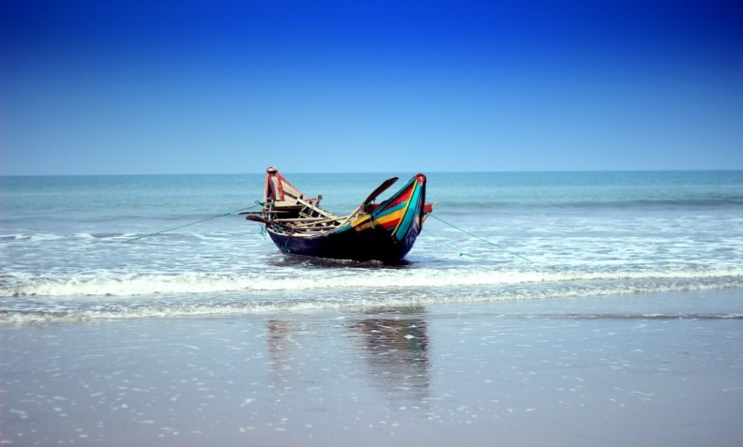
2.2. Tourists Places In Chittagong:
    2.2.1. Cox’s bazar:
Cox’s Bazar is one of the most attractive tourist spots & the longest sea beach in the world (approx. 120 km long). Miles of golden sands, towering cliffs, surfing waves, rare conch shells, colorful pagodas, Buddhist temples and tribes, delightful seafood–this is Cox’s Bazar, the tourist capital of Bangladesh
Figure: Cox’s Bazar

Slide 7
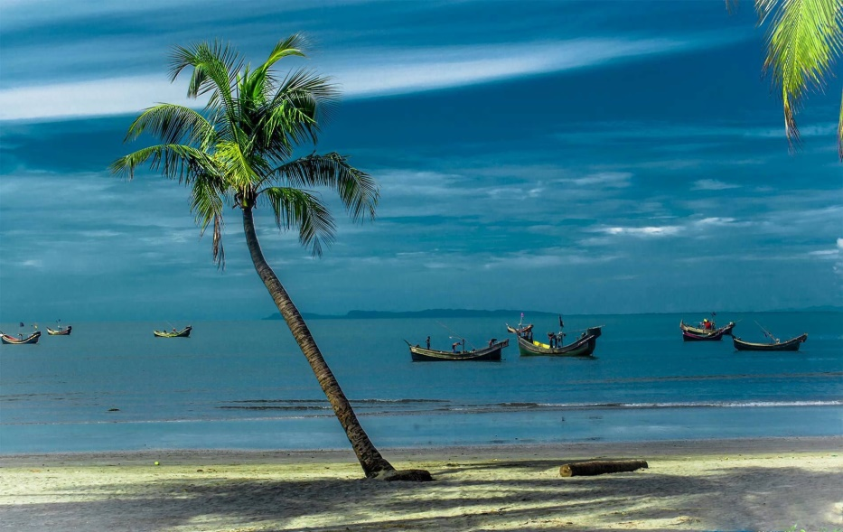
    2.2.2. Saint Martins Island:
St. Martins Island is the most beautiful Coral Island where you will find live corals. Its only 30 km from Teknaf and you can go there by local motorboat, tourist boats, or sea truck. This small coral island about 10km (6mi) southwest of the southern tip of the mainland is a tropical cliché, with beaches fringed with coconut palms and bountiful marine life. It’s possible to walk around the island in a day because it measures only 8 sq km (3 sq mi), shrinking to about 5 sq km (2 sq mi) during high tide.
Figure: Saint Martins Island

Slide 8
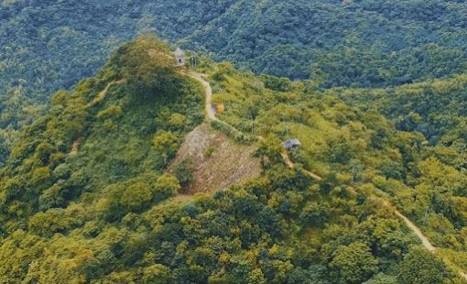
    2.2.3. Sitakundo Hill Tracks:
The famous Chandranath Temple & Buddhist temples are in Sitakundu, 37 km for from Chittagong city. Famous among the many temples in this place, the Chandranath Temple and the Buddhist Temple has a footprint of Lord Buddha. These places particularly the hilltops are regarded as very sacred by the Buddhists and the Hindus. Siva-chaturdashi festival is held every year in February when thousands of pilgrims assemble for the celebrations, which last about ten days.
Figure: Chandranath Temple Hill Track

Slide 9
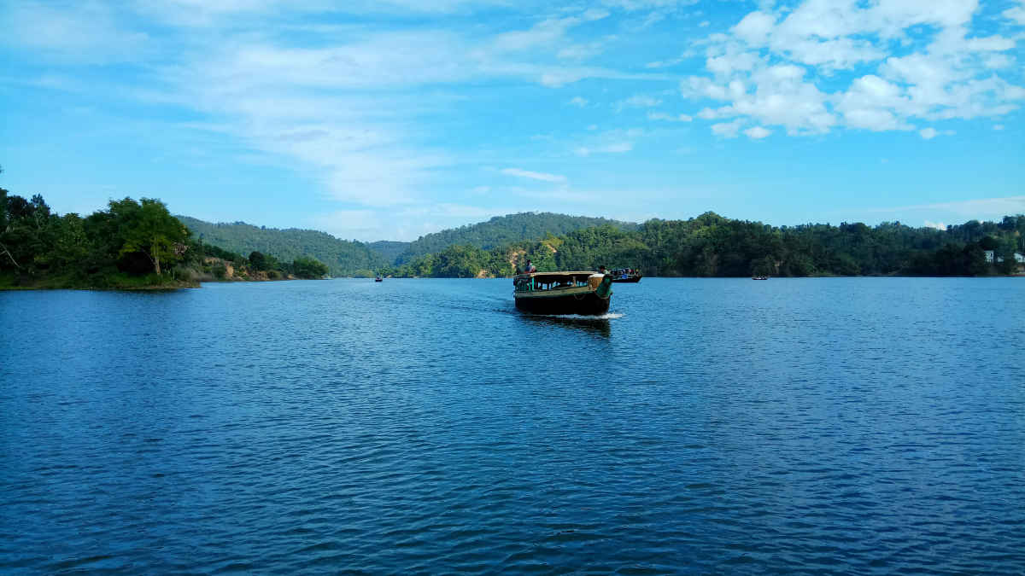
    2.2.4. Rangamati:
Rangamati, a lush and verdant rural area belonging to the Chakma tribe, is open to visitors, as is Kaptai Lake. The lake, ringed by thick tropical and semi-evergreen forests, looks like nothing else in Bangladesh. Rangamati is a big portion of natural beauties of Bangladesh. From Chittagong a 77 km. road amidst green fields and winding hills will take you to Rangamati. It is also connected by waterway from Kaptai.
Figure: Kaptai Lake

Slide 10
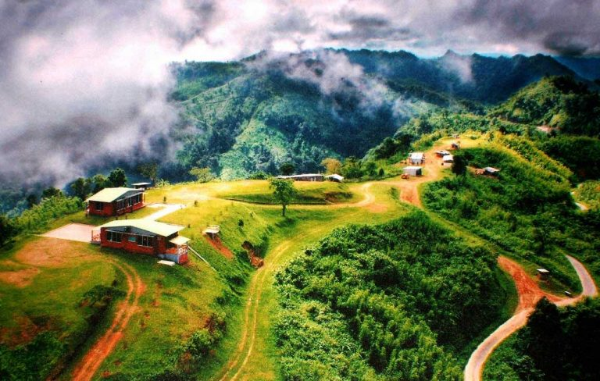
    Sajek Valley:
Sajek Valley is an emerging tourist spot in Bangladesh situated among the hills of the Kasalong range of mountains in Sajek union, Baghaichhari Upazila in Rangamati District. The valley is 1,476 feet (450 m) above sea level. Sajek valley is known as the Queen of Hills & Roof of Rangamati.
Figure: Sajek Valley

Slide 11
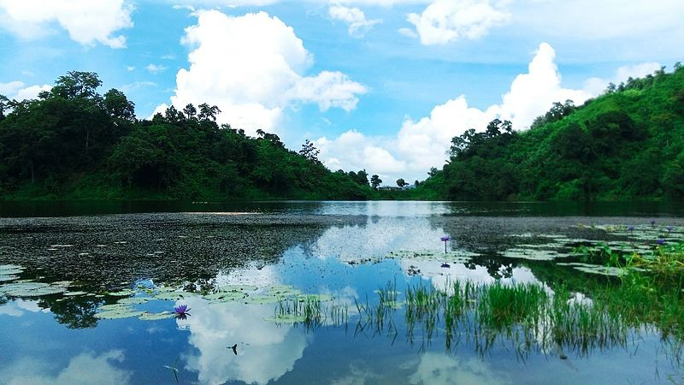
    2.2.5. Bandarban:
Boga Lake: Bagakain Lake or Boga Lake is one of the most magnificent lakes in the country. This 15-acre wide natural lake is about 18 km far from Ruma Sadar Upazila under Bandarban. Placed about 3000 feet high above the sea-level, Boga Lake fascinates visitors with blue water, big rocks, surrounding greenery, local tribal communities, etc. It is believed that Boga Lake was created by an earthquake that occurred 2000 years ago.
Figure: Boga Lake

Slide 12
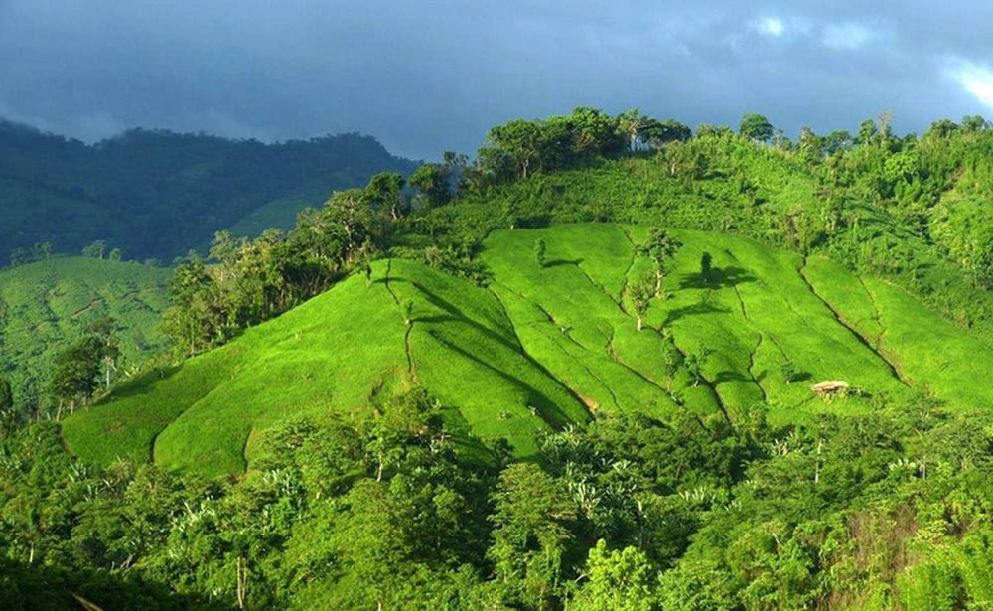
    Tajing Dong:
Tajingdong Mountain is located at Remakri Pangsha union in Ruma Upazila under Bandarban Hill District. In local tribal dialect “Tajing” means ‘Great’ and the ‘Dong’ means ‘Hill’. So the whole word stands for “Great hill”. Tajingdong is also popular as “Bijoy”. Adventure tourists love to explore Tajingdon during the winter season. This mountain will amaze you with diverse natural beauties, like hide-and-seek of clouds on the hill-top, dense forests, hills and mountains, wildlife, zigzagging paths over the green hill, natural springs, hilly roadside, and the surrounding inhabitants’ simple lifestyle, tradition, and culture.
Figure: Tanjing Dong

Slide 13
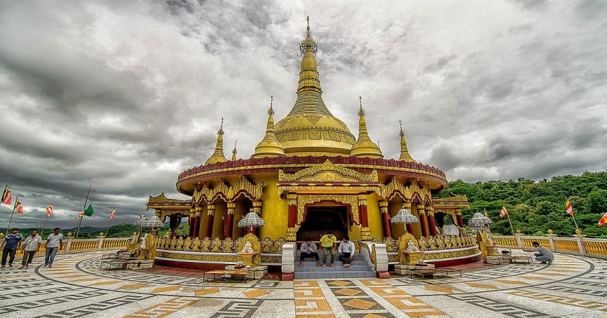
    Bandarban Golden Temple
It is said that Buddhism is the religion of peace. Bandarban is the pious hub of Theravada Buddhism practiced by tribal communities like Marma or Mogh. Here you will find Buddha Dhatu Jadi, the largest Theravada Buddhist Temple of Bangladesh and the second biggest Buddha sculpture in the country. This Buddhist temple is called ‘kyang’ in the local language. It is also popular as the ‘Bandarban Golden Temple’ to the tourists.
Figure: Golden Temple

Slide 14
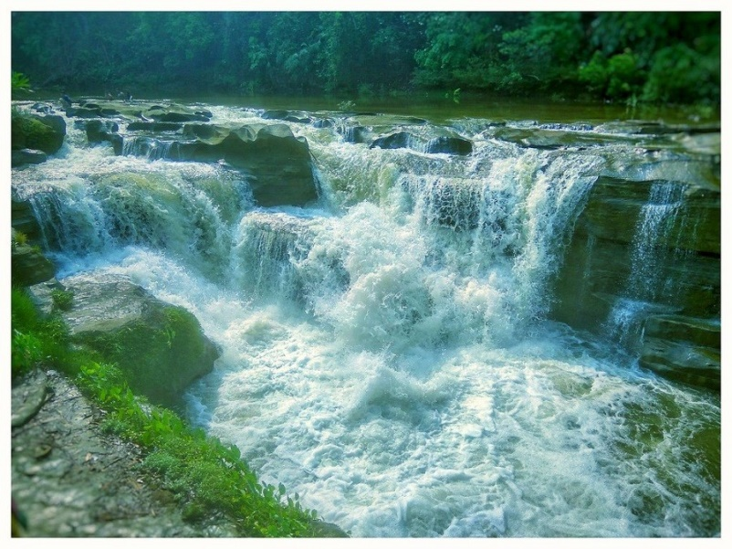
    Nafakhum Waterfall:
Nafakhum is also called the Remakri waterfall. Nafakhum falls under the unruly hilly river Sangu at Remakri in Thanchi Upazila of Bandarban Hill District. In this natural waterfall, a heavy flow of water pours down with great power, sound, and volume declaring pride and grandeur. Not to mention, Nafakhum is one of the most voluminous natural cascades in Bangladesh.
Figure: Nafakhum Waterfall

Slide 15
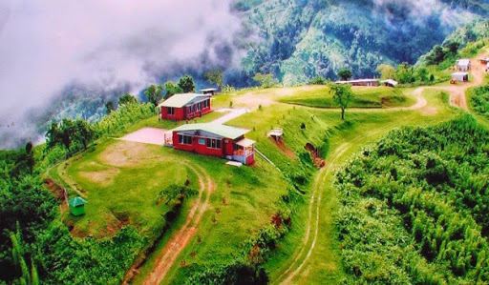
    Nilgiri Mountains:
Nilgiri is another favorite of tourists in Bandarban. Standing 3500 feet above sea level, Nilgiri is located in Thanchi thana in Bandarban Hill District. You can touch the moving clouds while standing over a hill-top from there. The beauty of Nilgiri varies with the change of seasons. During winter this place becomes foggy. Tourists love to enjoy a campfire in such weather. While in monsoon this place gets nearly covered by the fleeting clouds. Besides these, from Nilgiri, you can enjoy the spectacular view of the sunrise, sunset, sinuous Sangu River, surrounding greenery, etc.
Figure: Nilgiri

Slide 16
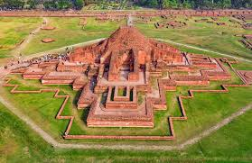
MD. REFATUL ISLAM 18-37818-2
    Somapura Mahavihara :
1.Somapura Mahavihara in Paharpur, Badalgachhi Upazila, Naogaon District, Bangladesh is among the best known viharas, centres of learning. It was designated as a UNESCO World Heritage Site in 1985. the Somapura Mahavihara as built by the second Pala king Dharmapala. A number of monasteries grew up during the Pāla period in ancient India in the eastern regions of the Indian subcontinent

Slide 17
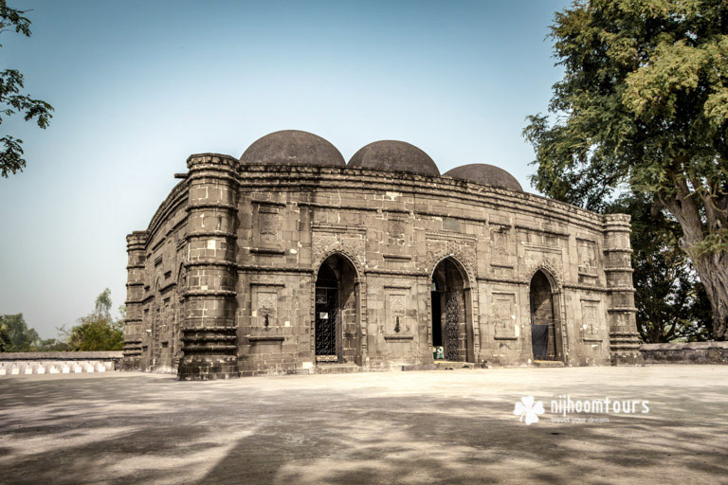
    Kusumba Mosque :
Kusumba Mosque is a mosque in Manda Upazila of Naogaon District, Bangladesh. It was built in 1558-59. Kusumba Mosque is named after the village of Kusumba. It was built during the period of Afghan rule in Bangladesh by a high-ranking official named Sulaiman. It was built under one of the last Suri rulers. His name was Ghiyasuddin Bahadur Shah. Although the mosque was built under the suri rule, the architectural pattern was not influenced by the earlier Suri architecture of North India. It was constructed with a Bengal style. the most interesting thing is we can see the kusumba Mosque at BDT 5 taka note.

Slide 18
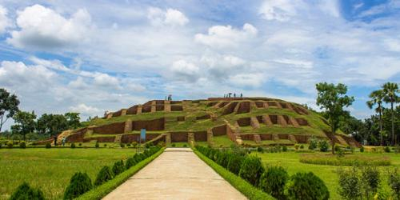
    Mahasthangarh :
Mahasthangarh is one of the earliest urban archaeological sites so far discovered in Bangladesh. The village Mahasthan in Shibganj upazila of Bogra District contains the remains of an ancient city which was called Pundranagara . Mahasthangar the ancient capital of Pundravardhana. ‘Mahasthan’ means ‘great sanctity’ and ‘garh’ means fort. It is believed that the rulers of the Maurya dynasty founded the city.

Slide 19
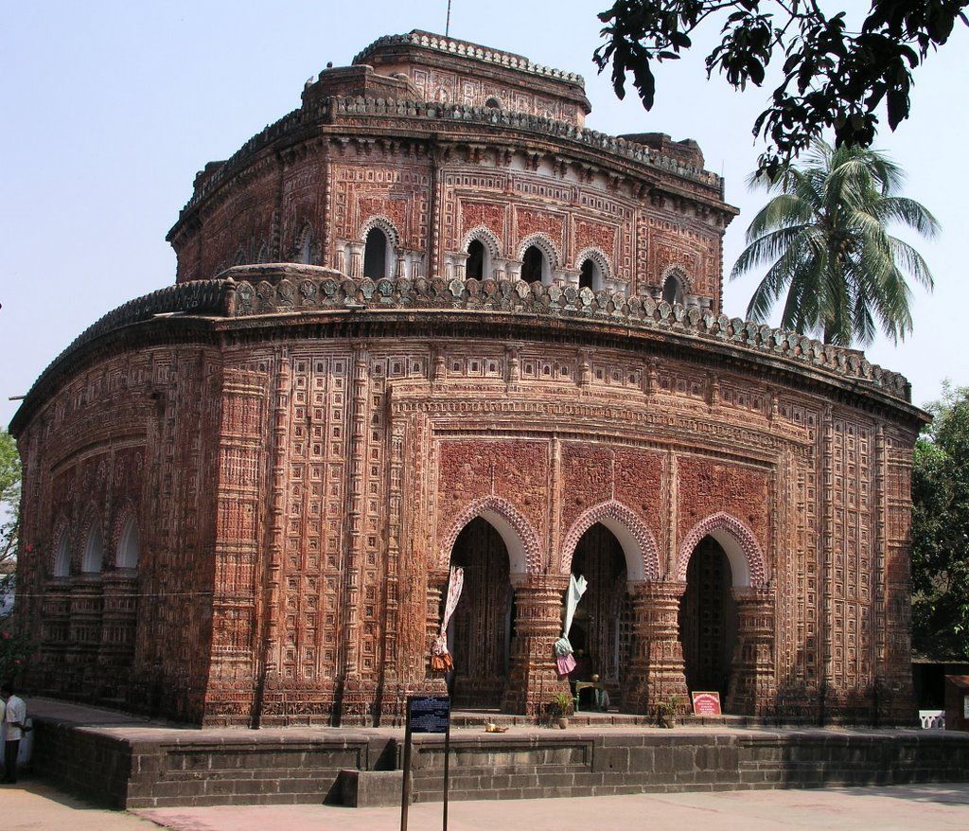
    Kantanagar Temple:
Kantanagar Temple, commonly known as Kantaji Temple or Kantajew Temple is a late-medieval Hindu temple in Dinajpur, Bangladesh. The Kantajew Temple is one of the most magnificent religious edifices belonging to the 18th century. The temple belongs to the popular Hindu Kanta or Krishna and this is most popular with the Radha-Krishna cult (assemble of memorable love) in Bengal. This beautiful temple is dedicated to Krishna and his wife Rukmini Built by Maharaja Pran Nath.

Slide 20
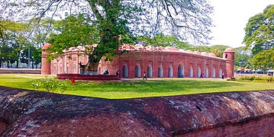
    The Sixty Dome Mosque :
The Sixty Dome Mosque more commonly known as Shait Gambuj Mosque or Saith Gunbad Masjid), is a mosque in Bangladesh. It is part of the Mosque city of Bagerhat, a UNESCO World heritage. It is the largest mosque in Bangladesh from the sultanate period (1204-1576). It was built during the Bengal Sultanate by Ulugh Khan Jahan, the governor of the Sundarbans. It has been described as "one of the most impressive Muslim monuments in the whole of the Indian subcontinent.

Slide 21
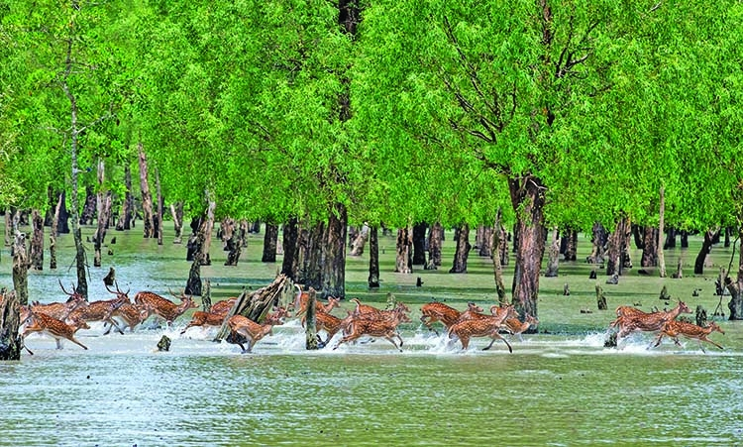
    Sundarbans :
The Sundarbans is a mangrove area in the delta formed by the confluence of the Ganges, Brahmaputra and Meghna Rivers in the Bay of Bengal. It spans from the Hooghly River in India's state of West Bengal to the Baleswar River in Bangladesh. It comprises of closed and open mangrove forests, land used for agricultural purpose, mudflats and barren land, and is intersected by multiple tidal streams and channels. Four protected areas in the Sundarbans are enlisted as UNESCO World Heritage Sites,

Slide 22
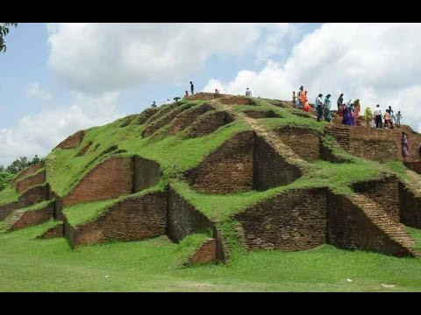
    Moinamoti :
Moinamoti is an isolated low, dimpled range of hills, dotted with more than 50 ancient Buddhist settlements dating between the 8th and 12th century CE. It was part of the ancient Samatata division of Bengal. It extends through the centre of the district of Comilla in Bangladesh. Moinamoti is located almost 8 miles from the city of Comilla. It is the home of one of the most important Buddhist archaeological sites in the region.

Slide 23
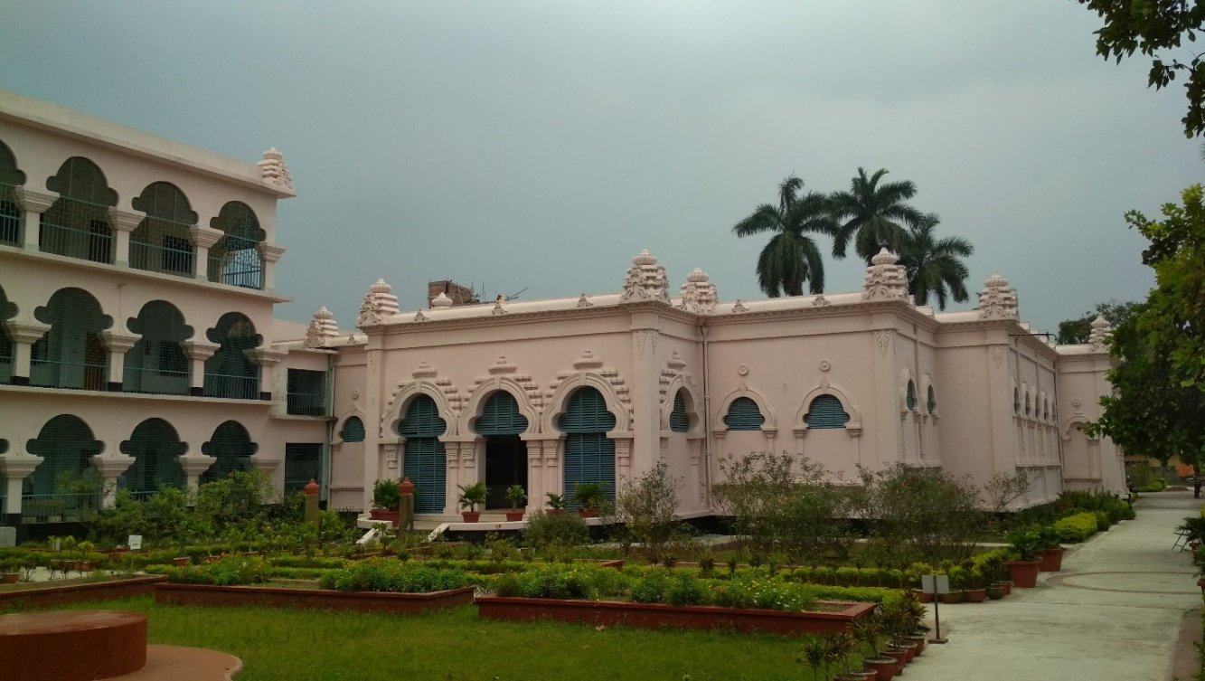
    Varendra Museum :
Varendra Museum (Bengali: বরেন্দ্র জাদুঘর) is a museum, research centre, and popular visitor attraction at the heart of Rajshahi and maintained by Rajshahi University in Bangladesh. It is considered the oldest museum in Bangladesh. It was the first museum to be established in East Bengal in 1910. The museum started out as the collection for Varendra Anushandan Samiti (or Varendra Investigation Society) and got its current name in 1919. The Rajahs of Rajshahi and Natore, notably prince Sharat Kumar Ray, donated their personal collections to Varendra Museum. Varendra refers to an ancient Janapada roughly corresponding to modern northern Bangladesh

Slide 24
Problems
HABIB, MD. TAHSINUR RAHMAN 18-37837-2
    Pollution problem:
Soil Pollution
Water Pollution
Air Pollution
Water Pollution
Sound Pollution

Slide 25
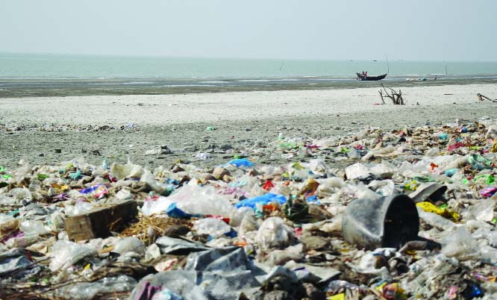
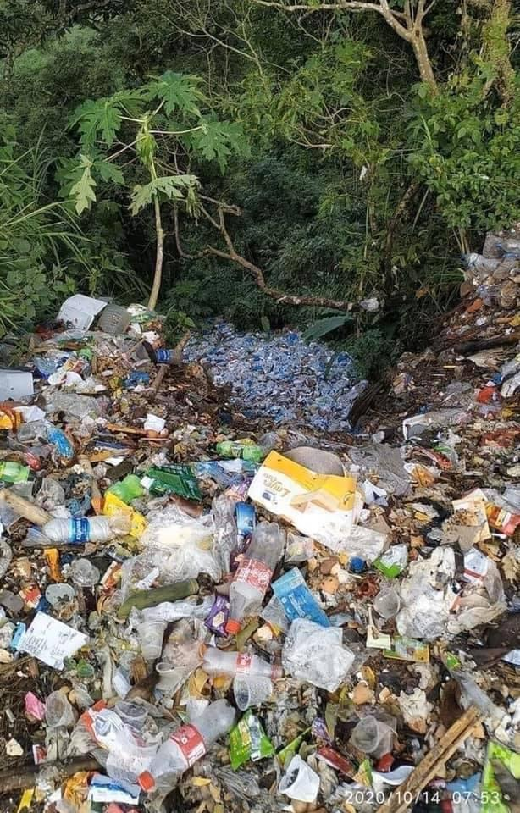
    Soil pollution:
We through plastic bottle here and there. When we go a picnic or some tourist place, we use one time plate and glass. But this kind of things are not clean properly. All this thing destroy the fertile of the soil. If it is going on then one day there will no plant for nature and also hills are not take their shape.
Fig: Kuakata
Fig: Sajek Vally

Slide 26
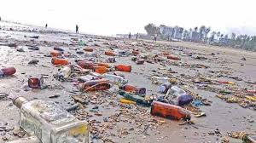
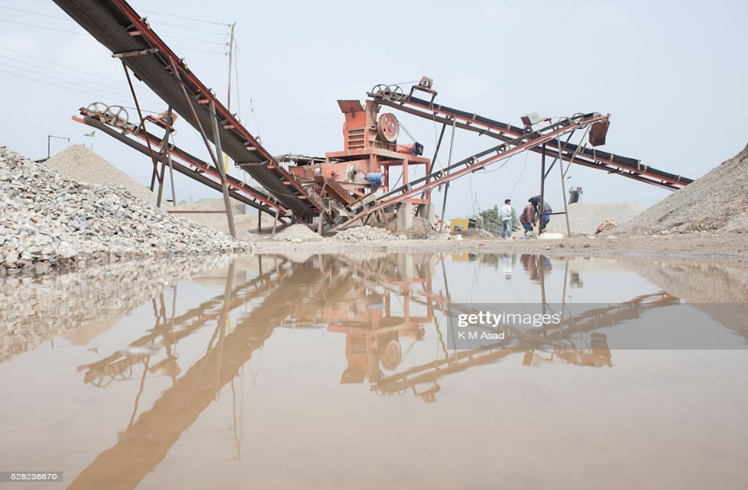
    Water pollution:
Cox Bazar is the largest sea beach in the world. In the picture we see a lot of bottles in the water. Not only in Cox Bazar also in the river have seen it. It pollutes the water as well the nature and for this reason we lost many fishes and aquatic animals.
In another picture we see a stone crusher machine that broke the stones. If we crush all the stones then the water of the river always muddy and big stones are the beauty of the nature.
Fig: Cox Bazar
Fig: Stone crusher in Jaflong
make noise and air polluted

Slide 27
    Air pollution:
Air is very important thing for nature. If a tourist place air is not clean then the spot is not visited by any tourist and also harmful for the nature.
A tourist place is always a refreshment place for a tourist. Any person never want that he/she goes a place and that is full of noise that cause his/her migrant problem.
Sound pollution:

Slide 28
Tourist spots problem:
    Lack of Infrastructure Facilities:
Current status of infrastructure facilities is not developed in many tourist place in Bangladesh. For this reason in spite of the presence of many tourism potentials, Bangladesh’s share of income from tourism is very poor. With poor infrastructure, little marketing sense and direction, and a national carrier too busy serving the labor traffic, tourism potentials of Bangladesh this far remained untouched. One of the key aspects of infrastructure is the availability of monetary funds during travel. Even until recently, the ATMs outside Dhaka aren't connected to the international network, and traveler’s cheques are very difficult to cash.

Slide 29
    Political Instability:
Bangladesh is a democratic country and every five years changes its government by the election. After and before election period violates all the political parties countrywide, at that time domestic and international tourist afraid to move to the tourist destination. Due to political instability Bangladesh loss, a huge amount of currency and tourism industry suffer significantly as well.

Slide 30
    Involvement of Non Professional Peoples:
Non-professional peoples are involving in tourism business; this is the one of the important problem for tourist. When the tourism sector earns more profit in other countries than our country faces problem by the non-professional staffs. So the government needs to ensure professional people’s involvement in a related sector to promote our tourism sector.

Slide 31
    Lack of Proper Training and Human Resources Related to Tourism:
Developed human capital is key asset for any industry, trained up human resources always play an important role to develop it. Tourism industry is a key sector to increase GDP in any region like Bangladesh. In this regard, Bangladesh Parjatan Corporation has established National Hotel Tourism Training (NHTTI) in 1974. A two-year diploma course on HotelManagement has been started in 2002. However, the above initiatives of BPC are not sufficient to meet the needs of all tourist spots in the country. Besides, some recent research findings (Siddiqui 2006), (Rahman 2007), (Parveen 2009), (MD Kamrul Hassan, 2013), and (Khondker & Ahsan 2015) proved that still there is acute shortage of tourism experts in most hotels and motets of tourist areas in Bangladesh. But now in tourist place established a private University where are two years diploma course on Hotel Management already started.

Slide 32
    Visa Problems:
Visa policy of the government is one of the main reasons behind the foreign tourists' reluctance to visit Bangladesh. If the government lifts visa restrictions for visitors from Europe, USA, and other western countries, around 20 lakh foreign tourists will come to Bangladesh in a couple of years. Now it requires about 15 to 20 days for a Bangladeshi visa even for a European citizen (The Daily Star, May 29, 2008).

Slide 33
Lack of Proper Planning from Government:
According to the World Travel and Tourism Council’s Bangladesh Country Report 2017 (www.wttc.org) supported that the tourism generates the direct contribution to GDP and it was BDT840.2 billion (USD10.6 billion), 4.3% of total GDP in 2016 and it is forecast to rise by 7.2% in 2017 and to rise by 7.1% per annum to BDT1.783.0billion (USD22.6billion), 4.7% of total GDP in 2027. It is a global report but in Bangladesh no reliable report, data or statistics on tourism are available. But this assumed investment how, when and where will be invested are not clear. All policy, planning and moneys are allocated for already established as tourist organization. Now “Development Authorities” is trying to develop tourism industry of tourist place. There is no extra planning or budget allocation for the development of other spot to establish as a popular tourists spot. So the Government should provide special facilities to both local & foreign investors to invest in this industry considering its economic growth and development. The Government may give the Tax holiday to more and more development of tourism industry and set up hotels and restaurants in the tourist areas all over the country. As a result, foreign investors will be interested to invest in this industry.

Slide 34
Lack of Marketing and Updated Information:
All the important districts for tourist destination and is definitely needs to be advertised properly on the popular tourist related websites. There should be coordination of information and services between these websites and popular hotels, restaurants, shops and travel services of each place of tourist spots in Bangladesh. We need to take pragmatic steps to develop and updated our websites to increase international tourist flow. It also needs to share update information in popular websites and advertise in different ways. For instance, Cambodia has its tourism websites in eight languages; Thailand, Malaysia, Indonesia in 12 languages, and we have ours only in one language, English.

Slide 35
Lack of Security and Safety:
Security and safety is the most important thing for tourism development in any tourism spot like Bangladesh. Many important destination for tourist, the security system is not to develop yet. Sometimes it creates more problems for tourist due to kidnapping and hijacking issues. In the midnight tourists cannot move to tourists spot, because they can attack by the hijacker or band. Government and other non-government organizations are trying to serve safety and security for the local and international tourists but it is not enough, that’s why foreign tourists are disagreeing to stay a longer period in some tourist. This issue leads to loss huge foreign currencies of the country. Moreover, due to lack of sufficient security foreign tourists rarely stay in the tourist area after evening time to enjoy the rare natural beauty without any anxiety.

Slide 36
Travelling problem:
Road safety:
The most real danger when travelling around Bangladesh is road safety, which is extremely poor, especially on intercity highways. Bus travel is, quite frankly, scary, and road deaths are all too common. Travel by train when you can, or take domestic flights if your budget allows. Within larger towns and cities, take extra care when walking as a pedestrian because city- centre roads – and pathways – can best be described as hectic, and are often downright dangerous. Many roadside pavements are laid directly over sewer culverts so be wary of broken slabs.

Slide 37
Crime:
Bangladesh is generally safe and few tourists experience serious crime. Pickpocketing and snatching on crowded buses and at busy markets is not as endemic as in some other Asian countries, but it does happen. Some foreigners have been mugged, some at gunpoint, in upmarket areas of Dhaka, such as Gulshan – be careful after dark. We have had some rare reports of harassment of foreigners in the form of pushing, stone throwing and spitting, but such incidents are very uncommon.

Slide 38
Scams:
Tourism has not really established itself in Bangladesh, and neither have tourist-related scams. Generally speaking, people are incredibly honest. The most common problem is that of being over-charged, but in a non-fixed price market, this can hardly be called a scam. There are the usual hassles with rickshaw, CNG (auto-rickshaw) and taxi drivers, though even here the level of harassment is minimal compared to some nearby countries, and in many towns it’s possible to just hop on a rickshaw without pre-negotiating a price and not suffer the consequences.

Slide 39
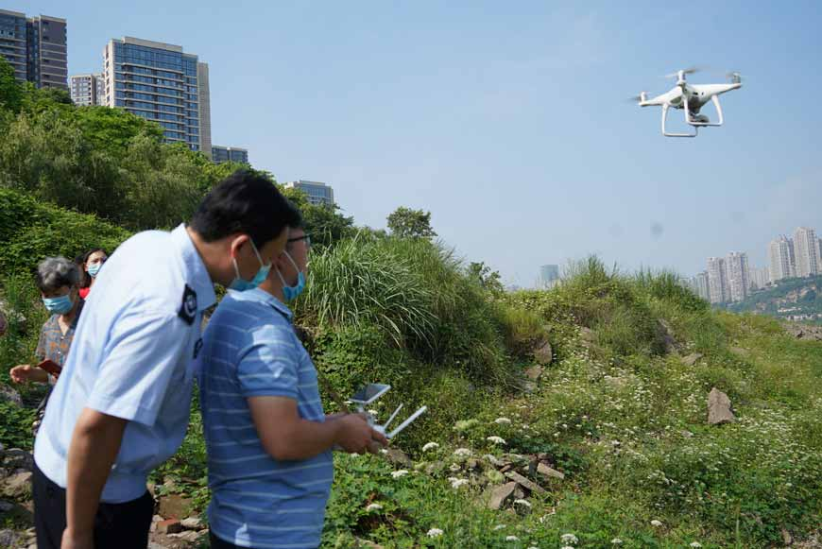

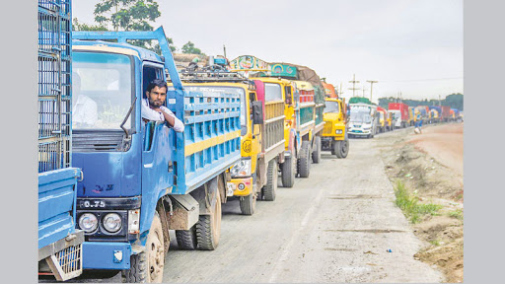
KIBRIA, RASEL 18-37797-2
Development
Safety and Security:
When it’s about travel, first things come in mind about the safety and the security.
The number of tourists polices and private security must be increase in tourists places and government should arrange proper tanning and patrol equipment such as drone and car for them to provide quick response.
In seasonal period such as Eid, New year eves, public holiday tourist place become over crowdie. It’s become very hard to maintain safety issue. Besides it’s also create highway traffic . To solve this problem fixed number of people can allowed and pre-booking system can be implemented.
Figure: Live monitoring with
drone
Figure: Car for quick response
Figure: Massive traffic jam
on Dhaka-Tangail highway

Slide 40
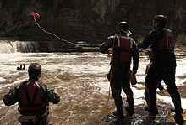
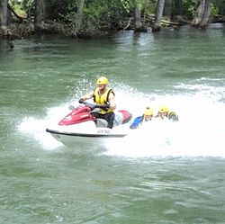
Safety and Security:
Government should make some policy and train tourist agency's for foreign tourists. Foreign tourists must travel under an agency to void unnecessary harassment.
Local authority must take necessary steps to create awareness both traveler and local people. Because sometimes tourists make unnecessary hassle with local people.
In riverine area must ensure swift water rescue.
Figure: Usage of a throw bag in a swift water rescue exercise
Figure: Swift water rescue drill

Slide 41
Archeological Sites:
Proper excavation, preservation and conservation of the archeological sites of Bangladesh in the best possible way.
Implement the extensive recommendations by the UNESCO for repair and protection of the Bagerhat and Paharpur monuments.
Not only to ensure physical protection but to make the site more visually interesting to visitors.
Improve access road to the sites.

Slide 42
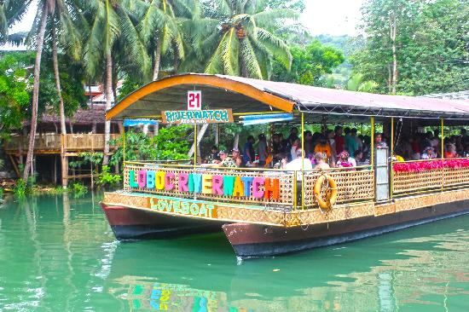
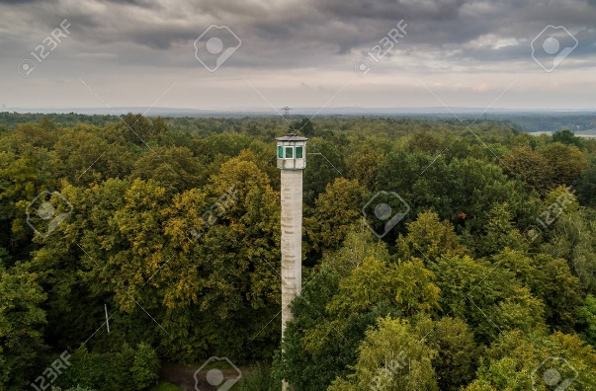
Eco-tourism Products:
Sundarbans - easy and smooth accessibility to the Mangrove forest.
Establish watch tower within the forest.
Install standard and modem cruise-ship for package tour to the Sundarbans.
Proper publicity and marketing of the product a long-term conservation and preservation strategy should be taken for this mangrove forest, like the Everglades in USA.
Fixed facility development within the zone like animal-breeding should be prohibited.
Floating Restaurants and Eco-lodge should be created at the sites.
Figure: Floating Restaurants
Figure: watch tower

Slide 43
Teknaf Peninsula:
Proper management of the area from destruction and illegal encroachment.
Develop easy access to the area, construct the required numbers of bridges and culverts where necessary.
Create light infrastructure for the easy access from the road through the hills to reach beach, the accessibility to St Martins Island, Sonadia Island should be ensured by engaging private sector; tourist facilities should be created at St Martin's and Sonadia Islands.
Establish a strong coordination with the Ministry of Environment of Forests to develop eco-tourism in this area.

Slide 44
Chittagong Hill Tracts:
Narrow and Bumpy roads needs to be improved.
Security and safety for foreign tourists should be ensured.
Proper publicity and marketing of this region.
Conservation of nature.
Participation of ethnic communities in tourism to improve their livelihood.

Slide 45
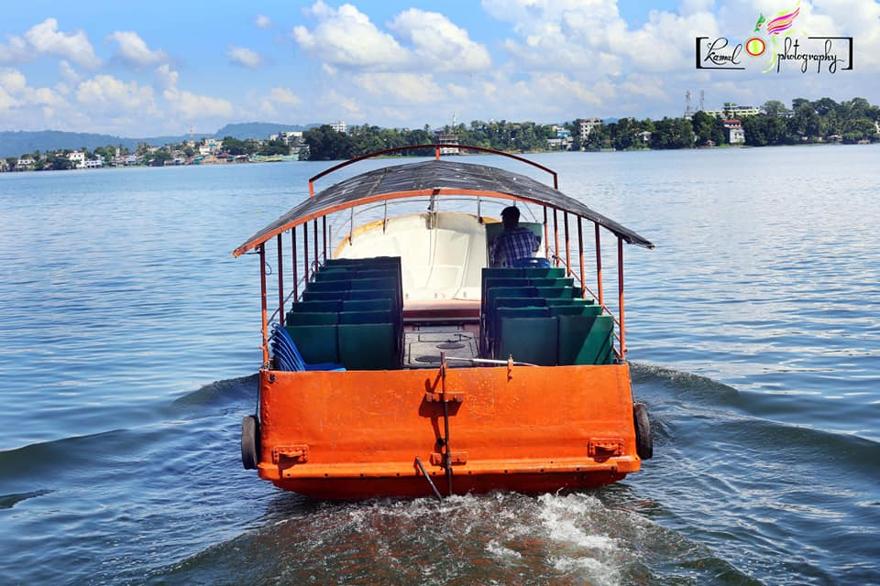
Tanguar and Hakaluki Haor:
Develop water transport to the Haor sites during winter to watch migratory birds.
Develop night halt facilities for the tourists within the local community train and register local youths as tour guides and involve them during the tourist season.
Livelihood of the local community to be involved in the seasonal tourism industry for protection and conservation of the Haors.

Slide 46
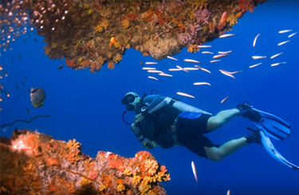
Riverine Tourism:
Where possible such as St. Martin's, must arrange the facility of SCUBA DIVING
Offer a potentially safer, secure and private means of seeing the country without the problem of crowds gathering around tourists which occurs 'on the ground‘.
Encourage private tour operators to get involved in riverine tourism
Organize sightseeing tours, overnight trips with all types of food and beverage facilities on board.
Offer relatively comfortable, slow journey to the heart of the Sundarbans; make site excursion on small country boat into riverine villages. Create skilled cruise guides Arrange rural cultural events for tourists.
Figure: SCUBA DIVING

Slide 47
Rural Tourism:
Develop a small number of villages in the medium-term; to complement the river tourism products and as destinations for the day trips from Dhaka
The village should feature historical and contemporary artifacts in museum, the making and selling of handicrafts and articles for domestic use, demonstrations of local craftsmanship, eating places with stalls preparing traditional food and displays of dancing, singing folkloric and religious rites
Hygiene and other sanitation facilities should be created
Routes entry and exit of the villages allowing for tours to the villages should be followed by stalls selling arts and crafts.

Slide 48
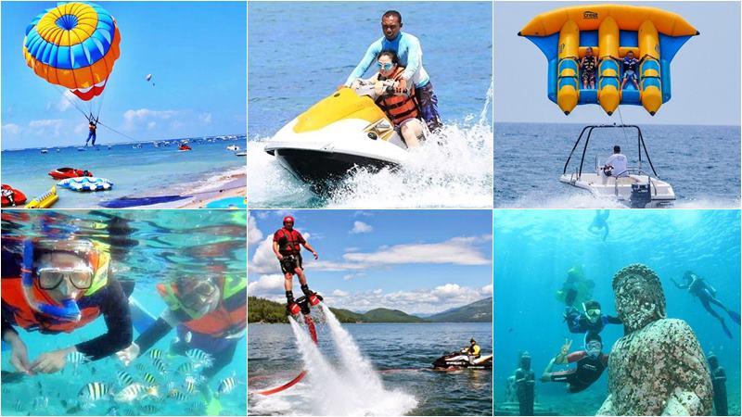
Cox's Bazar Beach:
Must ensure Swift water rescue.
Develop infrastructure or easy access.
Develop land and water transport facilities for sightseeing tours and cruising.
Install water sports facilities.
Develop typical Rakhayne ethnic community for cultural events.
Develop certain suitable portion of the beach as Special and Exclusive Tourist Area.
Build up community awareness.
Figure: water sports

Slide 49
Kuakata Beach:
Promote Kuakata Beach as an attractive tourism product and provide required tourist facilities.
Develop and promote a portion of Kuakata (Gangamati) beach into an exclusive Tourist Area.
Stress to be given on the marketing of ancillary products of tourism.
Showcasing local Rakhayne community for cultural events.
Training on community awareness and their virtual participation to the promotion of tourism.

Slide 50
MD. SAJID AL SAKIB 18-38085-2
Future Prospects and Suggestions
Though not rich in this industry, Bangladesh has significant and rich resources for this industry. She has got huge possibilities to flourish in the industry. She possesses a lot of attractive spots or places or centers to reform and represent.
If those are maintained, reconstructed and utilized in a proper way to get the visitors worldwide through the propaganda and advertisements, the tourism industry could be the highest incoming source for the national economy.

Slide 51
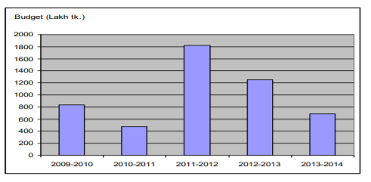
Contribution of Tourism in Bangladesh Economy
The importance of tourism sector has increased overtime. In 2009-2010, 838 was allocated for tourism sector from national budget. This has been increased to 1818 in 2011-2012. However, lately there is a decreasing trend in tourism expenditure. In 2013-2014, tourism expenditure in national budget has been falling to 683. This decreasing trend may be due to the current political crisis, which has discouraged tourism in Bangladesh.
Figure 1: Distribution of money at the tourism sector in the national budget

Slide 52
Contribution of Tourism in Bangladesh Economy
IT is a data of 2013-2014 which published in daily Newspaper prothom Alo. Now in 2020 in increase huge budget.
The picture of day-to-day and even year-to-year performance of the economy of Bangladesh is a mixture of accomplishment and failure, not significantly different from that of the majority of poor Third World countries. The government and people of Bangladesh are entitled to take some pride in the degree of success they have achieved since independence.
It has the ability to introduce Bangladesh with the people around the world.
Tourism industry can also help us to create a better image in the world
It can also help Bangladesh in business purpose.

Slide 53
Contribution of Tourism in Bangladesh Economy
Bangladesh has a large number of tourist spot in its area. All of them are special in their own character. So all of them have individual attraction for the tourist if some contractual work is done for easier movement
These tourist spots also can eliminate the unemployment problem of Bangladesh. Specialist said that more than 30% employment could be increased if the government takes proper step for the development of tourism areas.
If we can make a position in the 7 wonders through Cox’s Bazar and Sundarbans then the prospects of tourism industry in Bangladesh will be higher and higher
As a third world country in the world Bangladesh can promote its position through the proper utilization of tourism industry.

Slide 54
Impact of Tourism
1.Tourism industry of Bangladesh has a greater impact and prospect in the overall socio-economic condition of Bangladesh.
2. Bangladesh has a large number of known and unknown tourist spot around the country such as Cox’s Bazar, Kuakata, Kantajee Tample,Saint Martin’s Island, Sonargoan, Sylhet, Sundarbans, Ramsagor, and soon.
3. In the Bangladesh, tourism has not achieved the optimal level of development and status .Tourism business in Bangladesh, as measured biyearly tourist arrivals. With 1 million in 2012 it constitutes about 0 .125 per cent of world total of over 800 million.
4. A large number of tourists come to visit Bangladesh each and every year. Though these number can be increased through proper steps and policies.

Slide 55
Recommendations
Advertisement plays a vital role to run any anything as well. But in my analysis, I have found that the TV and internet advertisement of tourism sites in Bangladesh is not satisfactory at all. So the government as well as all class people of the country should take more attention to advertising.
Government should Show leadership by defining coherent and streamlined management structures that can efficiently drive New Tourism;
Industry should: Adapt strategic thinking so as to develop tourism with benefits for everyone;

Slide 56
Recommendations
Construction of modern communication;
Potential infrastructures;
Effective propaganda.
Security of the tourists.
Standard facilities.
Research and training.

Slide 57
Conclusion:
Today’s world is a competitive one. Every kind of talents and treasures must have to be utilized properly to materialize the path of prosperity and success of a developing nation like ours. We have the resources to build up an image of tourist heaven. Why not we take the options to climb the ladder of development and be an emerging nation? We should do this, and so we must proceed regarding our tourism industry right at this moment when no ‘Aladin’s lamp‘ is at our hand for progress.

Slide 58
THANK YOU

